Slide 1
Software Requirements Engineering
Lecture 1

Slide 2
General Information
Course Code: SE 210
Course Title: Software Requirements Engineering
Total Credits: 3
Instructor: Engr. Sara Rehmat
Email: sara.rehmat@nu.edu.pk
Contact: (091) 111-128-128 (Ext: 122)
Office no. 23, 1st floor

Slide 3
Grade Distribution
Class Participation: 5%
Assignments (Around 3): 5%
Presentations & Reports on Case Studies (Around 3): 5%
Quizzes (Weekly): 10%
Sessional-1: 15%
Sessional-2: 15%
Final Exam: 45%

Slide 4
Policies
Grading Policy:
Inter Quartile Range (IQR) method will be used for grading.
Attendance Policy:
Minimum 80% attendance is required for appearing in final exams. Anyone joining class later than 20 minutes will be marked absent.
Plagiarism Policy:
Zero tolerance policy will be adopted towards plagiarism of any sort. Plagiarism includes copying the contents from the internet or from the class fellows as they are. The students copying and the students from whom the assignments are copied, will be awarded zero.

Slide 5
Books
Text Book:
Software Requirements, Third Edition by Karl Weigers and Joy Beatty (pdf version uploaded on Slate)
Reference Books:
Requirements Engineering, A Good Practice Guide by Ian Sommerville and Pete Sawyer, 1997

Slide 6
Course Objective
This course introduces students to the process of requirements engineering and helps them understand important issues in requirement engineering.
It will help them to learn and apply the RE concepts for elicitation, specification, modelling and analysis of software requirements.
Managing requirements and how to deal with changing requirements is also an objective of this course.

Slide 7
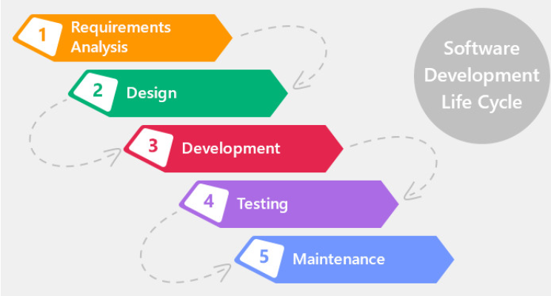
Course Overview

Slide 8
Course Overview
Software Requirement Engineering is the 1st step in Software Engineering Process
Software Requirements Engineer is the face to the customer and the liaison between the customer and the developers and the rest of the software development team.

Slide 9
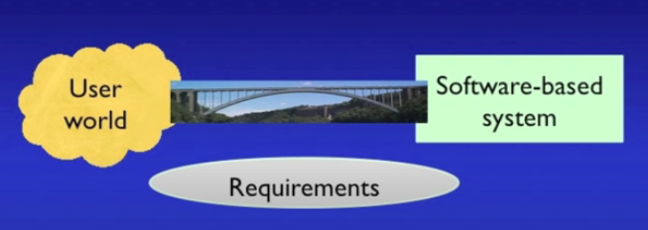
What is a requirement?

Slide 10
What is a requirement? (contd..)
Requirements represent the real-world problems in a way that can be utilized by Software Engineers to build software systems as a solution to those real world problems.
Examples:

Slide 11
What is Software Requirement Engineering?
The process of finding out, analyzing, documenting, checking and managing the requirements for the Software Systems is called requirements engineering (RE).
Finding out -> Elicitation
Analyzing -> Analysis
Documenting-> Specification
Checking-> Validation
Managing-> Management

Slide 12
Introduction to Software Requirement Engineering
Requirements Engineering
Requirements Development
Requirements Management
Elicitation
Analysis
Specification
Validation

Slide 13
Why Requirement Engineering
“The hardest single part of building a software system is deciding precisely what to build. No other part of the conceptual work is as difficult as establishing the detailed technical requirements, including all the interfaces to people, to machines, and to other software systems. No other part of the work so cripples the resulting system if done wrong. No other part is more difficult to rectify later.”
Frederick Brooks, “No Silver Bullet: Essence and Accidents of Software Engineering”

Slide 14
Cost of Requirements Problems
The major consequence of requirements problems is rework—doing again something that you thought was already done—late in development or after release.
Rework often consumes 30 to 50 percent of your total development cost (Shull, et al. 2002; GAO 2004), and requirements errors can account for 70 to 85 percent of the rework cost (Leffingwell 1997).

Slide 15
Cost of Requirements Problems
In September 1999, NASA lost its $125-million Mars Climate Orbiter when it tried to enter the orbit, just 100 kilometers too close to Mars. The mission failed due to poor requirements management: it was not discussed earlier in the stage whether the ‘navigation software’ required metric units or imperial units.

Slide 16
Problems in Requirements Engineering
Insufficient user involvement
Inaccurate planning
Creeping user requirements
Ambiguous requirements
Gold plating
Overlooked stakeholders

Slide 17
Benefits from a high-quality requirements process
Fewer defects in requirements and in the delivered product.
Reduced development rework.
Faster development and delivery
Fewer unnecessary and unused features.
Lower enhancement costs.
Fewer miscommunications.
Reduced scope creep.
Reduced project chaos.
Higher customer and team member satisfaction.
Products that do what they’re supposed to do

Slide 18
Course Outline
Week | Lecture | Topic
1 | 1 | Introduction to the course, Requirements Engineering Definition and Activities
 | 2 | Part1: Introduction to Software Requirements Software Requirements Definition, Levels/Types of Requirements, Quiz 1
2 | 3 | Role of Customer, Business Analyst in Requirement Engineering
 | 4 | Good Practices in Software Requirement Engineering, Quiz 2
3 | 5 | Part2: Requirements Development Establishing business requirements
 | 6 | Identifying users, Quiz 3
4 | 7 | Presentation 1
 | 8 | Requirement Elicitation
5 | 9 | Understanding Requirements
 | 10 | Documenting Requirements, SRS templates, Guidelines for writing requirements
6 | Sessional-1

Slide 19
Course Outline
Week | Lecture | Topic
 | 11 | Modeling Requirements (Data Flow Diagrams, Swimlane Diagrams, State-transition Diagrams),
7 | 12 | Software Quality Requirements, Constraints
 | 13 | Requirements gathering through Prototyping, Types of Prototypes, Mock ups, Proofs of Concept, Reading Assignment 1, Quiz 4
8 | 14 | 2.7 Prioritizing Requirements, Rationale and Techniques of Prioritizing Requirements
 | 15 | 2.8 Requirement Validation and Verification, Reviews, Testing, Quiz 5
9 | 16 | Presentation 2
 | 17 | Requirements Reuse, Common Reuse Scenarios, Requirements Pattern,
10 | 18 | Estimating efforts required for Requirement Engineering, Estimating project sixe from Requirements, From Requirements to Design and Code, From Requirements to Tests
 | 19 | Part3: Requirements for specific project classes Requirements for Agile Projects, Enhancement and Replacement Projects, Quiz 6
11 | Sessional-2

Slide 20
Course Outline
Week | Lecture | Topic
 | 20 | Requirements for Commercial Of the Shelf Products, Outsourced projects, Business Automation projects,
12 | 21 | Requirements for Business Analysis projects, Real-time projects, Reading Assignment 2
 | 22 | Part4: Requirements Management Requirements Management Practices, Quiz 7
13 | 23 | Managing Changing Requirements, Change Control, Process Description,
 | 24 | Change Control Process Description, Quiz 8
14 | 25 | Requirements Traceability
 | 26 | Tools for Requirements Engineering, Quiz 9
15 | 27 | Specific Requirement Management tool Introduction, Reading Assignment 3
 | 28 | Specific Requirement Management Tool Tutorial
16 | 29 | Presentation 3
 | 30 | Software Requirements Risk Management, Quiz 10

