Slide 1
No
Previous Activity
False
True
Previous Activity ==
register patient
register patient
False
True
bill patient
gender ==
male
False
True
regular treatment
expert treatment

Slide 2
No
Previous Activity
No
Previous Activity
False
True
False
True
Previous Activity ==
register patient
register patient
Previous Activity ==
register patient
register patient
False
True
False
True
bill patient
gender ==
male
bill patient
regular treatment
False
True
regular treatment
expert treatment

Slide 4

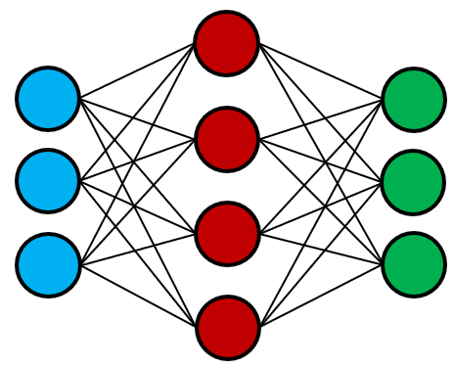
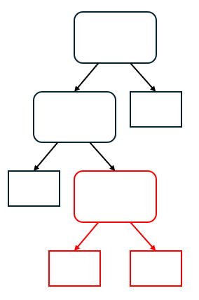
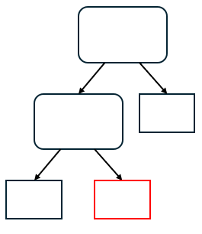
Event Log Data
Training
Neural Network
Knowledge
Distillation
Fine-Tuning
Distilled
Decision Tree
Modification
Modified
Decision Tree

Slide 5
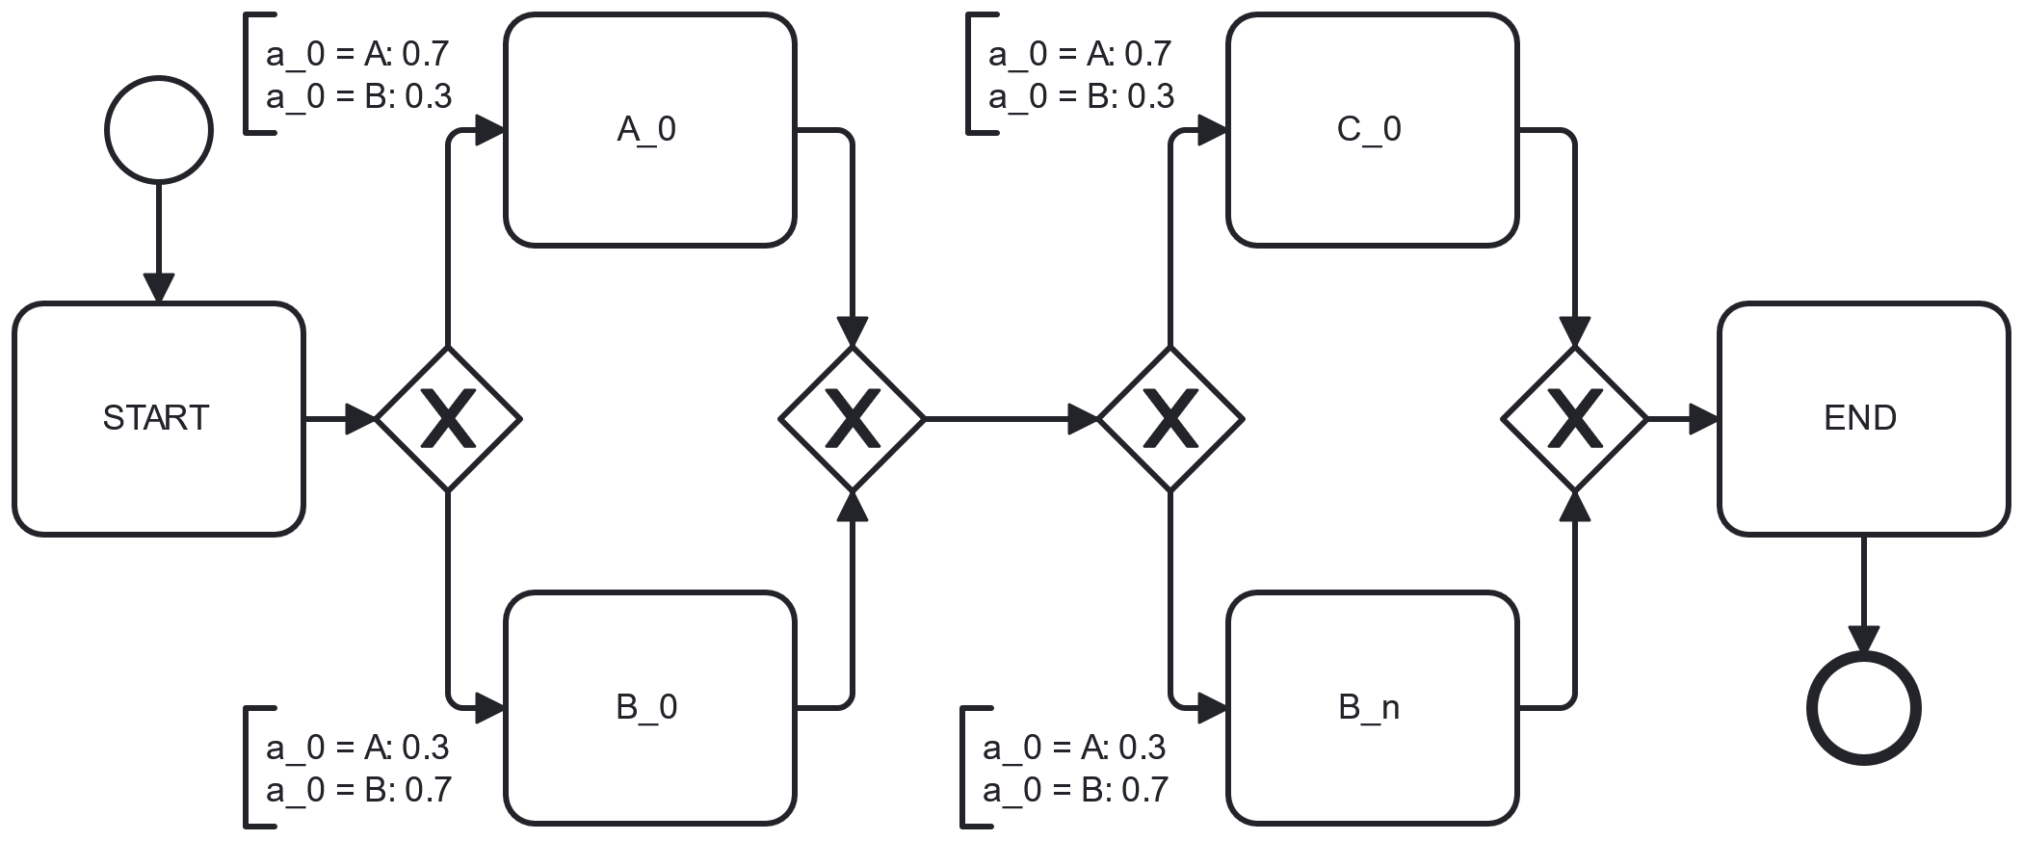

Slide 6
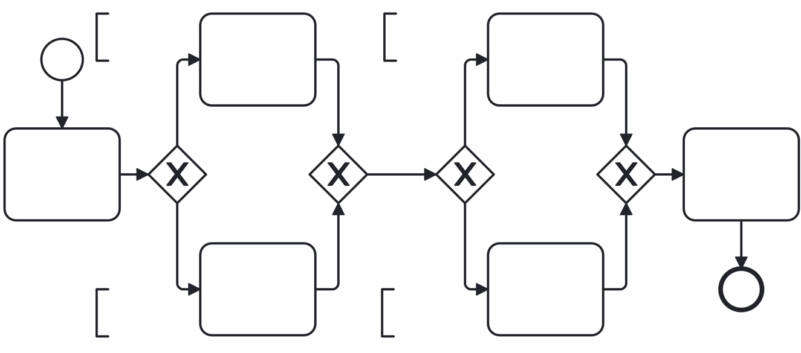








$$a_{0}=A: 0.7 \\ a_{0}=B: 0.3$$
$$a_{0}=A: 0.7 \\ a_{0}=B: 0.3$$
$$A_{0}$$
$$C_{0}$$
start
end
$$B_{0}$$
$$D_{0}$$
$$a_{0}=A: 0.3 \\ a_{0}=B: 0.7$$
$$a_{0}=A: 0.3 \\ a_{0}=B: 0.7$$

Slide 7
<PAD>: [1, 0, 0, 0, 0]
register patient: [0, 1, 0, 0, 0]
regular treatment: [0, 0, 1, 0, 0]
expert treatment: [0, 0, 0, 1, 0]
regular treatment: [0, 0, 0, 0, 1]
Male: [1, 0]
Female: [0, 1]
Male: [1, 0]
Female: [0, 1]

Slide 8
Input
Hidden
Output

Slide 9






Input
Weighted Sum
Activation Function
Output
$$x_{1}$$
.
$$w_{1}$$
.
.
$$w_{n}$$
Σ
$$σ$$
$$x_{n}$$
$$b$$

