Slide 1

Machine Learning for Data Analysis Classifying Developers’ Income
COMP20121
Hassaan Naveed | N0898071

Slide 2
Introduction

Slide 3

The Data Analysis Problem
Analysis of the “2020 Stack Overflow Annual Developer Survey”
Understand data set
Conduct thorough analysis
Describe Characteristics Low and High Income Developers
Exploratory Data Analysis
Cluster Analysis
Build Machine Learning models
Classification Models
Predict Low and High Income Developers

Slide 4

2020 Stack Overflow Developer Survey
65,000 Responses
Over 180 Countries and Territories
All aspects of programmers lives
Between 5th and 28th February 2020
Identify Major Features Linked to Salary
Years Spent Coding Professionally
Country
Education Level
Development Type
Languages Worked With

Slide 5
Machine Learning

Slide 6
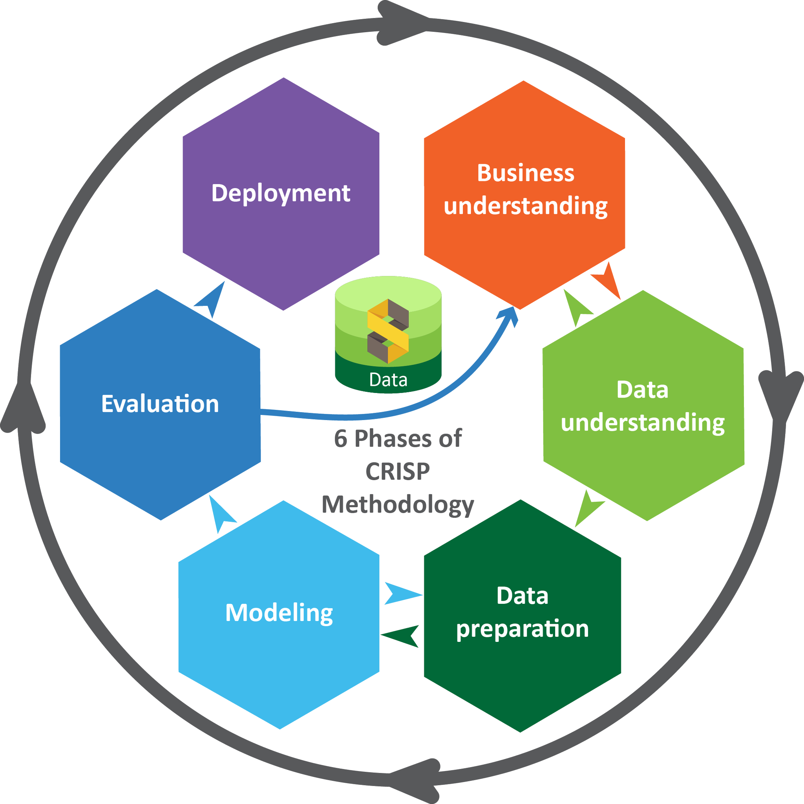
The Process
CRISP-DM Methodology
Feature Selection
Data Pre-Processing
Exploratory Data Analysis
Data Transformation
Cluster Analysis
Model Implementation
Model Evaluation

Slide 7

Data Pre-Processing and EDA
Removal of missing values
29,705 missing salary values
Replacement of missing values
Calculating modal values
Dropping would leave to severe reduction of data
Outliers
Limit salary feature between bounds
2500 to 250,000
Performed Exploratory Data Analysis

Slide 8
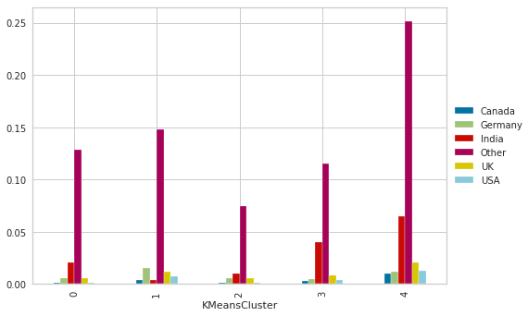
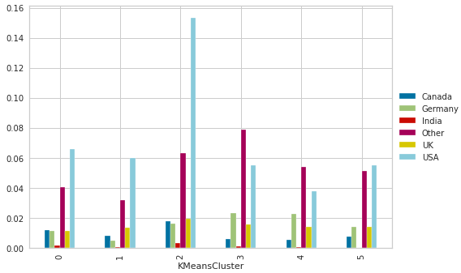
Cluster Analysis
Data Transformation
K-Means Clustering Algorithm
Low Income: k=5
High Income: k=6
Country affected the most
US based developers earn highest
India based developers earn lowest
Other features had varying impacts
Some jobs and languages associated with high income
Others with low income

Slide 9
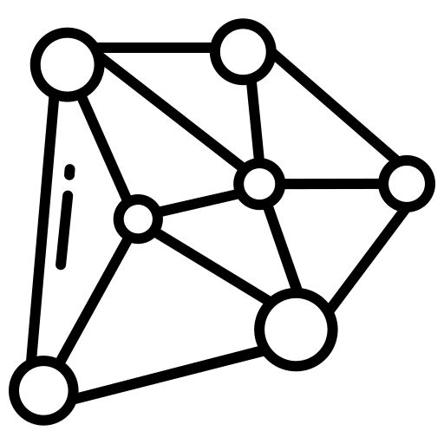
Algorithm Implementation
Several Classification Algorithms used
K-Nearest Neighbour
Decision Tree
Logistic Regression
Artificial Neural Network
Ensemble Learning
Random Forest
Voting
AdaBoost
HyperParameter Tuning
Grid Search
Randomized Search

Slide 10
Results

Slide 11
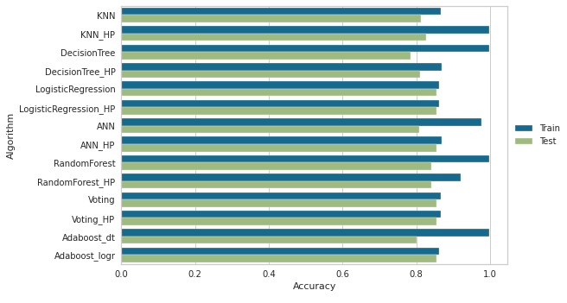
Model Performance
Highest Training Accuracy: 99.7%
K-Nearest Neighbour (Hyperparameter Tuned)
Decision Tree
Random Forest
AdaBoost
Highest Testing Accuracy: 85.5%
Logistic Regression
Voting

Slide 12

Advantages
Overwhelmingly correct predictions
Wide range of models
EDA after feature selection
In-depth study of features
Study relationships and make assumptions
EDA after data cleansing
Explore clean data
Don’t make false assumptions
Hyperparameter Tuning
Highest accuracy possible

Slide 13

Limitations
No models performed over 90% on new data
Overfitting
Reduced through hyperparameter tuning
EDA After Feature Selection
Could be missing features that have strong impact
Salary limited to 250,000 USD
Potentially not outliers

Slide 14

Conclusion
Followed CRISP-DM Methodology
Performed vital steps of machine learning
EDA
Cluster Analysis
Model Implementation
Produced Accurate Machine Learning Models
Able to predict high and low income developers

Slide 15
Thank You!

