Slide 1
A Parallel Algorithm Template for Updating Single-Source Shortest Paths in Large-Scale Dynamic Networks
Hassaan Afzal (22i-0918)
Raza Khan (22i-1234)
Muhammad Asjad (22i-1227)

Slide 2
INTRODUCTION
SSSP is crucial in transportation, communication, and social networks
Real-world graphs evolve and static recomputation is inefficient
Goal: Efficiently update SSSP after edge insertions/deletions

Slide 3
Algorithmic Framework
1. Identify Affected Vertices
• Parallel processing of inserted/deleted edges
• Mark vertices using Affected and Affected_Del flags
• No lock/sync needed in this phase
2. Update Affected Subgraphs
• Iterative relaxation until convergence
• Rooted tree structure avoids cycle formation
• Convergence replaces heavy synchronization

Slide 4
Implementation
GPU (OpenCL/CUDA)
Offload distance update kernels to GPU via OpenCL/CUDA
Use one thread per edge or per frontier vertex
Minimize divergence via worklist compression and sorting
Use atomic operations for dist[] to avoid data races
Profile with Nsight/CUDA Profiler for hotspot tuning
Shared-Memory (OpenMP)
Dynamic scheduling for load balancing
Asynchronous update levels reduce barrier frequency
Batch Processing & Hotspots: Large batches of edge updates create memory hotspots. We split changes into smaller batches

Slide 5
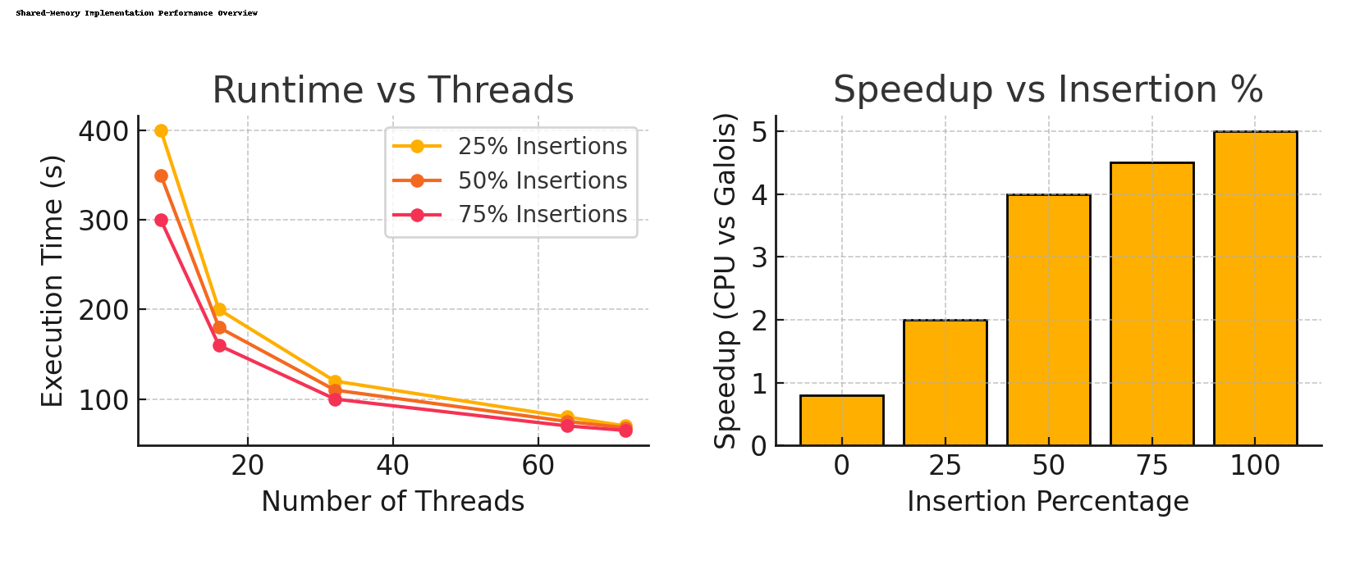
Performance Result
The proposed framework performs well compared to the re-computation based approaches when the edge insertion percentage is 50 percent or more of the total changed edges.

Slide 6
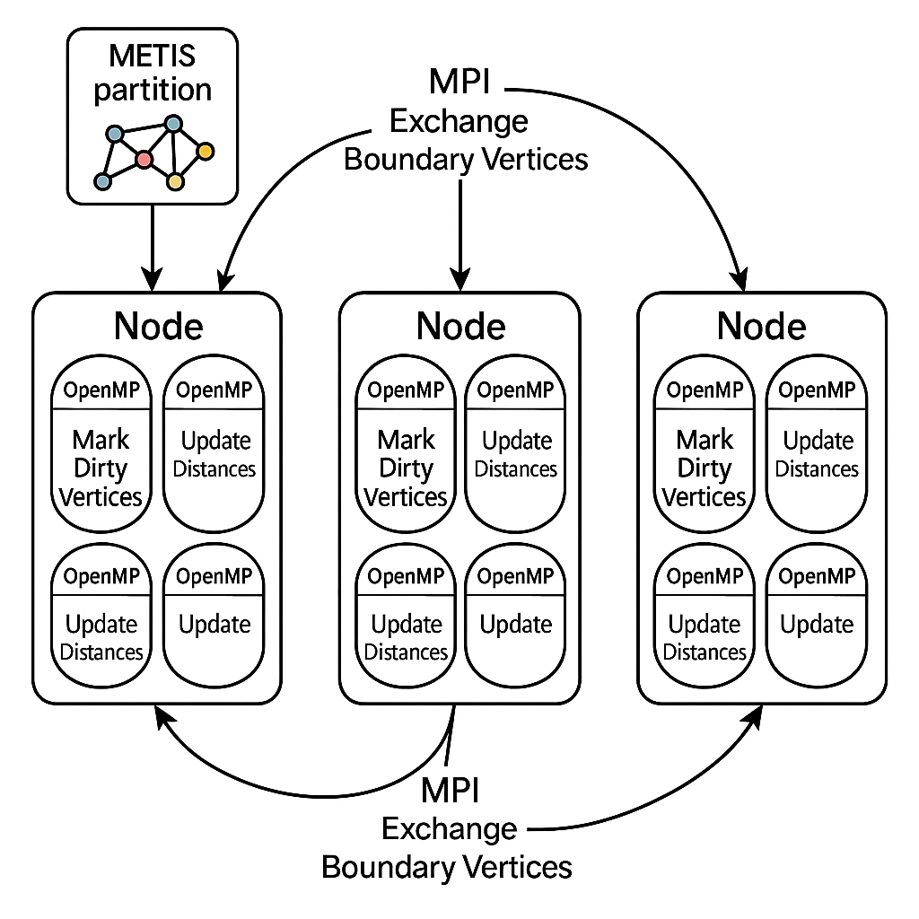
Parallel Design Strategy for Dynamic SSSP Updates

Slide 7
Hotspots & Mitigation
Deletion‐Induced Subtree Disconnects causing load‐imbalance in OpenMP/OpenCL loops.
Excessive MPI exchanges if METIS cuts too many edges in high‑change regions.
Multiple threads/warps fighting over the same cache lines.
METIS Tuning: Adjust balance vs. cut‐size to reduce boundary work.
OpenMP: Smaller dynamic tasks, batches to smooth memory.
MPI: Use non‑blocking collectives and only exchange changed boundary vertices

Slide 8
Dependency Management
Identify shared data structures: dist[], parent[], flags[]
Classify dependencies: RAW (read-after-write), WAR (write-after-read), WAW (write-after-write)
Determine independent tasks: vertex relaxations vs. subtree updates
Plan OpenMP synchronization: barriers, atomic updates, critical sections
Design MPI boundaries: exchange only updated boundary vertices
Use METIS partitioning to minimize inter-rank dependencies

Slide 9
Thank You

