Slide 1

Studify AI
Don't just watch lectures. Learn from them.
An AI tutor that pauses any YouTube lecture, asks you to explain it, and finds exactly where your understanding broke.
AI Hackathon Pakistan 2026 | Education track
Muhammad Alyan (Team Lead) | Abdullah (Frontend) | Hassan Bin Gheas (Backend)
Notes:
[~15 s] Hi judges, we're Team Studify AI, Education track. One line: we built an AI tutor that makes learners more capable, not more dependent. Everything today is working software, and I'll show it in the demo.

Slide 2


Studify AI
IMPACT
Watching a lecture feels like learning.
Most of the time, it isn't.
Passive video
Answer-giving AI
You nod along, the video ends, and you can't explain what you just watched. Nothing forces you to recall it.
Ask, get the answer, move on. The tool does the thinking, and the learner grows more dependent with every use.
Illusion of learning
Outsourced thinking
2 / 11
Notes:
[~30 s] Two failure modes. Video lectures are passive: you feel like you understood, but nothing forced recall. And the popular fix, AI that just hands out answers, makes it worse: the tool does the thinking. For students, especially where access to good tutors is limited, that dependence is the real risk. Note: add a sourced statistic here if the team has one; we deliberately didn't invent one.

Slide 3
Studify AI
IMPACT
Our idea: the AI asks.
The learner answers.
Typical AI study tool
Studify AI
Ask
Pause at a key idea
vs
Get the answer
Explain it in your words
Forget it
Get diagnosed, try again
3 / 11
Notes:
[~25 s] Our insight is to flip the roles. Studify never gives the answer first. It pauses the lecture, asks the student to explain the idea, finds the gap in their understanding, and asks again. Capability comes from retrieval and correction, which is active recall, a well-studied learning technique.

Slide 4
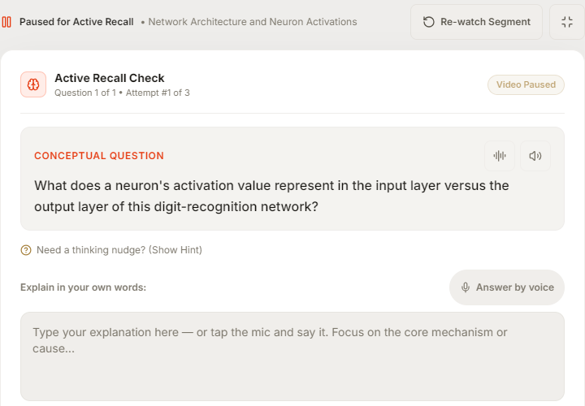
Studify AI
CREATIVE AI
Any YouTube lecture becomes a Socratic session
Pause
The player stops at each chapter end and locks skipping.
1
Ask
AI writes recall questions from what the lecture said.
2
Diagnose
Your answer is judged for understanding, not keywords.
3
Re-ask
A sharper follow-up targets the gap, then the chapter unlocks.
4
4 / 11
Notes:
[~40 s] Paste any public YouTube lecture. We pull the captions and Gemini splits it into 3 to 6 chapters, anchored to real caption timestamps. The player pauses at each chapter end and will not let you skip ahead until you answer. Questions come from what the lecture said, not from generic prompts.

Slide 5
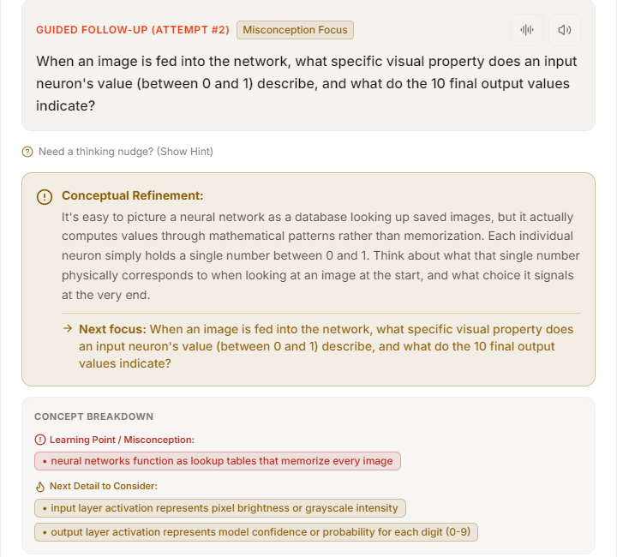
Studify AI
CREATIVE AI
It diagnoses the
misconception
CORRECT
MISCONCEPTION
INCORRECT
1
A 0-100 mastery score, plus what you understood, what is missing, and which mental model is wrong.
2
Follow-ups adapt: first a rephrase, then a narrower question aimed at the misconception.
3
After 3 attempts the chapter is flagged Needs Review and you move on. The server enforces that limit.
5 / 11
Notes:
[~45 s] This is the core of the product. The evaluator returns one of three verdicts, a mastery score, and lists what you understood, what is missing, and which misconception you hold. The follow-up gets narrower with each attempt. The three-attempt ceiling is enforced on the server, not trusted to the model, and we never mark an answer correct just because attempts ran out. That keeps the learner honest and unblocked.

Slide 6



Studify AI
CREATIVE AI
It sees the screen and hears you
Explain this screen
Answer out loud
Keyframe flashcards
Gemini vision reads the paused frame: equations to LaTeX, diagrams, and on-screen text.
Speak your explanation. Browsers without speech support fall back to Gemini audio transcription.
Each chapter's key frame becomes an active-recall flashcard that feeds your notes.
If media tools are unavailable, Studify keeps working in text-only mode. Nothing blocks the learner.
6 / 11
Notes:
[~30 s] Lectures are visual, so the tutor is too. Explain this screen sends the paused frame to Gemini vision and returns the equation as LaTeX, the diagram description, and the key concept. Students can answer by voice. Everything degrades gracefully: if media tools are unavailable, text-only mode still works.

Slide 7
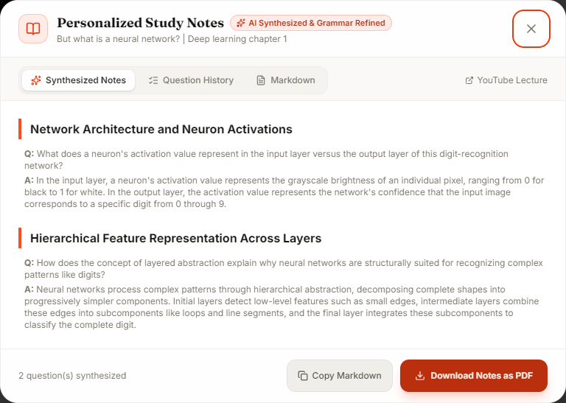
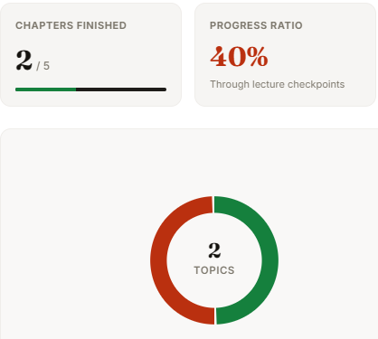
Studify AI
IMPACT
The result: notes in your own words,
with your gaps marked
Your words.
Your gaps.
Your next step.
Built from the student's own answers, polished for grammar, with a Concepts to Revisit list for every misconception. Exported as a themed PDF.
7 / 11
Notes:
[~30 s] At the end the student gets study notes assembled from their own answers, polished for grammar but preserving their ideas, with a Concepts to Revisit list for every misconception we found. They download it as a PDF. The dashboard shows mastery per chapter, so they know what to review before an exam. Screens shown are from a real session on the 3Blue1Brown neural-network lecture.

Slide 8
Studify AI
VIABILITY
Built to keep working in the real world
Gemini models
Fallback chain of 3
Learner's browser
React 19, Vite, Tailwind
Live on Vercel
FastAPI backend
Transcripts, chaptering, grading,
vision, notes + PDF
YouTube
Captions, frames
Always works
No accounts needed
Bring your own key
Accessible
If Gemini fails, heuristic fallbacks still chapter, grade, and write notes.
Stateless backend. Session resume lives in the browser.
Users can supply a free Gemini key per session.
WCAG AA contrast, focus traps, 44px touch targets, light and dark.
Built with Qoder, Alibaba Cloud's agentic coding platform.
8 / 11
Notes:
[~40 s] Viability. Thin React front end on Vercel, FastAPI backend, no database. The AI layer is a fallback chain of Gemini models, and if all of them fail, heuristic fallbacks keep the core flow alive, so a demo or a classroom never dead-ends. Users can bring their own key. We built it with Alibaba Cloud's Qoder agentic coding platform. The model layer is swappable, which is why Qwen on Model Studio is first on our roadmap. Be ready: we did not deploy on Alibaba Cloud, so say that plainly if asked.

Slide 9
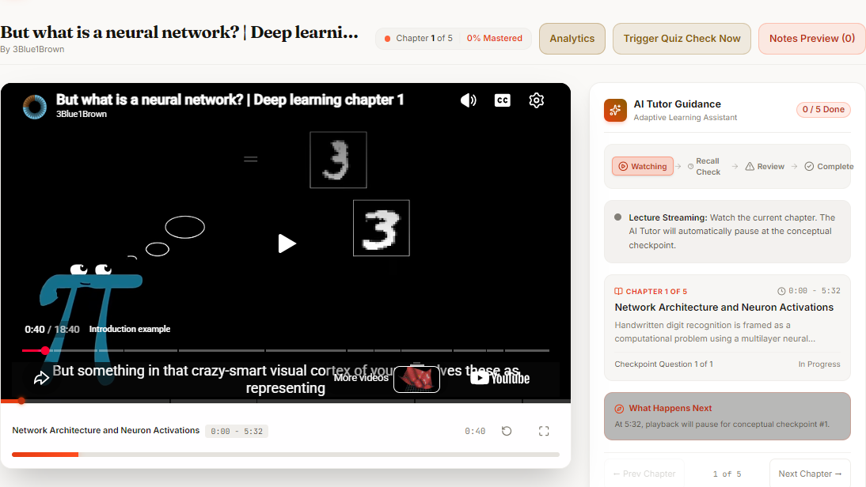
Studify AI
DEMO
See it in 90 seconds
Recorded demo, 90 seconds
9 / 11
Notes:
[~90 s] Play the recording. Narrate: paste a lecture, chapters appear, video pauses and locks, wrong answer gets a misconception diagnosis, a better answer unlocks the next chapter, Explain screen, then download the PDF notes. Backup: if video fails, the screenshots on slides 4 to 7 show each step. Keep studify_demo.mp4 in the same folder as this deck and link the poster image to it (Insert > Link) before presenting.

Slide 10
Studify AI
VIABILITY
Honest limits, and what comes next
Today's limits
Roadmap
Needs YouTube captions on the video
Very long lectures: only the first part of the transcript is used for chaptering
Frame analysis needs a video download, which YouTube can block from cloud IPs
No sign-in or rate limiting yet; test coverage is partial
Qwen on Alibaba Cloud Model Studio as a second model backend
Urdu and regional-language lectures and questions
Teacher view: class-level misconception reports
Spaced-repetition review of flagged concepts
10 / 11
Notes:
[~25 s] We would rather tell you the limits than have you find them. It needs captions, very long lectures are truncated for chaptering, and frame analysis depends on downloading video. Next steps: Qwen on Model Studio as a second model backend, Urdu and regional languages, and a teacher view. Roadmap items are plans, not shipped features.

Slide 11
Capable learners,
not dependent ones.
Muhammad Alyan
Team Lead
Abdullah
Frontend Developer
Hassan Bin Gheas
Backend Developer
Try it: studify-ai-three.vercel.app
github.com/HassaanGhayas/Zed_AI
Thank you. Questions?
Notes:
[~15 s] Studify AI exists so learners become more capable, not more dependent. It is live, you can try it now, and we would love your questions. 3-minute cut: slides 1, 3, 4, 5, 9, 11. 5-minute cut: add 2, 6, 7, 8.

Slide 12
Studify AI
BACKUP
Backup: how an answer is graded
Inputs
Question, expected concept, chapter summary, transcript excerpt, student answer, attempt number, prior attempts
Outputs
Status, mastery score 0-100, understood / missing / misconceptions, retry question, advance and review flags
Attempt 1
Rephrase the question to guide toward missing concepts
Attempt 2
Narrower question aimed at the identified misconception
Attempt 3
No retry. Flag Needs Review and let the student move on. Never auto-marked correct
No Gemini
Keyword-overlap heuristic evaluator keeps the flow alive
Backup A
Notes:
Backup for Q&A on the evaluator.

Slide 13
Studify AI
BACKUP
Backup: API surface and resilience
Endpoint | What it does
POST /api/video/process | URL to captions to 3-6 chapters with questions
POST /api/qa/evaluate | Socratic grading with adaptive follow-up
POST /api/video/explain-frame | Gemini vision on the paused frame
POST /api/video/segment-visual | Key frame analysis plus a flashcard
POST /api/voice/transcribe | Spoken answer to text
POST /api/notes/generate | download-pdf | Personalised notes, then themed PDF
Resilience
3-model Gemini fallback chain
Timeline repair for hallucinated timestamps
Transcript cache, retries, best caption track
Heuristic chaptering, grading, and notes
Backup B
Notes:
Backup for Q&A on architecture.

