Slide 1
Employee Salary prediction
CAPSTONE PROJECT
Presented By : Shaik Hassain
Student Name : Shaik Hassain
College Name : Rajiv Gandhi University Of Knowledge Technologies
- Ongole
Department : Coputer Science And Engineering

Slide 2
OUTLINE
Problem Statement (Should not include solution)
System Development Approach (Technology Used)
Algorithm & Deployment (Step by Step Procedure)
Result
Conclusion
Future Scope(Optonal)
References
►
►
►
►
►
►
►

Slide 3
Problem Statement
In today’s data-driven world, individuals often find it challenging to understand how various aspects of their personal and professional profiles influence their income potential and overall life trajectory. Without the right tools and insights, making informed decisions about career paths, education, financial planning, and healthcare becomes overwhelming. This project aims to explore the critical gaps in personal income awareness and the absence of integrated, personalized support systems for life planning.
Difficulty in identifying the key factors that impact income levels.
Lack of accessible, interpretable tools for personal data-driven insights.
Disconnection between career planning and financial, healthcare, or educational goals
Limited support for making informed, long-term decisions based on individual profiles.
►
►
►
►

Slide 4
System Approach
The "System Approach" This section outlines the overall strategy and methodology used in developing and deploying the AI-powered salary prediction and life planning system.
1. System Requirements
Platform : Google Colab (Cloud-based Jupyter Notebook environment)
Deployment : Streamlit with Ngrok for public web access
Hardware : No local GPU/CPU required (cloud-hosted)
Operating System : Linux-based (Colab environment)
Storage : Google Drive integration (optional for file I/O)

Slide 5
System Approach
2. Libraries Required to Build the Model
pandas – for data manipulation
numpy – for numerical operations
scikit-learn – for preprocessing, modeling, and evaluation
joblib – for saving and loading trained models
matplotlib, seaborn – for data visualization
shap – for SHAP value-based model explanation
streamlit – for building the interactive user interface
openai – for integrating AI Mentor (optional)
pyngrok – for exposing the local app to the internet via ngrok

Slide 6
Algorithm & Deployment
This section describes the step-by-step procedure followed to build, train, explain,
and deploy the salary prediction and life planning system.
Step-by-Step Procedure
1. Data Acquisition :
Load dataset (adult.csv) from public or uploaded source.
Handle missing values and outliers.
2. Data Preprocessing :
Encode categorical features using LabelEncoder.
Normalize/scale if needed.
Split data into training and testing sets.

Slide 7
Algorithm & Deployment
3. Model Training :
I.Train multiple models:
Logistic Regression
Random Forest
K-Nearest Neighbors
Support Vector Machine
Gradient Boosting
II. Evaluate performance using Accuracy, F1 Score.
4. Model Selection & Saving :
Select best-performing model based on metrics.
Save the model using joblib for future use.

Slide 8
Algorithm & Deployment
5. Explainable AI:
Use SHAP to explain individual predictions.
Highlight top features influencing salary class.
6. Streamlit UI Development :
Build a clean, interactive interface using streamlit.
Include filters, prediction output, graphs, and AI Mentor insights.
7. Deployment :
Deploy app via ngrok to generate public link from Colab.
Secure API key using Streamlit secrets

Slide 9
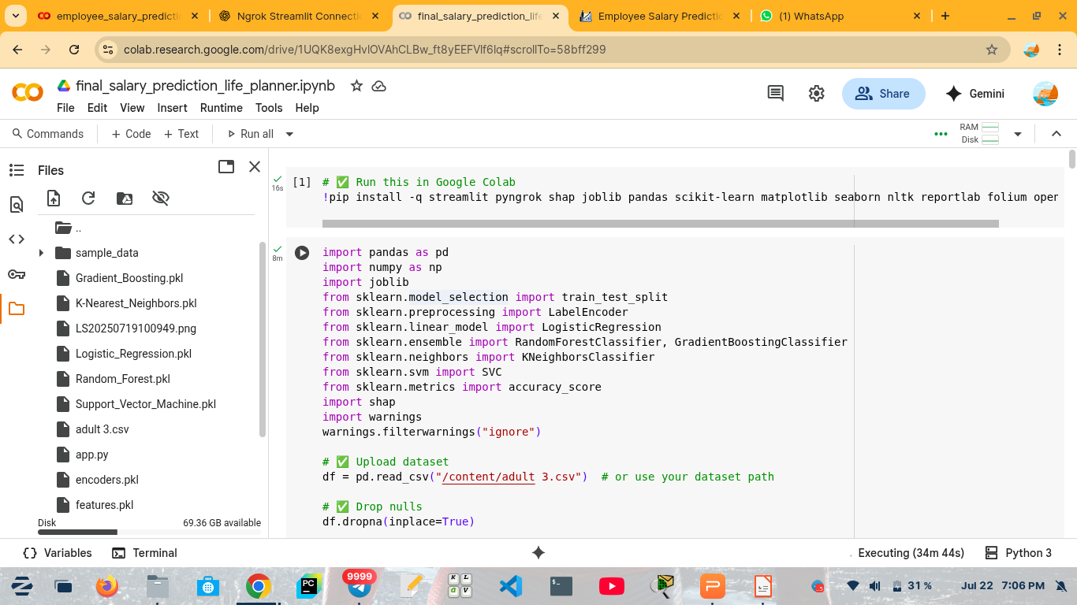
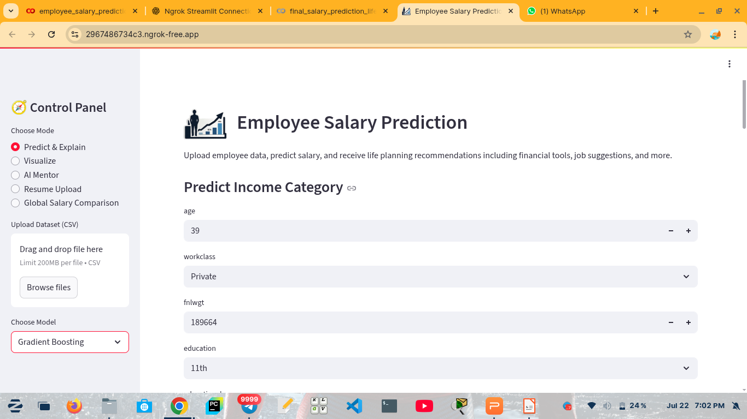
Result
Code Running In Google Colab : Home Page :

Slide 10
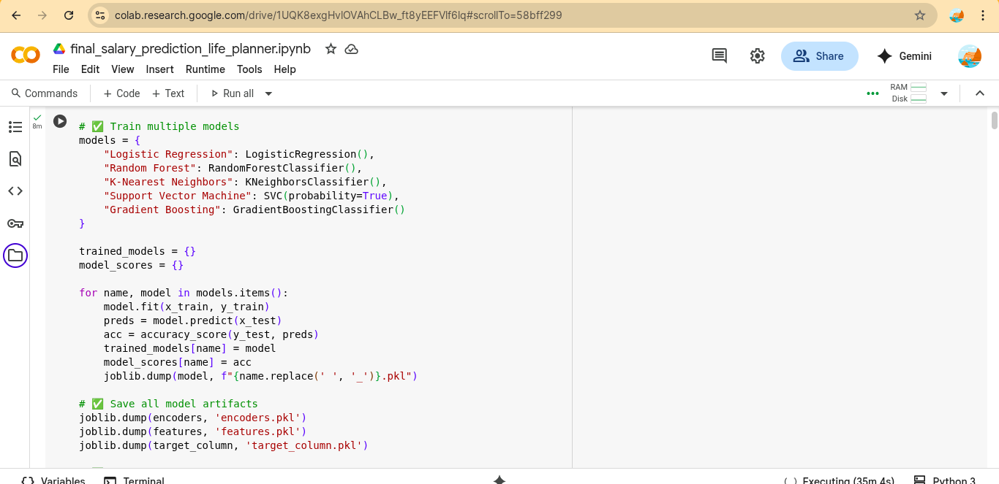
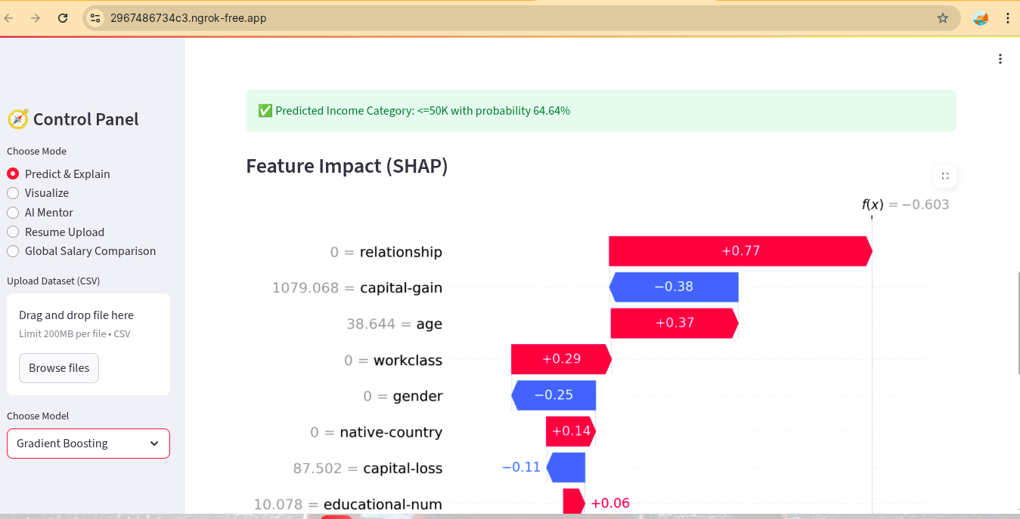
Result
Different Model Training : Selected Feature Impact on Salary :

Slide 11
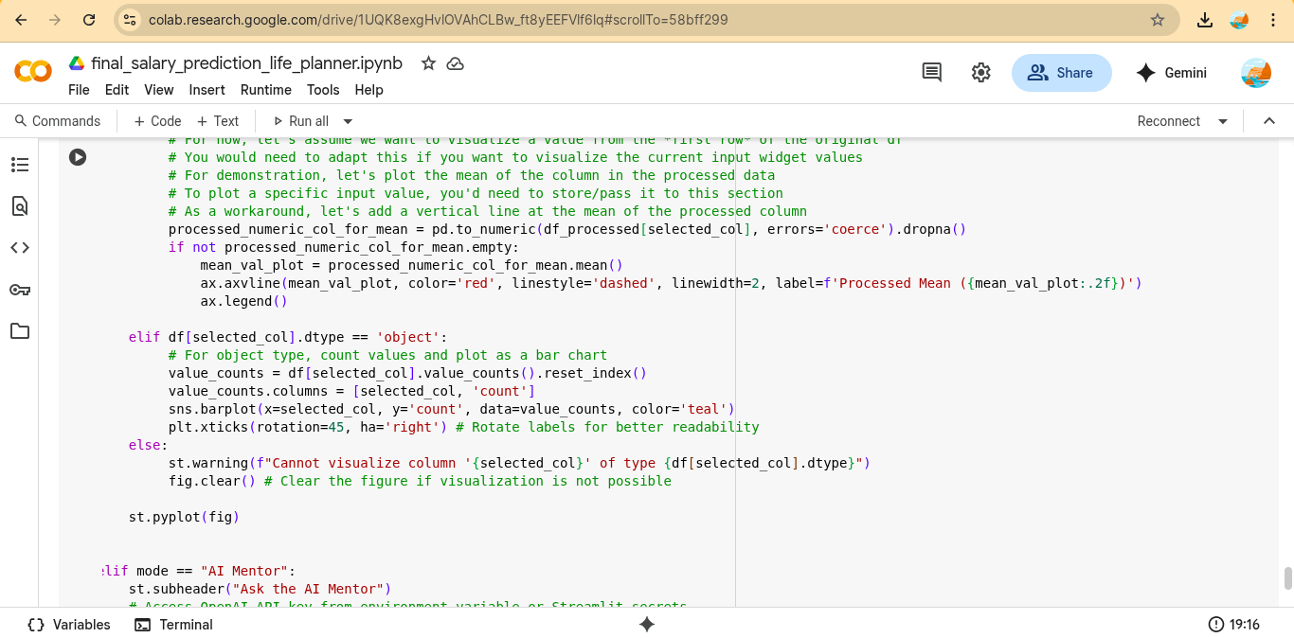
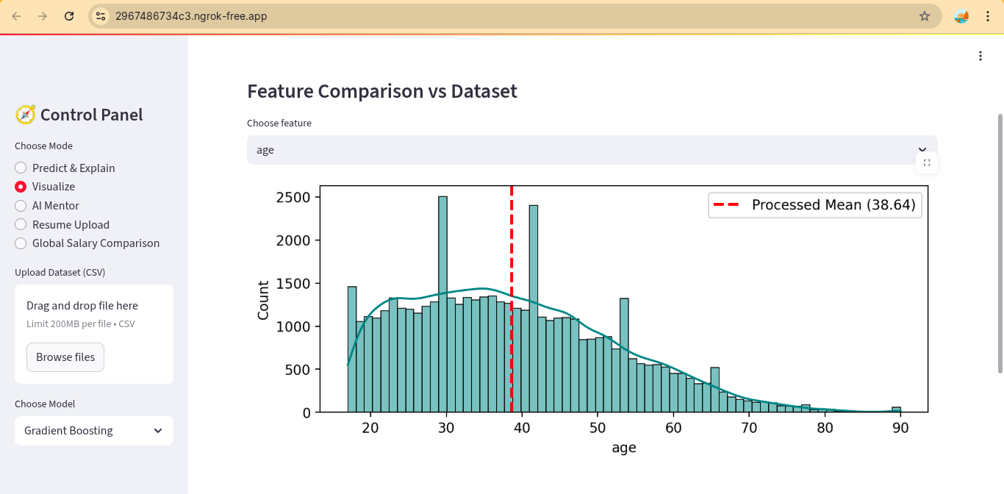
Result
Visualization Code : Bar Chart :

Slide 12
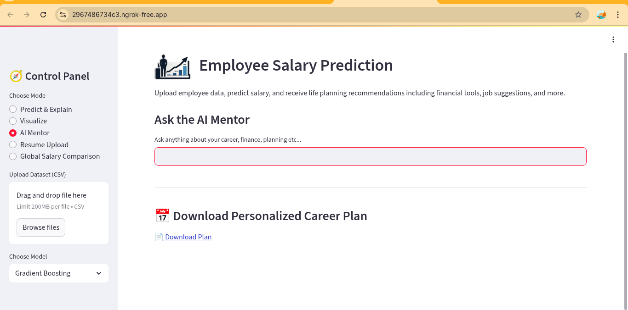
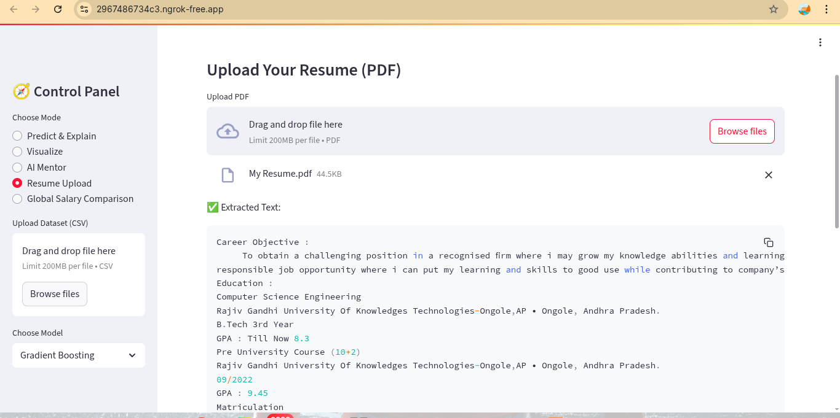
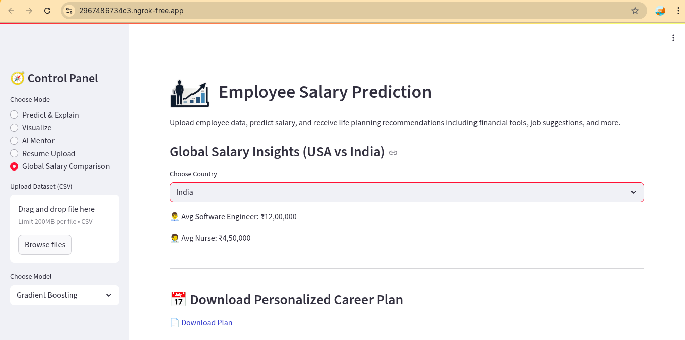
Result
1
1)
2)
3)
1. Ask the AI Mentor
2. Uploading Resume
3. Global Salary Comparison

Slide 13
Github Link
https://github.com/HassainShaik-074/Employee_Salary_Prediction

Slide 14
Conclusion
This project demonstrates the successful application of machine learning for salary prediction, combined with life planning support for users. By leveraging classification models and explainable AI (SHAP), it delivers not only accurate predictions but also actionable insights for users’ financial, career, and educational growth. The system is user-friendly, deployable in Colab, and designed with a professional UI for broader accessibility.
Findings :
Achieved reliable predictions using multiple ML models.
Integrated SHAP for transparent model explanations.
Delivered personalized financial, career, and educational guidance.
Challenges :
Data preprocessing and handling imbalanced classes.
Managing API keys and deployment issues in Colab.

Slide 15
Future scope(Optional)
The system can be further enhanced to provide deeper personalization, broader functionality, and enterprise-grade scalability. Potential future expansions include:
What-if Analysis: Allow users to simulate changes in input features and see impact on salary predictions.
AI Mentor Chatbot: Provide real-time career and financial advice using conversational AI.
Global Salary Comparison: Compare predictions across countries for relocation planning.
PDF Report Generation: Enable downloadable personalized career and financial plans.
Resume & Job Integration: Upload resumes and suggest job roles from real-time job boards.
User Authentication: Secure login system for saving progress and history.
Mobile-Friendly & API Access: Broaden accessibility via mobile apps and API support for integration.

Slide 16
References
1. UCI Machine Learning Repository – Adult Dataset
https://archive.ics.uci.edu/ml/datasets/adult
2. Lundberg, S.M., & Lee, S.-I. (2017).
A Unified Approach to Interpreting Model Predictions (SHAP).
Advances in Neural Information Processing Systems (NeurIPS).
https://arxiv.org/abs/1705.07874
3. Scikit-learn: Machine Learning in Python
Pedregosa et al., Journal of Machine Learning Research, 2011.
https://scikit-learn.org/
4. Streamlit Documentation – Building Data Apps
https://docs.streamlit.io/
5. OpenAI API Documentation – GPT-based Solutions
https://platform.openai.com/docs

Slide 17
THANK YOU

