Slide 1



Smart Garbage Classification Using MobileNetV2
Presented By : Shaik Hassain
Student Name : Shaik Hassain
College Name : Rajiv Gandhi University Of Knowledge
Technologies - Ongole, AP.
Department : Computer Science and Engineering

Slide 2

Learning Objectives
►
Understand the need for automated garbage classification in waste management.
Learn how to use MobileNetV2 for image-based classification tasks.
Apply transfer learning techniques to train models efficiently.
Organize and preprocess image datasets for deep learning.
Use data augmentation to enhance model generalization.
Evaluate model performance using accuracy, loss curves, and confusion matrix.
►
►
GOAL
►
►
►
Source :
www.freepik.com/

Slide 3
Tools and Technology used
●
●
●
●
●
●
●
●
Python – Programming language used for implementation
TensorFlow / Keras – Deep learning frameworks for model development
MobileNetV2 – Pre-trained CNN model used for transfer learning
Matplotlib & Seaborn – Libraries for data visualization
scikit-learn – For evaluation metrics like classification report and confusion matrix
Jupyter Notebook – Interactive environment for developing and running code
NumPy – For numerical and array operations
ImageDataGenerator – For preprocessing and augmenting image datasets

Slide 4
Methodology
►
►
►
►
►
►
Dataset Preparation
Organized images into train/val/test folders; ensured clean class structure.
Data Preprocessing
Applied normalization and augmentation (rotation, flip, zoom) for robustness.
Transfer Learning
Used MobileNetV2 as the base model with added custom classification layers.
Model Training
Trained with Adam optimizer and label smoothing; used callbacks for optimization.
Fine-Tuning
Unfroze top layers of MobileNetV2 to improve accuracy via low learning rate training.
Evaluation & Saving
Evaluated with accuracy, loss curves, confusion matrix; saved final model.

Slide 5
Problem Statement:
Manual waste segregation is time-consuming, inefficient, and prone to human error. With increasing urban waste, there is a critical need for an automated garbage classification system that can accurately identify different types of waste materials.
This project addresses the challenge by leveraging deep learning and transfer learning techniques to build a model capable of classifying garbage into distinct categories such as cardboard, glass, metal, paper, plastic, and trash — ultimately promoting efficient recycling and environmental sustainability.

Slide 6
Solution:
We developed an AI-powered garbage classification system using MobileNetV2, a lightweight and efficient convolutional neural network.
Key Features of the Solution:
Utilized transfer learning to reduce training time and improve accuracy.
Trained the model on a labeled dataset with 6 waste categories: cardboard, glass, metal, paper, plastic, and trash.
Implemented data augmentation to enhance model generalization.
Fine-tuned the model using a smaller learning rate for better performance.
Achieved up to 86% classification accuracy, making the system suitable for real-world waste segregation tasks.
This solution helps automate the sorting of waste, enabling faster and more accurate recycling processes.
►
►
►
►
►
►

Slide 7
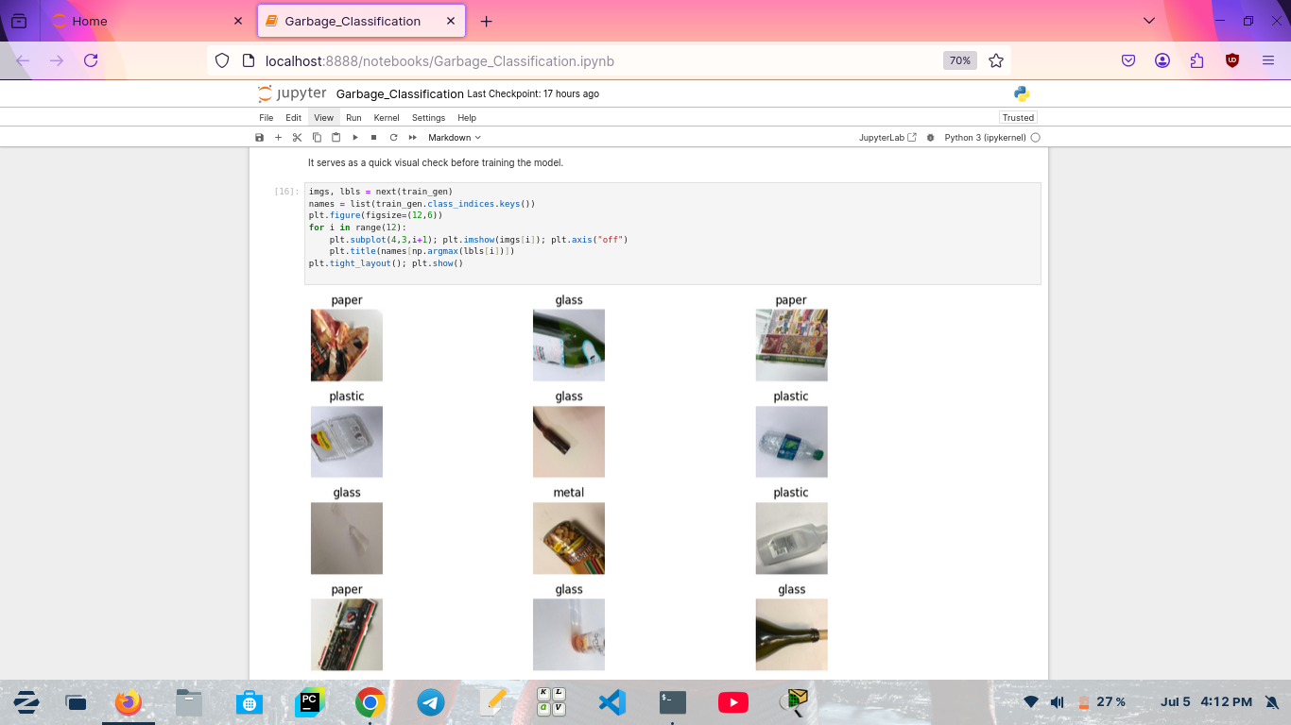
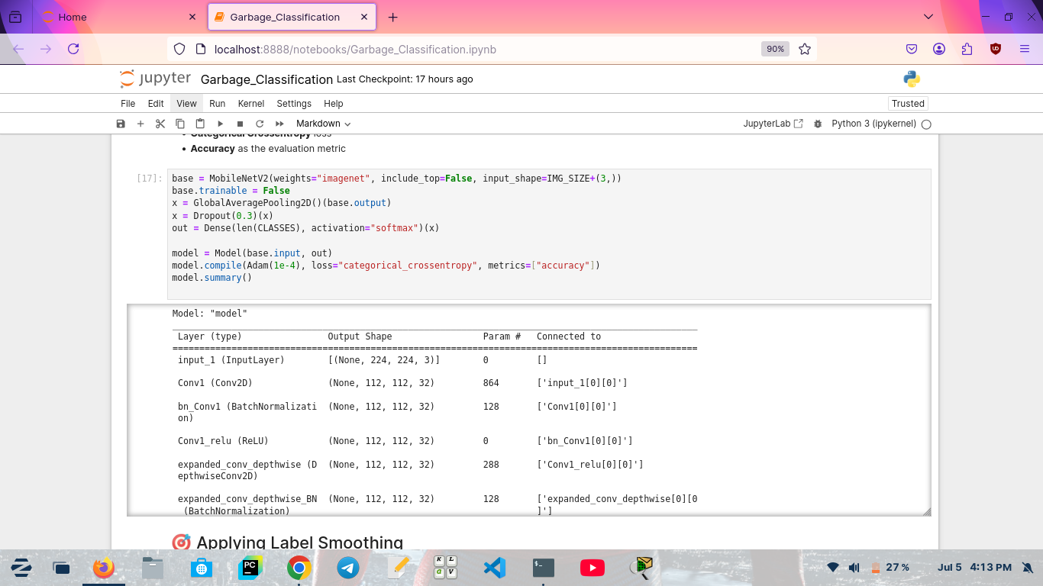
Screenshot of Output:
Sample Traning Images : Model Summary :

Slide 8
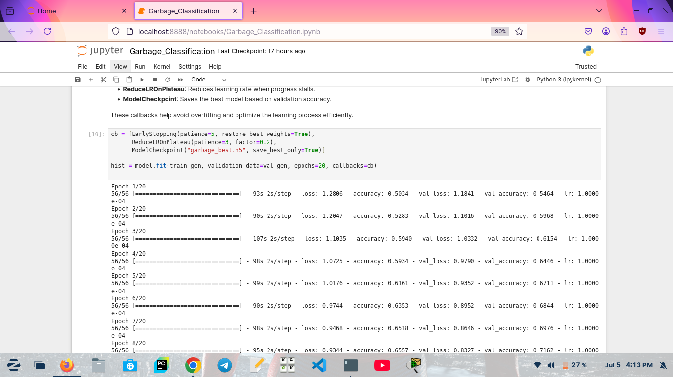
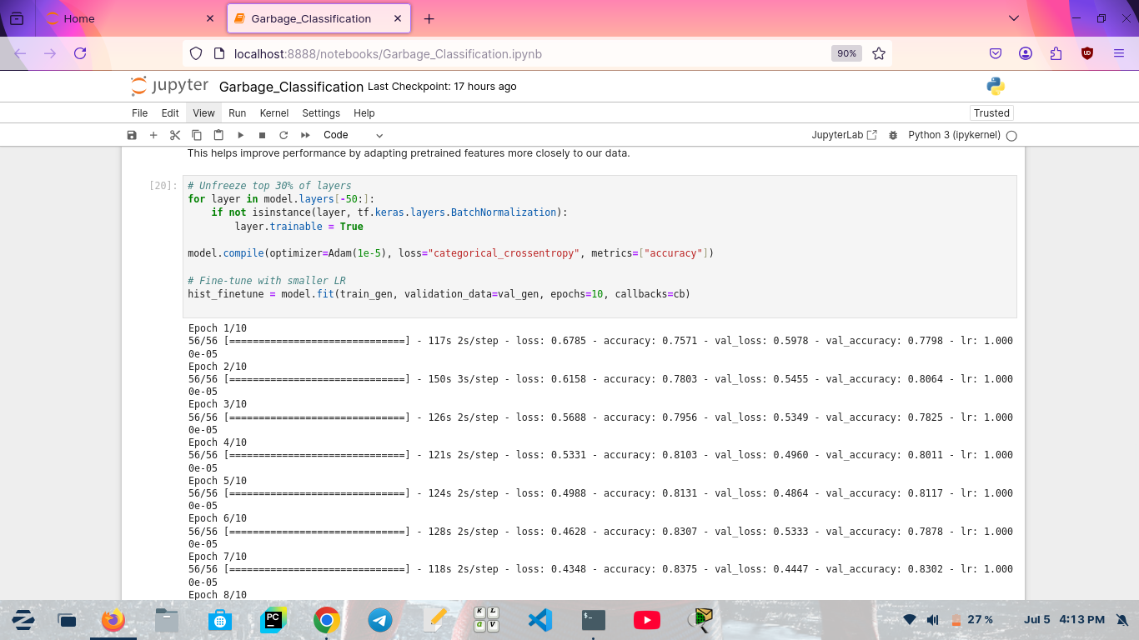
Screenshot of Output:
Model Training : Fine-Tuning The Model :

Slide 9
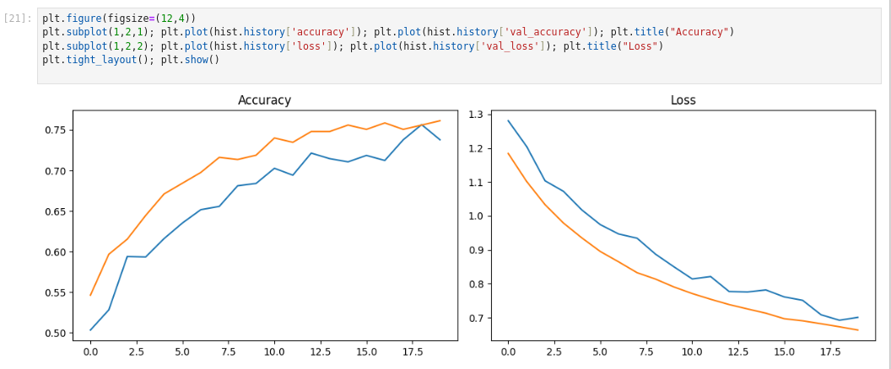
Screenshot of Output:
Training & Validation Performance :

Slide 10
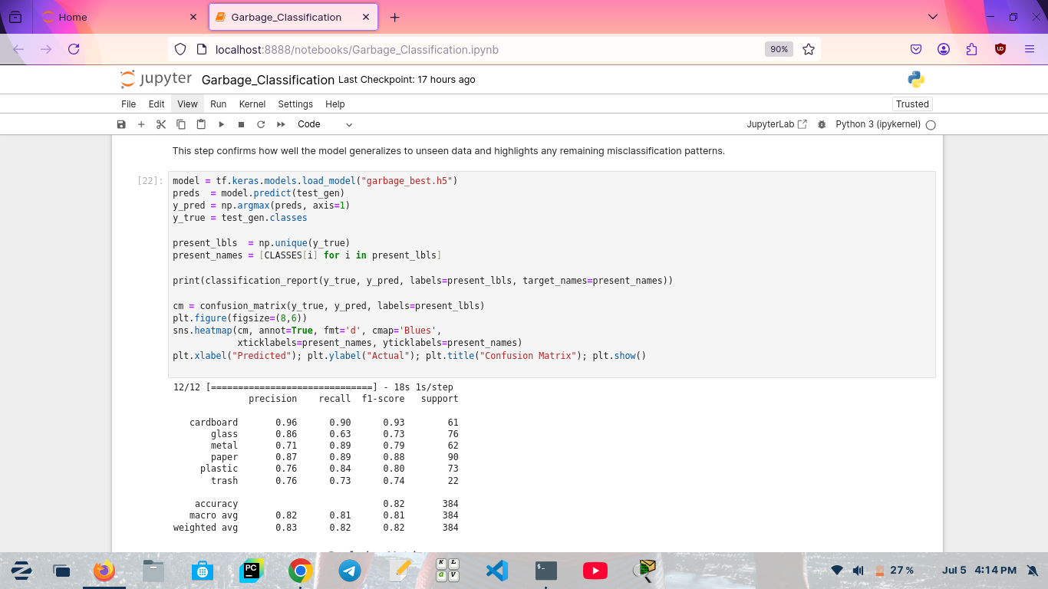
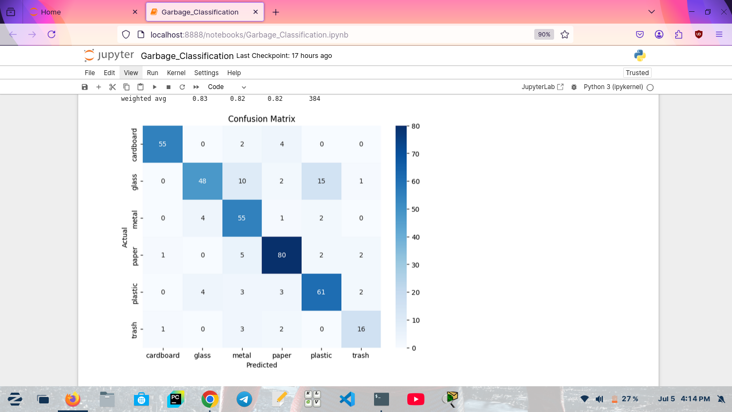
Screenshot of Output:
Final Evalution on Test Data :

Slide 11
Conclusion:
Successfully developed a garbage classification model using MobileNetV2 with transfer learning.
Achieved a notable accuracy of 86%, demonstrating strong performance in multi-class waste identification.
Applied techniques such as data augmentation, label smoothing, and fine-tuning to enhance model robustness.
Validated model performance using visual predictions, confusion matrix, and classification reports.
The project showcases the potential of deep learning in automating waste segregation, contributing to efficient recycling and environmental sustainability.

