Slide 1
Project Title : Secure Data Hiding in Images Using Steganography
CAPSTONE PROJECT
Presented By: Shaik Hassain
Student Name : Shaik Hassain
College Name : Rajiv Gandhi University Of Knowledge Technologies
- Ongole, AP.
Department : Computer Science and Engineering

Slide 2
OUTLINE
Problem Statement
Technology used
Wow factor
End users
Result
Conclusion
Git-hub Link
Future scope

Slide 3

Problem Statement
With the rise of cyber threats, securing sensitive attackers.
Traditional encryption techniques are often targeted by attackers.
Steganography offers a way to hide data within images, making it undetectable to hackers.
This project implements a Python-based tool for
securely embedding data in images.

Slide 4
Technology used
Programming Language: Python
Libraries: OpenCV, PIL (Pillow), NumPy, Steganography library, Tkinter, Filedialog, Messagebox.
Platform: Windows/Linux

Slide 5
Wow factors
What makes this project stand out from other project(Unique features) :
Uses LSB (Least Significant Bit) steganography for high security
Data remains hidden within images without altering visible quality
Supports text and file hiding inside images
Simple GUI-based interface for non-technical users

Slide 6
End users
Who are the end users
Cybersecurity professionals
Government agencies for confidential communication
Journalists and whistleblowers for secure information transfer
General users concerned about digital privacy

Slide 7
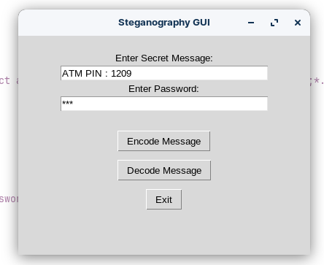
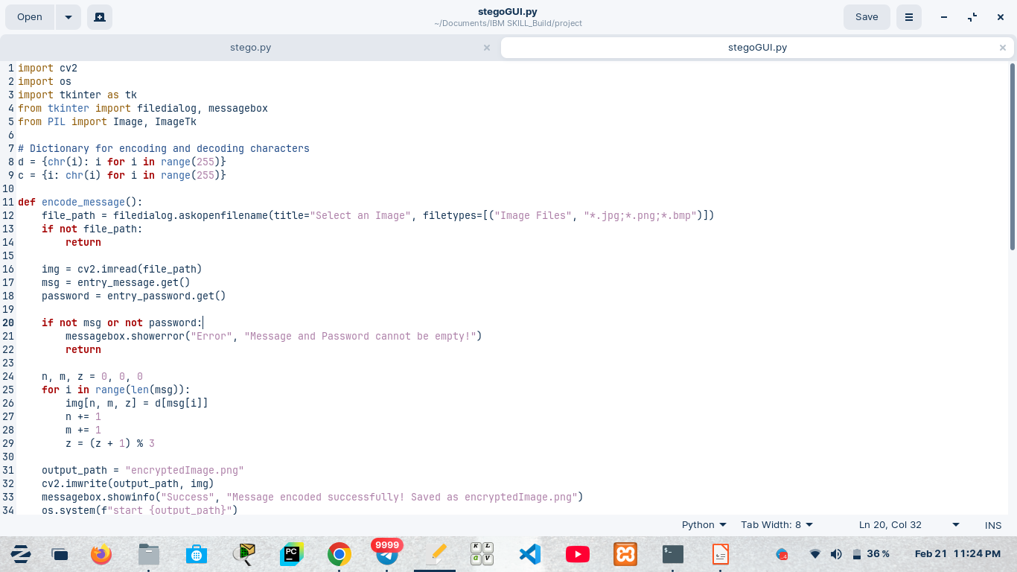
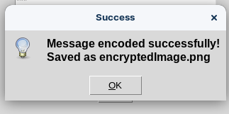
Results
Screenshots of the outcome (min 3)

Slide 8
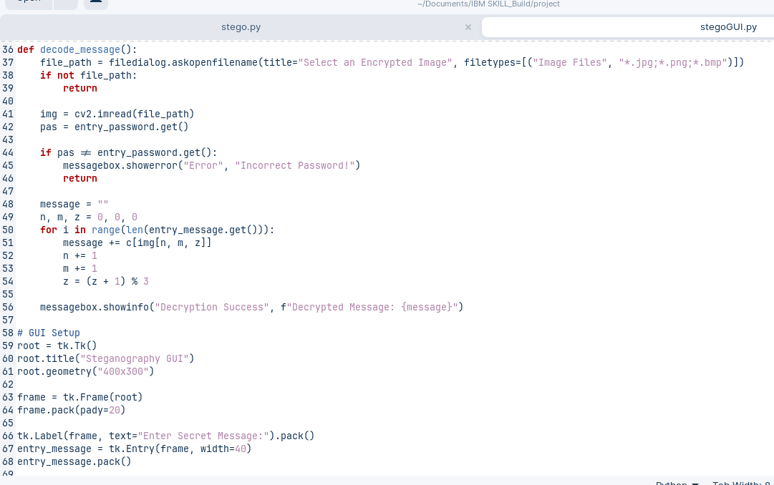
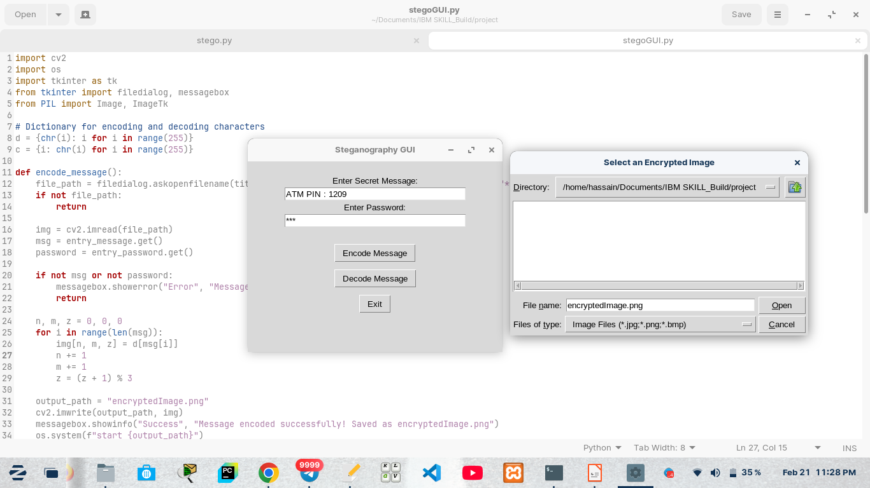
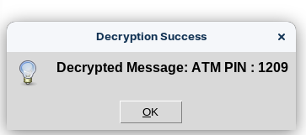
Results
Screenshots of the outcome (min 3)

Slide 9
Conclusion
The "Secure Data Hiding in Images Using Steganography" project successfully demonstrates how steganography can be used to embed secret messages within digital images, ensuring confidentiality and security.
By leveraging Least Significant Bit (LSB) substitution, the project enables seamless encoding and decoding of messages without noticeable alterations to the image. The Graphical User Interface (GUI) enhances usability, making it accessible even to non-technical users. This project is a practical application of information security and cryptography, proving its effectiveness in preventing unauthorized access to sensitive data.

Slide 10
GitHub Link
Make sure that there should be readme file
Link :
https://github.com/HassainShaik-786/AICTE_PROJECT-Secure-Data-Hiding-in-Images-Using-Steganography-..git

Slide 11
Future scope(optional)
The project can be further enhanced by incorporating the following improvements:
Advanced Encryption Integration : Implementing AES or RSA encryption before embedding the message will add an extra layer of security.
Support for Different File Formats : Extending support to video (MP4), audio (MP3), and PDF files for hidden data storage.
Adaptive Steganography : Using deep learning techniques to optimize image selection and embedding strategies based on pixel analysis.
Cloud & Web-Based Steganography : Developing a web or mobile application to allow users to encode/decode messages securely from anywhere.
Anti-Forensic Techniques : Implementing steganalysis resistance methods to prevent detection by steganalysis tools.
With these enhancements, this project can evolve into a robust, real-world security tool for secure communication and data protection in the digital era.

Slide 12
THANK YOU

