Slide 1
KAREZ 2.0
AI-assisted pre-submission compliance for Pakistani government construction tenders
karez (n.) — the underground water channels of Balochistan: quiet infrastructure that carries something vital exactly where it is needed.
Alibaba Cloud AI Hackathon Pakistan 2026 • Bano Qabil / Alkhidmat Foundation
Notes:
Karez reads government construction tenders and audits a contractor's eligibility BEFORE submission - when paperwork defects can still be fixed. Named for the karez channels of Balochistan.

Slide 2
THE PROBLEM & WHO IT AFFECTS
Good contractors lose on paperwork, not price
In Pakistani public construction procurement, bids are opened in two envelopes (PPRA Rule 36(b)). The technical envelope is checked first — and a single administrative defect ends the bid before the price is ever read.
Who it affects
Contractors registered with the Pakistan Engineering Council — from C-A giants to C-6 small firms — bidding to NHA, LDA, C&W, WAPDA and Pak PWD. Small and mid-size firms are hit hardest: they have no dedicated compliance departments, and one rejected bid can waste months of preparation and lock up bid-security capital.
35–40%
of bids are technically disqualified for paperwork defects — before price evaluation
PKR 500B+
of government construction work is tendered every year in Pakistan
Rs. 500
the stamp-paper denomination that routinely kills billion-rupee bids
Notes:
35-40% technical disqualification rate; PKR 500B+ annual tender value. The defects are trivial and fixable - if caught before submission.

Slide 3
SIX WAYS A COMPLIANT BIDDER GETS REJECTED
The paperwork traps
✗
Wrong stamp-paper denomination
✗
Expired PEC renewal
✗
Short CDR / bid security
Affidavit on Rs. 100 paper where the tender demands Rs. 500 judicial stamp paper
Licence valid, but the annual renewal card for the current financial year is missing
Call Deposit Receipt a few million rupees below the required 2–5% of estimated cost
✗
Missing non-blacklisting affidavit
✗
PEC category or code mismatch
✗
Not on the Active Taxpayer List
No sworn declaration of never being blacklisted, attested by an Oath Commissioner
A C-2 firm bidding a C-A tender, or a licence missing the CE02 bridges code
Valid NTN, but the firm has dropped off FBR's ATL at the date of opening
Notes:
Each of these is a real, common disqualification ground under PPRA Rules 2004. None is about the quality or price of the work.

Slide 4
THE SOLUTION & AUDIENCE
Scan → extract → audit, in under a minute
1
Upload the tender
2
AI extracts criteria
3
Deterministic audit
4
Clause-by-clause verdict
Scanned or digital PDF — every page is read, not just page 1
→
Vision LLM pulls PEC, turnover, CDR, affidavit and JV clauses — each with its page number
→
A TypeScript rules engine (no LLM) compares criteria with the bidder's profile
→
PASSED / FAILED — DISQUALIFICATION RISK / FLAGGED FOR HUMAN REVIEW
And then it helps fix what it found
Executive audit report (print to PDF) • Technical-proposal skeleton • Affidavit text generator • CDR & JV calculators • Two-envelope packing checklist
Notes:
Audience: bid preparation teams at PEC-registered contractors, and the consultants who prepare bids for them. Demo target: scan to checklist in under 60 seconds.

Slide 5
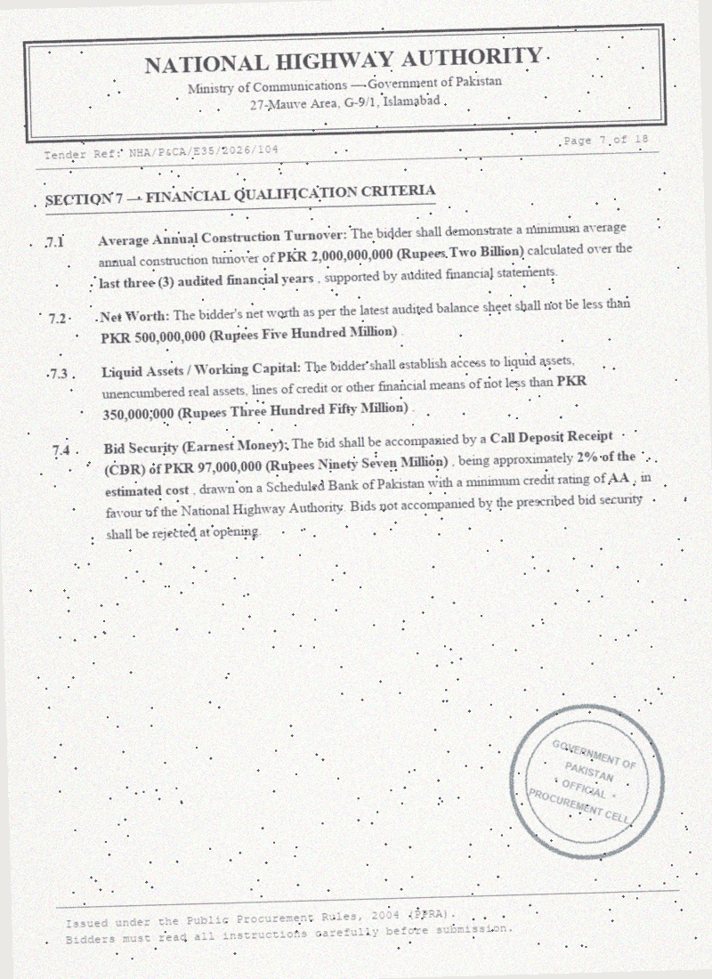
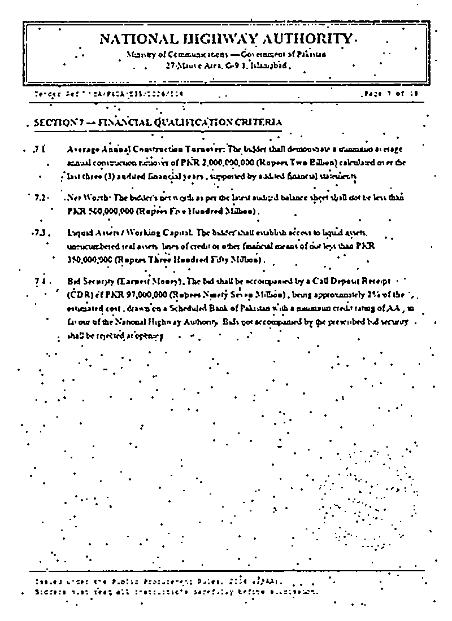
COMPUTER VISION PREPROCESSING
From a crooked photocopy to structured criteria
What the engine extracts from this page
✓ 3-yr avg turnover — PKR 2,000,000,000 (p. 7)
✓ CDR / bid security — PKR 97,000,000 (p. 7)
✓ Bank rating — AA, scheduled bank (p. 7)
⚠ PEC category — NOT STATED on this page
⚠ JV rules — NOT STATED on this page
Both are flagged for human review — never guessed.
→
Raw scan — tilted, speckled, blue agency stamp
Genuine output of scripts/clean_scanned_pdf.py (OpenCV): deskewed, stamp removed, binarized
Notes:
Left image is our synthetic demo scan; right is the actual output of the OpenCV pipeline in the repo - deskew, HSV blue-stamp removal, adaptive threshold, despeckle. Extraction keeps page references.

Slide 6
OUR CORE DESIGN DECISION
If it is not on the page, we say NOT STATED
No invented thresholds
A missing PEC category, turnover, CDR or stamp value is never replaced with a “typical” default — it is flagged for human review with the reason “not stated on the pages analysed”.
Failure is an error, not a template
If the AI provider is down, the user sees a red error banner. The app never fabricates tender data to keep the demo pretty.
Plausibility guards
Turnover above PKR 500 Billion or a CDR above PKR 50 Billion is flagged as a probable units error — not silently passed.
The drafter cannot invent facts
Unknown company details become [INSERT: …] placeholders. Failed audit checks are disclosed in the proposal and its cover letter — no false claims of full compliance.
Honest paperwork about the paperwork
The report is labelled an AI-assisted pre-submission audit, signed by the bidder's own reviewers — no imitation government signatures.
Notes:
This is the differentiator: a compliance tool must be trustworthy about its own limits. Unknown means flagged, never guessed. This principle is enforced in code - the provider layer throws instead of returning synthetic data.

Slide 7
INNOVATION & TECHNOLOGY
Probabilistic reading, deterministic judgment
Next.js 15 + React 19 + Tailwind 4
Dashboard, checklist, report & calculator UI
Why this architecture matters
The LLM only reads; it never judges. Eligibility verdicts come from auditable, deterministic rules — the same input always gives the same verdict.
Every extracted value carries its page reference, so a human can verify the clause in seconds.
Domain-encoded expertise: PEC category hierarchy (C-A is the only “No Limit” class), CDR = bid security = earnest money, judicial stamp paper rules, Rule 36(b) envelopes.
Human-in-the-loop: every flagged clause supports reviewer override with an audit trail.
OpenCV preprocessing (deskew, stamp removal, despeckle) for real-world photocopied tenders.
↓
pdf.js (in-browser)
Renders every page of the uploaded PDF — whole document analysed, not page 1
↓
AI provider layer
Gemini by default; Alibaba Cloud Qwen supported via one env var — provider-agnostic
↓
Deterministic compliance engine
Pure TypeScript rules — PEC ranks, turnover, CDR, stamp paper, ATL, JV. No LLM inside.
↓
Firebase Auth + Firestore
Multi-company workspaces with per-user security rules
Notes:
Key line: the LLM reads, the rules engine judges. Gemini is default; Qwen path ships in the repo (DASHSCOPE_API_KEY) - provider-agnostic by construction.

Slide 8
FEASIBILITY
This is built and running — not a mock-up
✓
Whole-PDF analysis (≤15 MB) or up to 12 rendered page images
✓
Clause-by-clause checklist with page jumps & OCR-confidence flags
✓
PEC category / specialization code matching (C-A … C-6)
✓
Turnover, liquid assets & CDR checks with deficit amounts
✓
Stamp-paper & non-blacklisting affidavit verification
✓
FBR NTN / Active Taxpayer List status check
✓
JV rules: partner cap, lead & minor share thresholds
✓
Executive audit report — print-ready, disclaimered
✓
Technical-proposal skeleton with [INSERT] placeholders
✓
Affidavit generator, CDR & JV calculators, envelope checklist
✓
Urdu / English client briefing + WhatsApp summary
✓
Multi-company workspaces (Firebase Auth + Firestore)
Verified: npx tsc --noEmit ✓ npm run build ✓ OpenCV pipeline runs from the CLI ✓ 3 annotated sample tenders with synthetic scan pages in the repo
Notes:
Everything on this slide exists in the public repo and is exercised in the live demo. Nothing shown is a mock.

Slide 9
NEED & IMPACT
What one avoided disqualification is worth
Months of work preserved
Capital unlocked
A technical rejection wastes the full bid-preparation cycle — surveys, rate analysis, document attestation — and the tender does not wait.
Bid security (2–5% of project cost) sits frozen with a rejected bid. For a PKR 5B tender that is ~PKR 100M of working capital.
Days → under a minute
Fairer competition
Manual cross-checking of a 100+ page tender against a firm's documents takes days of a senior engineer's time. Karez does the first pass in under 60 seconds.
When small and mid-size firms stop losing on formalities, more qualified bidders survive to price evaluation — better outcomes for public money.
Notes:
Impact framing: the tool pays for itself the first time it catches a Rs. 500 stamp paper mistake on a billion-rupee bid.

Slide 10
WHERE THE CHANNEL FLOWS NEXT
Roadmap
KPPRA, SPPRA, BPPRA and Punjab PPRA variations encoded in the same deterministic engine
Automatic preprocessing pipeline choice for scanned vs digital documents
Combine partner profiles into a single audited joint-venture entity
Provincial rule packs
Server-side OCR routing
JV profile consolidation
EPADS addenda watcher
Encrypted past-bid repository
Monitor e-procurement portal for corrigenda that silently change deadlines or criteria
Reuse a firm's verified certificates and affidavits across bids, safely
Notes:
Same honest engine, wider coverage: provincial rules first (biggest demand), then EPADS integration.

Slide 11
See it work in 60 seconds
Load the NHA E-35 sample → watch the clause-by-clause audit → switch to the under-qualified bidder profile → every disqualification lights up → print the audit report.
Public repository
Live deployment
Judges' demo login
github.com/Hassam-Taimuri/karez-2.0
karez-20.vercel.app
Provided with the submission entry
Karez 2.0 — honest infrastructure for honest bidding.
Notes:
Close on the honesty principle. Fill the three [INSERT] boxes after the repo push, deployment, and demo-account creation.

