Slide 1

NLP Chatbot Using Dialogflow
Group Id: F24PROJECT88F2E (BC210414987)
Supervisor Name: Abdullah Qamar

Slide 2
Introduction
An NLP-based chatbot developed using Dialogflow to assist restaurant customers by automating order placement, answering queries, and providing support just like a human waiter would!
It engages with users in natural conversations, helping them browse menus, customize orders, and track deliveries effortlessly. Whether a customer wants to book a table, check food availability, or leave feedback, the chatbot provides a smooth, interactive, and friendly experience, ensuring convenience and efficiency for both customers and restaurant staff.

Slide 3
Objective
To create an AI-powered chatbot that enhances the customer experience by enabling natural, human-like conversations for seamless order management, instant support, and personalized interactions. The chatbot will act as a virtual assistant, helping users browse menus, place orders, track deliveries, and resolve queries all while ensuring a smooth and engaging dining experience.

Slide 4
Technology Stack
Dialogflow (NLP) – Understands user queries and processes natural language.
Python (Backend & Features) – Handles authentication, authorization, and profile management.
MySQL (Database) – Stores user details, orders, and chatbot interactions.
Flask (API Development) – Connects the frontend, backend, and Dialogflow.
HTML/CSS/JavaScript (Frontend) – Provides an interactive customer dashboard.

Slide 5
System Architecture
The user interacts with the chatbot via a web or mobile interface.
The chatbot processes the input using Dialogflow NLP to detect intent and extract entities.
Dialogflow triggers the relevant intent and forwards necessary data to the backend API.
The backend processes the request, retrieves or updates data in the MySQL database.
A response is generated and sent back to Dialogflow, which then displays it to the user.

Slide 6
Key Features
Automated Order Placement – Users can place food orders easily.
Menu Browsing – Displays available dishes with pricing and details.
Order Status Tracking – Allows users to check delivery or pickup status.
Customer Support Queries – Handles FAQs, complaints, and assistance.
User Authentication & Profile Management – Secure login, order history, and preferences.

Slide 7
Working Process
User registers or logs in with authentication.
Role-based access ensures the correct dashboard.
User sends a query (e.g., "I want to order a pizza.").
Chatbot detects intent and extracts details (e.g., food item, quantity).
If needed, chatbot asks follow-up questions (e.g., "Which size?").
Order details are processed and stored in the database.
Chatbot confirms the order (e.g., "Your pizza is confirmed. Estimated delivery: 30 minutes.").
Users manage profiles (view orders, update details).

Slide 8
Database Integration
Users table – Stores customer details and authentication credentials.
Orders table – Stores order information and user association.
Products table – Stores menu items and availability.
Support tickets table – Handles customer complaints.
Order items table – Links orders and products.
Authentication & Authorization – Ensures secure user login and role-based access.
Profile Management – Allows users to view past orders and update details.

Slide 9
Use Case Scenario
User: I want to order a burger.
Chatbot: Sure! Which type of burger would you like?
User: Cheese burger.
Chatbot: Would you like to add fries or a drink?
User: Yes, add fries.
Chatbot: Great! Your order is confirmed. It will be ready in 20 minutes.

Slide 10
Challenges & Solutions
Handling Ambiguous Queries – Trained chatbot with diverse data for better understanding.
Maintaining Session History – Implemented session storage in the backend.
Database Integration Delays – Optimized SQL queries and added caching for faster response.

Slide 11
Future Enhancements
Voice-Based Interactions – Enables talking instead of typing.
Reservation System – Allows table bookings in advance.
Customer Feedback – Collects ratings and reviews.

Slide 12
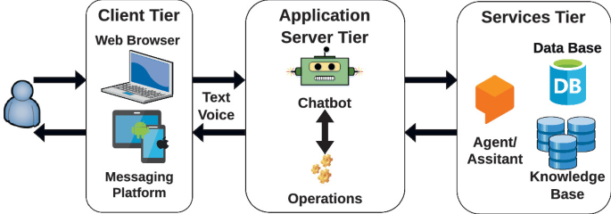
Architecture Design Diagram

Slide 13
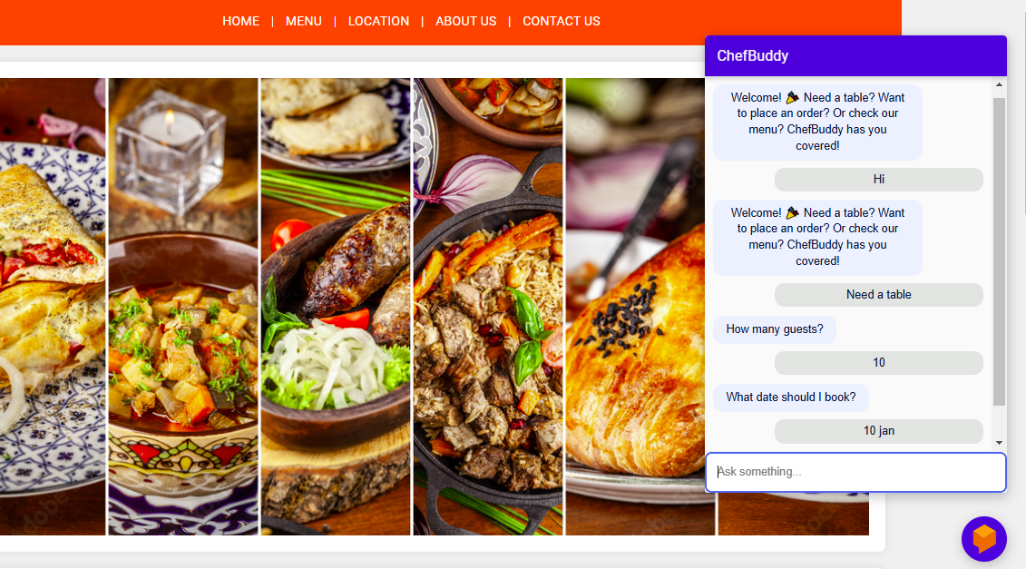
Interface Design

Slide 14
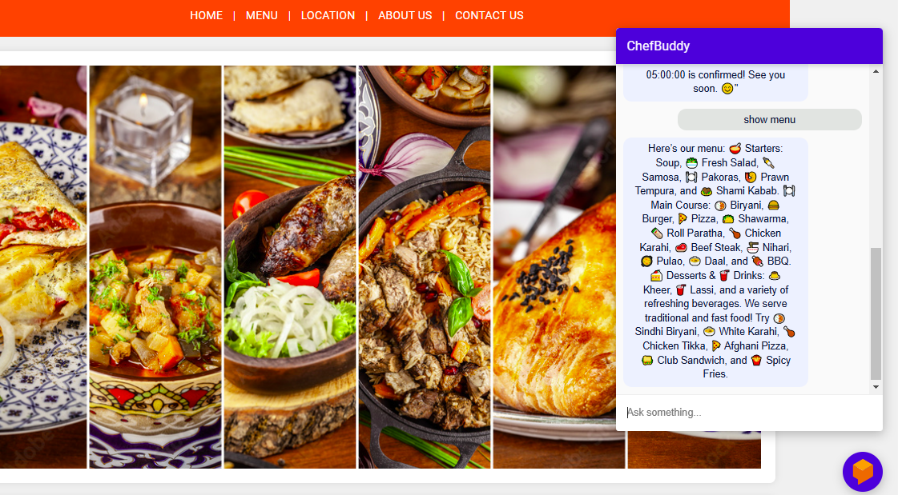
Show menu

Slide 15
GitHub Repository Link
https://github.com/Hassamkhan888/Prototype-Assignment-BC210414987

