Slide 1

IPV4 Header
SANS 401
@HassanAlAchek

Slide 2

PLAN
Network Protocols
Layer 3
Internet Protocol (IP)
Internet Control Message Protocol (ICMP)
Layer 4
Transmission Control Protocol (TCP)
User Datagram Protocol (UDP)
Tcpdump

Slide 3
PLAN
Network Protocols
Layer 3
Internet Protocol (IP)
Internet Control Message Protocol (ICMP)
Layer 4
Transmission Control Protocol (TCP)
User Datagram Protocol (UDP)
Tcpdump

Slide 4
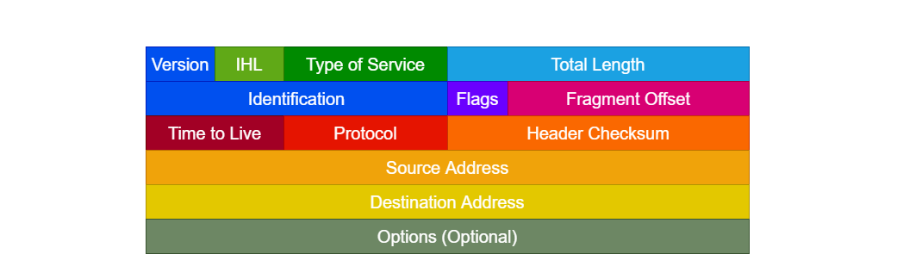
IPV4 Header

Slide 5
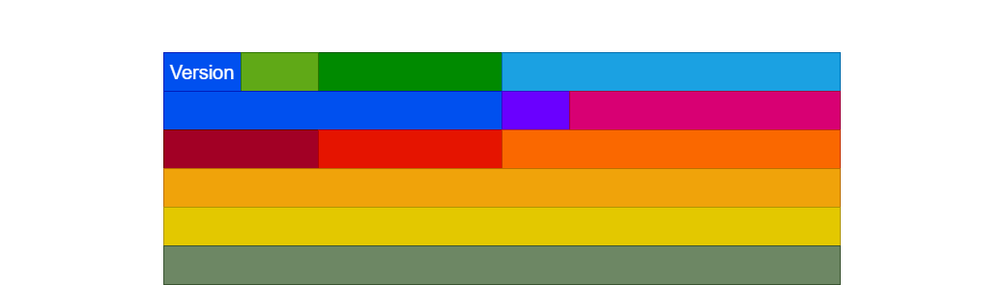

IP Version, 4 bits
IPV4
4 = 0100
IPV6
6 = 0110

Slide 6
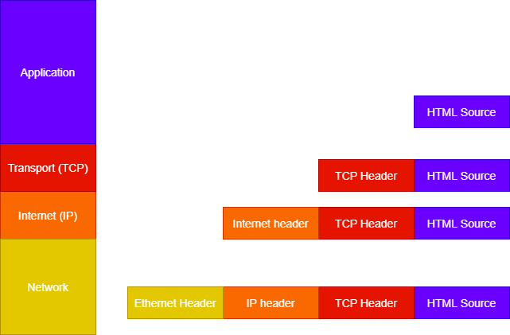
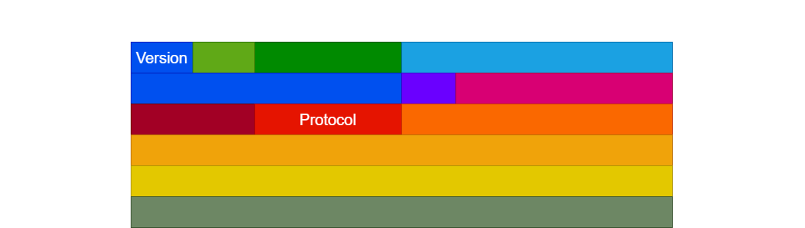
Protocol, 8 bits
6 = TCP
17 = UDP
1 = ICMP

Slide 7
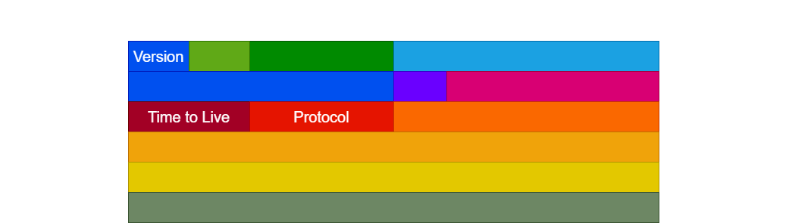
Time To Live ( TTL ), 8 bits

Slide 8
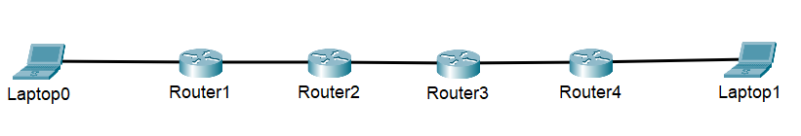
Hop
Hop
Hop
Hop
TTL = 32
TTL = 31
TTL = 30
TTL = 29
TTL = 28

Slide 9
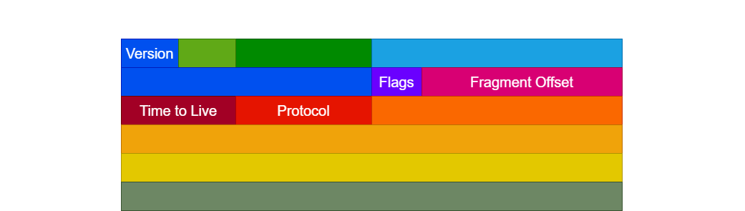
Fragmentation, 16 bits
Packet
Packet
Packet
Fragmentation

Slide 10
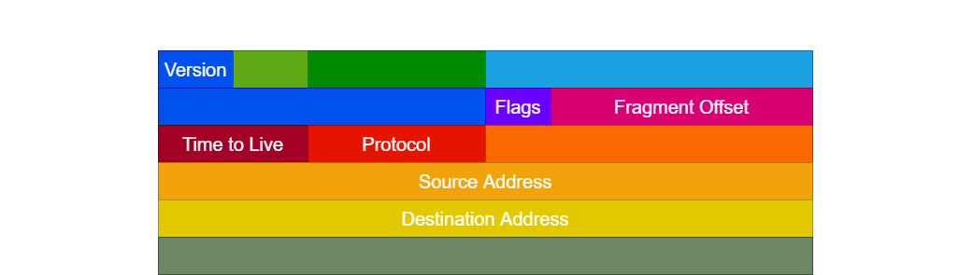


Source and Destination Address, 32 bits

Slide 11

Thank You !

