Slide 1
Transport Equity Analysis
via Formal Verification
Turn-Based Stochastic Multi-Player Games · UK DfT Transport Personas
Corridor: Giffnock → University of Glasgow | Updated 21 July 2026
Home
Stop
Interchange
Dest.

Slide 2
What Question Are We Asking?
9 DfT Transport Personas
5 Transport Policies
Can formal verification reveal which transport policies best balance user cost, operator revenue and emissions across diverse traveller types?
Elderly (no car)
Less Mobile
Young Low Income
Older Less Affluent
Young Family
Urban Professional
Suburban Family
Empty Nester
Heavy Car User
Normal (baseline)
High Frequency
Low Fare
Road Charge
Accessible Service

Slide 3
Why Not Just Simulate?
Simulation
Formal Verification
Runs many random scenarios
Results are statistical estimates
Cannot guarantee optimality
May miss rare but critical events
Output: average / distribution
Exhaustively explores all states
Results are mathematical guarantees
Computes provably optimal strategies
Handles adversarial conditions
Output: exact probability / value

Slide 4
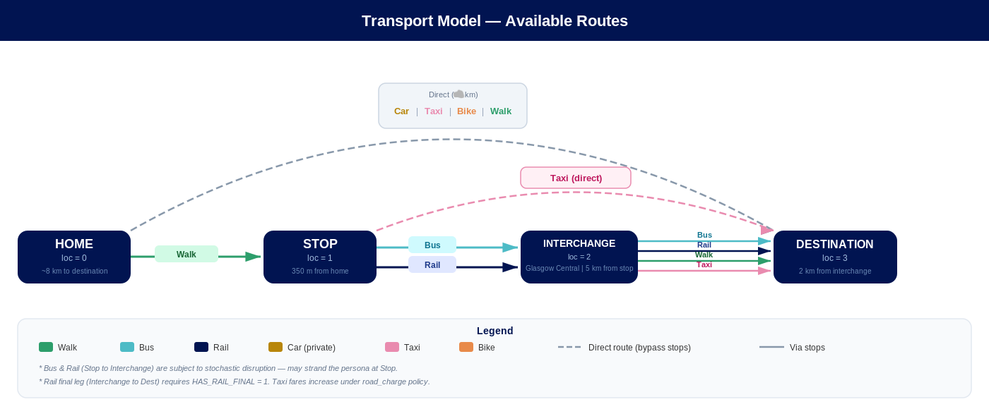

Slide 5
First Approach: Concurrent Stochastic Game (CSG)
Persona
Operator
Environment
Navigates the journey;
chooses mode step by step
Responds to
accessibility requests
Adversarial: weather,
cancellations, disruptions
Why we moved from CSG to SMG
Multi-objective not supported in CSG — Pareto fronts and combined reliability/cost queries (multi(...)) require a turn-based SMG.
Unrealistic simultaneity — in a CSG, environment and persona act at once. In reality a traveller first observes conditions, then decides. SMG enforces this naturally.

Slide 6
Transition to Turn-Based SMG
Phase 0 — Manager
Phase 1 — Persona
Acts exactly once at the start
Chooses a transport policy (0–4)
Probabilistically samples: weather, lift availability, accessible bus
Hands control to the persona
Navigates the journey step by step
Chooses mode at each location (bus, rail, taxi, walk…)
Faces probabilistic disruptions (delay / cancel)
Loops until arrived at destination or gives up
Why disruptions aren't a third player
A fully adversarial environment player would force worst-case-only analysis — too pessimistic for comparing realistic policies.
Disruptions (delay, cancellation, lift failure) are instead embedded as fixed probabilities inside the persona's own actions: more realistic, and still fully quantitative.

Slide 7
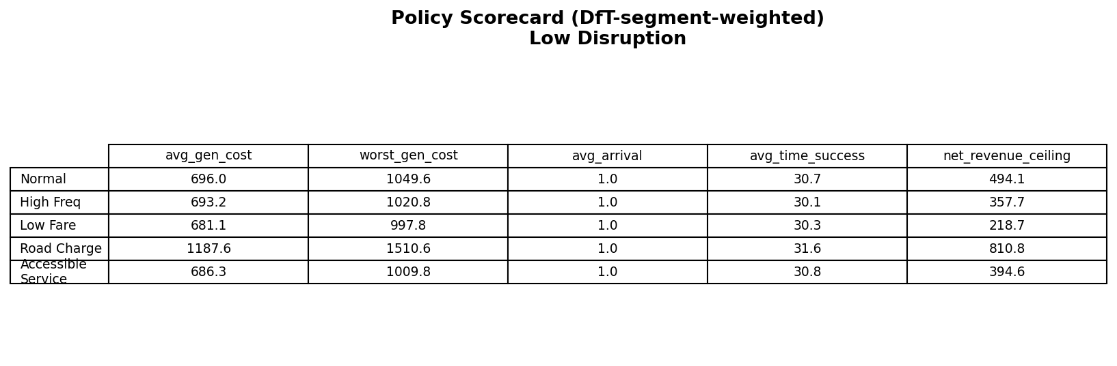
Giving the Manager a Real Objective
generalized_cost: the persona's true objective — time, fare and walking distance combined via per-persona weights (value of time, fare sensitivity, walking aversion).
revenue: fares actually paid, plus road-charge income — the operator's income side.
policy_cost: subsidies (low fare) and amortised fixed costs (high frequency, accessible service) — the operator's spending side.
Framed as a Stackelberg game: the manager commits to one policy, the persona then reacts optimally — we compute that best response exactly for each of the 5 policies.

Slide 8
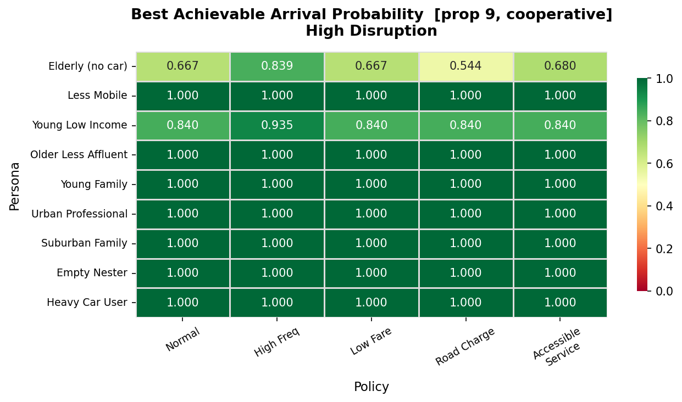
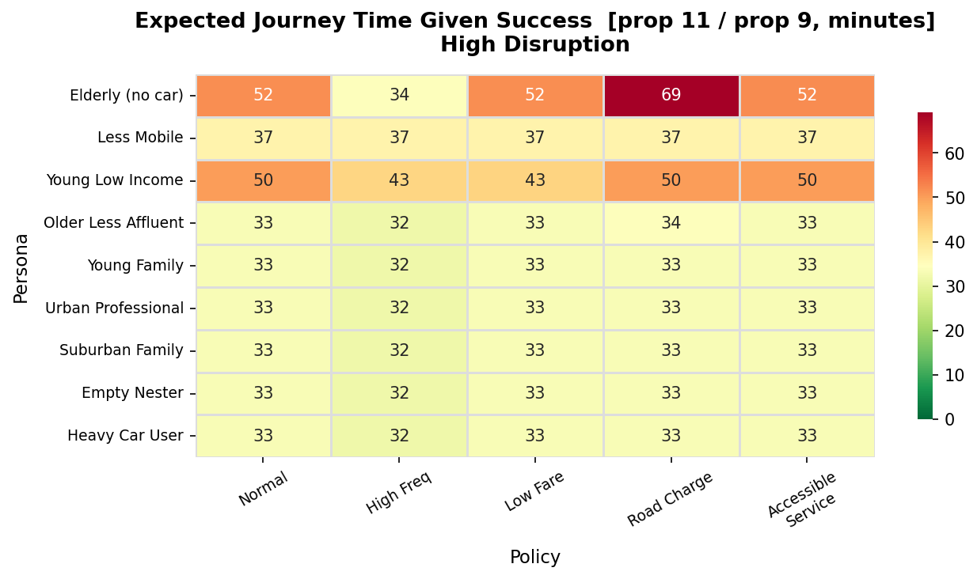
Key Results — Reliability & Time, High Disruption
All 9 personas, all 5 policies, high-disruption scenario (current model — attempt/ride split, corrected fares, audited persona parameters).
Under low disruption, all 9 personas reach the destination with probability 1.0 regardless of policy — the gap only opens up once disruption is severe.

Slide 9
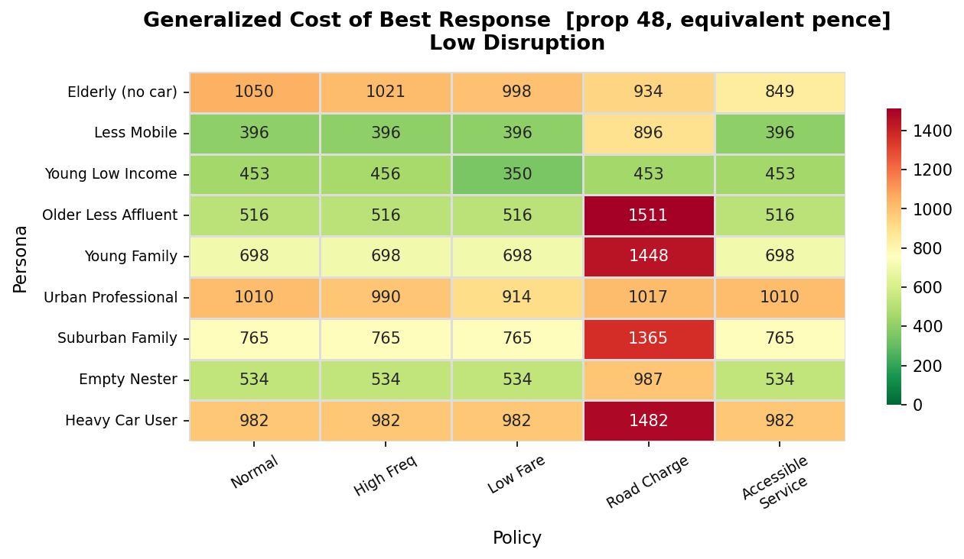
Car-Lock-In: When Cost Can't Be Escaped
less_mobile: generalized cost 396 → 896 equivalent pence under Road Charge (a flat +500p pass-through) — in every policy, arrival probability stays exactly 1.0. No behavioural escape route exists.

Slide 10
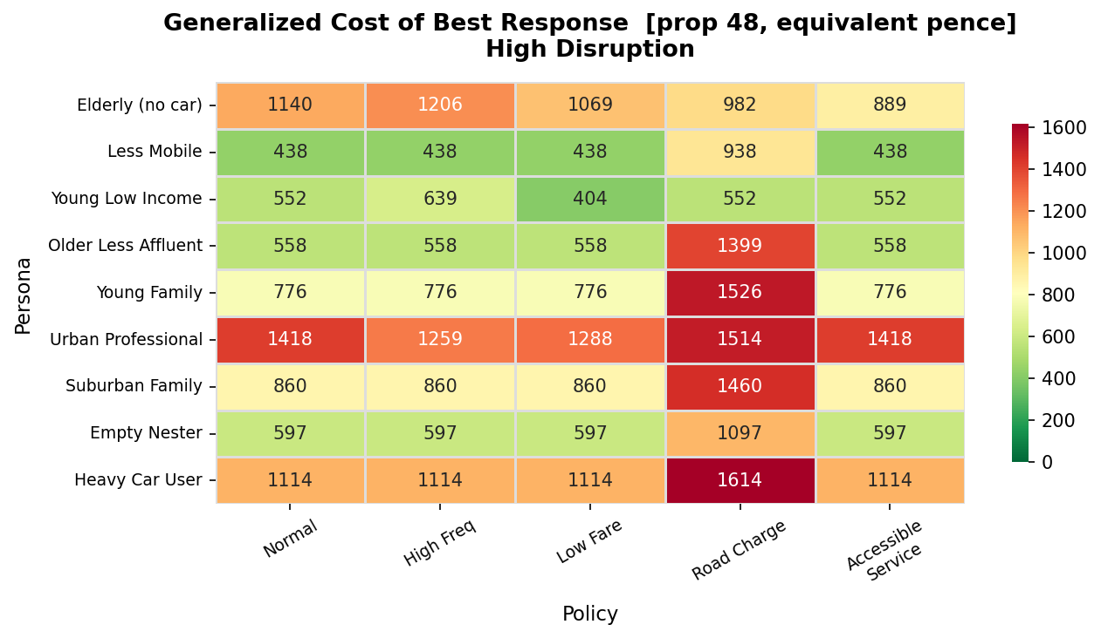
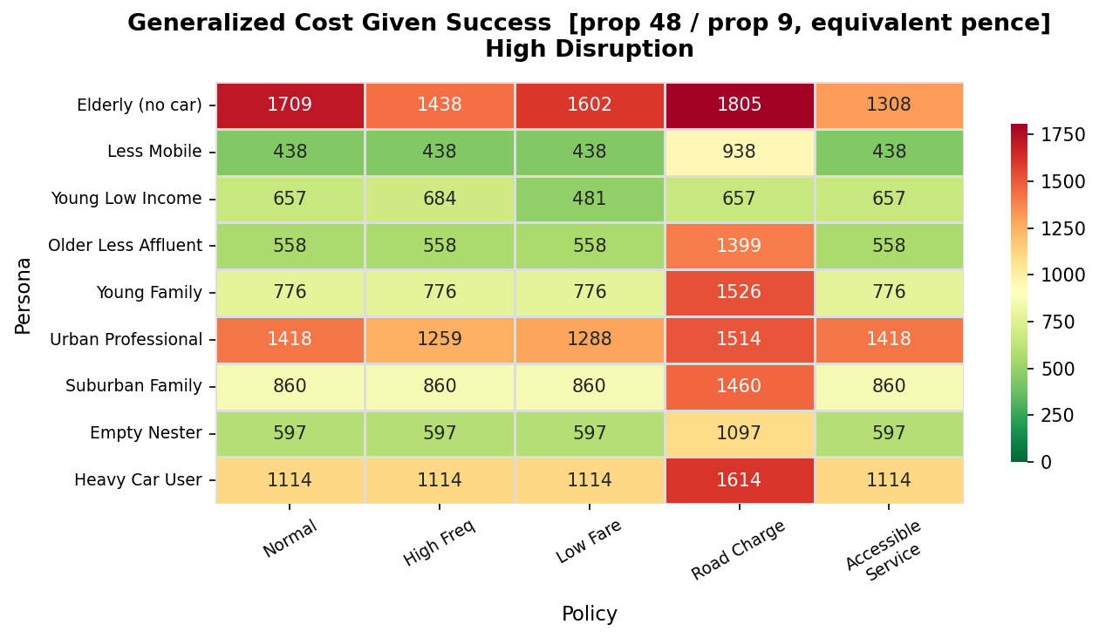
A Modelling Lesson: The Free-Abandonment Bias
give_up costs ≈ 0 in generalized_cost. As a policy makes paying more costly, “try the free option, abandon if it fails” becomes attractive — pulling the raw expectation down and creating apparent (false) improvements.
Fix: condition on success — divide by P(arrival) — to see cost given the journey actually completes (right).

Slide 11
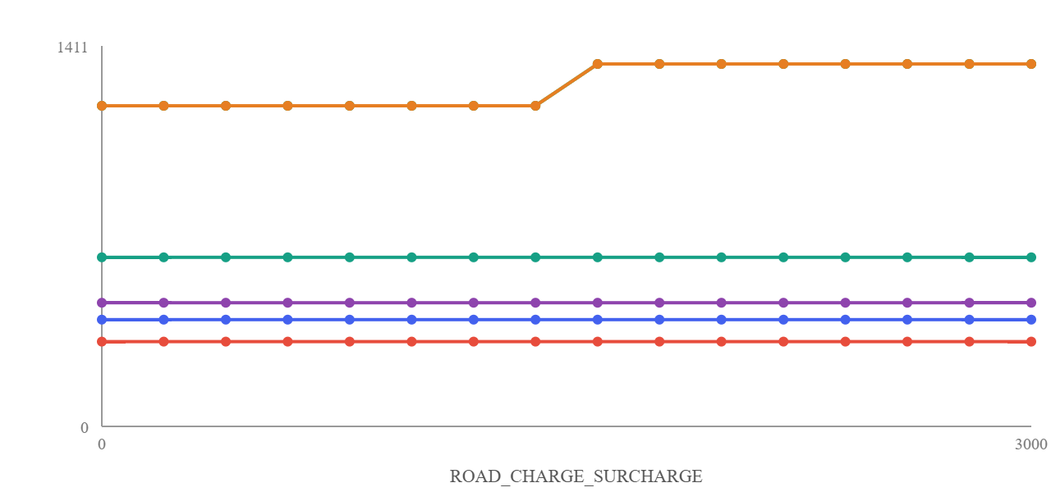
Interactive Tooling: Parameter Sweeps On Demand
A web app drives PRISM directly from editable persona / scenario / fare JSON — no hand-written PRISM invocations.
Sweep button on key constants (fares, surcharges, disruption probabilities): runs PRISM's native ranged constants in one pass, not one call per value.
Results stream live; charts export straight to SVG/PNG for reports and slides like this one.

Slide 12
Validating Inputs Against the Official DfT Personas Pack
All 9 personas checked against DfT's “Meet the Personas” pack. 4 values corrected:
less_mobile
HAS_BUS_PASS
false
→
true
heavy_car_user
W_TIME
20
→
25
elderly_no_car
W_FARE
1.0
→
2.5
urban_professional
W_TIME / W_FARE
30 / 1.0
→
18 / 1.2

Slide 13
Status & Next Steps
Model: manager/persona SMG, generalized_cost + revenue/policy_cost rewards, 63 properties, validated against real PRISM runs.
Tooling: webapp with parameter sweeps, figure generation, chart export — all 9 personas × 5 policies × 2 scenarios reproducible on demand.
Known limitation: free-abandonment bias identified and mitigated for display; a structural (headway) fix remains a documented option, not yet built.
Next: short paper drafted— venue and exact numbers still to be finalised.

