Slide 1
Personalized recommendations based on user’s tweets
DTI5125[EG] Data Science Applications Project

Slide 2
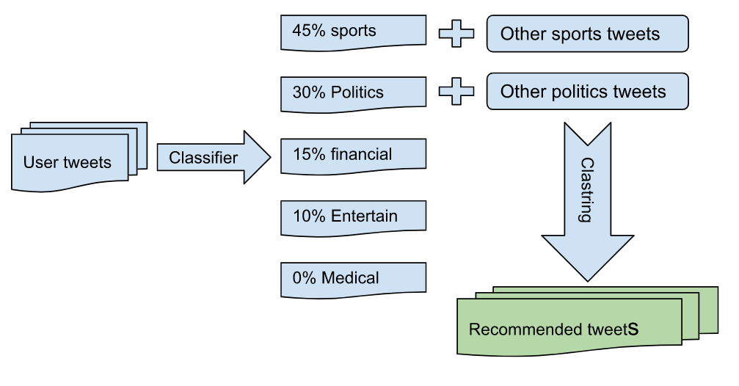
Problem formulation
The project aims to identify users' interests by classifying their tweets into categories; e.g. sports, entertainment, politics etc. And based on that, recommend other tweets that the users are more likely interested in.

Slide 3
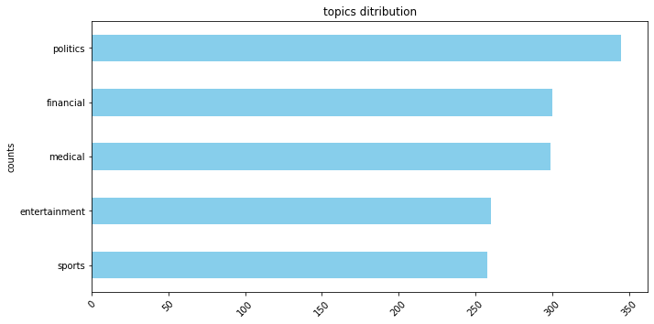
Data Preparation
Data Integration:
Data set is obtained by integrating two different datasets into one single dataset.
Data cleaning:
Regex was used to :
Remove user name from the tweet
Remove tweets URLs
Make sure that only English characters and numbers are included
NLTK was used to:
Remove stopwords
Apply stemming

Slide 4
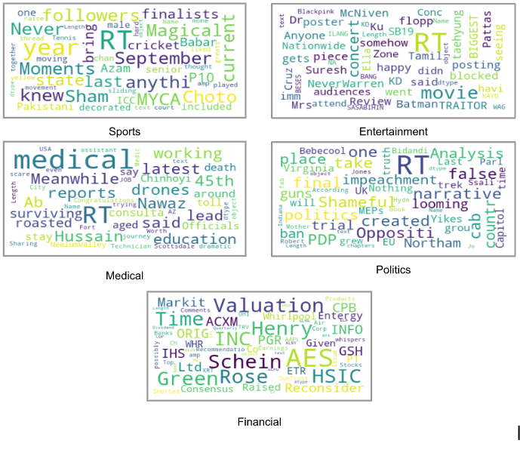
Text feature engineering
Bag of words transformation was applied to the text to use it with the Kamen's classifier.
PCA feature reduction to two features was applied on the BOW for training and visualization

Slide 5
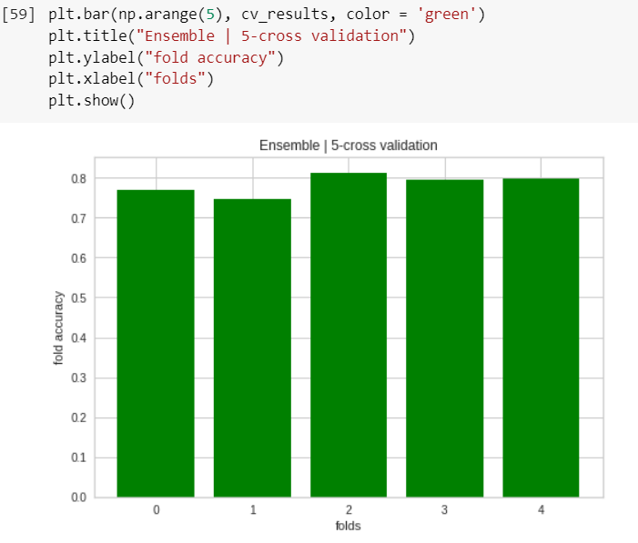
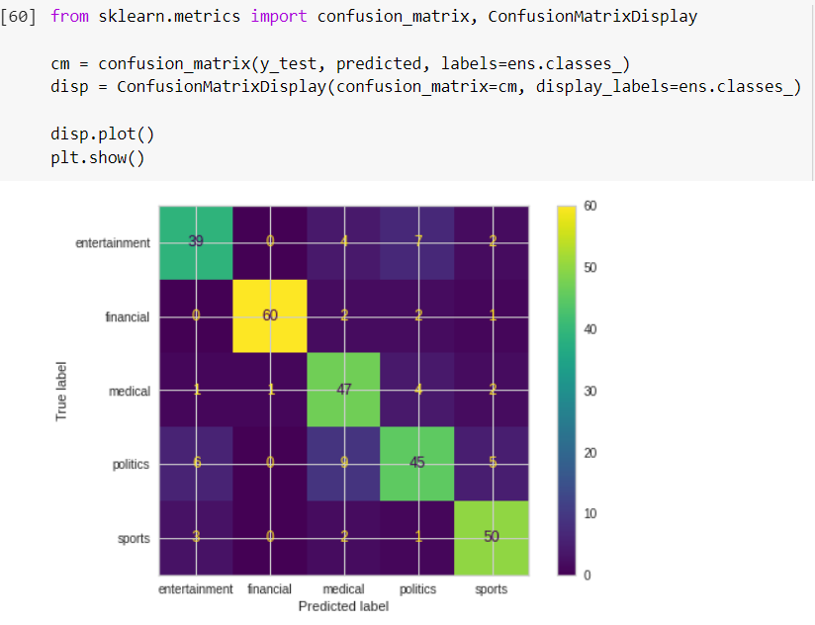
Classification models
A heterogeneous ensemble model classifier combined of:
Support vector Machine.
Naive Bayes classifier
Random Forest.
the final label results using soft voting
Training:
5-fold cross validation
average accuracy of validation set = 0.769%
test the final classification model on the test data
accuracy of the model on the test set = 0.80%

Slide 6
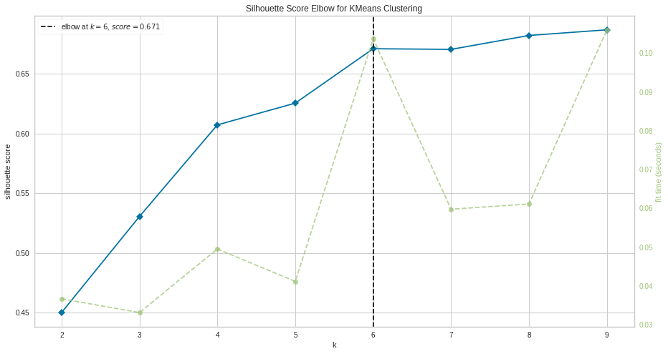
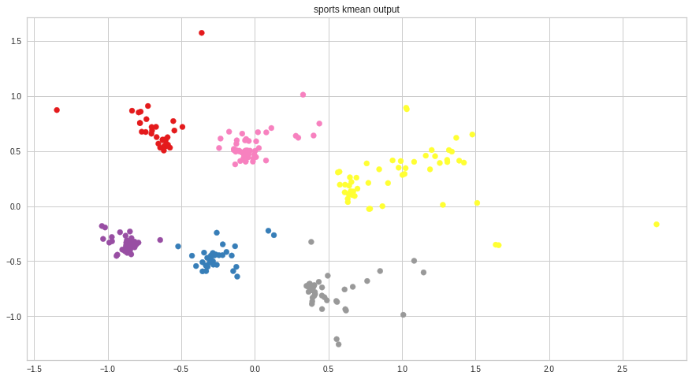
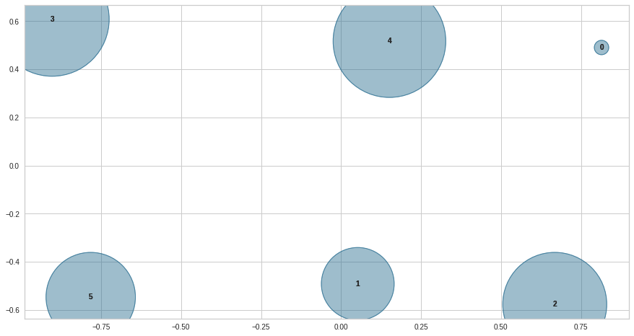
Clustering model
Even if two users are interested in sports, that does not mean that they are interested in the same sports topics.
So, clustering is then performed to determine which tweets are more similar to the user’s tweets.

Slide 7
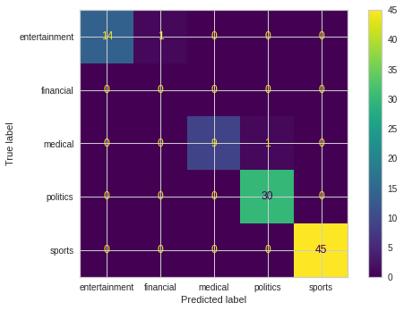
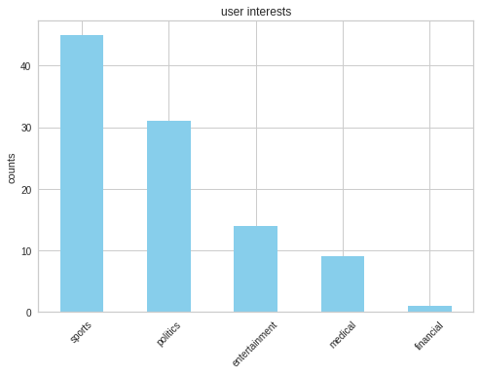
Test case
Classification
Virtual user account with the following tweets distribution:
45% sports
30% politics
15% entertainment
10% medical
0%financial
Classification results:
the test user's top interests are sports(45%) and politics(31%)

Slide 8
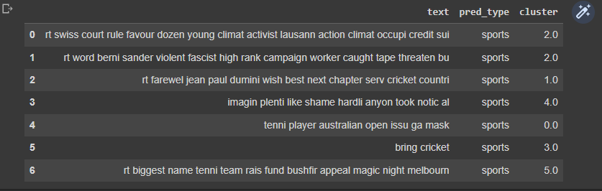
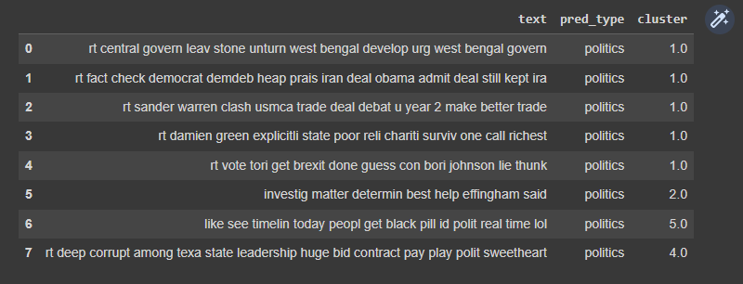
Test case
Clustering
•Find out the user prefers which sports and politics tweets.
•Recommend similar tweets with the same percentages.

Slide 9
Error Analysis
In this project three approaches of error analysis are used:
Documents average length in correct predictions VS Documents average length in wrong predictions.
Fields Distribution in correct predictions VS Fields Distribution in wrong predictions.
Finally, most frequent words that could be the reason why model had misclassification.

Slide 10

Error Analysis (Docs Avg length)
As we can see documents length in both wrongly and correctly predicted samples are almost the same as the have nearly the same average value. So there is no problem with documents length

Slide 11
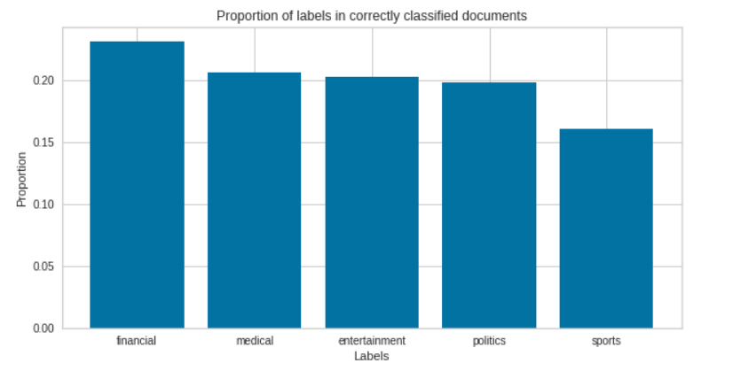
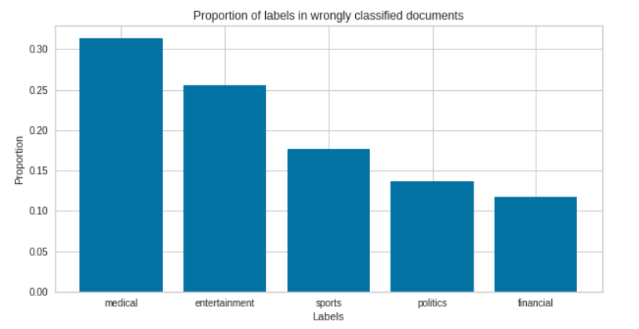
Error Analysis (Fields Distribution)
We can notice that in wrongly predicted
samples, about 55% of them are of the
“Medical & Entertainment” fields
In correctly predicted sample this is not
the case as samples are uniformly
distributed with respect to fields.
This means that bias towards “Medical
& Entertainment” are not possibly just a
chance and could be vital part of the
problem.

Slide 12
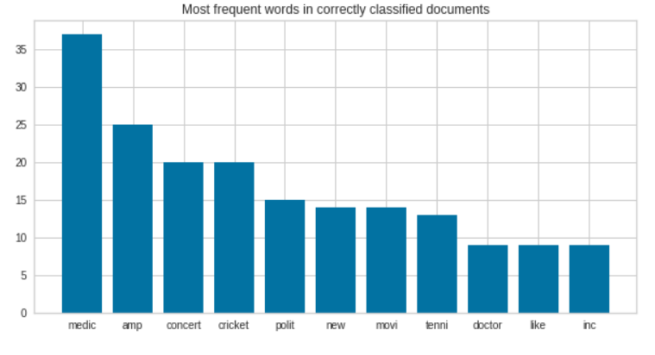
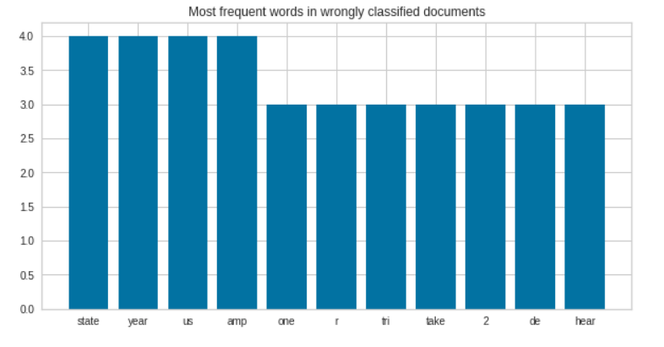
Error Analysis(Freq Words)
In the right-bottom fig, we can see the most freq-words in the wrongly classified samples.
Most of these words don’t even exist in correct prediction samples.
More interesting observation that in correctly-classified docs many of these words don’t exist in wrong pred-docs, despite the fact that some of them have frequency > 20, while the most frequent word in the wrong-docs has only frequency = 4

Slide 13

Future Work
Take into consideration, depending
historical models such as LSTM,
that we provide tweets history, in our
data, so that we become able to
if a user is still interested in a field
he no longer does
Make the model ready for
Deployment specially for twitter
platform
May be apply association rules to
which fields a user may be interested
in, in the same time

Slide 14
THANK YOU

