Slide 1

AQUA-TECH
Microsoft Azure - Machine Learning ROV
2019 MATE international ROV competition

Slide 2
AQUA-TECH
Aqua: Latin word means ‘Word’ – Tech: refers to ‘Technology’

Slide 3
Abstraction
What’s it all about?
Aqua-Tech aims to utilize Microsoft Azure AI platform to classify aquatic species in real time using the mounted cameras on the ROV or any type of image sources.

Slide 4
Components
1. Python Application (Dealing with Azure AI Platform).
2. Web Application (Dealing with users).
How is it connected?

Slide 5
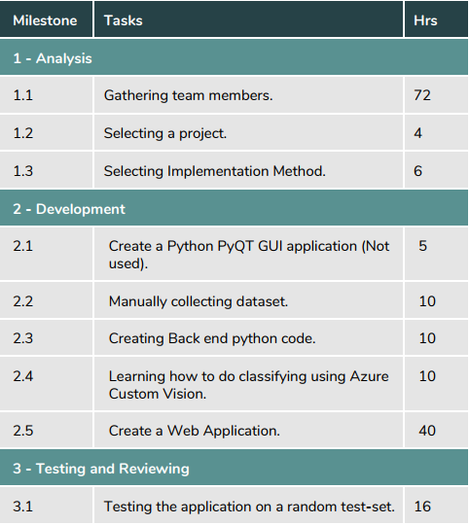
Milestones
How many hours it took from us? 173

Slide 6
CONNECTION
How can I classify an image using AQUA-TECH?
Azure AI Platform
Dataset
AJAX
Result
Python Application
Web Application

Slide 7
How to use?
How can I classify an image using AQUA-TECH?
Image file / Image URL / Live Video!

Slide 8
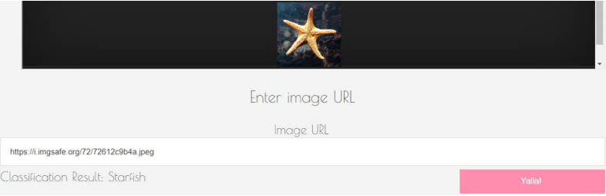
Example
How can I classify an image using AQUA-TECH?

Slide 9
Model Precision
Percentage of the correct results?

Slide 10
Purposes
Educational
Commercial
Who will benefit from it?

Slide 11
Enhancements
Dataset
Documentation
Wiki
Anything Else besides the classification?

Slide 12
Dataset
No dataset available!
Searching Script..
16 * 100
Open source!

Slide 13
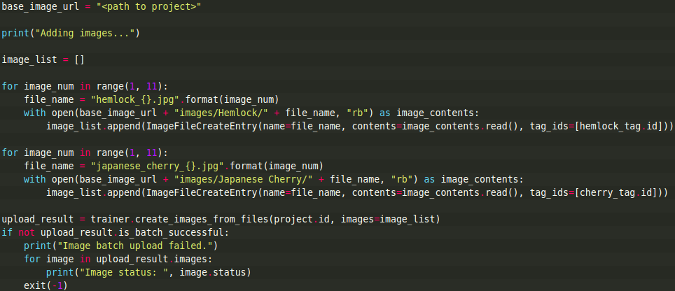
Enhancements
Dataset
Documentation
Wiki
Anything Else besides the classification?

Slide 14
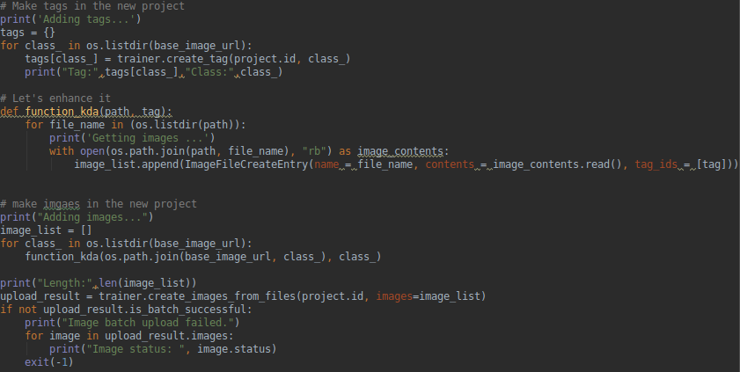
Enhancements
Dataset
Documentation
Wiki
Anything Else besides the classification?

Slide 15
What’s next?
More species.
Automating Learning.
Counting objects.
Is this the final step? No.

Slide 16
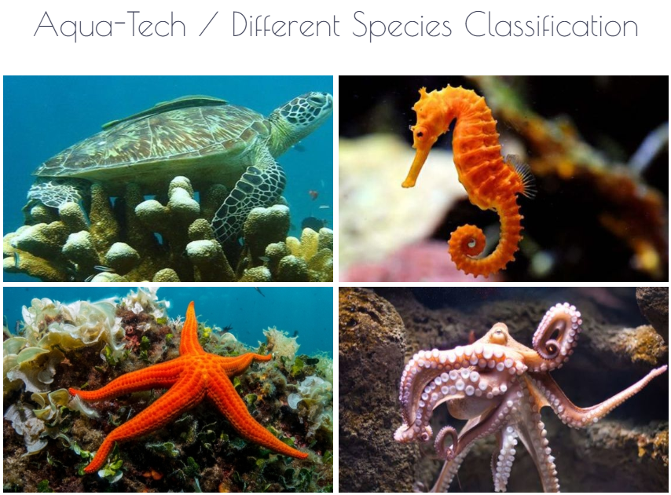
Project
You can browse to: http://robotechazure.ml/
to try it yourself!

Slide 17
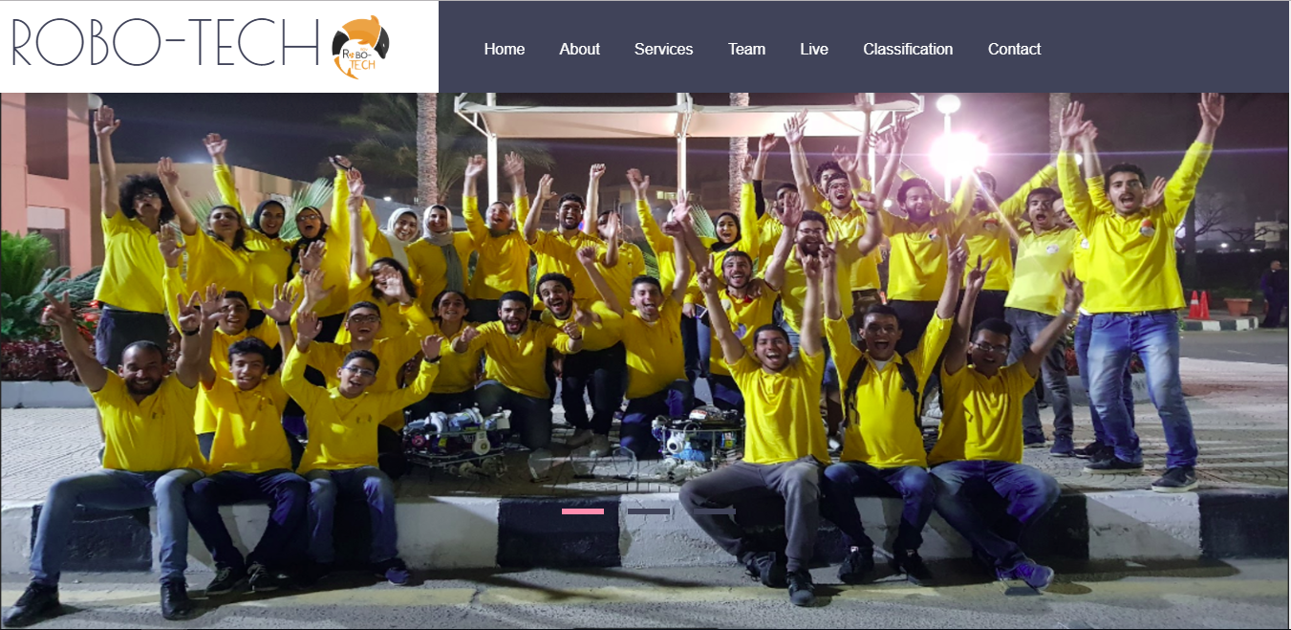
THANK YOU!
Hassan El-seoudy

