Slide 1

Smart Playlist Generation Using Clustering and Spotify Audio Features
A data-driven approach to automated playlist creation
Dataset: 5,000 Spotify tracks
Hassan Merai Xuan Liu Konul Aslanova

Slide 2
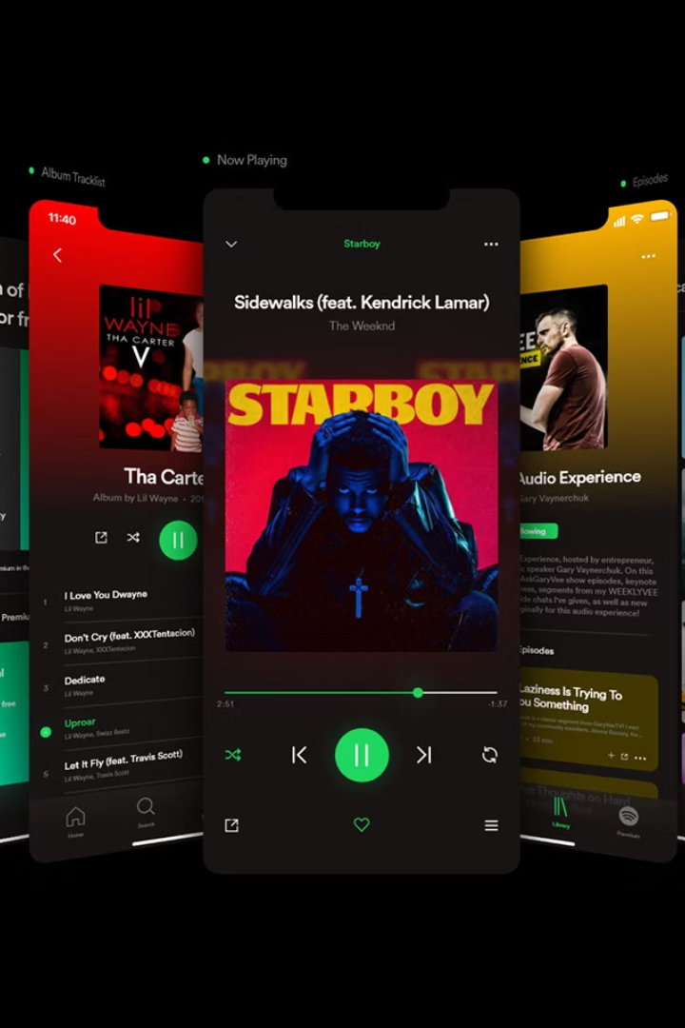




Project Objective
Automatically generate playlists grouped by musical similarity
Ensure each playlist has between 50 and 250 songs
Rely purely on audio features, not metadata
Prioritize musical traits that align with human listening perception

Slide 3
Our Approach
Collect audio features from Spotify API
Normalize features using MinMaxScaler
Apply custom feature weights to emphasize perceptual relevance
Perform initial clustering using KMeans
Re-cluster with KMeansConstrained to enforce playlist size constraints
Generate final playlists from resulting clusters

Slide 4
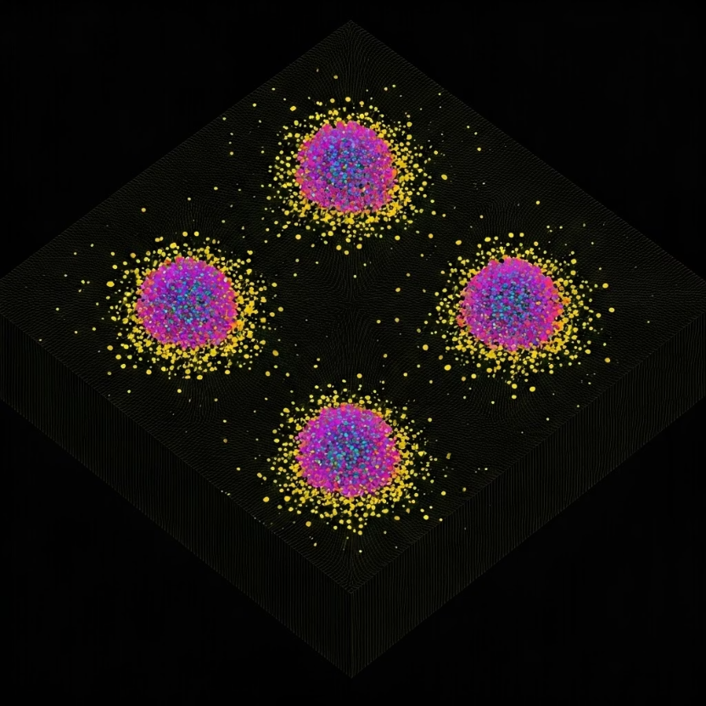
Initial Clustering with KMeans
Chose k=5 based on silhouette and inertia scores then sub-clustering
Good cluster separation, but...
Playlist sizes became inconsistent when sub-clustered

Slide 5
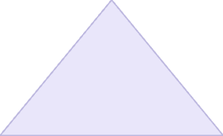





The Problem
Inconsistent Playlist Sizes
Not suitable for real-world playlists
Required Size Control
Needed within clustering method
Feature Importance
Better guidance for clustering needed
Some clusters had <50 songs, others >250

Slide 6
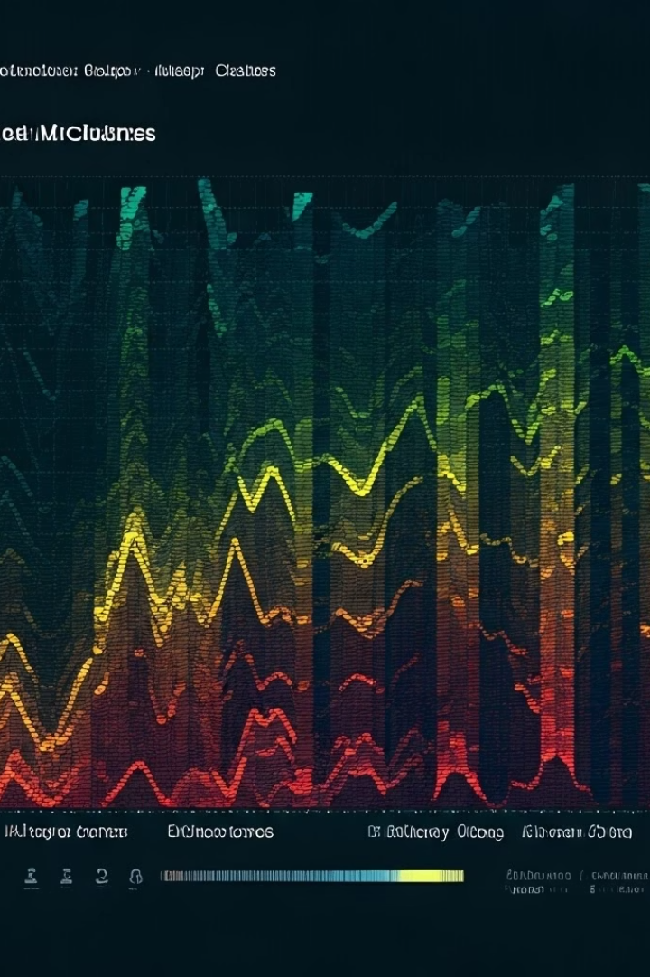
Solution: KMeansConstrained + Feature Weighting
Size Constraints
Supports size_min and size_max parameters
Weighted Features
Re-applied clustering with weighted features to reflect listening experience
Perceptual Emphasis
Acousticness & Instrumentalness (×1.5): distinguish natural vs. electronic and vocal vs. instrumental music
Danceability (×1.2): emphasize rhythm
Duration, Loudness, Speechiness (×0.5–0.8): reduced impact due to lower perceptual relevance
Result
45 balanced, perceptually meaningful playlists

Slide 7




Features Used
Weighted Features (High)
Weighted Features (Medium)
acousticness (1.5)
energy (1.0)
instrumentalness (1.5)
valence (1.0)
1
2
danceability (1.2)
tempo (1.0)
Dropped Features
Weighted Features (Low)
key, mode, time_signature (low variance)
4
3
speechiness (0.8)
loudness (0.8)
artist, genre, song_name (non-numeric)
liveness (0.7)
duration_ms (0.5)

Slide 8


Playlist Examples
Playlist 1 (Cluster 22)
Playlist 2 (Cluster 14)
High danceability, mid-tempo, high valence
Low energy, high acousticness
Feels like a summer chill playlist
Ideal for studying or relaxation

Slide 9





Are Spotify Features Human-Meaningful?
Mood Matching
Features like energy, tempo, valence often match human-perceived mood
Style Recognition
Acousticness and instrumentalness help surface stylistic similarities
Missing Context
However, no awareness of lyrics, language, genre or cultural context
Compensation
Weighting features helps compensate for these gaps

Slide 10
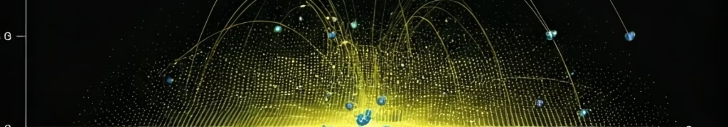
Is KMeans a Good Fit?
Pros
Cons
Fast and easy to implement
Assumes equal-sized, spherical clusters
Interpretable and tunable
No soft membership (e.g., songs in multiple playlists)
Enhanced with feature weighting and size constraints
Verdict:
With weighted features and constrained sizing, KMeans becomes a practical and human-aligned solution

Slide 11

Next Steps
Use UMAP/t-SNE for visualizing clusters
Incorporate genre tags, lyrics, or user preferences
Explore soft clustering (e.g., GMM)

Slide 12


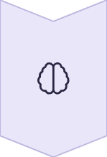

Final Thought
Beyond Data Clustering
Smart playlists aren't just about clustering data
Human Perception
They're about mimicking how humans perceive, group, and enjoy music
Human-Like Listening
Weighted features helped us teach the algorithm to "listen like a human"

Slide 13
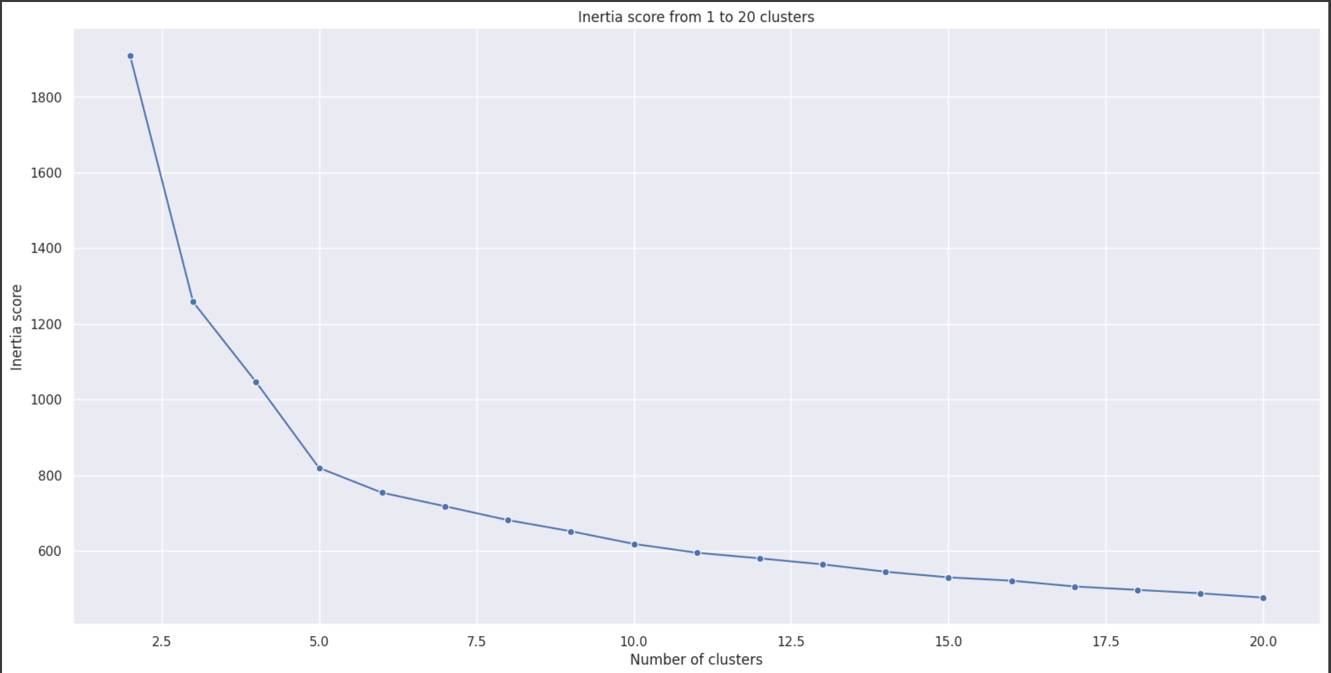
First step of clustering: using Inertia score

Slide 14
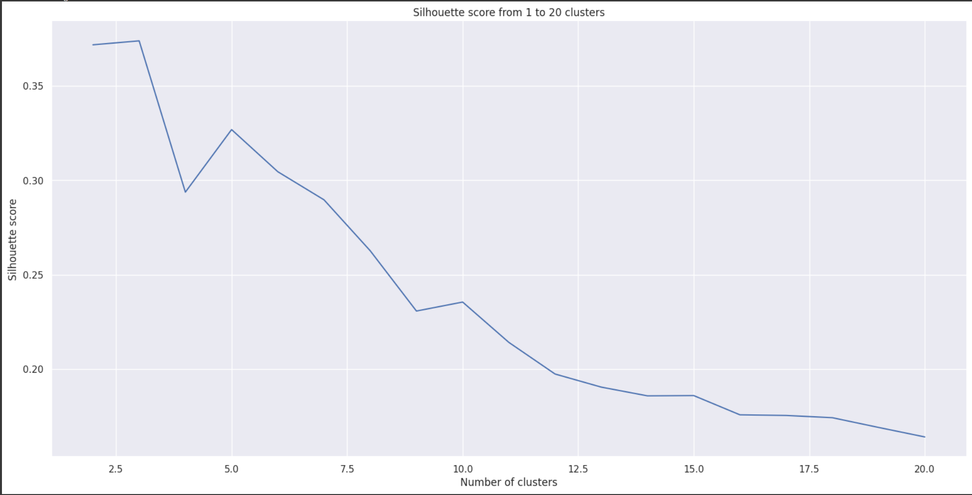
First step of clustering: using Silhouette score

Slide 15
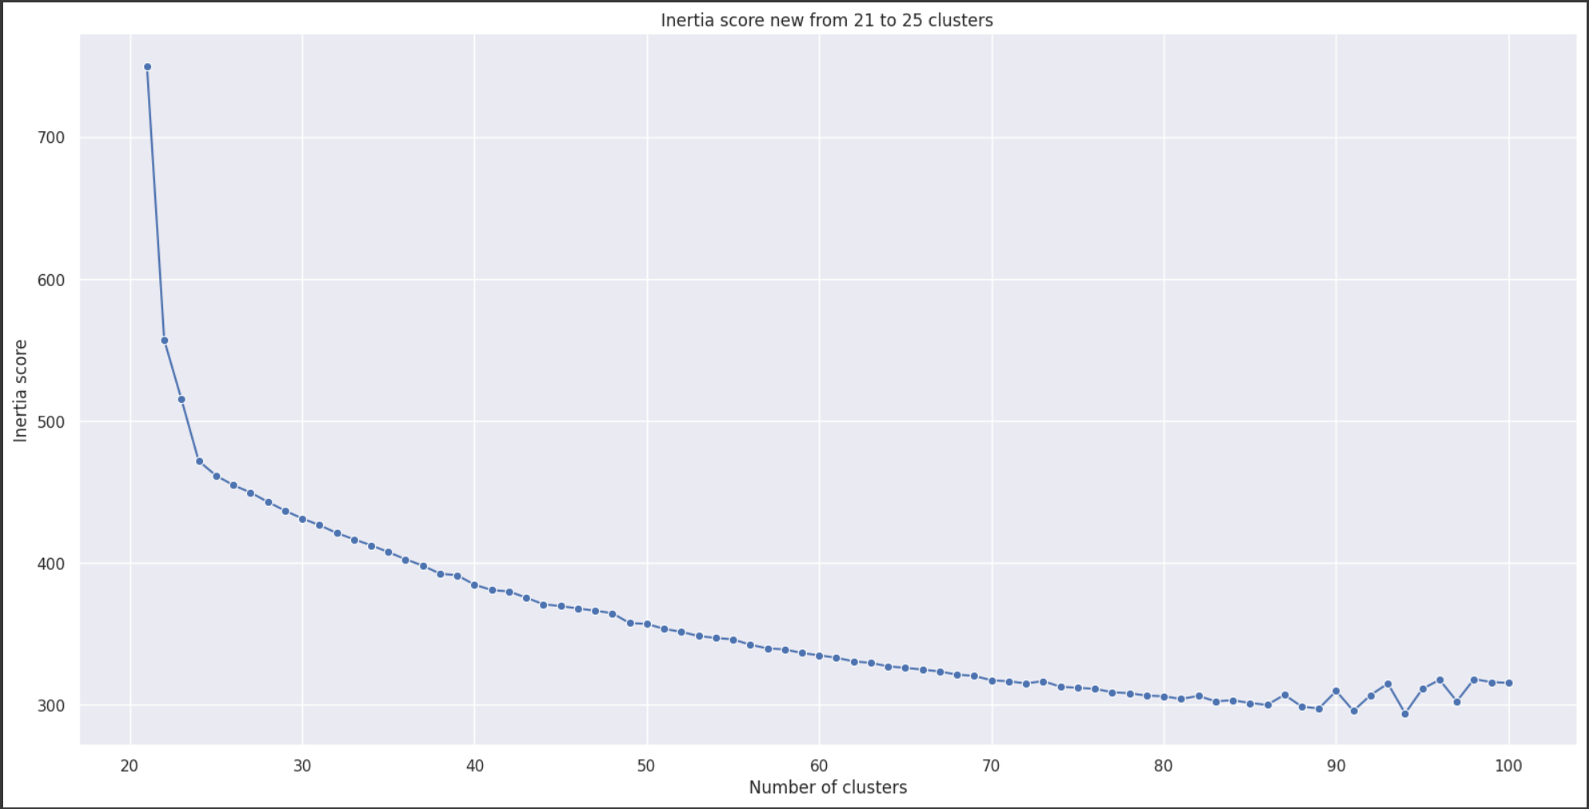
Finding n of clusters for K-Means constrained (Inertia)

Slide 16
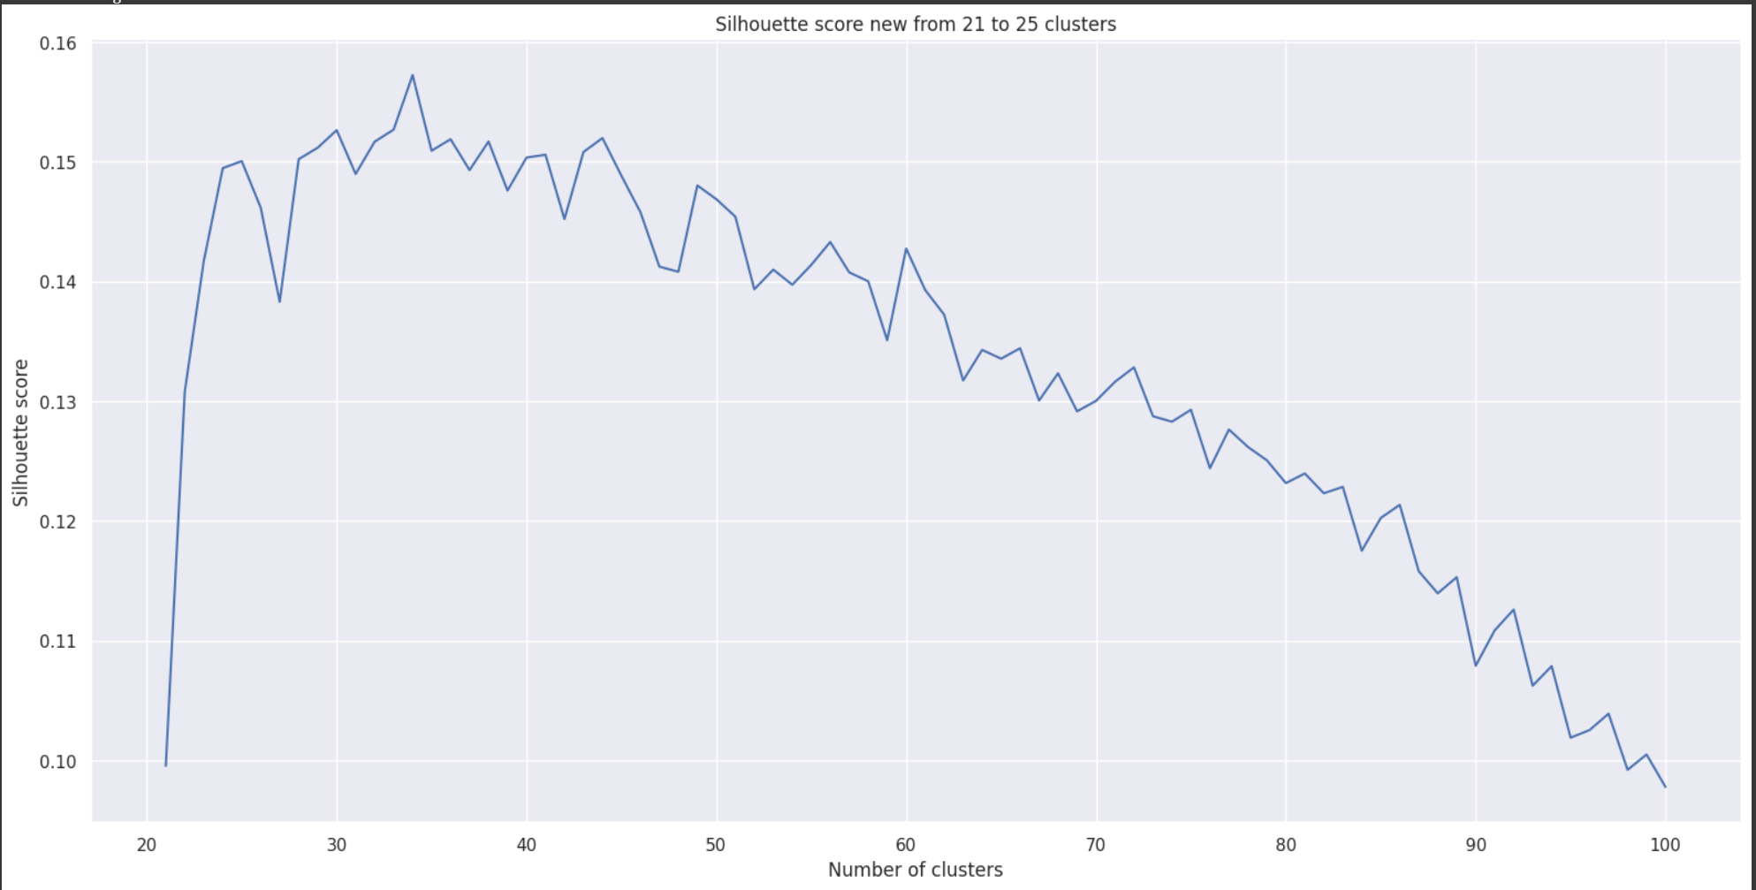
Finding n of clusters for K-Means constrained (Silhouette)

Slide 17
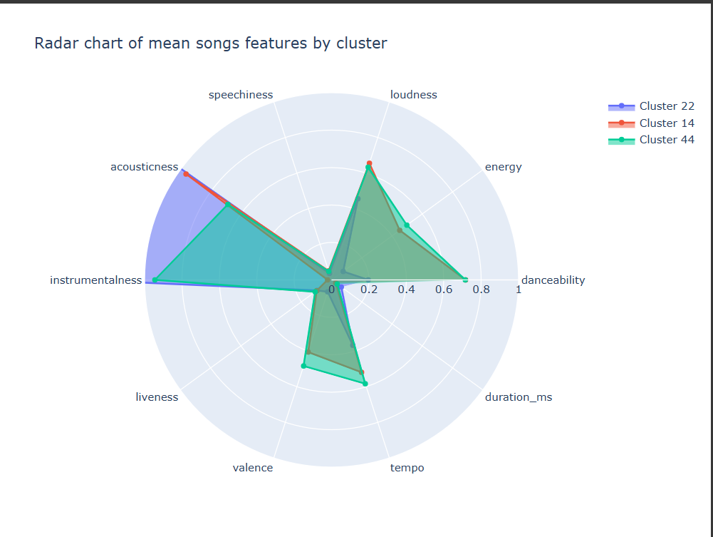

Slide 18
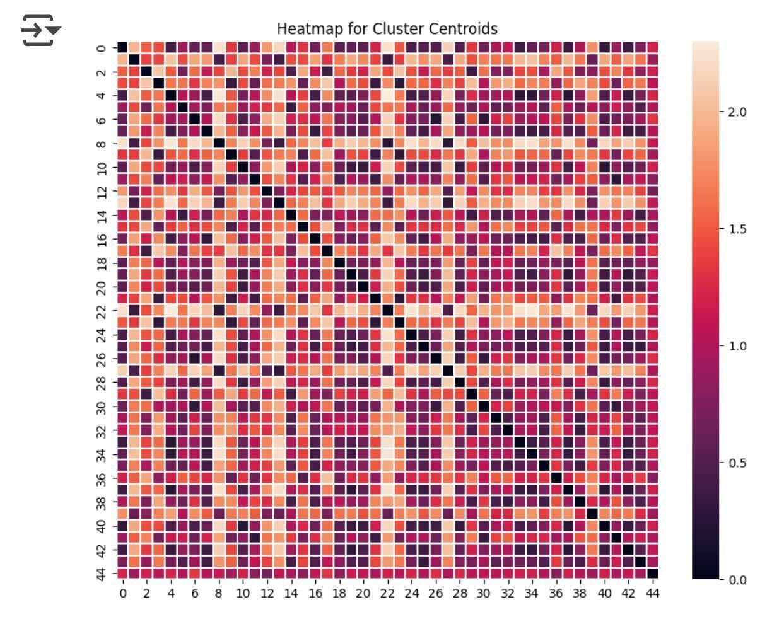

Slide 19
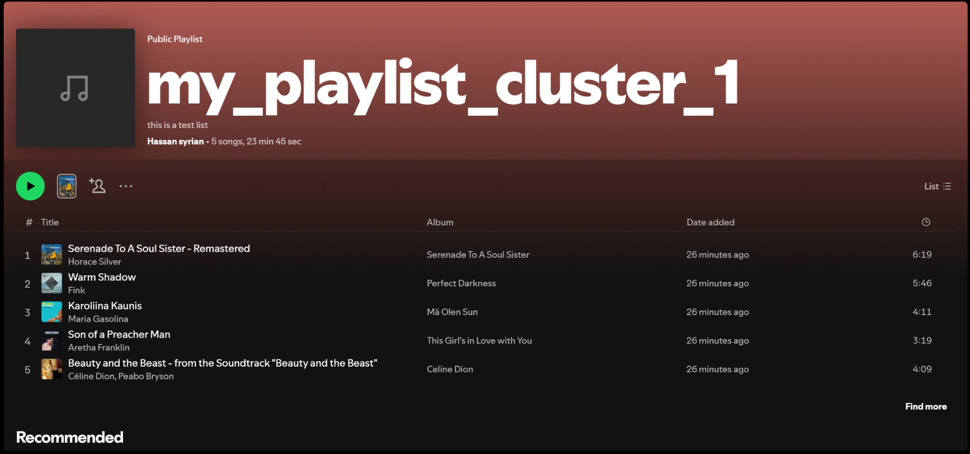

Slide 20
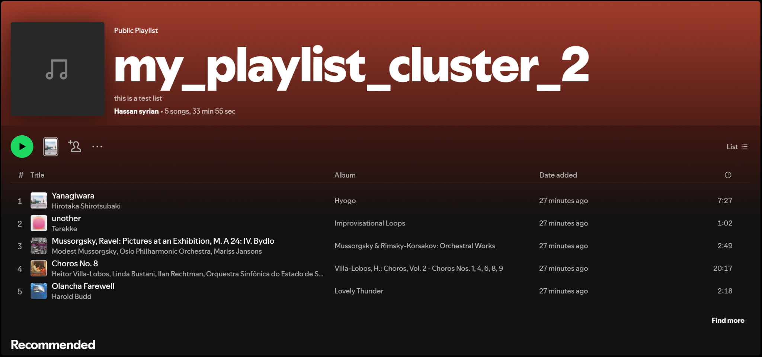

Slide 21
