Slide 1

Assignment no: 07
CST 640 LR PRODUCT AND PRODUCT DEVELOPMENT

Slide 2
Introduction
In this assignment we will be focusing to analyse customer feedback and prioritize features or functionality for a developer-focused tool using the [MoSCoW Matrix/KANO Model].
I am working as a Product Manager at CodeCrafters Inc.
Our task is to select a developer-focused tool, analyse realistic customer feedback and use a prioritization model to enhance the tool based on user needs.

Slide 3
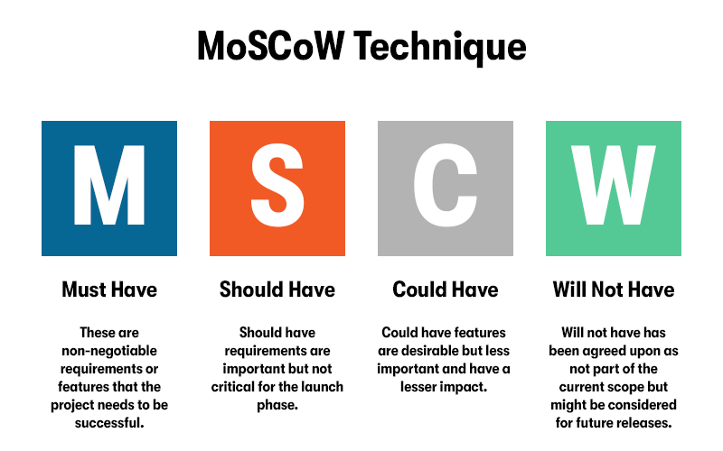
MoSCoW

Slide 4
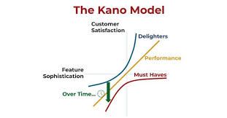
Kano Model

Slide 5
Examination of Feedback
Benefits of the Features: While users value features like version history, real-time collaboration, and straightforward design, they also point out places where navigation may be improved.
Prospects for Improvement: Recurring sync problems, improved third-party tool integration, and the addition of configurable dashboards or sophisticated analytics are examples of common feedback.

Slide 6
Model for Prioritization
Boost sync reliability during periods of high usage and guarantee real-time collaboration and version history stability.
Improved third-party integrations and easier navigation are key components of a better user experience.
While offline editing support is delayed, investigate configurable dashboards and sophisticated reporting features for next editions.

Slide 7
Findings and Reflections
Emphasis on the Customer: Addressing Must-Have features resolves critical pain points, ensuring user satisfaction and trust.
Enhancements in Strategy: Implementing Should-Have features boosts the tool’s competitive edge while maintaining focus on immediate deliverables.
Future Planning: Could-Have and Won’t-Have features provide clarity for long-term development, enabling efficient resource allocation and roadmap planning.

Slide 8
Stratified Suggestions
Quick Attention: Enhance version control and sync reliability for must-have features, making sure that important user issues are successfully addressed..
Goals for the Midterm: In order to improve user experience and grow the user base, strengthen third-party integrations and optimize navigation operations..
Long-Term Planning: For further updates, consider cutting-edge features like configurable dashboards and analytics while investigating the viability of offline editing.
Constant Enhancement: Consistently collect and evaluate user input, using beta testing to improve and verify new features.

Slide 9
Conclusion
Important Results: Features were clearly prioritized using the MoSCoW Matrix, which addressed current user issues and complemented long-term expansion plans.
Impact: Increased transparency of the roadmap for developers and stakeholders, promoting trust and retention through strategic enhancements and focused fixes.
Next Actions: Get started with the implementation Features should be both necessary and desirable, users should be involved in testing and validation, and updates should be improved through an ongoing feedback loop.

Slide 10
Citations And References
AltexSoft. (n.d.). Most popular prioritization techniques and methods: MoSCoW, RICE, Kano model, walking skeleton, and others, from https://www.altexsoft.com/blog/most-popular-prioritization-techniques-and-methods-moscow-rice-kano-model-walking-skeleton-and-others/
Author Unknown. (n.d.). How can you prioritize requirements using MoSCoW? LinkedIn. Retrieved from https://www.linkedin.com/advice/1/how-can-you-prioritize-requirements-using-moscow
HotPMO. (n.d.). MoSCoW vs. Kano: How to prioritize effectively, from https://www.hotpmo.com/management-models/moscow-kano-prioritize/

Slide 11
THE END
Of
Assignment

