Slide 1

DeployGuard
Final Year Project II — Implementation
Deterministic source-to-cloud deployment control plane
Implementation review • industrial visit • live deployment demonstration
Hasan Sajjad • Faria Fatima • Tania Khawar
Department of Computer Science • Air University Islamabad
Implementation baseline: test2 • reviewed 13 September 2026

Slide 2
What DeployGuard is
A self-service product that turns a supported repository into a verified cloud release.
Developer experience
Control-plane responsibility
Operational result
Connect GitHub
Select branch and service
Configure environment
Deploy from one product surface
Freeze source identity
Resolve build/runtime contracts
Enforce policy and cost gates
Coordinate cloud lifecycle
Immutable image
AWS runtime
Verified stable release
Rollback, destroy and evidence
DeployGuard’s contribution is the lifecycle and deterministic control plane—not the cloud services it orchestrates.

Slide 3
Problem being solved
Cloud deployment fails at the boundaries between tools, state and application assumptions.
Repository uncertainty
Configuration drift
Operational uncertainty
Which service? Which workspace? Which dependencies? Which application port?
Source, build inputs, runtime variables and cloud state can diverge over time.
A workflow can finish while the application is unhealthy, unreachable or misconfigured.
Recovery complexity
Security & cost
Redeploy, rollback and destroy need exact historical identity and ownership boundaries.
Deployment speed without security, identity and cost controls creates new failure modes.
The FYP-II implementation makes these boundaries explicit contracts instead of implicit assumptions.

Slide 4
Research foundation
Consensus literature was used to ground the implementation choices, while FYP-II focuses on the system we built.
Platform engineering
Infrastructure as Code
DevSecOps
Self-service platforms reduce infrastructure cognitive load when treated as products with clear golden paths.
Anjum (2026); Pitkar (2026)
Declarative infrastructure improves repeatability and reduces configuration drift compared with manual provisioning.
Kasarla (2025)
Embedding vulnerability scanning in delivery pipelines strengthens security before deployment.
Marandi et al. (2023); Kim et al. (2025)
Code-to-cloud automation
AI + infrastructure operations
Research supports integrated source analysis, infrastructure generation and cloud deployment as an automation direction.
Odunsi et al. (2025)
Recent reviews place AI across IaC generation, validation and operational analysis while highlighting the need for reliable evidence.
Pahl et al. (2026)
DeployGuard applies these principles through deterministic contracts, evidence-driven verification and explicit lifecycle ownership.

Slide 5
FYP-II implementation outcomes
The implementation spans the full deploy → operate → recover → destroy lifecycle.
Repository intelligence
Build specification
exact SHA • service discovery • workspace boundaries
canonical target • dependencies • package identity • fingerprint
Cloud lifecycle
Runtime safety
GitHub Actions • OIDC • ECR • Terraform • ECS/Fargate
ports • health • managed DB • release generations
Security
Operations
Trivy • secrets • RBAC • audit • capability verification
CloudWatch • monitoring • AI troubleshooting • FinOps • billing

Slide 6
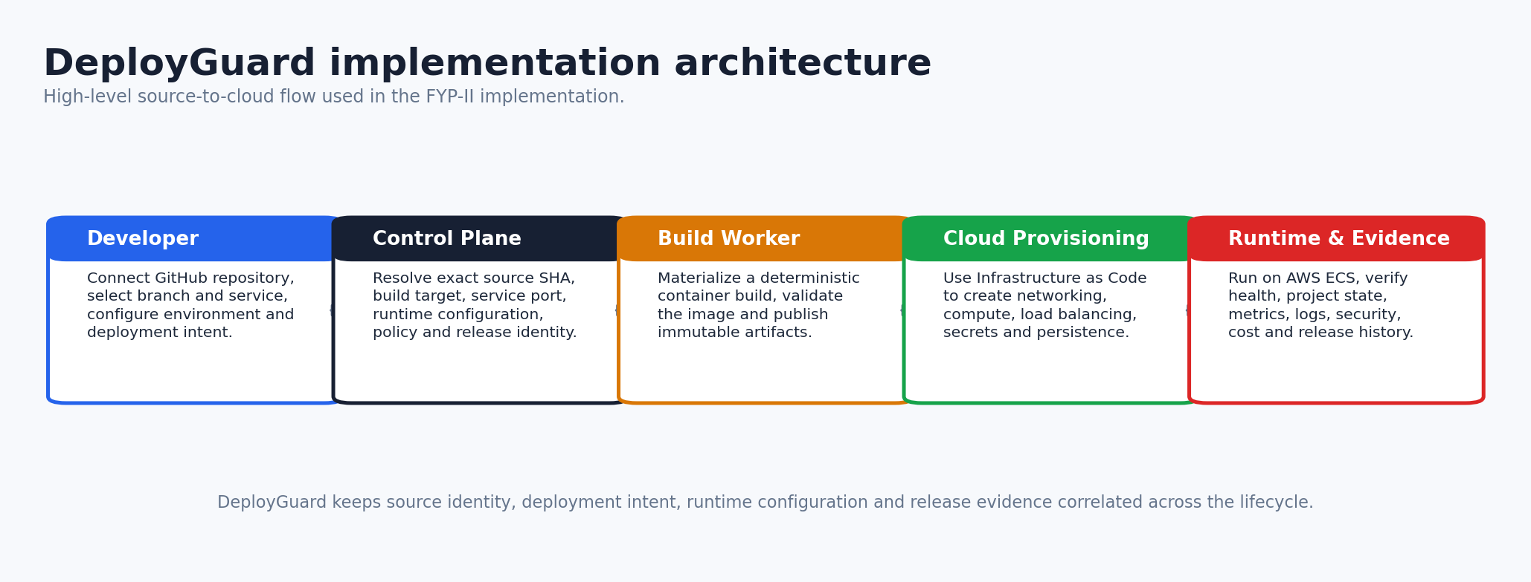
Implementation architecture
A layered control plane converts repository intent into a verified runtime.
Product abstraction: Repository → canonical deployment specification → build worker → immutable image → Terraform/AWS → verified release.

Slide 7
Control-plane ownership
Clear ownership prevents Terraform, runtime orchestration and product state from fighting each other.
Layer | DeployGuard ownership | Execution dependency
Source & admission | exact commit, project/service identity, configuration readiness | GitHub repository
Build | canonical build target, port, runtime config, immutable identity | container build subsystem
Infrastructure | intent, capability checks, lifecycle admission | Terraform + AWS APIs
Runtime | success criteria, release promotion, failure classification | Amazon ECS / ALB
Operations | state, evidence, cost, diagnostics, rollback/destroy decisions | CloudWatch / ECR / Secrets / EFS
One authoritative owner per decision is a core implementation invariant.

Slide 8
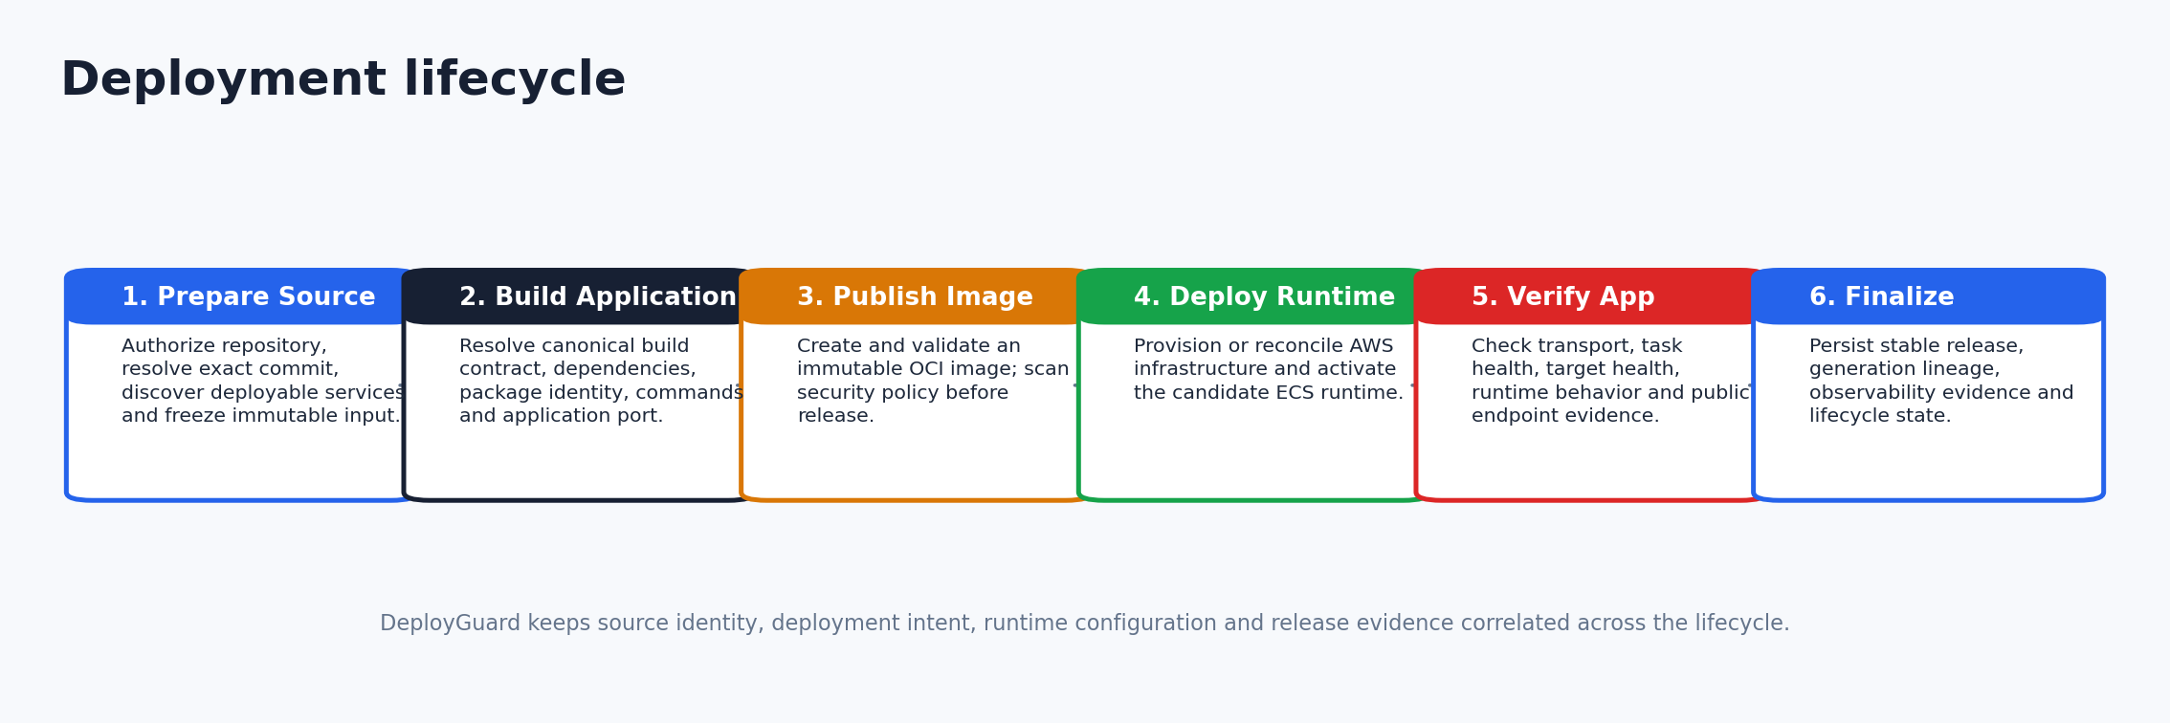
Six-stage deployment pipeline
The user sees a stable lifecycle while internal work remains deeply automated.
Prepare Source → Build Application → Publish Image → Deploy Runtime → Verify Application → Finalize Release

Slide 9
Canonical build target
DeployGuard freezes “what should be built” before cloud mutation.
Exact source SHA
Service directory
Workspace / build / install roots
Package identity
Deployment contract
Execution metadata
Dependency paths
Evidence + SHA-256 fingerprint
Supported build contracts
JS_STANDALONE
JS_WORKSPACE_MEMBER
PYTHON_STANDALONE
Supported package managers:
npm • pnpm • yarn • bun
The immutable specification prevents different stages from re-interpreting the same repository differently.

Slide 10
Repository analysis and service selection
Fail closed when the service boundary is ambiguous or unsupported.
Repository
Service boundary
Workspace evidence
Dependencies
Canonical target
exact checkout
selected directory
manifests + lockfiles
local path analysis
resolved or blocked
Why this matters
Admission behavior
Monorepos can contain multiple packages, sibling dependencies and conflicting package-manager evidence. DeployGuard creates one explicit boundary before build execution.
Resolved → continue
Ambiguous / invalid / unsupported → stop with deterministic failure evidence

Slide 11
Automatic application-port authority
Port resolution follows evidence priority rather than a single framework guess.
Priority | Evidence | Examples
1 | Explicit configuration | server.port • framework config
2 | Source binding | listen(...) • app.run(...)
3 | Start command | --port / -p
4 | Environment | PORT / SERVER_PORT
5 | Framework default | Next/Nest 3000 • Django/FastAPI 8000 • Flask 5000
Conflicting evidence is rejected instead of silently choosing an arbitrary port.

Slide 12
Container build subsystem
The platform owns the build contract; the worker materializes it into an OCI image.
Input
Resolve
Build
Validate
Publish
source SHA + canonical target
install/build/start behavior
configuration-driven worker
runtime image checks
immutable ECR artifact
Build-time boundary
Runtime boundary
Only declared build capabilities and dependencies affect build materialization.
PORT, HOST, runtime environment and secret references remain separate from build identity.

Slide 13
GitHub Actions and AWS identity
Short-lived OIDC federation replaces repository-specific long-lived AWS keys.
DeployGuard
GitHub Actions
OIDC
AWS STS
AWS APIs
dispatch immutable inputs
workflow identity
audience + subject trust
short-lived role session
scoped lifecycle actions
Before dispatch, DeployGuard validates trust and lifecycle-specific AWS capability requirements.

Slide 14
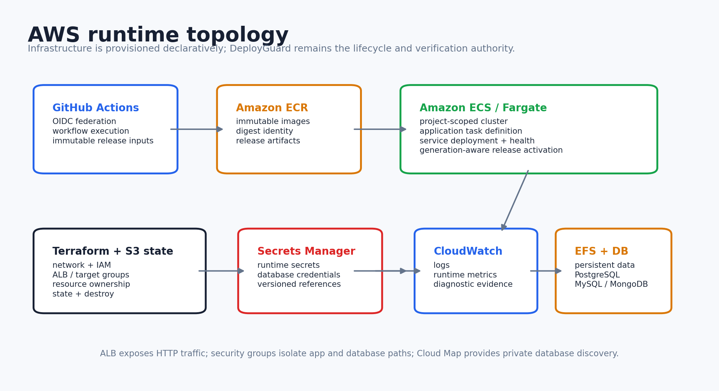
AWS runtime architecture
Terraform provisions infrastructure; DeployGuard verifies and promotes runtime success.

Slide 15
Infrastructure ownership and state
Declarative infrastructure is a source of truth, but runtime release truth remains explicit.
Terraform owns
DeployGuard owns
ECS owns
ECS resource existence
ALB / target groups
Security groups
IAM execution roles
EFS + database infra
Secrets infrastructure
Remote state + final destroy
deployment admission
runtime readiness
active verified release
failure ownership
manual rollback target
cloud cleanup verification
state reconciliation
task scheduling
service rollout primitives
health/stability signals
active task execution
release update mechanics
Later infrastructure reconciliation must not unintentionally revert a verified active application release.

Slide 16
Managed database implementation
Database support is part of the deployment contract, not a manual post-deploy step.
Engine | Port | Persistence | Readiness
PostgreSQL 16 | 5432 | EFS | pg_isready + runtime health
MySQL 8 | 3306 | EFS | mysqladmin + credential/grant reconciliation
MongoDB 8 | 27017 | EFS | authenticated ping
Secret injection
Network boundary
Database passwords and URLs are generated/stored through AWS Secrets Manager and referenced by the attached application service.
Database security-group ingress is restricted to the attached application service; private service discovery resolves the DB endpoint.

Slide 17
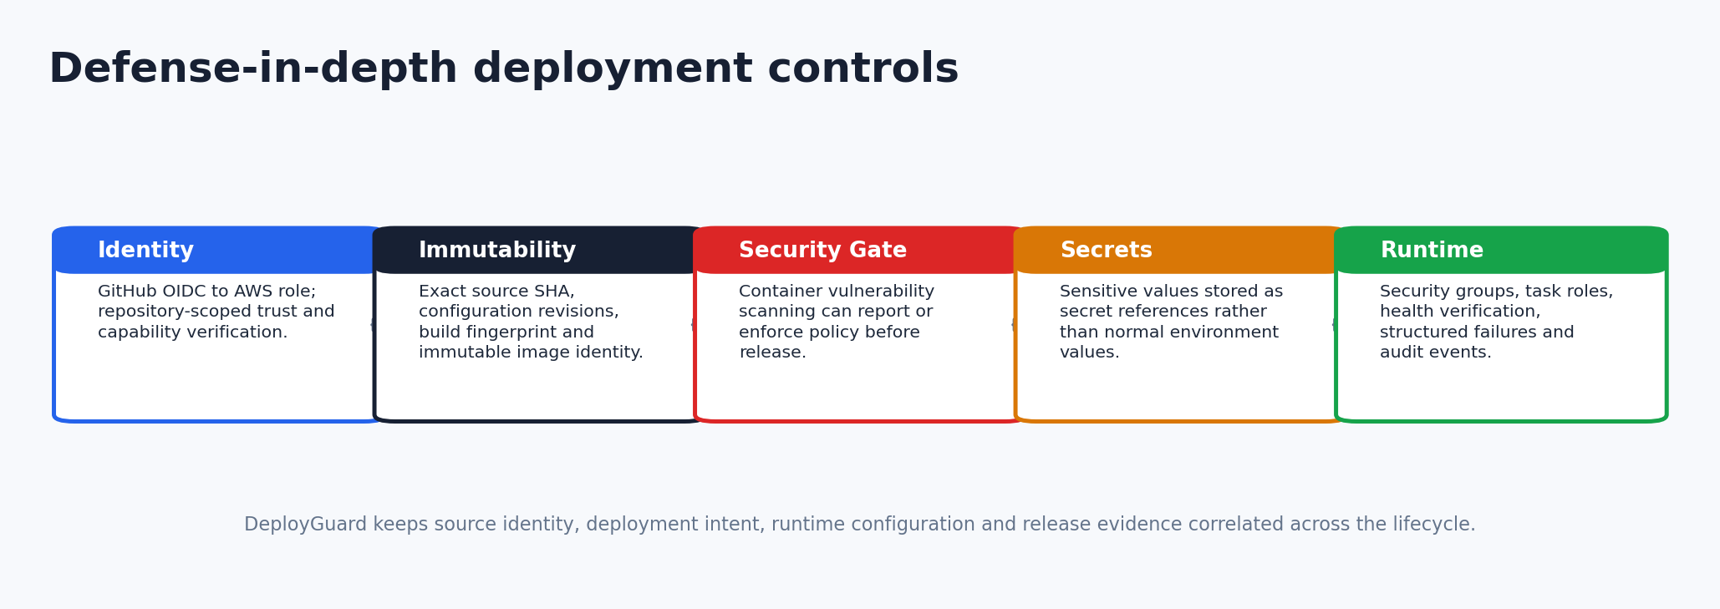
Security architecture
Security is embedded across identity, artifact, configuration and runtime stages.
Vulnerability scanning can operate in visibility mode or enforcement mode before a release advances.

Slide 18
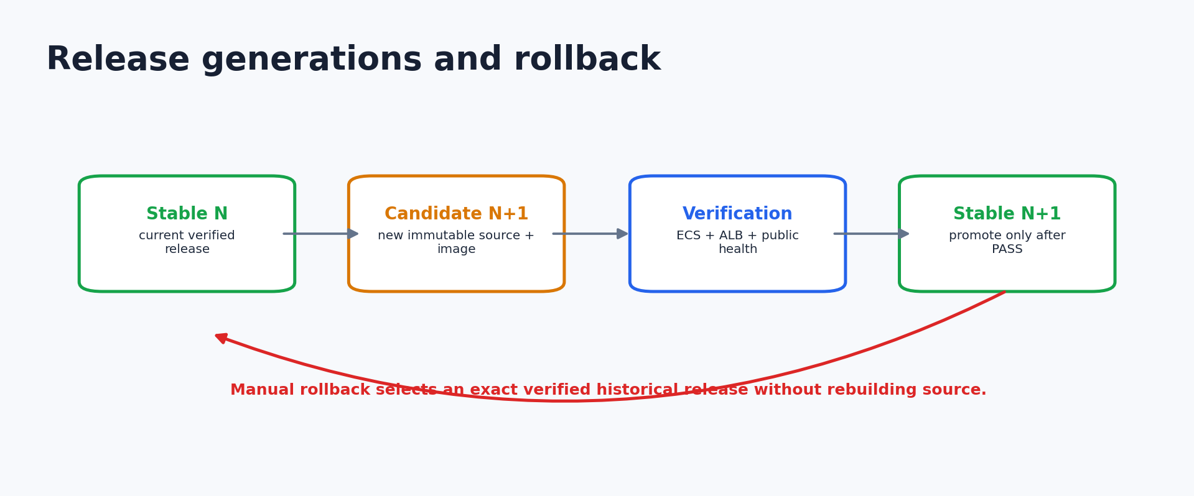
Release generations
A candidate is never “stable” merely because infrastructure exists.
Database constraints enforce one live generation and one deploying candidate per project/environment.

Slide 19
Redeploy path
Code-only release changes avoid unnecessary full infrastructure reprovisioning.
Source change
Build + scan
Task revision
ECS update
Verify + promote
new exact SHA
new immutable image
register immutable runtime
roll service
stable only on PASS
Release-only updates preserve infrastructure ownership while advancing the active runtime revision.

Slide 20
Manual rollback
Rollback reuses a proven historical release instead of rebuilding old source.
Select
Validate
Activate
Verify
Promote
verified historical release
artifact + config compatibility
ECS previous revision
runtime + public health
move stable pointer
Key invariant
Rollback is an immutable release selection operation—not a source rebuild.

Slide 21
Destroy and cloud cleanup
Destruction is a verified lifecycle operation, not a blind delete call.
Confirm
Destroy
Verify
Cleanup
Finalize
explicit destructive admission
Terraform resource deletion
AWS inventory reconciliation
non-IaC residue handling
control-plane state closed
Project inventory, TTL cleanup and admin cleanup surfaces help detect orphaned resources after interrupted operations.

Slide 22
Observability and failure diagnostics
The product stores structured evidence so a failure can be classified, explained and recovered.
Evidence surface | Implementation
Pipeline | stage timing • status • terminal code • service identity
Workflow | run/job evidence • duration • dispatch state
AWS runtime | ECS events • stopped tasks • ALB target health • CloudWatch
Failure contract | owner • provider • root-cause code • retry decision
Monitoring | CPU/memory • latency • Prometheus/Grafana projections
Unknown evidence remains UNVERIFIED rather than being forced into a misleading root-cause category.

Slide 23
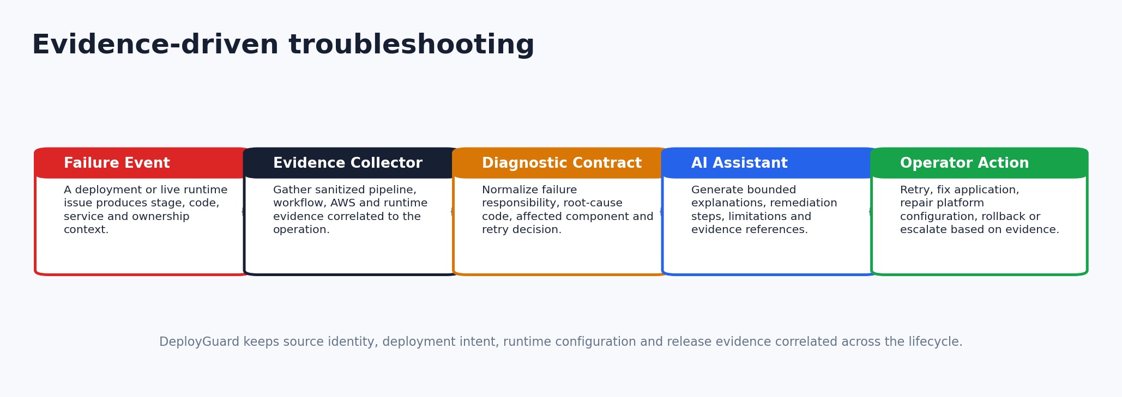
AI-assisted troubleshooting
AI is advisory; deterministic evidence remains authoritative.
Provider failure falls back to evidence-only diagnostics, preserving useful troubleshooting without inventing facts.

Slide 24
FinOps and billing
Cost is treated as a deployment policy dimension alongside security and technical readiness.
Cost evidence
Policy
Commercial layer
Plan-derived estimate
resource breakdown
monthly total
change vs previous estimate
persisted cost history
warning threshold
subscription tier limit
approval-required state
block/resume pipeline
audit trail
plans
subscriptions
checkout
invoices + payments
usage counters + entitlements
A technically valid deployment can still be paused when its predicted cost violates policy.

Slide 25
Verification and certification strategy
FYP-II evidence is built from executable contracts, not only screenshots.
Repository contracts
Lifecycle
service discovery • build target • port • env isolation
deploy • redeploy • rollback • destroy • state reconciliation
Security
Runtime
OIDC • capability model • Trivy • secret boundaries
ECS stability • health • multi-service • DB prerequisites
UI
Full stack
deployment journey • recovery • monitoring • destructive operations
backend build • frontend build • integration • browser workflow

Slide 26
FYP-II live demonstration
Show the implementation as one coherent lifecycle.
1
2
3
4
5
6
Connect repo
Deploy
Workflow + AWS
LIVE app
Evidence
Destroy
Keep one known-safe supported repository ready.
Show exact commit / deployment identity before cloud execution.
Open AWS evidence only after the platform lifecycle shows the corresponding stage.
Finish by proving both the public application and cleanup lifecycle.

Slide 27
Current limitations and next engineering steps
The implementation is intentionally bounded; future work expands scale without weakening determinism.
Current limitation | Next step
JavaScript/Python-focused deployment contract | add additional ecosystem contracts behind explicit admission
AWS-primary runtime | provider adapters and capability contracts for other compute backends
Per-project resource overhead | shared ingress, resource pooling and bin-packing
Basic release promotion | canary / weighted traffic / blue-green policies
Security scanning focused on image vulnerabilities | SBOM, provenance signatures and stronger supply-chain policy
AI advisory troubleshooting | richer SLO/evidence correlation while preserving deterministic authority

Slide 28
What we implemented
DeployGuard is a control plane, not a collection of cloud scripts.
Core contribution
Integrated product capabilities
• Immutable source/build/runtime identity
• Deterministic admission and configuration
• Governed cloud lifecycle
• Verified stable-release promotion
• Release generations + rollback/destroy
• Structured failure ownership and evidence
• Managed databases + persistence
• Security and federated cloud identity
• Observability and state reconciliation
• FinOps + billing
• AI-assisted troubleshooting
• Developer and operator interfaces
The FYP-II value is the implemented lifecycle correctness that connects these capabilities into one product.

Slide 29
DeployGuard
Repository → deterministic contracts → immutable image → AWS runtime → verified stable release
FYP-II Implementation • Questions & Live Demo
Hasan Sajjad • Faria Fatima • Tania Khawar

