Slide 1
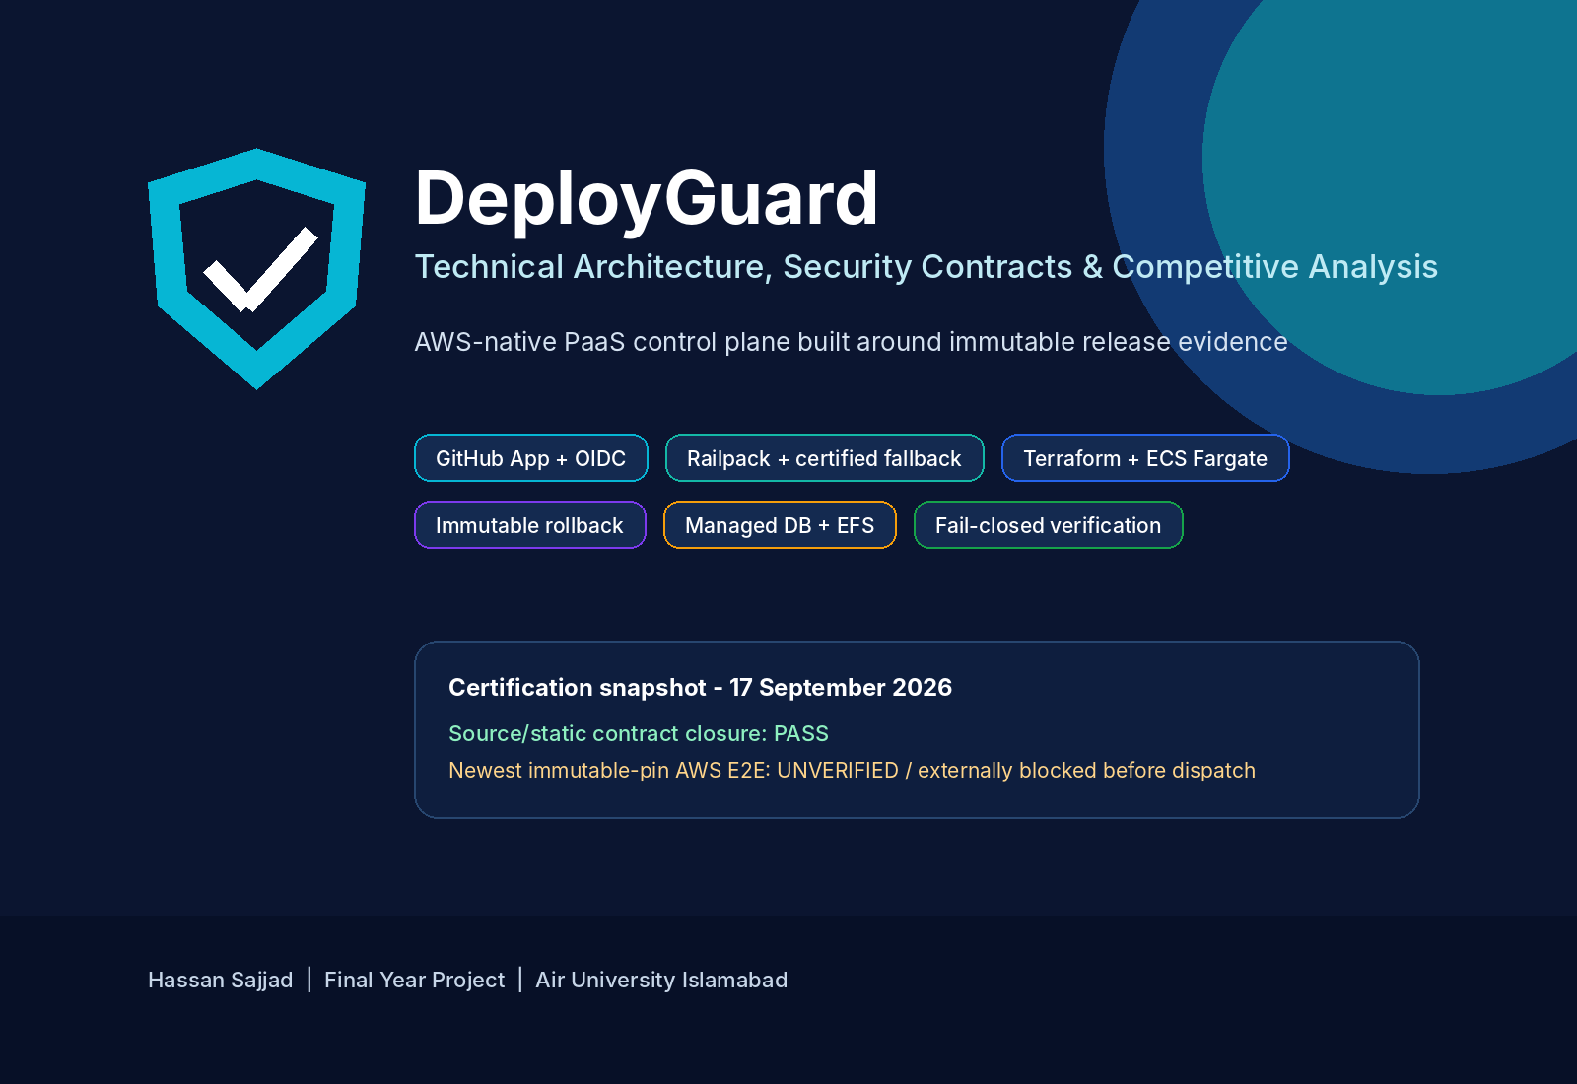
DEPLOYGUARD • FYP • 01
Hassan Sajjad • Sep 2026

Slide 2
PRODUCT THESIS
DeployGuard in one sentence
An evidence-driven AWS PaaS control plane that converts an exact Git commit into an immutable, verified ECS release - and refuses to promote it until identity, configuration, infrastructure and runtime evidence agree.
Own the AWS runtime
Prove the release
Bound destructive actions
ECR • ECS • ALB • EFS • Secrets • S3
Source → digest → task definition → runtime evidence
Tags • namespaces • shared-foundation exclusions
Current freeze: source/static closure PASS • newest-pin AWS E2E UNVERIFIED / blocked before dispatch
DEPLOYGUARD • FYP • 02
Hassan Sajjad • Sep 2026

Slide 3
WHY DEPLOYGUARD EXISTS
The problem we chose to solve
A “green pipeline” is not enough when deployment spans source interpretation, IAM, state, containers, networking, secrets and rollback.
Source ambiguity
Cloud ambiguity
Branch moved, service root wrong, stack detection wrong.
Wrong account/role/state path can be valid syntax but wrong target.
Release ambiguity
Cleanup ambiguity
Tag says “latest”, task definition changed, rollback rebuilds old source.
Destroy succeeds partially but shared resources or residue are mishandled.
DEPLOYGUARD • FYP • 03
Hassan Sajjad • Sep 2026

Slide 4
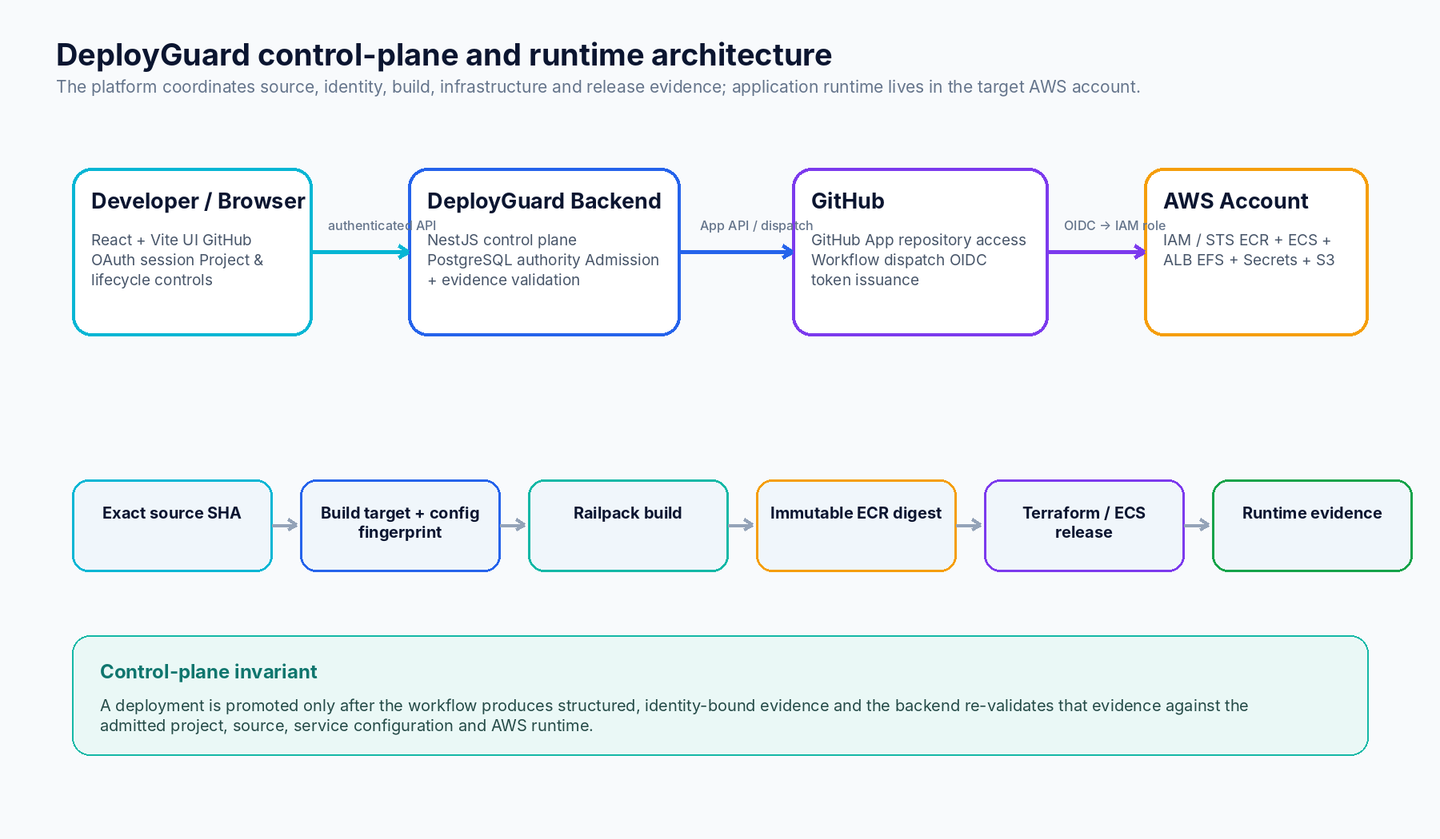
SYSTEM
Architecture: control plane outside, runtime inside AWS
DEPLOYGUARD • FYP • 04
Hassan Sajjad • Sep 2026

Slide 5
SECURITY
Five trust boundaries drive the design
Browser → backend
OAuth state + signed HttpOnly session + RBAC
Backend → GitHub
GitHub App installation + exact repository/source identity
Backend → AWS
STS account guard + IAM/OIDC admission
GitHub → AWS
OIDC web identity into dedicated Actions role
Workflow → backend
Structured evidence artifact re-validated before promotion
DEPLOYGUARD • FYP • 05
Hassan Sajjad • Sep 2026

Slide 6
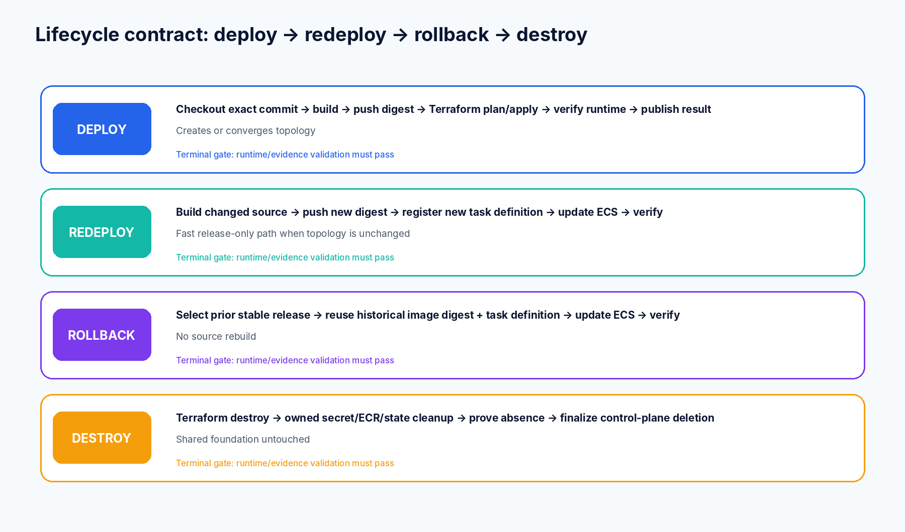
DEPLOY / REDEPLOY / ROLLBACK / DESTROY
Lifecycle contract
DEPLOYGUARD • FYP • 06
Hassan Sajjad • Sep 2026

Slide 7
BEFORE AWS
Admission freezes what “this deployment” means
1
Exact source SHA
2
Service & build target
3
Port
Moving branch refs are resolved to an immutable commit.
Repository-relative path, workspace contract and fingerprint.
Concrete evidence or framework default; $PORT is valid dynamic usage.
4
Config
5
Cloud capability
Build/runtime scopes, reserved HOST/PORT, secret refs, DB aliases.
Account match, OIDC trust and effective IAM simulation.
DEPLOYGUARD • FYP • 07
Hassan Sajjad • Sep 2026

Slide 8
BUILD
Build path: deterministic first, fallback only when proven safe
Railpack 0.38
Classifier
Certified Docker fallback
Identity: version + checksum verified
Inputs: sealed build environment and immutable secret refs
Output: local immutable image required before publication
Question: was this a proven Railpack internal failure?
Fail closed: application build errors do not trigger fallback
Evidence: sanitized terminal failure contract
Selection: exact supported contract/template
Secrets: BuildKit secret mounts
Supply chain: pinned template + digest/base image constraints
DEPLOYGUARD • FYP • 08
Hassan Sajjad • Sep 2026

Slide 9
IMMUTABILITY
Release identity is a chain, not a tag
Git SHA
Build target
revision
Runtime config
revision
ECR sha256
digest
ECS task
definition
AWS runtime
evidence
The backend promotes only after the terminal artifact proves this exact mapping is running.
DEPLOYGUARD • FYP • 09
Hassan Sajjad • Sep 2026

Slide 10
TERRAFORM
AWS runtime topology
ECR
ECS Fargate
ALB
Service-scoped repositories
immutable digests
Per-project cluster
per-service task/service
Per-service ALB/target/listener
transport-ready probe
IAM
CloudWatch
S3 state
Project execution role
Secrets read only when needed
Per-service log groups
runtime metrics/logs
project/environment/runtime
.tfstate + .tflock
Current boundary: public ALB + public-subnet Fargate; HTTP/80 in reference runtime. Private subnets + HTTPS/WAF are hardening roadmap items.
DEPLOYGUARD • FYP • 10
Hassan Sajjad • Sep 2026

Slide 11
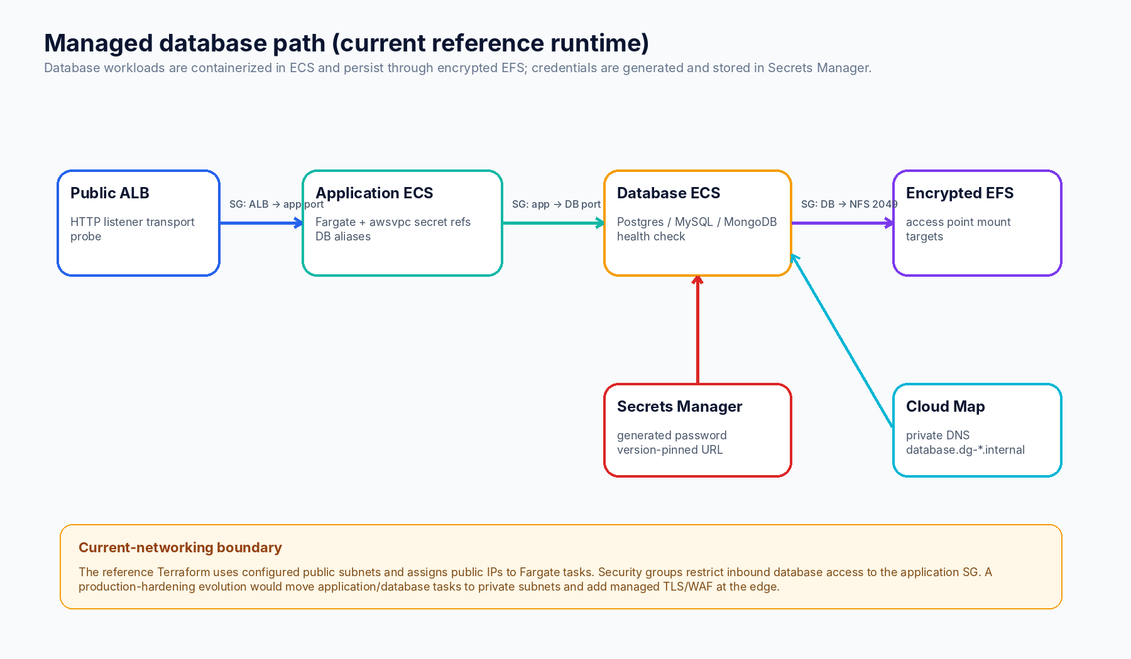
DATA
Managed DB: persistent container topology, not an external black box
DEPLOYGUARD • FYP • 11
Hassan Sajjad • Sep 2026

Slide 12
RELEASE OPERATIONS
Redeploy and rollback avoid unnecessary infrastructure work
Changed-source Redeploy
Rollback
Build: new source → new ECR digest
Topology: reuse existing Terraform outputs
Runtime: register new task definition + update ECS
Guardrail: service-port/topology mismatch rejects fast path
Gate: full runtime verification still required
Build: none
Artifact: prior immutable digest
Runtime: historical task definition identity
Safety: only eligible immediate rollback target
Gate: verify ECS/ALB/public transport after update
DEPLOYGUARD • FYP • 12
Hassan Sajjad • Sep 2026

Slide 13
SAFETY
Destroy is an evidence-producing lifecycle operation
01
Terraform destroy
Owned AWS topology
02
Runtime secrets
Exact namespace + ownership tags
03
ECR cleanup
Missing repo = already clean; real errors fail
04
State cleanup
Environment-scoped state/lock absence
05
Control-plane finalization
Only after verified cloud deletion
DEPLOYGUARD • FYP • 13
Hassan Sajjad • Sep 2026

Slide 14
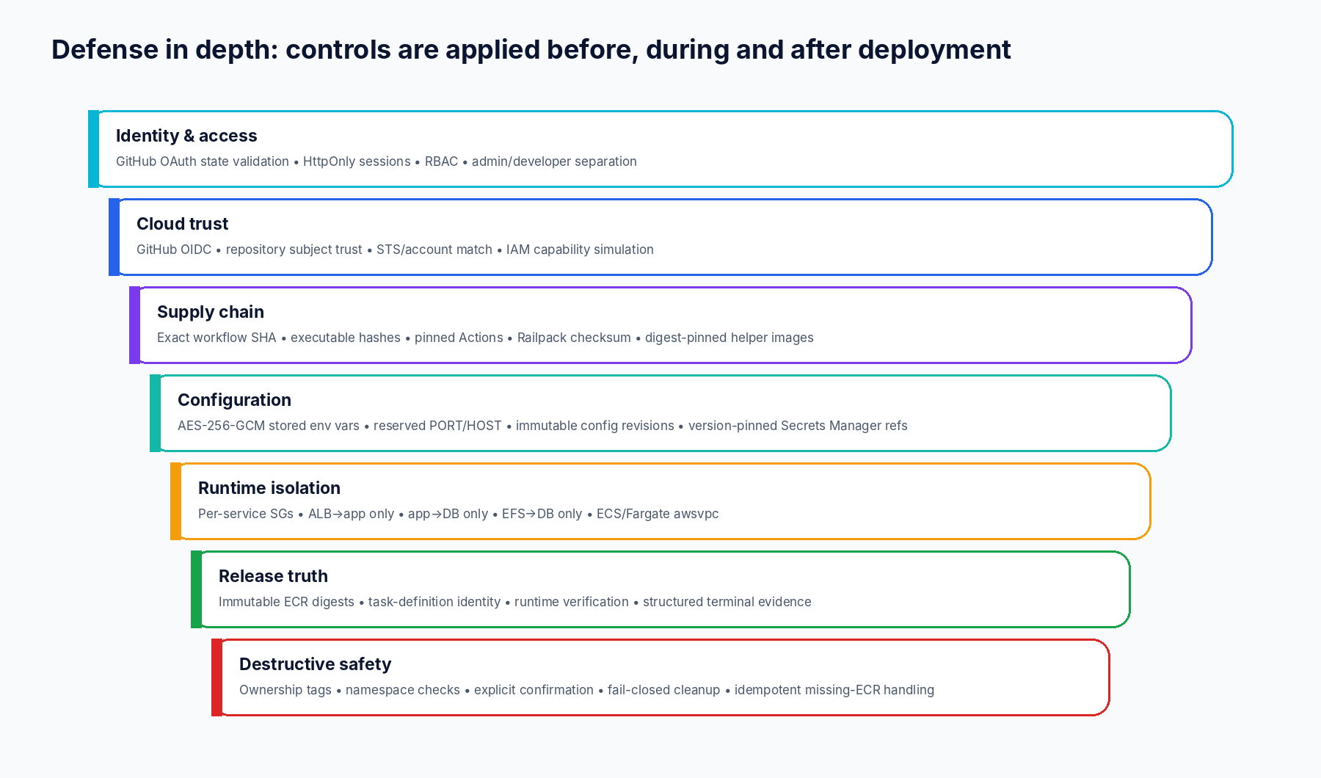
SECURITY
Security is layered around release integrity
DEPLOYGUARD • FYP • 14
Hassan Sajjad • Sep 2026

Slide 15
SECURITY CONTROLS
Identity, secrets and cloud trust
User identity
Configuration
AWS trust
OAuth state
At rest
Actions
callback must match random cookie
AES-256-GCM
GitHub OIDC → dedicated role
Session
Runtime secrets
Backend
HttpOnly • SameSite=Lax • signed audience/expiry
Secrets Manager + immutable version ID
separate AWS identity
RBAC
Rollback
Guard
readonly / developer / admin
does not follow mutable AWSCURRENT
STS account = configured account = role account
DEPLOYGUARD • FYP • 15
Hassan Sajjad • Sep 2026

Slide 16
SECURITY
Supply-chain and evidence controls
Exact workflow SHA
Executable SHA-256 contract
40-character immutable pin
Workflow + Terraform + verification + fallback assets
Pinned Actions
Pinned helper images
checkout / AWS credentials / Terraform / artifacts / Trivy
BuildKit + transport probe digests
Railpack checksum
Structured artifacts
Builder identity verified before build
Success and DG_* failure evidence are bounded and validated
DEPLOYGUARD • FYP • 16
Hassan Sajjad • Sep 2026

Slide 17
PRODUCT SURFACE
Operations beyond deploy
Observability
Failure diagnostics
AI troubleshooting
CloudWatch logs/metrics • Prometheus export • live-runtime resolver
Ownership/provider/stage + retry decision from structured evidence
Sanitized evidence-assisted analysis; not deployment authority
Cost evidence
Billing & entitlements
Notifications
Infracost + project cost projections
Subscriptions • usage • checkout • invoice • payment • webhooks
Preferences/subscriptions/delivery + SNS adapter
DEPLOYGUARD • FYP • 17
Hassan Sajjad • Sep 2026

Slide 18
OPERATIONS
Performance behavior: optimize work, do not invent benchmarks
Deploy
Build + ECR + Terraform + ECS/ALB verification
Most work
Redeploy
Build + ECR + new task definition + ECS update
Skips Terraform apply
Rollback
Historical digest/task definition + ECS update
No rebuild
Destroy
Terraform destroy + cleanup proofs
Deletion-bound
No newest-pin latency / throughput / cost benchmark is claimed until AWS E2E is rerun.
DEPLOYGUARD • FYP • 18
Hassan Sajjad • Sep 2026

Slide 19
COMPETITIVE ARCHITECTURE
DeployGuard vs Vercel vs Render vs Heroku
DeployGuard
Vercel
Render
Heroku
Ownership
AWS account
Vercel infra
Render infra
Heroku runtime
Release ID
Digest + task def + evidence
Deployment
Deploy/artifact
Release + slug/OCI
IaC/state
Terraform + S3 lock
Platform / Build Output
render.yaml Blueprint
Platform release model
Rollback
Historical ECS identity
Point domain to old deploy
Deploy old artifact
New release from old slug/config
DB/persist
ECS DB + EFS
External data services
Managed DB / disk
Add-ons / external
Security angle
OIDC/IAM + release integrity
Edge/WAF/protection
Managed service network
Dyno isolation / spaces
DEPLOYGUARD • FYP • 19
Hassan Sajjad • Sep 2026

Slide 20
HONEST POSITIONING
Clear differences - and where competitors are stronger
Vercel
Best-in-class managed web/Functions + edge/WAF/deployment protection. DeployGuard gives AWS-resource ownership and explicit IAM/Terraform evidence instead.
Render
Managed service + Blueprint model with strong simplicity; persistent disks/managed Postgres. DeployGuard exposes the AWS topology and release proof chain.
Heroku
Mature dyno/release/config-var abstraction. DeployGuard is lower-level: ECS task definitions, ECR digests and Terraform state are first-class contract objects.
Trade-off
DeployGuard gains auditability/control but assumes more IAM, networking and cloud-operation responsibility.
DEPLOYGUARD • FYP • 20
Hassan Sajjad • Sep 2026

Slide 21
SECURITY HONESTY
What we do NOT claim yet
Newest-pin production certification
TLS/WAF
Blocked before dispatch; no current-pin AWS E2E proof.
Reference runtime is HTTP/80. HTTPS/ACM/WAF are hardening roadmap.
Private app/DB subnets
Managed DB = RDS
Current runtime uses configured public subnets + public IP with SG restrictions.
No. It is containerized DB + EFS; HA/PITR/backups need further product work.
Autoscaling
Least privilege in Test 2 certification
Not part of the currently inspected certified Terraform topology.
Temporary broad AdministratorAccess was used to unblock certification; tighten after E2E.
DEPLOYGUARD • FYP • 21
Hassan Sajjad • Sep 2026

Slide 22
FREEZE STATUS
Certification snapshot
TEST 2
TEST 3
Head: 54ddc957…
Pin: df86ae471…
Static defect closure: PASS
Historical live: Deploy / Rollback / Destroy PASS on older pin
Newest-pin E2E: UNVERIFIED - blocked before dispatch
Head: 1d5a243a…
Pin: 0ebf940d…
Static defect closure: PASS
Source readiness: PASS
Newest-pin E2E: UNVERIFIED - separate AWS configuration missing
DEPLOYGUARD • FYP • 22
Hassan Sajjad • Sep 2026

Slide 23
DEMO
Presentation demo: prove the contract, not just the UI
1
GitHub login → project → exact repo/branch/service
2
Show resolved build target + port + environment/DB requirements
3
Deploy: source SHA → build → ECR digest → Terraform → ECS/ALB evidence
4
Change source → Redeploy → prove new digest/task definition
5
Rollback → prove prior digest/task definition restored with no rebuild
6
Managed DB → show EFS + Secrets + Cloud Map + DB-first activation
7
Destroy → prove project resources/state removed; shared foundation remains
DEPLOYGUARD • FYP • 23
Hassan Sajjad • Sep 2026

Slide 24
CONCLUSION
DeployGuard’s strongest differentiator
Release truth is explicit.
Source identity + build/config interpretation + cloud identity + immutable runtime + verification evidence must agree before promotion.
Control and auditability over hidden infrastructure - with the responsibility that comes with owning AWS.
Next gate: run the frozen Test 2 + Test 3 AWS E2E lifecycles on the exact pins.
DEPLOYGUARD • FYP • 24
Hassan Sajjad • Sep 2026

Slide 25
SOURCES
Reference basis
DeployGuard source
Official platform docs
Frozen Test 2 / Test 3 source: workflow, capability contracts, Railpack deployment service, Terraform runtime, verification scripts, auth/security, observability, billing and troubleshooting modules.
Vercel: deployments, Build Output API, Instant Rollback, security, Functions
Render: deploys, rollbacks, persistent disks, Blueprints, service types
Heroku: dynos, releases, config vars, Container Registry & Runtime
Comparison is architectural, not a claim that DeployGuard is universally superior. Vendor-managed PaaS products intentionally offer lower operational burden and mature platform security; DeployGuard intentionally exposes AWS ownership and release evidence.
DEPLOYGUARD • FYP • 25
Hassan Sajjad • Sep 2026

