Slide 1
Graphical Programming with C#

Slide 2
Chapter Ι Introduction To C#

Slide 3

Introduction
C# is pronounced "C-Sharp".
C# (C-Sharp) is a programming language developed by Microsoft that runs on the .NET Framework.
C# is used for:
Mobile applications
Desktop applications
Web applications
Web services
Web sites
Games
Database applications
And much, much more!
Why Use C#?
It is one of the most popular programming language in the world
It is easy to learn and simple to use
C# is an object oriented language which gives a clear structure to programs and allows code to be reused, lowering development costs
As C# is close to C, C++ and Java, it makes it easy for programmers to switch to C# or vice versa

Slide 4
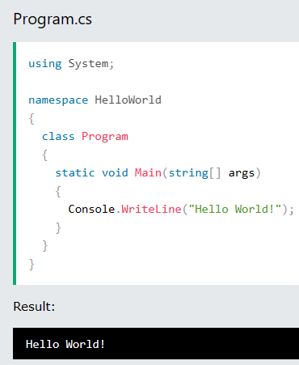
C# Syntax
Create a C# file called Program.cs, and we used the following code to print "Hello World" to the screen:
Example explained
Line 1: using System means that we can use classes from the System namespace.
Line 2: A blank line. C# ignores white space. However, multiple lines makes the code more readable.
Line 3: namespace is used to organize your code, and it is a container for classes and other namespaces.
Line 4: The curly braces {} marks the beginning and the end of a block of code.
Line 5: class is a container for data and methods, which brings functionality to your program. Every line of code that runs in C# must be inside a class. In our example, we named the class Program.
Line 6: Console is a class of the System namespace, which has a WriteLine() method that is used to output/print text. In our example it will output "Hello World!".

Slide 5



C# Output
To output values or print text in C#, you can use the WriteLine() method:
You can add as many WriteLine() methods as you want. Note that it will add a new line for each method:
You can also output numbers, and perform mathematical calculations:

Slide 6


C# Comments
Comments can be used to explain C# code, and to make it more readable. It can also be used to prevent execution when testing alternative code.
Single-line Comments
Single-line comments start with two forward slashes (//).
Multi-line Comments
Multi-line comments start with /* and ends with */.
Any text between /* and */ will be ignored by C#.

Slide 7


C# Variables
Variables are containers for storing data values.
In C#, there are different types of variables (defined with different keywords), for example:
int - stores integers (whole numbers), without decimals, such as 123 or -123
double - stores floating point numbers, with decimals, such as 19.99 or -19.99
char - stores single characters, such as 'a' or 'B'. Char values are surrounded by single quotes.
float stores fractional numbers. Sufficient for storing 6 to 7 decimal digits
string - stores text, such as "Hello World". String values are surrounded by double quotes
bool - stores values with two states: true or false
Declaring (Creating) Variables
To create a variable, you must specify the type and assign it a value:

Slide 8
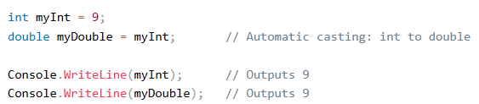
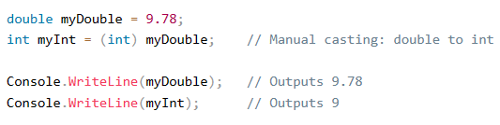
C# Type Casting
Type casting is when you assign a value of one data type to another type.
In C#, there are two types of casting:
Implicit Casting (automatically) - converting a smaller type to a larger type size
char -> int -> long -> float -> double
Explicit Casting (manually) - converting a larger type to a smaller size type
double -> float -> long -> int -> char
Implicit Casting
Explicit Casting

Slide 9
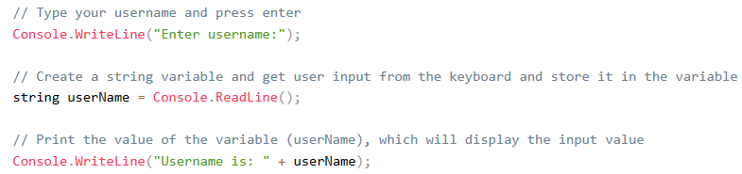

C# User Input
You have already learned that Console.WriteLine() is used to output (print) values. Now we will use Console.ReadLine() to get user input.
In the following example, the user can input his or hers username, which is stored in the variable userName. Then we print the value of userName:
Example

Slide 10
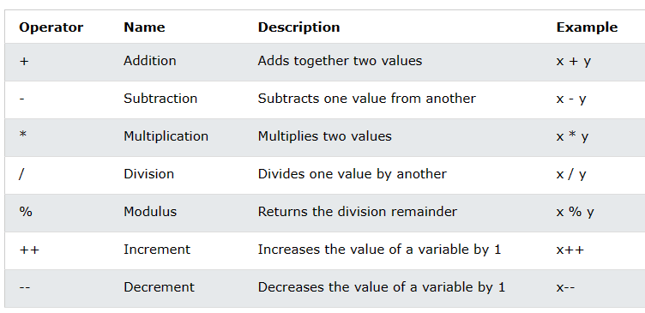
C# Operators
Operators are used to perform operations on variables and values.
Arithmetic Operators
Comparison Operators
Assignment Operators
Logical Operators
1-Arithmetic Operators
Arithmetic operators are used to perform common mathematical operations:

Slide 11
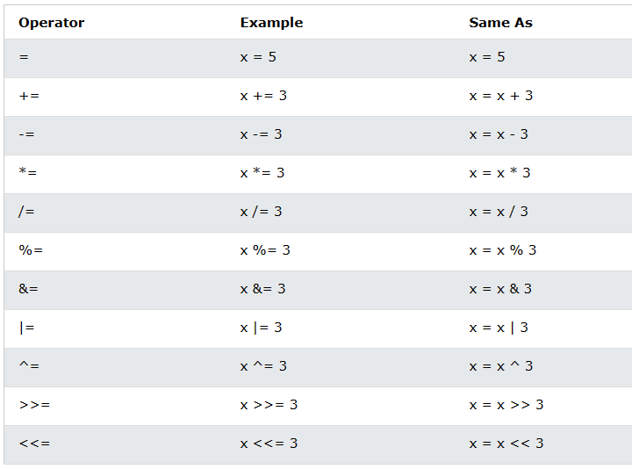
2-Assignment Operators
Assignment operators are used to assign values to variables.

Slide 12
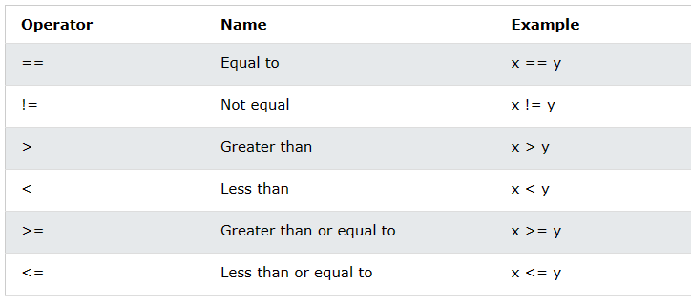
3-Comparison Operators
Comparison operators are used to compare two values (or variables).

Slide 13
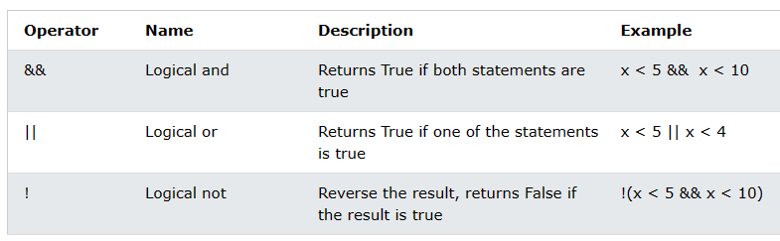
4-Logical Operators
Logical operators are used to determine the logic between variables or values:

Slide 14
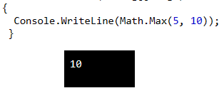




C# Math
The C# Math class has many methods that allows you to perform mathematical tasks on numbers.
Math.Max(x,y)
The Math.Max(x,y) method can be used to find the highest value of x and y:
Math.Min(x,y)
The Math.Min(x,y) method can be used to find the lowest value of of x and y:
Math.Sqrt(x)
The Math.Sqrt(x) method returns the square root of x:
Math.Abs(x)
The Math.Abs(x) method returns the absolute (positive) value of x:
Math.Round()
Math.Round() rounds a number to the nearest whole number:

Slide 15
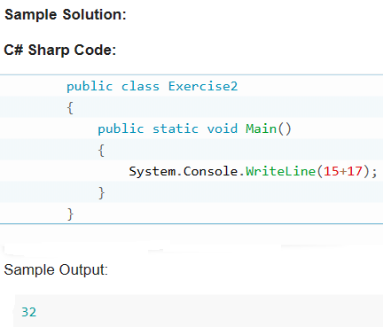
Exercice 1
Write a C# Sharp program to print the sum of two numbers.

Slide 16
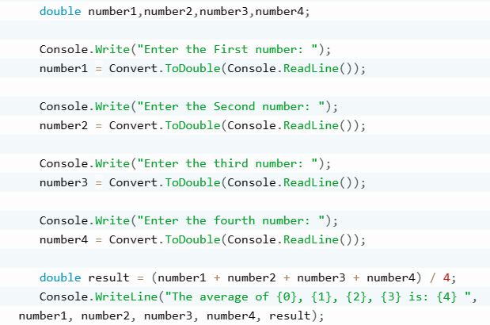
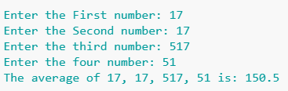
Exercice 2
Write a C# Sharp program that takes four numbers as input to calculate and print the average.

Slide 17
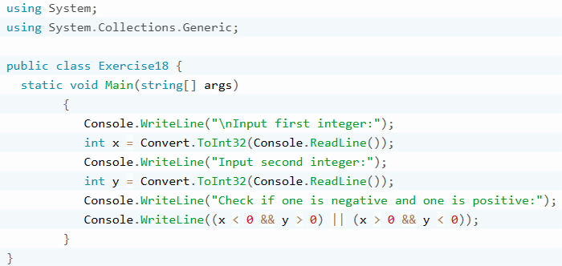
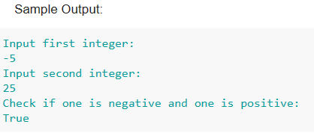
Exercice 3
Write a C# program to check a pair of integers and return true if one is negative and one is positive.

Slide 18
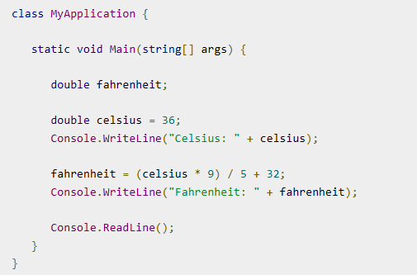
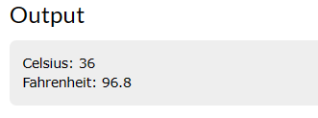
Exercice 4
Write a C# Program to perform Celsius to Fahrenheit Conversion

Slide 19
End

