Slide 1
Process concepts and management

Slide 2
Processes
A program in execution
An instance of a program running on a computer
The entity that can be assigned to and executed on a processor
A unit of activity characterized by a single sequential thread of execution, a current state, and an associated set of system resources

Slide 3
Process Concept
Process – is a program in execution
Process execution must progress in sequential fashion
Program is passive entity stored on disk (executable file), process is active
Program becomes process when executable file loaded into main memory
Execution of program starts via GUI mouse clicks, command line entry of its name, etc.

Slide 4
Notion of resources
A resource is any entity that a process needs to run (CPU, memory, peripherals ...)
A resource can be characterized by the number of processes that can use it at the same time:
Any number of processes. There are no controls to be implemented. Example: Clock
Several processes, but in limited numbers.
Only one process can be use it at any instant, called a critical resource (such as the CPU)

Slide 5
Process Concept (Cont.)
One program can be several processes
Consider multiple users executing the same program
A running system consists of multiple processes
OS processes
Processes started by the OS to do “system things”
User processes
Executing user code, with the possibility of executing kernel code by going to kernel mode (system calls)

Slide 6
Process execution

Slide 7

Before: Uniprogramming
Processor must wait for I/O instruction to complete before preceding

Slide 8
Then: Multiprogramming
Processor has more than one program to execute
The sequence the programs are executed depend on their relative priority and whether they are waiting for I/O
After an interrupt handler completes, control may not return to the program that was executing at the time of the interrupt

Slide 9
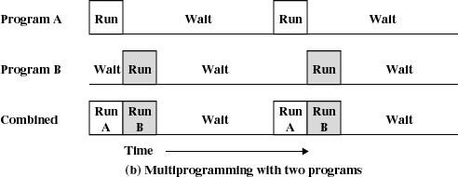
Multiprogramming
When one job needs to wait for I/O, the processor can switch to the other job

Slide 10
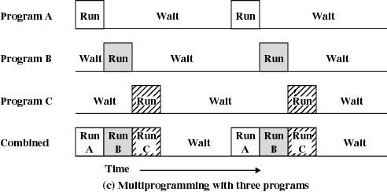
Multiprogramming

Slide 11
Now : Time Sharing
Using multiprogramming to handle multiple interactive jobs
Processor’s time is shared among multiple users
Multiple users simultaneously access the system through terminals
The OS allocates a set of time to each user. When this time is expired, it passes control to the next user on the system. The time allowed is extremely small and the users are given the impression that they each have their own CPU and they are the sole owner of the CPU. This short period of time during that a user gets attention of the CPU; is known as
a time slice or a quantum. The concept of time sharing
system is shown in figure.

Slide 12
Process execution: Time sharing
The OS allocates a set of time to each user. When this time is expired, it passes control to the next user on the system. The time allowed is extremely small
This short period of time during that a user gets attention of the CPU; is known as a time slice or a quantum.
When the CPU executes a process P, the OS switch the CPU to another process if:
– P is performing an I/O operation or the end of quantum is reached

Slide 13
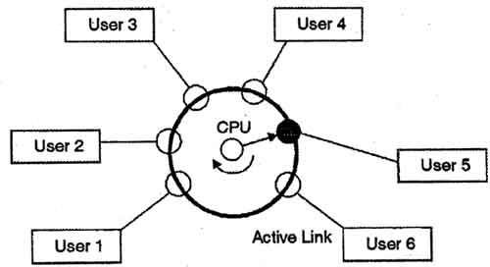
Process execution: time sharing
The concept of time sharing system is shown in figure.

Slide 14
OS Schedulers
Schedulers are special system software which handle process scheduling in various ways. Their main task is to select the jobs to be submitted into the system and to decide which process to run

Slide 15
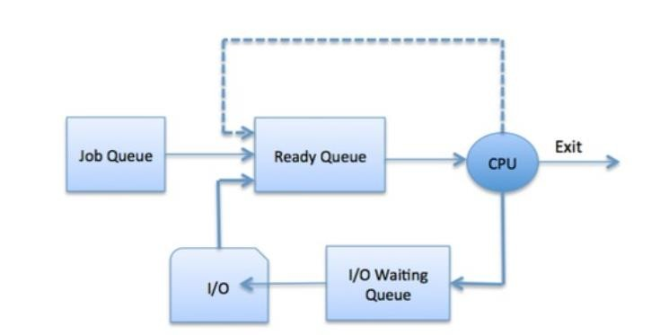
process scheduling queues
The Operating System maintains the following important process scheduling queues −
Job queue − This queue keeps all the processes in the system.
Ready queue − This queue keeps a set of all processes residing in main memory,
ready and waiting to execute. A new process is always put in this queue.
Device queues − The processes which are blocked due to unavailability of an I/O device constitute this queue.

Slide 16
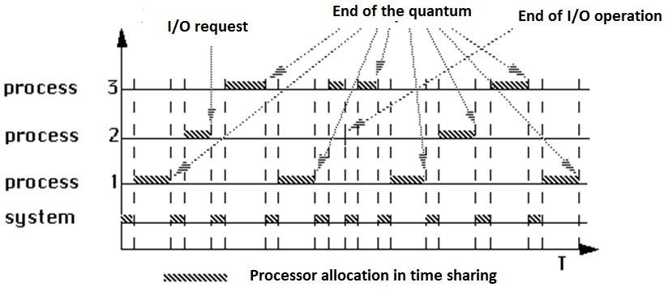
Time sharing : example
Causes interrupt to CPU that will enter the kernel mode to execute the interrupt routine
Processes of OS
(scheduler and interrupt handler)

Slide 17
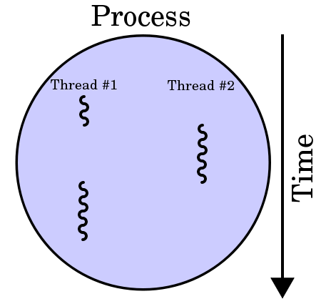
Thread
a thread of execution is the smallest sequence of programmed instructions that can be managed independently by an OS scheduler. A thread is a light-weight process (LWP), share the latter's instructions (its code) and its values (registers).
a thread is a component of a process.

Slide 18
Thread
Systems with a single processor generally implement multithreading by time slicing: the central processing unit (CPU) switches
between different software threads. This context switching generally happens very often and rapidly enough that users perceive the threads or tasks as running in parallel. On
a multiprocessor or multi-core system, multiple threads can execute in parallel, with every processor or core executing a separate thread simultaneously

Slide 19
Process state
In a uniprogramming system the notion of state has no matter
the process occupies the CPU until its termination
In a multiprogrammig system – time sharing Only one process can be running on any processor at any instant, although many processes may be ready and waiting.

Slide 20
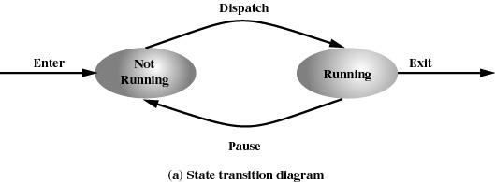
Two-State Process Model
Process may be in one of two states
Running
Not-running

Slide 21
Scheduler and Dispatcher are associated with process scheduling of an operating system.
The key difference between scheduler and dispatcher is that the scheduler selects a process out of several processes to be executed while the dispatcher allocates the CPU for the selected process by the scheduler.
The dispatcher is the module that gives a process control over the CPU after it has been selected by the short-term scheduler.
Notes:
Scheduler: The scheduler is responsible for deciding which process or thread should execute next on the CPU. Its main goal is to allocate CPU time fairly and efficiently among competing processes or threads. The scheduler takes into account various factors, such as process priorities, CPU utilization, and scheduling algorithms, to make informed decisions about process/thread scheduling.
Dispatcher: The dispatcher, also known as the dispatcher module or dispatcher routine, is responsible for implementing the context switch and transferring control of the CPU from the currently running process/thread to the selected process/thread. Its main function is to manage the mechanics of the context switch and facilitate the transfer of control.

Slide 22
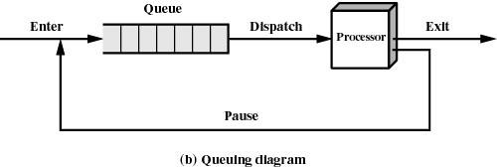
Not-Running Process in a Queue

Slide 23
A Five-State Model
As a process executes, it changes state
new: The process is being created
ready: The process is waiting to run by the CPU
running: Instructions are being executed in CPU
blocked or waiting: Process waiting for some event to occur
Terminated or exit: The process has finished execution
Only one process can be running on any processor at any instant, although many processes may be ready and waiting.

Slide 24
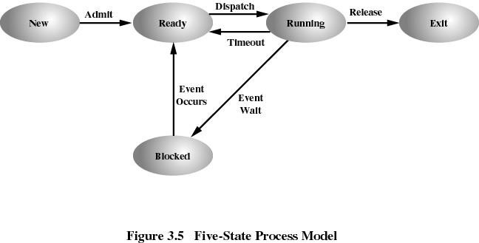
Release= end of process Timeout=end of quantum Event wait = I/O request Event occurs: end of I/O and return to ready to wait its turn

Slide 25
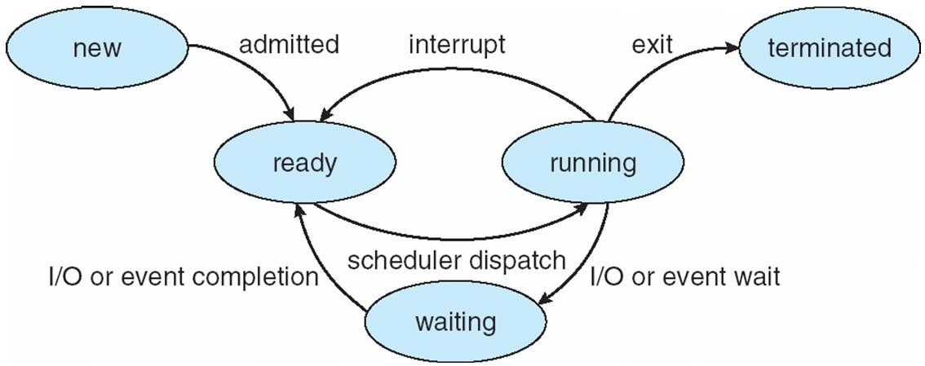
Diagram of Process State

Slide 26
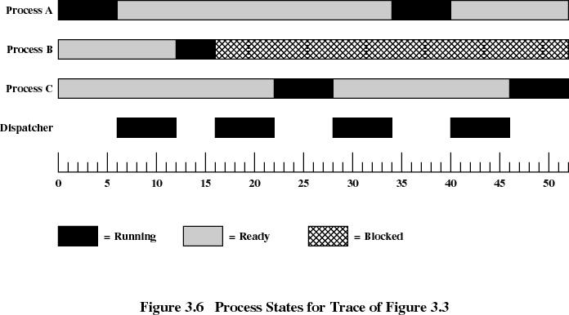

Slide 27
Transitions between states
Ready → Running
When the dispatcher of the CPU choose a process to execute
Running→ Ready
Result of an interruption caused by an event independent from the process
the interruption must be handled, so the process loses the CPU
Important case: end of the quantum (clock interruption)

Slide 28
Transitions between states
Running → Waiting (blocked)
When the process makes a system call (interruption generated by the process)
Ask for I/O operation: must wait the result
Need a response from another process
Waiting → Ready
When the expected event occurs

Slide 29
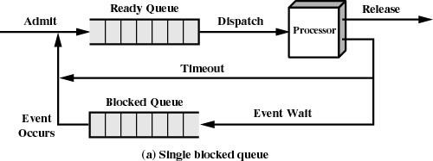
Using Two Queues

Slide 30
