Slide 1
Process scheduling

Slide 2
Foreword
Assume a single processor. How do we provide the illusion of multiple processors?
Multiplex in time! → multiprogramming
Each process needs a structure to hold:
Information about the running process
e.g. Program counter, Registers’ values (Integers, others…)
How to switch from one process to the next?
Need to save the current process state somewhere → PCB
Load the state of a new process from somewhere
What triggers switch?
Timer, voluntary yield, I/O, other things …
Notes:
When a process or thread voluntarily yields, it indicates that it has completed its current task or that it is at a point where it is willing to give up the CPU voluntarily, even if it has not yet finished its execution time slice.

Slide 3
Basic Concepts
Since maximum CPU utilization is obtained with multiprogramming
CPU might serve another process if the currently served one is waiting for I/O request
CPU–I/O Burst Cycle
Process execution consists of a cycle of CPU execution and I/O wait
CPU burst distribution
Affects the selection of an appropriate CPU-scheduling algorithm

Slide 4
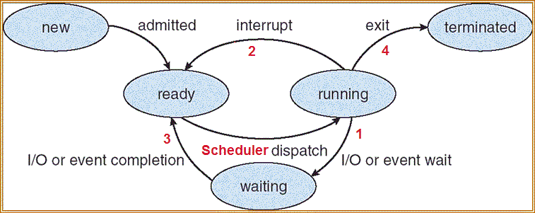
Diagram of Process State
As a process executes, it changes state
new: The process is being created
ready: The process is waiting to run by the CPU
running: Instructions are being executed in CPU
waiting: Process waiting for some event to occur
terminated: The process has finished execution
Only one process can be running on any processor at any instant, although many processes may be ready and waiting.

Slide 5
CPU Scheduler
Selects from among the processes in memory that are ready to execute, and allocates the CPU to one of them
CPU scheduling decisions may take place when a process:
Switches from running to waiting state
Switches from running to ready state
Switches from waiting to ready
Terminates
Scheduling under 1 and 4 is non-preemptive
All other scheduling is preemptive

Slide 6
CPU Scheduler
Non-preemptive
Under non-preemptive scheduling, once the CPU has been allocated to a process, the process keeps the CPU until it releases the CPU either by terminating or by switching to the waiting state.
Ex: Old operating system, some hardware, …
Preemptive
The scheduler decides when one process is to stop running, and a different process is to resume running.

Slide 7
Process Scheduling Queues
Maximize CPU use → quickly switch processes onto CPU for time sharing
Process scheduler selects among available processes for next execution on CPU → The OS manages multiple active process using state queues
Job queue – set of all processes in the system
Ready queue – set of all processes residing in main memory, ready and waiting to execute
Device queues – set of processes waiting for an I/O device. Each I/O device has its own wait queue.
Processes migrate among the various queues

Slide 8
Process Control Block (PCB)
Process Control Block (PCB): OS data structure to keep track of all processes
The PCB tracks the execution state and location of each process
The OS allocates a new PCB on the creation of each process and places it on a state queue
The OS de-allocates the PCB when the process terminates
PCB is stored in RAM
PCB contains:
Process state
New, ready, running, waiting, and terminated
Process number
pid
Program counter
Indicates the address of the next instruction to be executed for this process
CPU registers (vary in number & type depending on the computer arch.)
Accumulators, registers, stack pointers
CPU scheduling information
Process priority, scheduling queue pointers
Memory-management information
Values of base and limit registers, page tables, etc.
Accounting information
Amount of CPU or real time used, time limits,
account numbers, process numbers
I/O status information
List of I/O devices, list of files allocated to the process

Slide 9
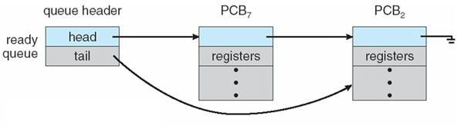
Ready Queue
Stored as a linked list
Header contains pointers to the first and final PCBs in the list
Each PCB includes a pointer field that points to the next PCB in the ready queue.
When the OS changes the state of a process, the PCB is unlinked from its current queue and moved to its new state queue

Slide 10
Dispatcher
Dispatcher module gives control of the CPU to the process selected by the short-term scheduler; this involves:
switching context (next slide)
switching to user mode
jumping to the proper location in the user program to restart that program
Dispatch latency – time it takes for the dispatcher to stop one process and start another running
Should be negligible

Slide 11
Context Switch
When CPU switches to another process, the system must save the state of the old process and load the saved state for the new process via a context switch
Context of a process represented in the PCB
Switching speed depends on memory speed, number of registers that must be copied, and special instructions (such as single instruction to load or store all registers)
Typical speeds range from 1 to 1000 μs.
Context-switch time is overhead; the system does no useful work while switching!
Switching time dependent on hardware support
Switching time may be bottleneck for complex OS

Slide 12
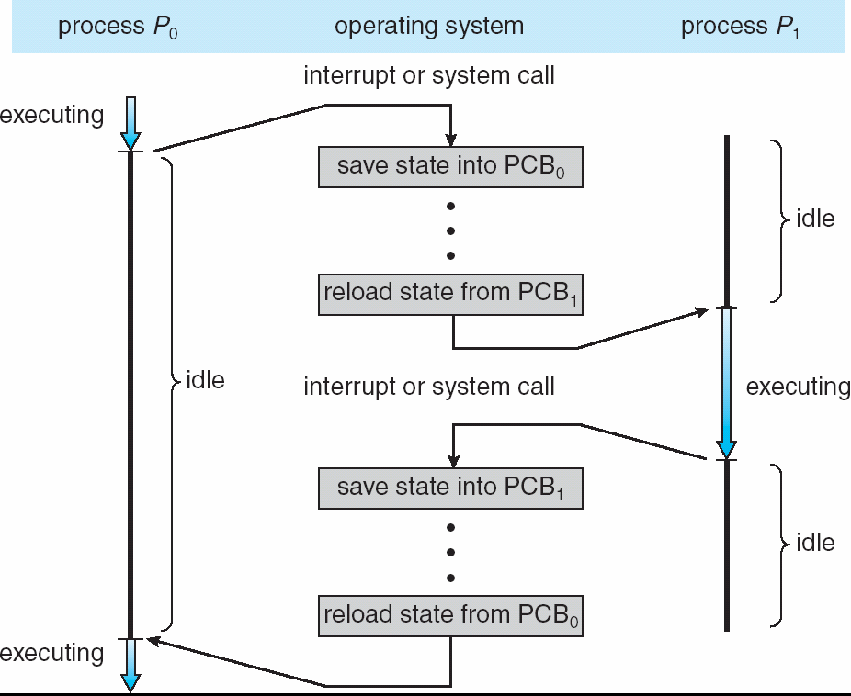

Switching between processes
PCB serves as the repository for any information that may vary from process to process.
The state information must be saved when an interrupt occurs, to allow the process to be continued correctly afterward.
Each process has its own PCB saved in RAM
12

Slide 13
Scheduling Criteria
CPU utilization – keep the CPU as busy as possible
Throughput – # of processes that complete their execution per time unit
Turnaround time – amount of time to execute a particular process (the time since the arrival of the process to its termination (waiting included))
Waiting time – amount of time a process has been waiting in the ready queue and in the waiting queue
Response time – amount of time it takes from when a request was submitted until the first response is produced

Slide 14
Scheduling Algorithm Optimization Criteria
Max CPU utilization
Max throughput
Min turnaround time
Min waiting time
Min response time

