Slide 1
Burst time
Every process in a computer system requires some amount of time for its execution.
Burst time is the total time taken by the process for its execution on the CPU.
Exit time
Exit time is the time when a process completes its execution and exit from the system.

Slide 2
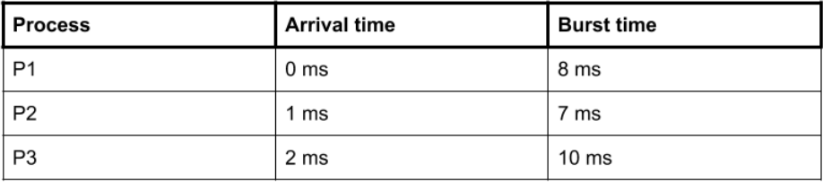
Arrival time
Arrival time is the time when a process enters into the ready state and is ready for its execution.

Slide 3
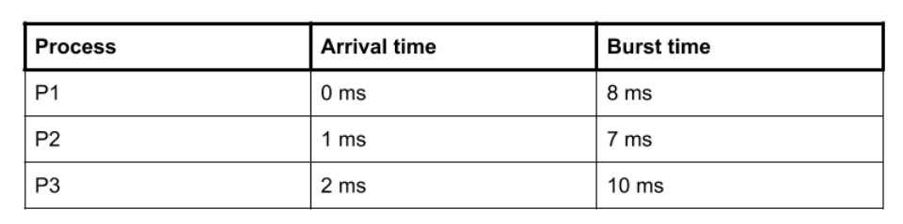
Response time
Response time is the time spent when the process is in the ready state and gets the CPU for the first time. For example, here we are using the First Come First Serve CPU scheduling algorithm for the below 3 processes:
Here, the response time of all the 3 processes are:
P1: 0 ms
P2: 7 ms because the process P2 have to wait for 8 ms during the execution of P1 and then after it will get the CPU for the first time. Also, the arrival time of P2 is 1 ms. So, the response time will be 8-1 = 7 ms.
P3: 13 ms because the process P3 have to wait for the execution of P1 and P2 i.e. after 8+7 = 15 ms, the CPU will be allocated to the process P3 for the first time. Also, the arrival of P3 is 2 ms. So, the response time for P3 will be 15-2 = 13 ms.
Response time = Time at which the process gets the CPU for the first time - Arrival time

Slide 4
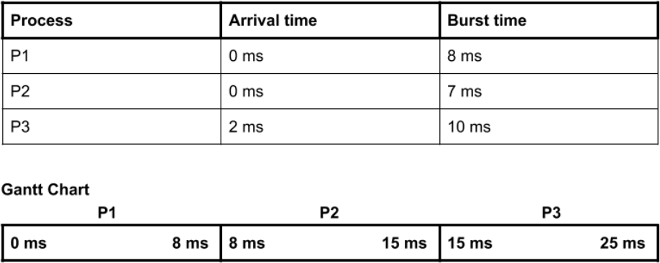
Waiting time
Waiting time is the total time spent by the process in the ready state waiting for CPU. For example, consider the arrival time of all the below 3 processes to be 0 ms, 0 ms, and 2 ms and we are using the First Come First Serve scheduling algorithm.
then the waiting time for all the 3 processes will be:
P1: 0 ms
P2: 8 ms because P2 have to wait for the complete execution of P1 and arrival time of P2 is 0 ms.
P3: 13 ms becuase P3 will be
executed after P1 and P2 i.e. after 8+7
= 15 ms and the arrival time of P3 is 2 ms. So, the waiting time of P3 will be: 15-2 = 13 ms.

Slide 5
Turnaround time
Turnaround time is the total amount of time spent by the process from coming in the ready state for the first time to its completion.
Turnaround time = Exit time - Arrival time

Slide 6
Process Burst Time
P₁ 24
First-Come, First-Served (FCFS) Scheduling
P₂ 3
3
P₃
Suppose that the processes arrive in the order: P₁ , P₂ , P₃
The Gantt Chart for the schedule is:
P₁ | P₂ | P₃
0
24 27 30
= 0; P₂ = 24; P₃ = 27
Waiting time for P₁
Average waiting time: (0 + 24 + 27)/3 = 17

Slide 7
Take into account the arrival time
Exercise: repeat the calculation:
P1 arrives at time 0
P2 arrives at time 2
P3 arrives at time 5
so P1 waits 0
but P2 waits 24-2 = 22 .
And p3 waits 27 – 5 = 22
P₁ | P₂ | P₃
0
24
27
30
Arrival of P2
128

Slide 8
FCFS Scheduling (Cont.)
Suppose that the processes arrive in the order:
P₂ , P₃ , P₁
The Gantt chart for the schedule is:
P₂ | P₃ | P₁
0 3 6
Waiting time for P₁ = 6; P₂ = 0; P₃ = 3
Average waiting time: (6 + 0 + 3)/3 = 3
Much better than previous case
Convoy effect short process behind long process
30

Slide 9
Shortest-Job-First (SJF) Scheduling
Associate with each process the length of its next CPU burst. Use these lengths to schedule the process with the shortest time
SJF is optimal – gives minimum average waiting time for a given set of processes
– The difficulty is knowing the length of the next CPU request

Slide 10
Example of SJF (nonpreemptive)
Process | Burst Time
P₁ | 6
P₂ | 8
P₃ | 7
P₄ | 3
SJF scheduling chart
•
P₄ | P₁ | P₃ | P₂
9
0
3 16
24
Average waiting time = (3 + 16 + 9 + 0) / 4 = 7

Slide 11
Example of SJF (nonpreemptive)
Process Arrival time | Burst time
P₁ 0.0 | 7
P₂ 2.0 | 4
P₃ 4.0 | 1
P₄ 5.0 | 4
P₁ |  |  |  |  |  |  | P₃ | P₂ |  |  |  | P₄
0
3
7 8
12
16
Average waiting time = (0 + 6 + 3 + 7)/4 = 4
11

Slide 12
Example of SJF (preemptive) : short remaining time first SRTF
Process Arrival time | Burst time
P₁ 0.0 | 7
P₂ 2.0 | 4
P₃ 4.0 | 1
P₄ 5.0 | 4
P₁ |  | P₂ |  | P₃ | P₂ |  | P₄ |  |  |  | P₁
0
2
4 5
7
11
16
Average waiting time = (9 + 1 + 0 +2)/4 = 3
12

Slide 13
Priority Scheduling
A priority number (integer) is associated with each process
The CPU is allocated to the process with the highest priority (smallest integer ≡ highest priority)
Preemptive
Nonpreemptive
SJF is a priority scheduling where priority is the predicted next CPU burst time
Problem ≡ Starvation – low priority processes may never execute
Solution ≡ Aging – as time progresses increase the priority of the process

Slide 14
Round Robin (RR)
Each process gets a small unit of CPU time (time quantum), usually 10-100 milliseconds. After this time has elapsed, the process is preempted and added to the end of the ready queue.
If there are n processes in the ready queue and the time quantum is q, then each process gets 1/n of the CPU time in chunks of at most q time units at once. No process waits more than (n-1)q time units.
Performance
q large ⇒ FIFO
q small ⇒ q must be large with respect to context switch, otherwise overhead is too high

Slide 15
Example of RR with Time Quantum = 4
Process | Burst Time
P₁ | 24
P₂ | 3
P₃ | 3
The Gantt chart is:
P₁ | P₂ | P₃ | P₁ | P₁ | P₁ | P₁ | P₁
0 4 7 10 14 18 22 26 30
Typically, higher average turnaround than SJF, but better response

Slide 16
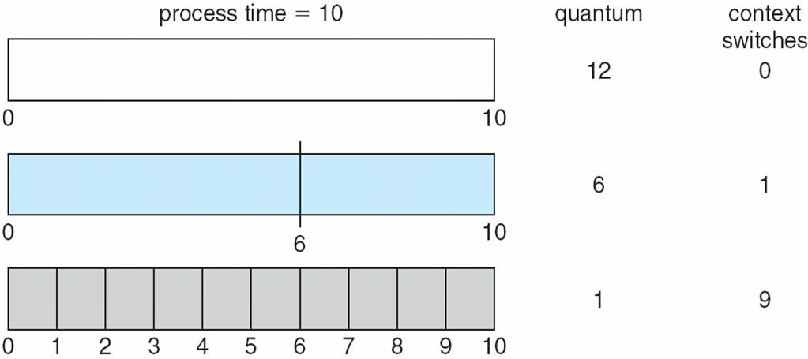
Time Quantum and Context Switch Time

