Slide 1
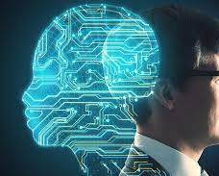
Artificial Intelligence
By Professor Nizar .A.Hamadeh

Slide 2
Artificial Intelligence
What is Artificial Intelligence:
Artificial Intelligence (AI) is a branch of computer science that specializes in designing and programming computer models that simulate the way humans think and react in certain situations.

Slide 3
Artificial Intelligence Methodologies
Systems that think like humans | Systems that think rationally
Systems that act like humans | Systems that act rationally

Slide 4
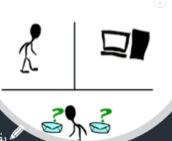
Artificial Intelligence Tests
Turing test
Turing Test applied by the British scientist Alan Turning in 1950
Is the way to measure a machine's ability to demonstrate human-like intelligence.
In the Turing test, a human evaluator engages in a natural language conversation with a machine and a human participant, without knowing which is which in specific time. If the evaluator is unable to distinguish the machine's responses from the human's responses, then the machine is said to have passed the Turing test so we can say we have intelligent system

Slide 5
Eugene Goostman (2014) Chat bot
The chatbot is designed to simulate the conversation of a 13-year-old Ukrainian boy and has been promoted as being able to pass the Turing test.
In 2014, Eugene Goostman participated in a Turing test competition organized by the University of Reading in England. The chatbot was able to convince 33% of judges that it was a human, which was just above the 30% threshold required to pass the test.

Slide 6
CAPTCHA-Test
A CAPTCHA (Completely Automated Public Turing test to tell Computers and Humans Apart) test typically involves presenting the user with a challenge that is easy for humans to solve but difficult for machines
The user may be asked to identify the letters or numbers in a distorted image or to solve a simple math problem. By requiring users to pass a CAPTCHA test, websites can protect themselves from automated bots and prevent spam, fraud, and other types of abuse

Slide 7
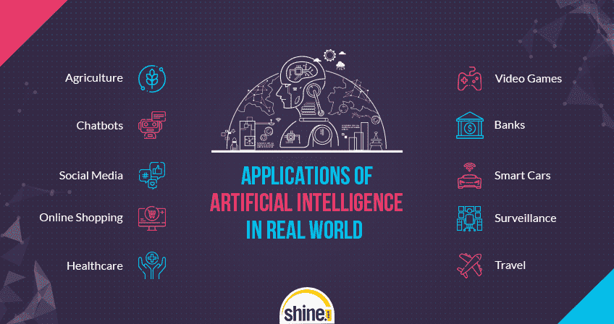
Some AI Fields
• Healthcare: AI algorithms are being used to analyze medical images such as X-rays, CT scans, and MRI scans to help doctors make more accurate diagnoses
• Finance: AI is being used for fraud detection and prevention in banking and financial services. AI algorithms can analyze transactions in real-time to identify suspicious activities, such as fraudulent credit card charges.
• Customer service: AI-powered chatbots and virtual assistants are being used by companies to improve customer service and support. These systems can handle basic customer queries, provide personalized recommendations, and even assist in online shopping.
• Education: AI is being used to personalize learning for students. Adaptive learning algorithms can analyze student performance data to provide personalized recommendations and support.

Slide 8
Intelligent Agents
CHAPTER 2

Slide 9
What is an Agent ?
What is a rational Agent?
Agent Task and environment
Different Classes of Agents

Slide 10
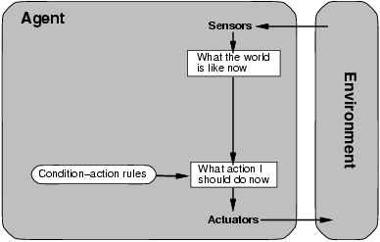
What is and Agent ?
Perceive the environment through sensors Precepts
Act the environment through actuators Actions

Slide 11
We use the term percept to refer to the agent’s perceptual
An agent percept sequence is the complete history for everything that the agent has ever perceived
The agent function maps from percept history to actions [F: P* A]

Slide 12
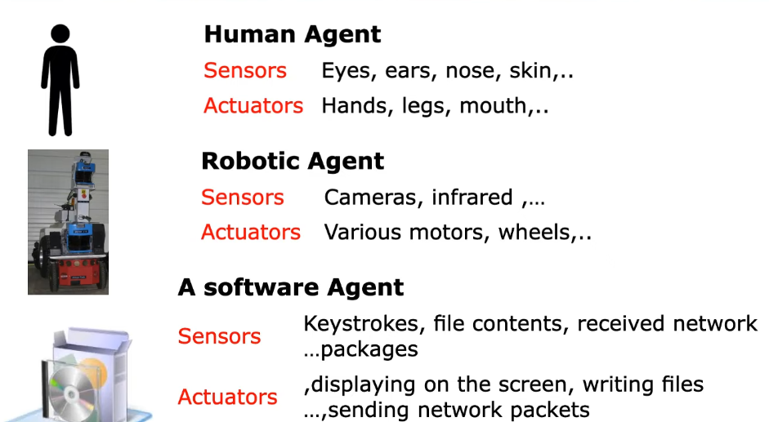
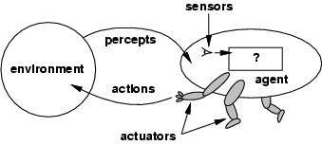
Agent Environment

Slide 13
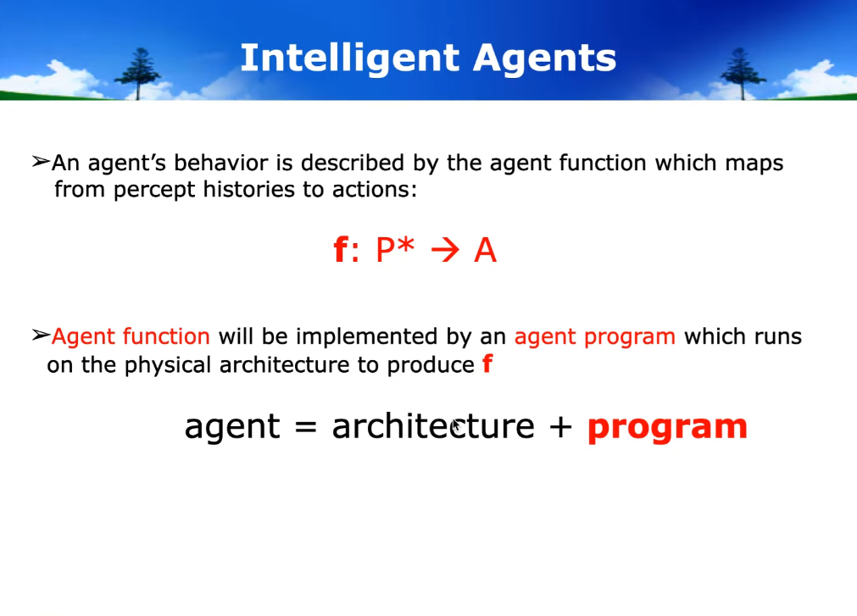

Slide 14
Autonomous Agent
Autonomous Agent has actions based on built in knowledge and experience
Autonomous Agent has initial knowledge that provides an ability to learn
Has ability to adapt in the environment

Slide 15
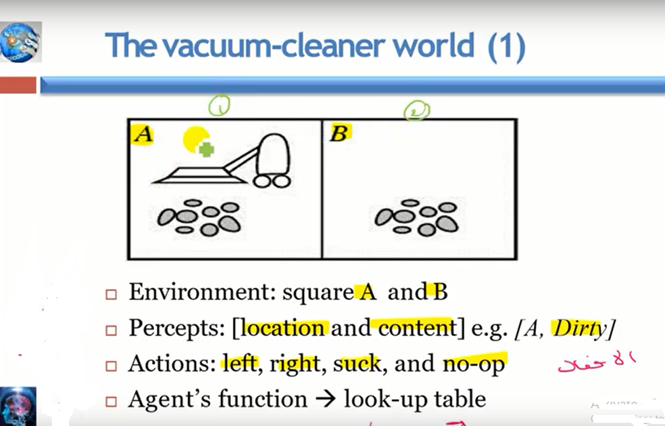
Example :1

Slide 16
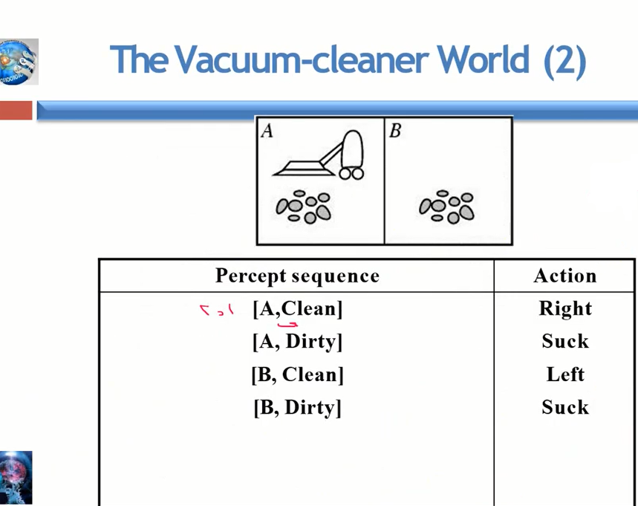

Slide 17
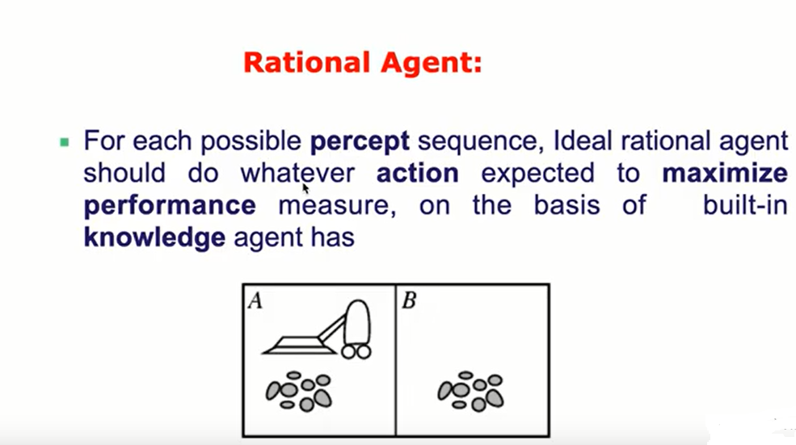

Slide 18
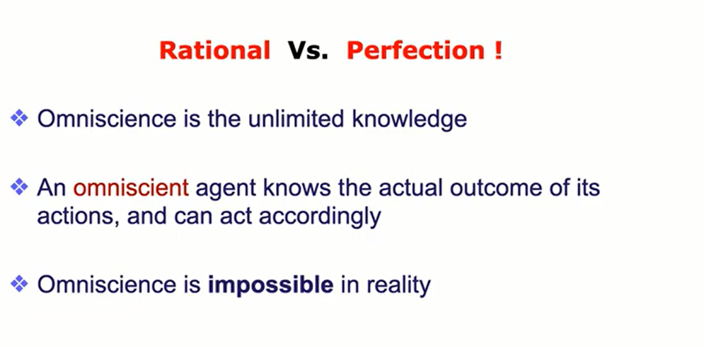

Slide 19
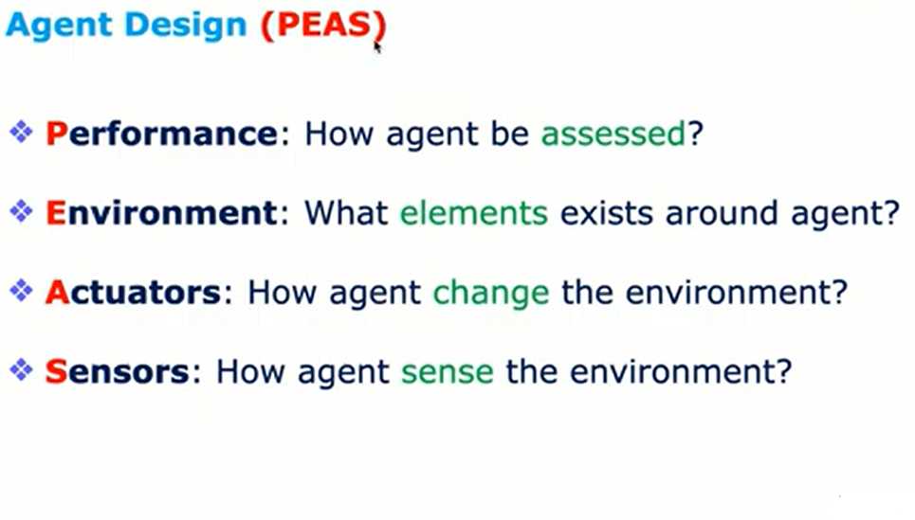

Slide 20
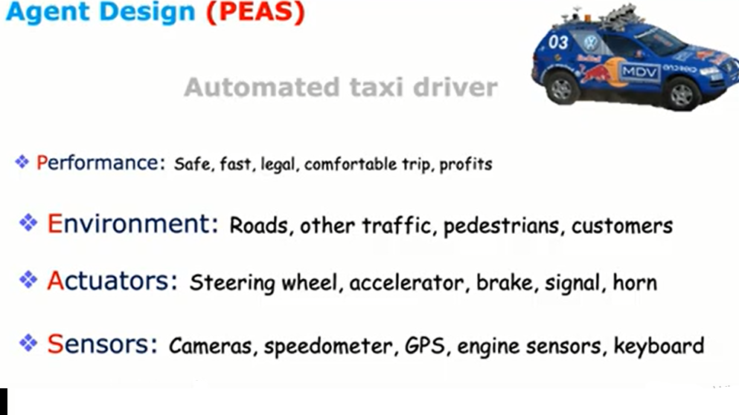








Slide 21
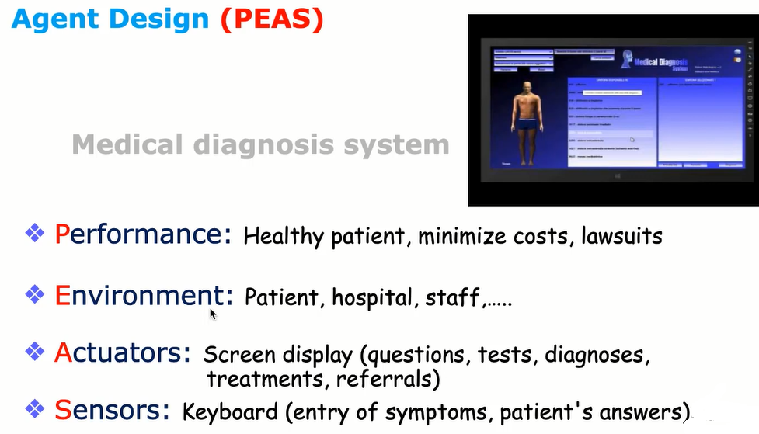


Slide 22
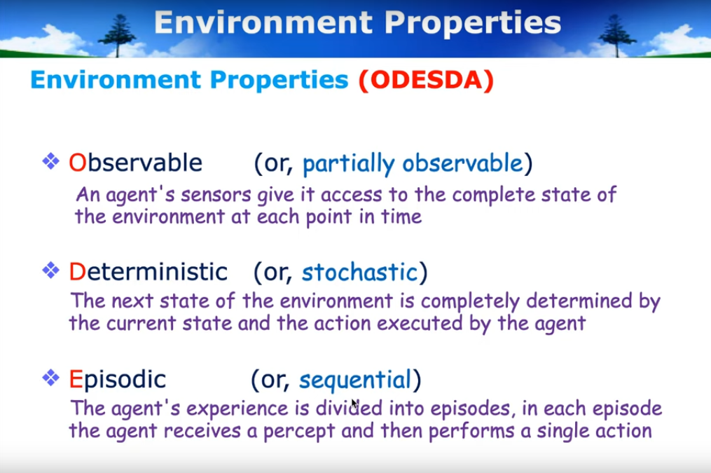

Slide 23
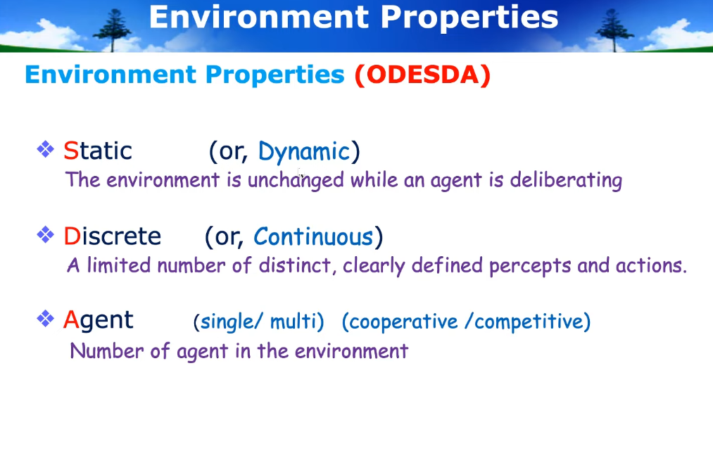

Slide 24
