Slide 1


Chapter 2
Intent

Slide 2
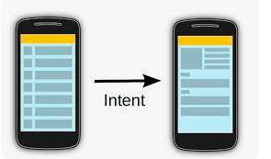
Definition
Android uses Intent for communicating between the components of an Application and also from one application to another application.
Intent are the objects which is used in android for passing the information among Activities in an Application and from one app to another also. Intent are used for communicating between the Application components and it also provides the connectivity between two apps.
Intent facilitate you to redirect your activity to another activity on occurrence of any event. By calling, startActivity() you can perform this task.

Slide 3
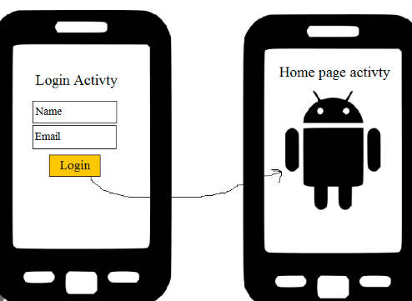
Android intents are mainly used to:
Start the service
Launch an activity
Display a web page
Display a list of contacts
Broadcast a message
Dial a phone call etc.

Slide 4
Intent Uses In Android
Intent for an Activity:
Every screen in Android application represents an activity. To start a new activity you need to pass an Intent object to startActivity() method. This Intent object helps to start a new activity and passing data to the second activity.
Intent for Services:
Services work in background of an Android application and it does not require any user Interface. Intents could be used to start a Service that performs one-time task(for example: Downloading some file) or for starting a Service you need to pass Intent to startService() method.
Intent for Broadcast Receivers:
There are various message that an app receives, these messages are called as Broadcast Receivers. (For example, a broadcast message could be initiated to intimate that the file downloading is completed and ready to use

Slide 5
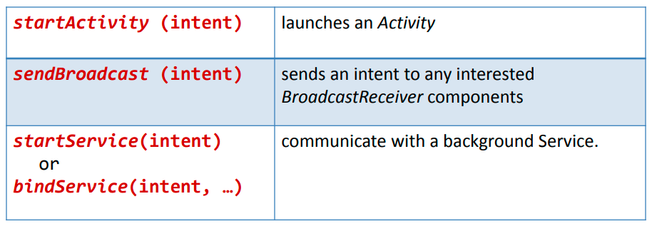
Intents are invoked using the following options:

Slide 6

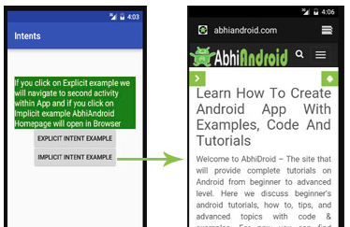
Types Of Intents
There are two types of intents in android: implicit and explicit.
1) Implicit Intent
In Implicit Intents we do need to specify the name of the component. We just specify the Action which has to be performed and further this action is handled by the component of another application.
The basic example of implicit Intent is to open any web page
.

Slide 7
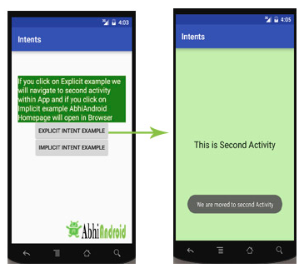
Explicit Intent:
Explicit Intents are used to connect the application internally.
In Explicit we use the name of component which will be affected by Intent. For Example: If we know class name then we can navigate the app from One Activity to another activity using Intent. In the similar way we can start a service to download a file in background process.
public void Class_Add_Btn(View view) { Intent i = newIntent(activity1.this,activity2.class); startActivity(i); }

Slide 8
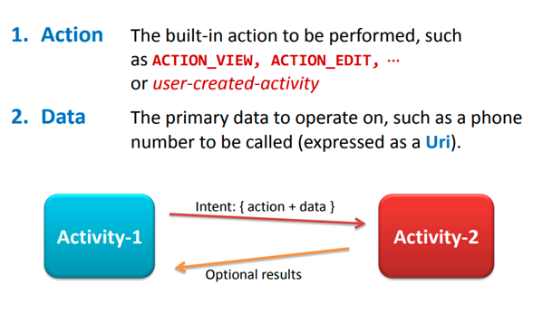
The main arguments of an Intent are:

Slide 9
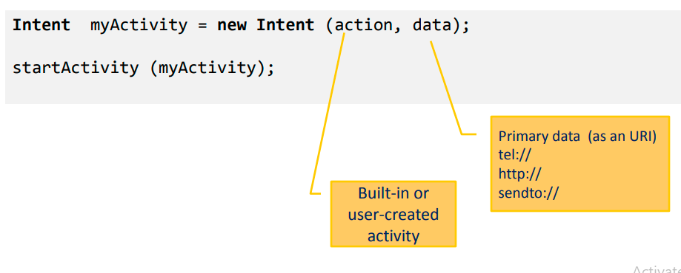
Typically an intent is called as follows:

Slide 10
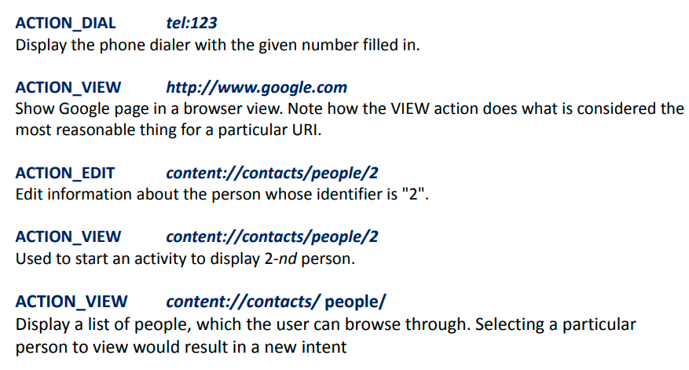
Examples of action/data pairs are:

Slide 11
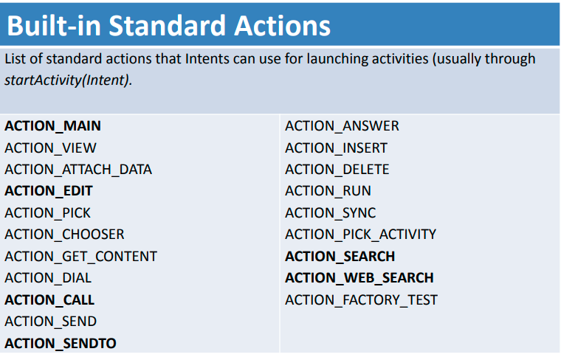

Slide 12
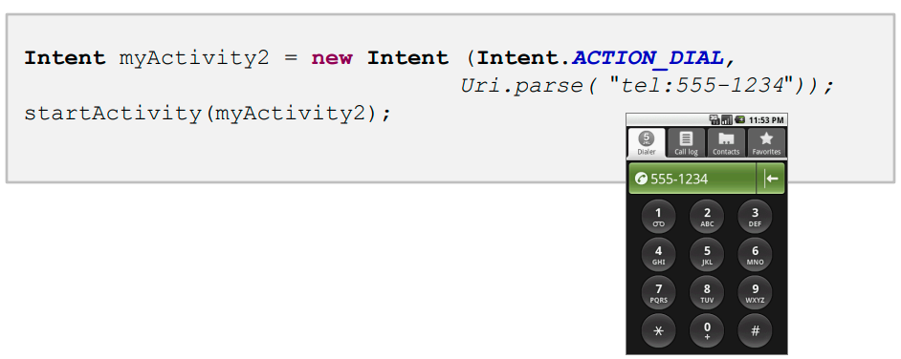
Example:
Display the phone dialer with the given number filled in.

Slide 13
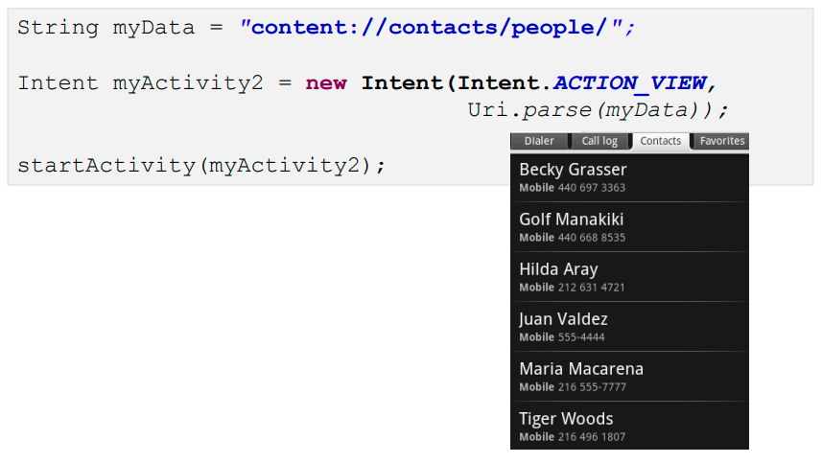
More Examples: Using Standard Actions
Show all your Contacts

Slide 14
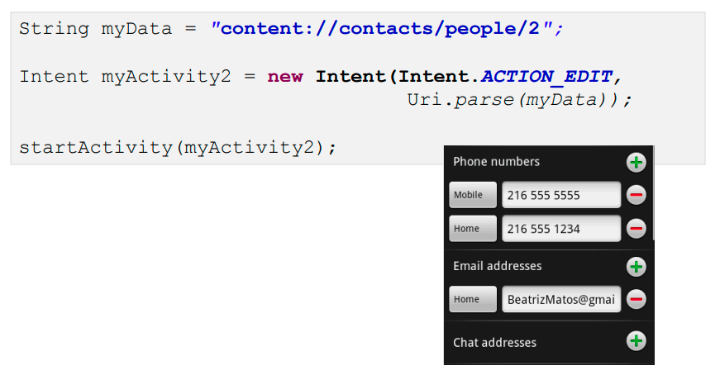
Edit a Particular Contact (ID = 2)

Slide 15
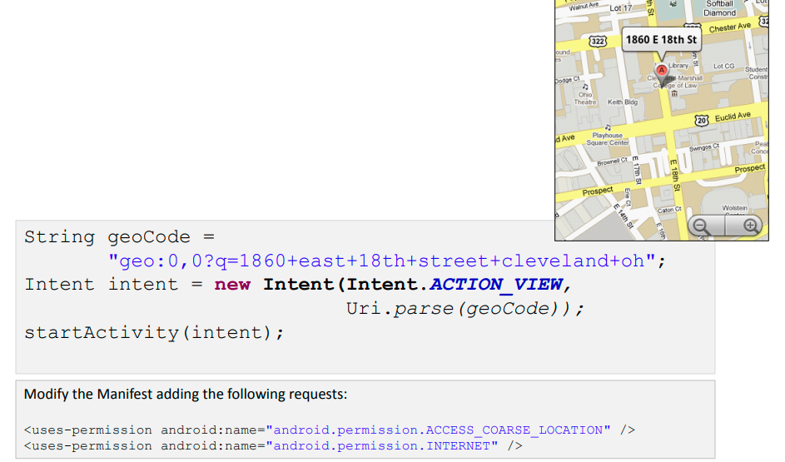
Geo Mapping an Address

Slide 16
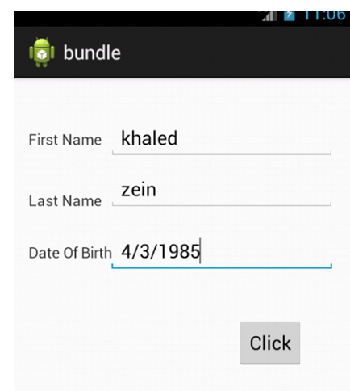
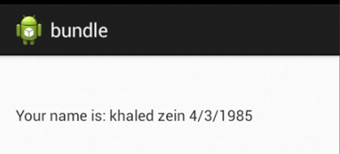
Bundle in Android
It is known that Intents are used in Android to pass to the data from one activity to another. But there is one another way, that can be used to pass the data from one activity to another in a better way and less code space ie by using Bundles in Android. Android Bundles are generally used for passing data from one activity to another.

Slide 17
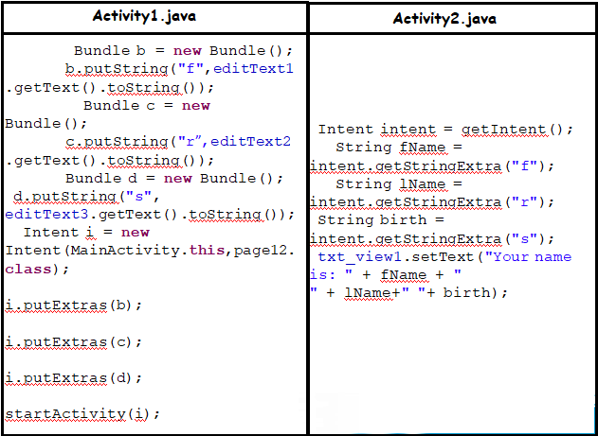
Code:

Slide 18
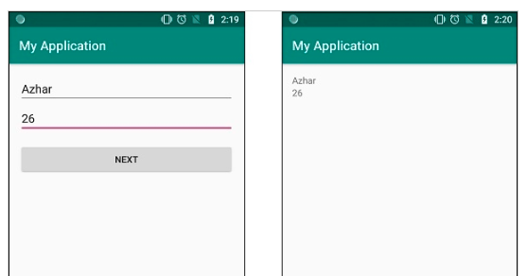
Example:
How to pass multiple data from one activity to another in Android?

Slide 19
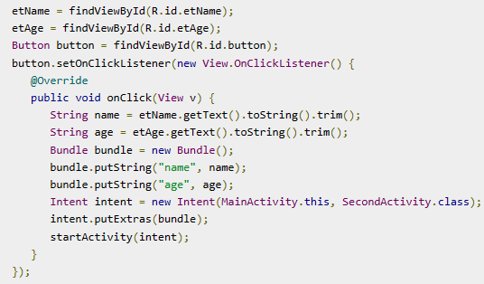
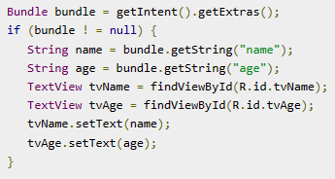
Activity1.java
Activity2.java

Slide 20
Intent Filters
An intent filter is an instance of the IntentFilter class. Intent filters are helpful while using implicit intents, It is not going to handle in java code, we have to set it up in AndroidManifest.xml. Android must know what kind of intent it is launching so intent filters give the information to android about intent and actions.
The intent filter specifies the types of intents that an activity, service, or broadcast receiver can respond.
Before launching intent, android going to do action test, category test and data test.
action - we use this property to define that the activity can perform SEND action.
category - we included the DEFAULT category for this activity to be able to receive implicit intents.
data - the type of data the activity can send.

Slide 21
Intent Filters
<action>
ACTION_VIEW: Use this action in intent with startActivity() when you have some information that activity can show to the user like showing an image in a gallery app or an address to view in a map app
ACTION_SEND: You should use this in intent with startActivity() when you have some data that the user can share through another app, such as an email app or social sharing app.
<category>
CATEGORY_BROWSABLE: The target activity allows itself to be started by a web browser to display data referenced by a link.
<data>
Adds a data specification to an intent filter. The specification can be just a data type, just a URI, or both a data type and a URI.

Slide 22
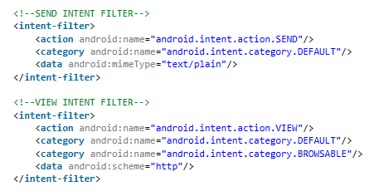
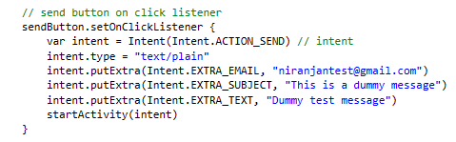
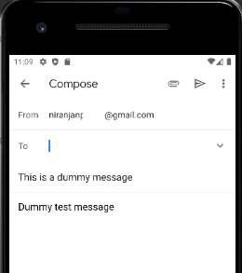
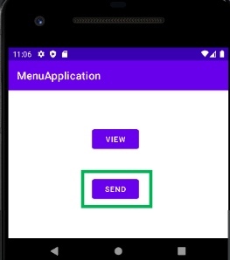
Intent Filters
For example, here's an activity declaration with an intent filter to receive an ACTION_SEND intent when the data type is text:

Slide 23


