Slide 2
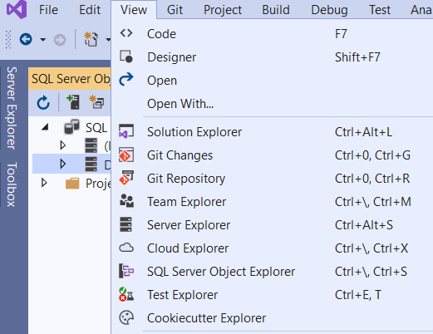
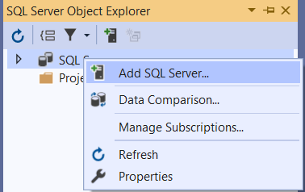

Slide 3
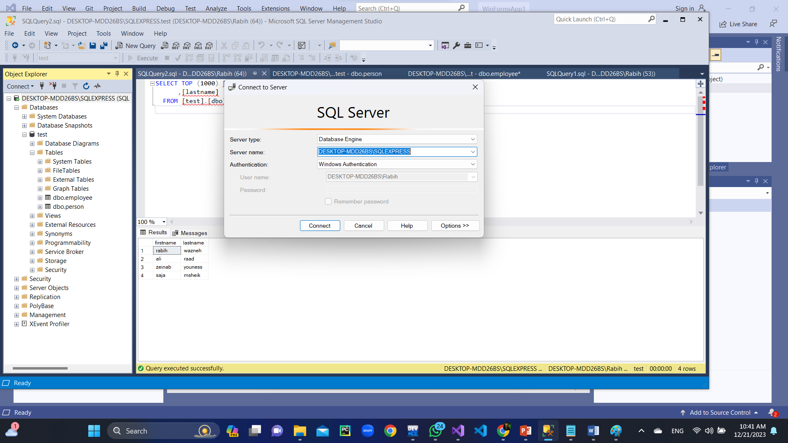

Slide 4
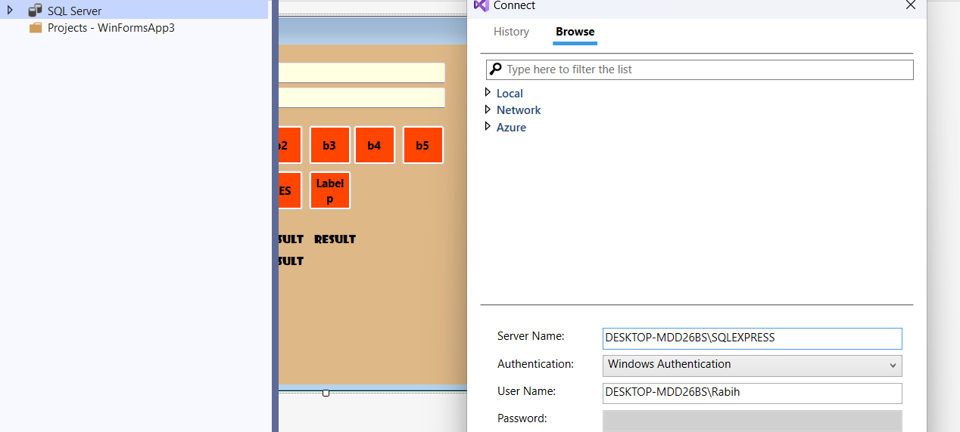
Then press connect

Slide 5
SqlConnection
Represent connection to sql database
SqlCommand
Represent the transact query to be executed in the sql server
SqlDataAdapter adpt;(serves as a bridge between a DataSet and SQL Server for retrieving and saving data.)
DataTable dt (t represents the database tables that provide a collection of rows and columns in grid form);

Slide 6
Connection
SqlConnection con = new SqlConnection("Data Source=DESKTOP-MDD26BS\\SQLEXPRESS;Initial Catalog=test;Integrated Security =True");
SqlCommand cmd;
SqlDataAdapter adpt;
DataTable dt;

Slide 7
selection
Select from a database:
con.Open();
dt = new DataTable();
adpt = new SqlDataAdapter("select * from employee", con);
adpt.Fill( dt);
dataGridView1.DataSource = dt;
con.Close();

Slide 8
Select with condition
con.Open();
adpt = new SqlDataAdapter("select * from person where firstname='" + textBox1.Text + "'", con);
dt = new DataTable();
adpt.Fill(dt);
dataGridView1.DataSource = dt;
con.Close();

Slide 9
Delete
con.Open();
cmd = new SqlCommand("delete from person where firstname='" + textBox1.Text + "'", con);
cmd.ExecuteNonQuery();
con.Close();
display();

Slide 10
Insert
con.Open();
cmd = new SqlCommand("insert into person values ('" + textBox1.Text + "','" + textBox2.Text + "')", con);
cmd.ExecuteNonQuery();
con.Close();
display();

Slide 11
Update
con.Open();
cmd = con.CreateCommand(); (allows you to send query to database)
cmd.CommandType = CommandType.Text;
cmd.CommandText = "update person set firstname='" + textBox2.Text + "'where firstname='" + textBox1.Text + "'";
cmd.ExecuteNonQuery();
con.Close();
display();
display();

