Slide 1
SDA-Pro
Security Incident Response &
Threat Mitigation Platform
Software Design & Architecture — Semester Project
Hassan Zahid (54481) | Malik Hamza Shahid (54523)
Submission: 3rd June 2026

Slide 2
Agenda
01 Executive Summary & Domain Problem
02 System Architecture (SOA, MVC, Layered, Event-Driven)
03 All 12 Design Patterns
04 End-to-End System Flow
05 Architecture Decision Records (ADRs)
06 Live Demo Output
07 Acceptance Criteria Checklist
08 Conclusion
SDA-Pro
Hassan Zahid (54481) | Malik Hamza Shahid (54523)

Slide 3
Executive Summary
What is SDA-Pro?

Slide 4
Executive Summary — SDA-Pro
The Platform
12
7
Distributed SOC (Security Operations Center) platform
Automates threat alert triage & response
Demonstrates all 12 GoF design patterns
Implements 4 architecture styles
Reduces MTTD and MTTR significantly
Design Patterns
Incident States
4
5
Architecture Styles
Response Actions
3
Alert Sources
SDA-Pro
Hassan Zahid (54481) | Malik Hamza Shahid (54523)

Slide 5
Architecture
4 Styles Working Together

Slide 6
4 Architecture Styles in SDA-Pro
SOA
MVC
8 autonomous service packages with defined contracts
SOC Dashboard: Controllers / Models / Views separation
Layered
Event-Driven
Adapter -> Service -> Domain within every service
EventBusPublisher + 4 Observer subscribers; decoupled updates
SDA-Pro
Hassan Zahid (54481) | Malik Hamza Shahid (54523)

Slide 7
SOA Service Map — 8 Services
Alert Ingestion
Threat Intel
Adapter + Factory Method + Singleton
Adapter + Proxy (Caching + RateLimit + AccessControl)
Enrichment & Correlation
Notification
Abstract Factory + Chain of Responsibility
Abstract Factory (Email + Slack + PagerDuty)
Incident Management
Audit
State Pattern (7 states)
Observer consumer — immutable logs
Response Orchestration
SOC Dashboard
Facade + Strategy + Decorator + Proxy
MVC — Controllers, Models, Views
SDA-Pro
Hassan Zahid (54481) | Malik Hamza Shahid (54523)

Slide 8
Design Patterns
All 12 Gang-of-Four Patterns

Slide 9
All 12 Design Patterns — Overview
Creational
Structural
Behavioral
Singleton
Composite
State
Factory Method
Facade
Chain of Resp.
Abstract Factory
Adapter
Observer
Decorator
Strategy
Proxy
SDA-Pro
Hassan Zahid (54481) | Malik Hamza Shahid (54523)

Slide 10
Creational Patterns — Deep Dive
Singleton
IngestionConfigManager, ThreatIntelCache, EventBusPublisher
One shared config, cache, event coordinator — prevents duplicate instances and inconsistent state
Factory Method
AlertNormalizerFactory, ResponseActionFactory
Different alert sources produce different formats; factory selects the right normalizer without client knowing
Abstract Factory
EnrichmentProviderFactory, PremiumEnrichmentFactory, StandardEnrichmentFactory, NotificationFactory
Create families of enrichment handlers (GeoIP+ThreatIntel+Asset) or notifiers (Email+Slack+PagerDuty) as a unit
SDA-Pro
Hassan Zahid (54481) | Malik Hamza Shahid (54523)

Slide 11
Structural Patterns — Deep Dive
Composite
AlertComponent, SingleAlert, AlertCampaign, IncidentCluster
Treat single alerts and multi-alert campaigns uniformly — enables enrichment and response on both without type checks
Facade
IncidentResponseFacade
Hides complex coordination of strategy+factory+decorator+proxy+events behind one assessAndRespond() call
Adapter
SplunkAdapter, FirewallAdapter, CrowdStrikeAdapter, VirusTotalAdapter, MISPAdapter
5 adapters convert 5 incompatible external APIs into SDA-Pro canonical interfaces without changing core logic
Decorator
AuditLogDecorator, ApprovalGateDecorator, RollbackDecorator, MetricsDecorator
Add audit/approval/rollback/metrics to response actions dynamically — chained at runtime without subclassing
Proxy
CachingThreatIntelProxy, RateLimitThreatIntelProxy, AccessControlThreatIntelProxy
Cache expensive API calls, enforce rate limits, validate roles — all transparent to the action/handler client
SDA-Pro
Hassan Zahid (54481) | Malik Hamza Shahid (54523)

Slide 12
Behavioral Patterns — Deep Dive
State
NewState, UnderTriageState, ContainmentState, EradicationState, RecoveryState, PostIncidentReviewState, ClosedState
7 state classes encapsulate state-specific behavior and enforce only legal incident lifecycle transitions
Chain of Resp.
DeduplicationHandler, GeoIPHandler, ThreatIntelHandler, AssetContextHandler, ClassificationHandler
5 enrichment stages chained at runtime — each handler processes and passes to next; pipeline is configurable
Observer
EventBusPublisher, DashboardUpdater, AuditLogger, NotificationDispatcher, MetricsCollector
EventBus publishes domain events; 4 observers react without publisher knowing them — true loose coupling
Strategy
AggressiveContainmentStrategy, BalancedStrategy, ConservativeStrategy, WatchAndWaitStrategy
Response algorithm selected at runtime by severity: CRITICAL=Aggressive, HIGH=Balanced, MEDIUM=Conservative
SDA-Pro
Hassan Zahid (54481) | Malik Hamza Shahid (54523)

Slide 13
End-to-End Flow
From Raw Alert to Closed Incident

Slide 14
End-to-End Flow — 6 Steps
Alert Ingestion
Incident Lifecycle
1
4
Adapter + Factory Method + Singleton
State Pattern (7 states)
Composite Grouping
Response Orchestration
2
5
Composite Pattern
Facade + Strategy + Decorator + Proxy
Enrichment Pipeline
Observer & Dashboard
3
6
Abstract Factory + Chain of Resp. + Proxy + Adapter
Observer + MVC
SDA-Pro
Hassan Zahid (54481) | Malik Hamza Shahid (54523)

Slide 15
Architecture Decision Records
5 Key Decisions Documented

Slide 16
Architecture Decision Records (ADRs)
SOA vs Microservices vs Modular Monolith
ADR-001
Modular SOA in one codebase — clear service boundaries without full microservices overhead
Synchronous vs Asynchronous Communication
ADR-002
Hybrid: sync for core flow, async EventBus for dashboard/audit/notification side effects
Database Strategy
ADR-003
In-memory for prototype; PostgreSQL (incidents/audit) + Redis (cache/sessions) for production
Threat Intel Caching Strategy
ADR-004
Proxy Pattern: CachingProxy + RateLimitProxy + AccessControlProxy chain before adapters
Real-Time Push Strategy
ADR-005
SDA-Pro
Observer-based in-memory event bus; maps to WebSockets/SSE + RabbitMQ/Kafka in production
Hassan Zahid (54481) | Malik Hamza Shahid (54523)

Slide 17
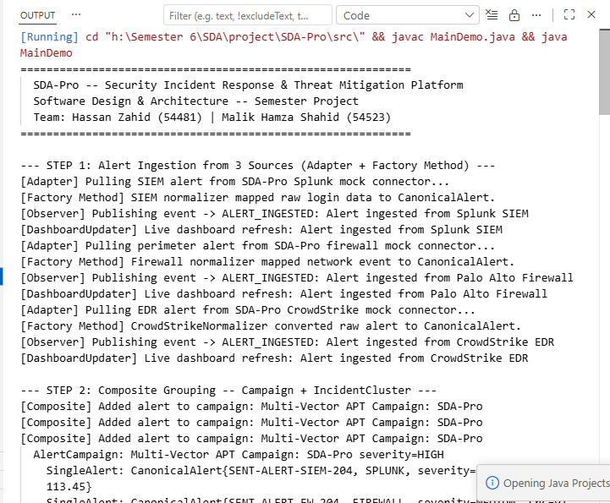
Live Demo Output — MainDemo.java
SDA-Pro
Hassan Zahid (54481) | Malik Hamza Shahid (54523)

Slide 18
Acceptance Criteria — All PASS
PASS
Alerts from 2+ sources ingested and normalized
3 sources (Splunk + Firewall + CrowdStrike)
PASS
Chain of Responsibility — min. 3 handlers
5 handlers implemented
PASS
Composite grouping into Campaigns / Clusters
AlertCampaign + IncidentCluster
PASS
Incidents through all 6 states
7 state classes
PASS
At least 2 response strategies executable
4 strategies (Aggressive/Balanced/Conservative/Watch)
PASS
2+ threat intel adapters via Proxy + Adapter
VirusTotal + MISP behind 3 proxy variants
PASS
All 12 patterns annotated // PATTERN: Name
35 annotations across 96 Java files
PASS
All 4 architecture styles documented
UML + ADRs + directory evidence
SDA-Pro
Hassan Zahid (54481) | Malik Hamza Shahid (54523)

Slide 19
Conclusion
All 12 GoF design patterns implemented naturally from domain requirements
All 4 architecture styles applied with full documentation and evidence
End-to-end pipeline: Alert ingestion -> Enrichment -> Incident -> Response -> Audit
Fully annotated source code (96 Java files, 35 pattern annotations)
Complete docs: UML diagrams, 5 ADRs, API contracts, demo output
Hassan Zahid (54481) | Malik Hamza Shahid (54523)

