Slide 1
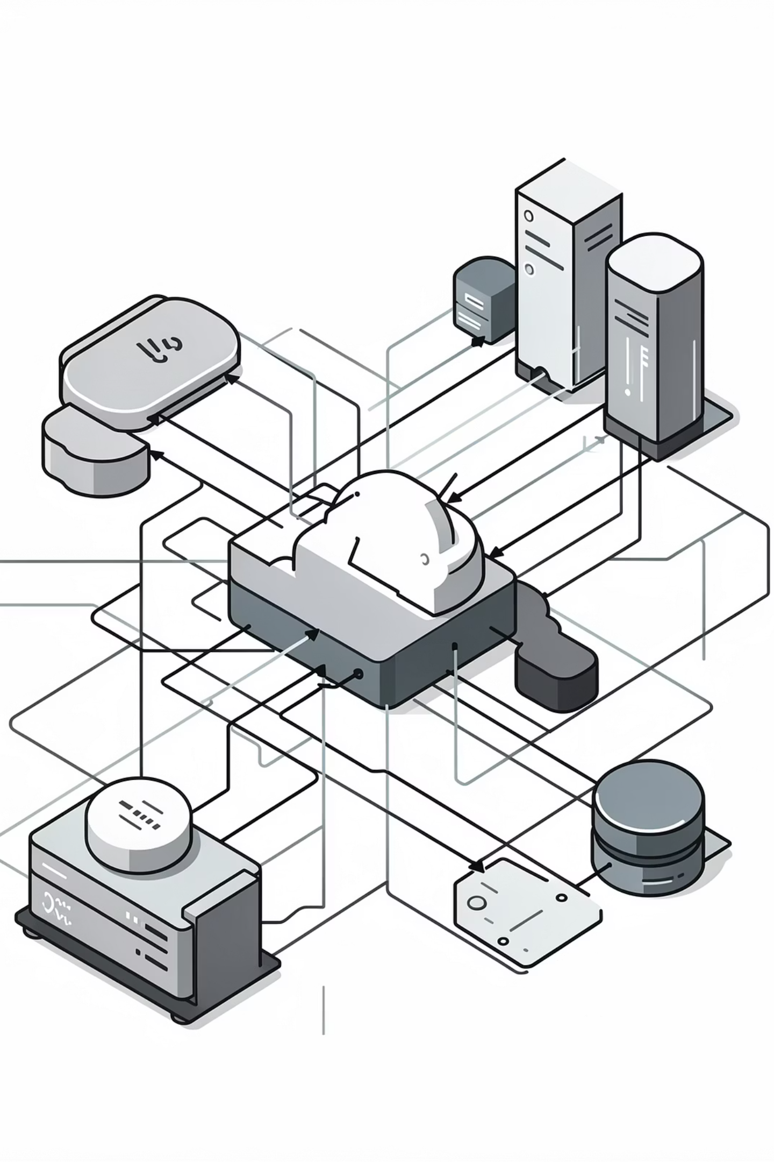
Monthly Progress Checkpoint
Sufi Hassan AsimJanuary 2026
DevOps & Cloud Learning + Project Onboarding

Slide 2

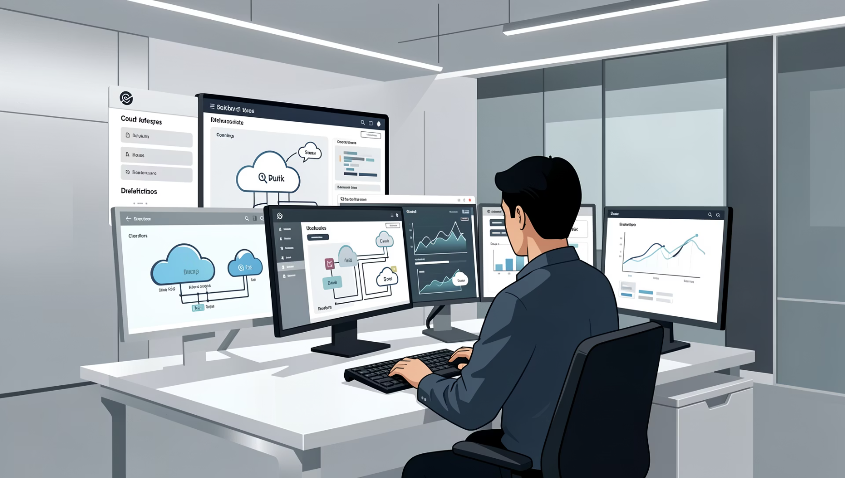
JANUARY OVERVIEW
Month at a Glance
This month marked a significant transition in my DevOps journey, focusing on two critical areas that form the foundation of effective cloud operations.
By month's end, I successfully transitioned from training environments into understanding and actively supporting production systems.
Cloud & DevOps Fundamentals
Real Project Onboarding
Building strong technical foundation through AWS and automation
Transitioning from training to live company systems

Slide 3
WEEK 1
JAN 1 – JAN 7
Cloud Foundations & Certifications
Key Outcome
AWS Core Concepts
Hands-On Deployment
Established a robust technical foundation essential for understanding and managing real-world infrastructure environments.
Mastered fundamental cloud architecture principles and AWS service ecosystem
Practiced deploying websites on AWS, gaining practical infrastructure experience
Technical Courses
Linux & CLI Mastery
Completed multiple certification-track courses covering cloud best practices
Strengthened command-line proficiency for cloud operations

Slide 4
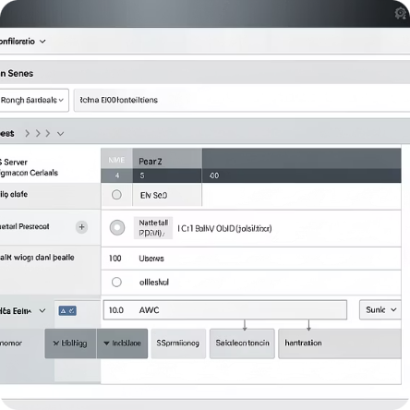
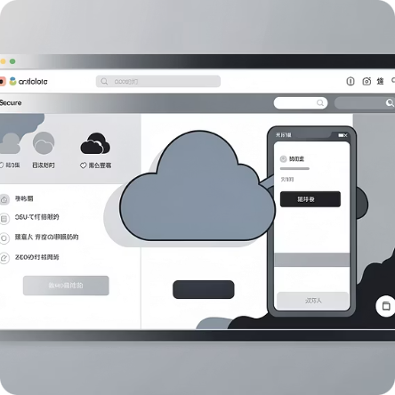
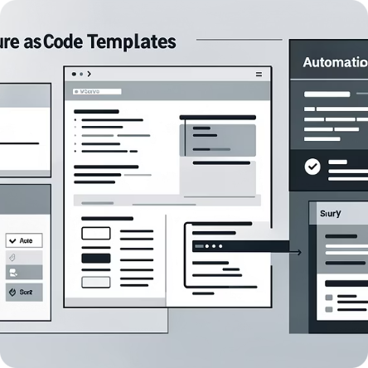
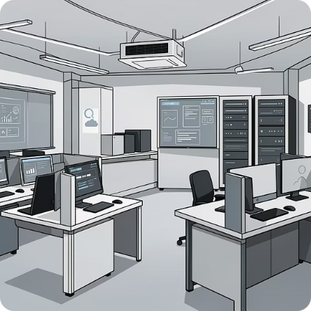

WEEK 2
JAN 8 – JAN 14
Servers, Automation & Secure Access
EC2 Server Management
AWS Systems Manager
Infrastructure Templates
Practical AWS Labs
Learned secure remote access protocols for production environments
Completed multiple lab exercises reinforcing cloud concepts
Gained hands-on experience configuring and managing cloud servers
Practiced automated infrastructure setup using IaC principles
Key Outcome: Developed confidence working directly with servers and navigating complex cloud environments.

Slide 5


WEEK 3
JAN 15 – JAN 21
CI/CD & Real Architecture Exposure
Learning Focus
01
Deployment Pipelines
Learned how automated CI/CD workflows streamline software delivery
Git Repo
02
Git to Cloud Flow
Understood version control integration with cloud deployment processes
Build & Test
03
Deploy to Cloud
Modern Architecture
Studied three-tier architecture: frontend, backend, and database layers
Monitor & Validate
04
Production Setups
Began working with production-grade configurations and environments
Key Outcome: Clear understanding of how modern applications are built, tested, and deployed in cloud environments.

Slide 6
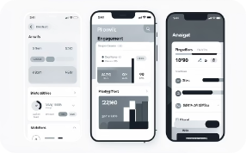
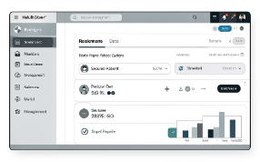
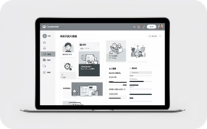


MAJOR MILESTONE
WEEK 4
JAN 22 – JAN 29
Real Project Onboarding & Support
This week represented a pivotal transition: moving from training environments into active company projects. I was officially onboarded to three production systems, and assigned the 4th project access just 1 day ago, gaining access to their infrastructure and beginning the process of understanding their architectures.
NGAGE
TBS Health
Sindh Ombudsman CMS
Novavia
Reviewed system architecture and deployment workflows
Gained access to production environment and began understanding health tech infrastructure
Assigned to design and deploy a secret stack for infrastructure
Familiarized with government system requirements and compliance standards
Key Outcome: Now familiar with real project structures, deployment processes, and production environment operations.

Slide 7
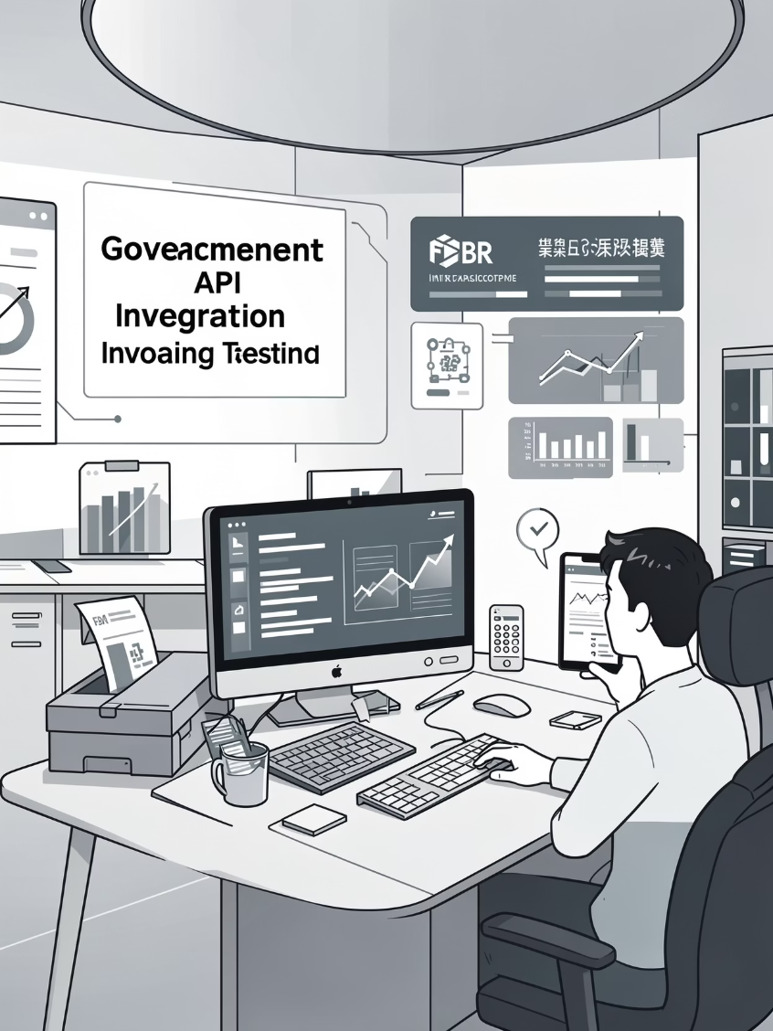

FEATURED WORK
FBR Digital Invoicing Integration
Contributed to a critical government API integration project for the Federal Board of Revenue's digital invoicing system. This work required precision and attention to official compliance standards.
My Contributions
Result: Integration testing completed successfully.
Studied official FBR technical documentation and API specifications thoroughly
Performed comprehensive API testing in sandbox environment
Successfully generated multiple valid test invoices meeting FBR standards
Assisted in the process of obtaining production access token approval

Slide 8
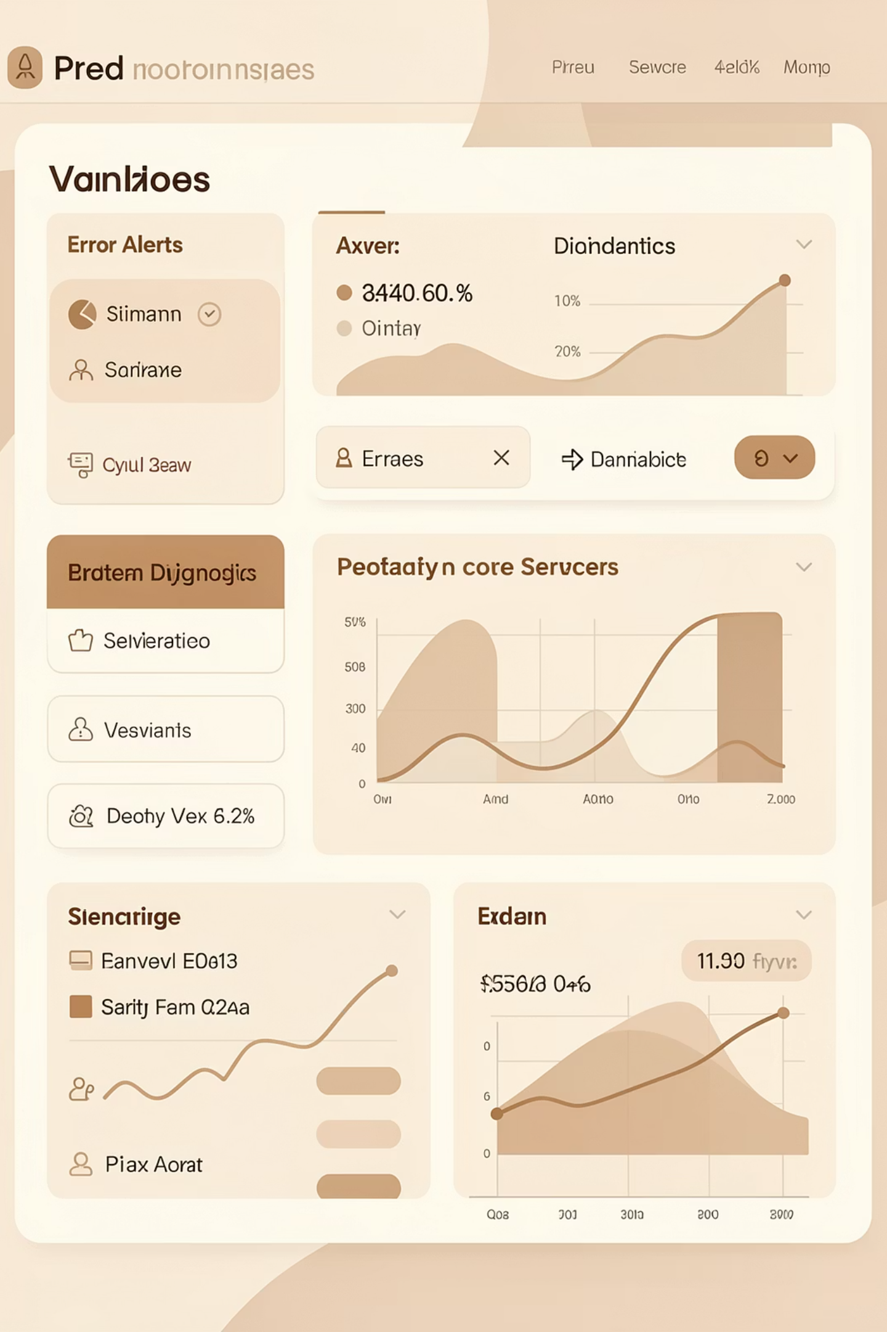
PRODUCTION ISSUE
Production Investigation: TBS Health
Gained valuable exposure to real-world production troubleshooting when the TBS Health application encountered performance issues in the live environment.
Key Outcome
Problem Identification
1
Application returned "Too Many Requests (429)" errors to users
This experience provided invaluable insight into how production systems are analyzed, diagnosed, and troubleshooted under real-world conditions. Understanding the relationship between application architecture and performance limitations is crucial for effective DevOps support.
Investigation
2
Helped analyze system behavior and identify potential bottlenecks
Analysis
3
Reviewed application logs and database connection pool usage patterns
Learning
4
Understood how backend resource limits and database connections affect performance

Slide 9
IMPLEMENTATION PLAN
NOVAAI PROJECT
Firebase Private Key Secret Management
Implementing a secure and automated solution for managing sensitive Firebase private keys within AWS.
Define Secrets Stack (CDK)
Integrate Secrets Stack
Grant App Permissions
Create a dedicated CDK stack for the Firebase private key secret.
Update CDK app entry to include the new Secrets Stack.
Update App Service Stack to accept secret name and grant read access.
Deploy & Set Secret Value
Update App Service Code
Deploy CDK, then populate the secret via AWS Secrets Manager console.
Modify application code to fetch the secret at runtime using AWS SDK.
Current Status: CDK stacks are created in the CI/CD repository. Next steps involve deployment and testing with real secret values in AWS Secrets Manager.

Slide 10
Skills Developed This Month
January marked substantial growth across both technical capabilities and professional competencies, establishing a foundation for effective DevOps operations.
Technical Growth
Professional Growth
AWS Cloud Environments
System Analysis
Team Collaboration
Deeper understanding of cloud architecture, services, and infrastructure management
Reading and understanding existing architectures and codebases effectively
Working alongside team members on active, production-level projects
Server & Deployment
Improved knowledge of server configuration, deployment processes, and automation
Technical Communication
Adaptability
Clearly documenting and communicating technical findings and progress
Quickly adjusting to new project environments and technical requirements
CI/CD Pipelines
Practical understanding of how pipelines work in real production projects
API Integration
Hands-on experience testing and validating government API integrations

Slide 11
MOVING FORWARD
Current Status & Next Focus
Current Status
Next Focus Areas
01
4 Active Projects
Systems Learning
Deployment Contributions
Successfully onboarded to NGAGE, TBS Health Novavia, and Sindh Ombudsman CMS
Actively studying each project's architecture and operational requirements
Take more active role in deployments and environment management
02
Contributing Support
Project-Specific DevOps
Providing assistance wherever possible while building deeper expertise
Master each project's unique DevOps processes and workflows
03
Increased Responsibility
Progressively own more DevOps tasks as understanding deepens

