Slide 1
M/M/1/M : FINITE CUSTOMER POPULATION
Prepared by:
Malak Mansour Ibrahim 20230418
Ganna Mohamed Ibrahim 20221044
Hassan Abdullah Hassan 20230123
Rahma Salah Eldiin 20230137
Mostafa Mohamed Amer 20201168

Slide 2
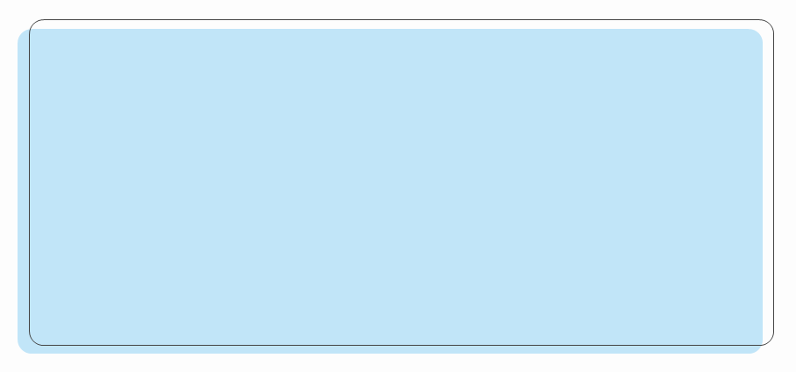
Birth-death Model and the coefficient
This is known as the finite-source model or machine repair model.
In traditional queuing models, customer population is assumed infinite But in this model, the system contains a finite number of users denoted by M.
A user is either:
Inside the system (queue or server)
Outside the system and in the process of arriving.
The arrival process is no longer a traditional Poisson process but rather have:
Exponential interarrival times mean (M − n)λ
Exponential service times mean μ
All users act independently.

Slide 3
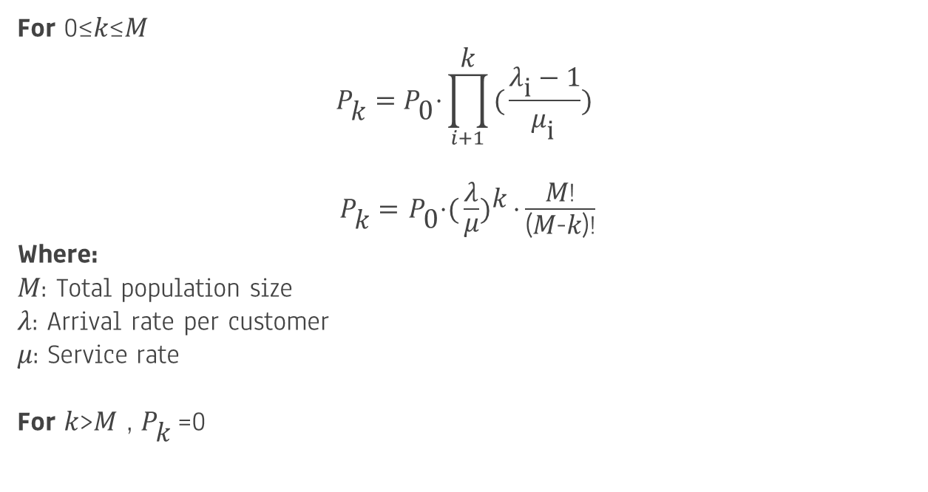
Steady-State Probabilities (Pₖ ,P₀)
For 0≤𝑘≤𝑀
$${\text{P}}_{\text{k}}^{}={\text{P}}_{\text{0}}^{}\text{⋅}\prod_{i+1}^{\text{k}}{{({\frac{{\text{λ}}_{\text{i}}^{}−1}{{\text{μ}}_{\text{i} }^{}}})}^{ }}$$
${\text{P}}_{\text{k}}^{}=$ ${\text{P}}_{\text{0}}^{}$⋅${({\frac{\text{λ}}{\text{μ}}})}^{\text{k}}\text{⋅}{\frac{\text{M}\text{!}}{\text{(}\text{M}\text{−}\text{k}\text{)!}}}$
Where:
𝑀: Total population size
𝜆: Arrival rate per customer
𝜇: Service rate
For 𝑘>𝑀 , ${\text{P}}_{\text{k}}^{}$=0

Slide 4

Steady-State Probabilities (Pₖ ,P₀)
For 0≤𝑘≤𝑀
$${\text{P}}_{0 }^{}={\left[\sum_{k=0}^{\text{M}}{{({\frac{\text{λ}}{\text{μ}}})}^{\text{k}}\text{⋅}{\frac{\text{M}\text{!}}{\text{(}\text{M}\text{−}\text{k}\text{)!}}}}\right]}^{−1}$$
Where:
𝑀: Total population size
𝜆: Arrival rate per customer
𝜇: service rate

Slide 5
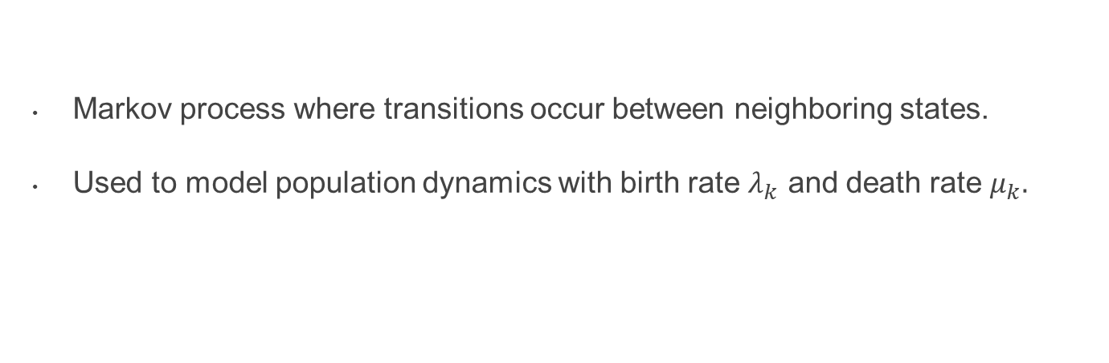
Birth-death PROCESS For single-server finite
Markov process where transitions occur between neighboring states.
Used to model population dynamics with birth rate $λ_{k}$ and death rate $μ_{k}.$

Slide 6
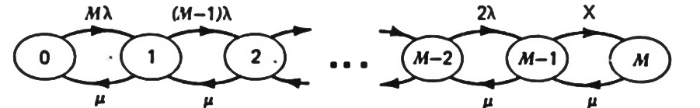
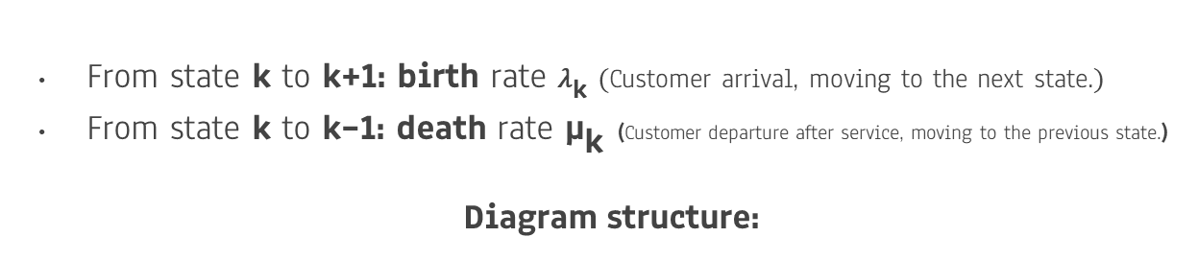
Birth-death DIAGRAM For single-server finite
From state k to k+1: birth rate ${\text{λ}}_{\text{k}}^{} (\text{Customer} \text{arrival}\text{, }\text{moving} \text{to} \text{the} \text{next} \text{state}\text{.})$
From state k to k−1: death rate ${\text{μ}}_{\text{k}}^{}$​(Customer departure after service, moving to the previous state.)
Diagram structure:
It models system evolution over time.

Slide 7

Performance Measures
Key Measures:
P0 = Probability that there are no customers in the system.
Pn = Probability that there are n customers in the system.
L = Average number of customers in the system.
Lq = Average number of customers in the queue.
W = Average time a customer spends in the system.
Wq = Average time a customer spends in the queue.
λ_eff = effective arrival rate
Pw = Probability that all servers are busy .
p = Utilization rate of each server (the percentage of time that each server is busy).

Slide 8
P₀ = 1 / [ Σ(M!/(M-n)!) (λ/μ)^n ]
Pₙ = (M!/(M-n)!) (λ/μ)^n P₀ , for n = 1, 2, ..., M
L = Σ n Pₙ
L_q = Σ_{n=1}^{M} (n-1) Pₙ
λ_eff = λ (M - L)
W = L / λ_eff
W_q = L_q / λ_eff

