Slide 1
Library Management System
By: Ammar Amin 20104536, Hassan Mikawi 20104451 and Omar Mohamed Anwar 20104420
To: Dr. Ashraf Tammam and TA Dalia Refaat

Slide 2
Scenario
The project aims to create a user-friendly library management system accessible to both library customers and staff for their respective needs. This includes functionalities such as staff members adding new books to the library database and customers borrowing books. The development process begins by identifying the necessary entities for the system.

Slide 3
Entities
Author: authorID, name
Book: ISBN, title
Staff: staffID, name
Member: memberID, name
Borrow: borrowID, dueDate

Slide 4
Now that we know what entities we need, we will design an ER diagram to illustrate the different relationships between our used entities.
For instance, a Book is written by its Author and a Member borrows a book.
The ER diagram below shows these relationships and more

Slide 5


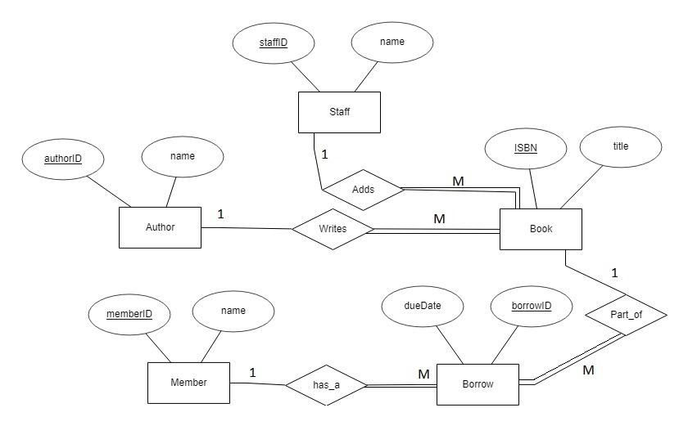

ERD
It contains relationships and participation constraints, which will be explained on the next slide

Slide 6
Relationships
Adds (one to many): a staff member can add many books. He doesn’t have to, though. However, is a book is added, it must be added by a staff member, not anyone else, which explains the total participation from one side.
Writes (one to many): very similar to the above relationship. An author writes many books, and a book must be written by an author.
Has_a (one to many): A member (or customer) can have many borrows and of course, a borrow must include a member in it.
Part_of (one to many): a book can be part of many borrows, and a borrow must have a book in it.

Slide 7

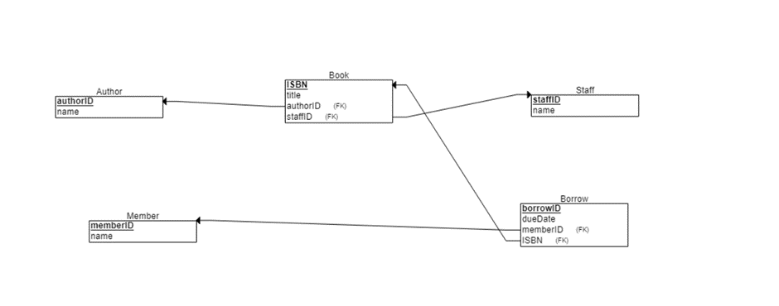
Relational schema before Normalization
No relationships are added yet

Slide 8
Relational schema after Normalization
After normalization we relizated that we don’t need normalization
As all enities in boyce-codd form

Slide 9
After coding the SQL (shown in the document), a brief summary of the GUI will be shown on the next few slides.

Slide 10

Library System Gui

Slide 11
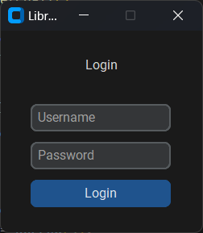
Login window
Check Login
Opens Staff window if found in database
Opens Member window if found in database

Slide 12
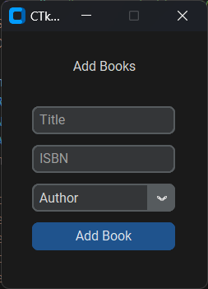
Staff window
Staff Enters The Book title and its ISBN
Staff chooses the author from the combobox who is currently entered in the database
Clicking Add Book adds the book to the database

Slide 13
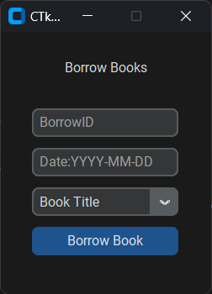
Member window
Member Enters BorrowID and the DueDate
Member Chooses the Book they want to borrow
Clicking the Borrow Book button adds the borrow record to the database and removes it from the borrow selection

