Slide 1
Unsupervised domain adaptation for device-free human activity recognition
By
Muhammad Hassan

Slide 2
What is Device Free Sensing?
Device-Free sensing, a method of carrying information about users’ behavior using commercially available WiFi devices, is gaining popularity among traditional approaches due to certain reasons.
It is a contact less sensing strategy with no need to fit any sensing equipment on the target, thus privacy is reserved.
CSI streams are available all the time as long as WiFi devices are there in the vicinity of an AP and there is no any constraints for lightening around the area or LOS requirements.

Slide 3
Received Signal Strength Indicator
Received signal strength indicator (RSSI) measures the signal power on the receiver side and associates it with the distance either from the reflected object or the transmitter. This signal strength is susceptible to multi-path fading.

Slide 4
Problem with RSSI
The major drawback with RSSI data is less reliability on individual AP-MP pairs for detecting an activity. Sometimes AP-MP pairs only show a silence period during an ongoing activity with not much fluctuation in RSSI data.
M. Youssef, M. Mah, and A. Agrawala. Challenges: device-free passive localization for wireless environments. In Proceedings of the 13th annual ACM international conference on Mobile computing and networking, pages 222–229, 2007.

Slide 5
Channel State Information
Multiple Input Multiple Output (MIMO) in WiFi devices can lead to diverse and rich data about how signals carry information about a surrounding environment, which refers to CSI.
Modern WiFi devices with IEEE 802.11 n/ac standards utilize Orthogonal Frequency Division Multiplexing (OFDM) with MIMO systems.

Slide 6
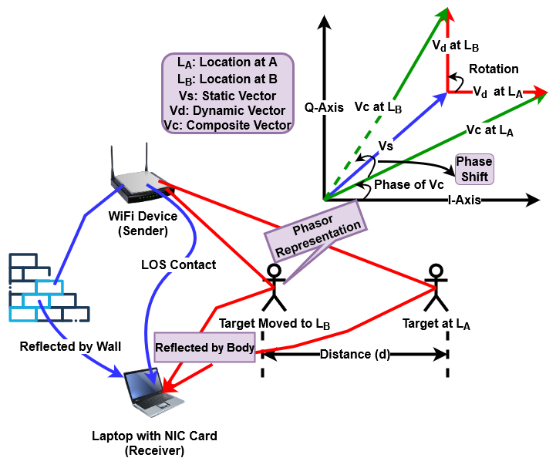

Slide 7
Preprocessing Steps
CSI magnitude values are being passed to a low pass filter to mitigate effect of noise as high spikes.
All the values are then being normalized to a scale of 255.
These normalized values consisting of columns as sub-carriers and rows as data features are being converted in an intensity image using imagesc in MATLAB.
Each image is being transformed into a 64 * 64 pixels.

Slide 8
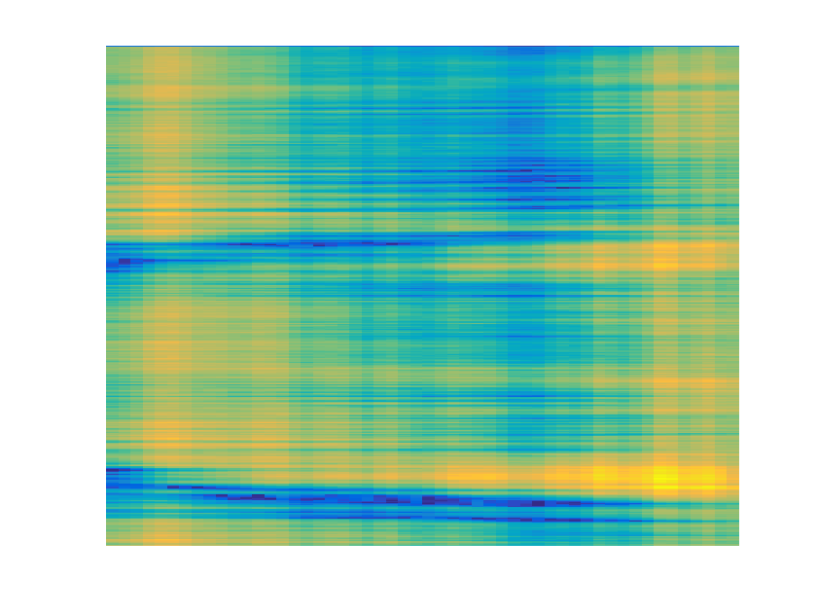
CSI generated image for activity walking by subject 1.
P. Fard Moshiri, R. Shahbazian, M. Nabati, and S. A. Ghorashi. A csi-based human activity recognition using deep learning. Sensors, 21(21):7225, 2021

Slide 9
Public Dataset Details
Dataset used in model simulation is publicly available at link below.
There are 52 subcarriers of CSI magnitudes, 20 trials taken for each experiment by 3 different subjects for 7 different activities.
P. Fard Moshiri, R. Shahbazian, M. Nabati, and S. A. Ghorashi. A csi-based human activity recognition using deep learning. Sensors, 21(21):7225, 2021

Slide 10
Problem Statement
The field of human activity recognition is concerned about the model performance in cross-domain conditions. Models proposed by the researchers in past performed well when they were tested on the same subject and environment used for model training. Unfortunately, their performance suffers from acute degradation due to three main causes.

Slide 11
Research Objectives
Cross-User (testing on different subjects)
Cross-Environment (testing on different environments)
A combination of both cross-user and cross-environment.

Slide 12
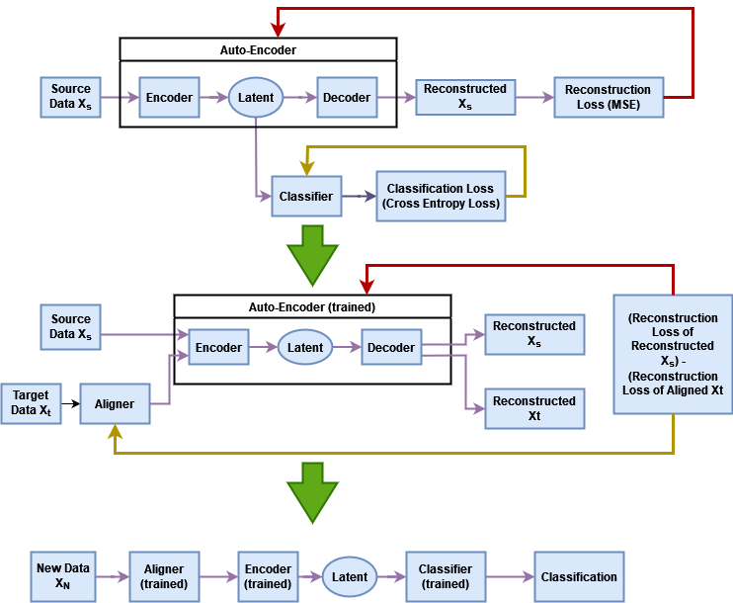
Proposed Model
Farshchian, Ali, et al. "Adversarial domain adaptation for stable brain-machine interfaces." arXiv preprint arXiv:1810.00045 (2018).

Slide 13
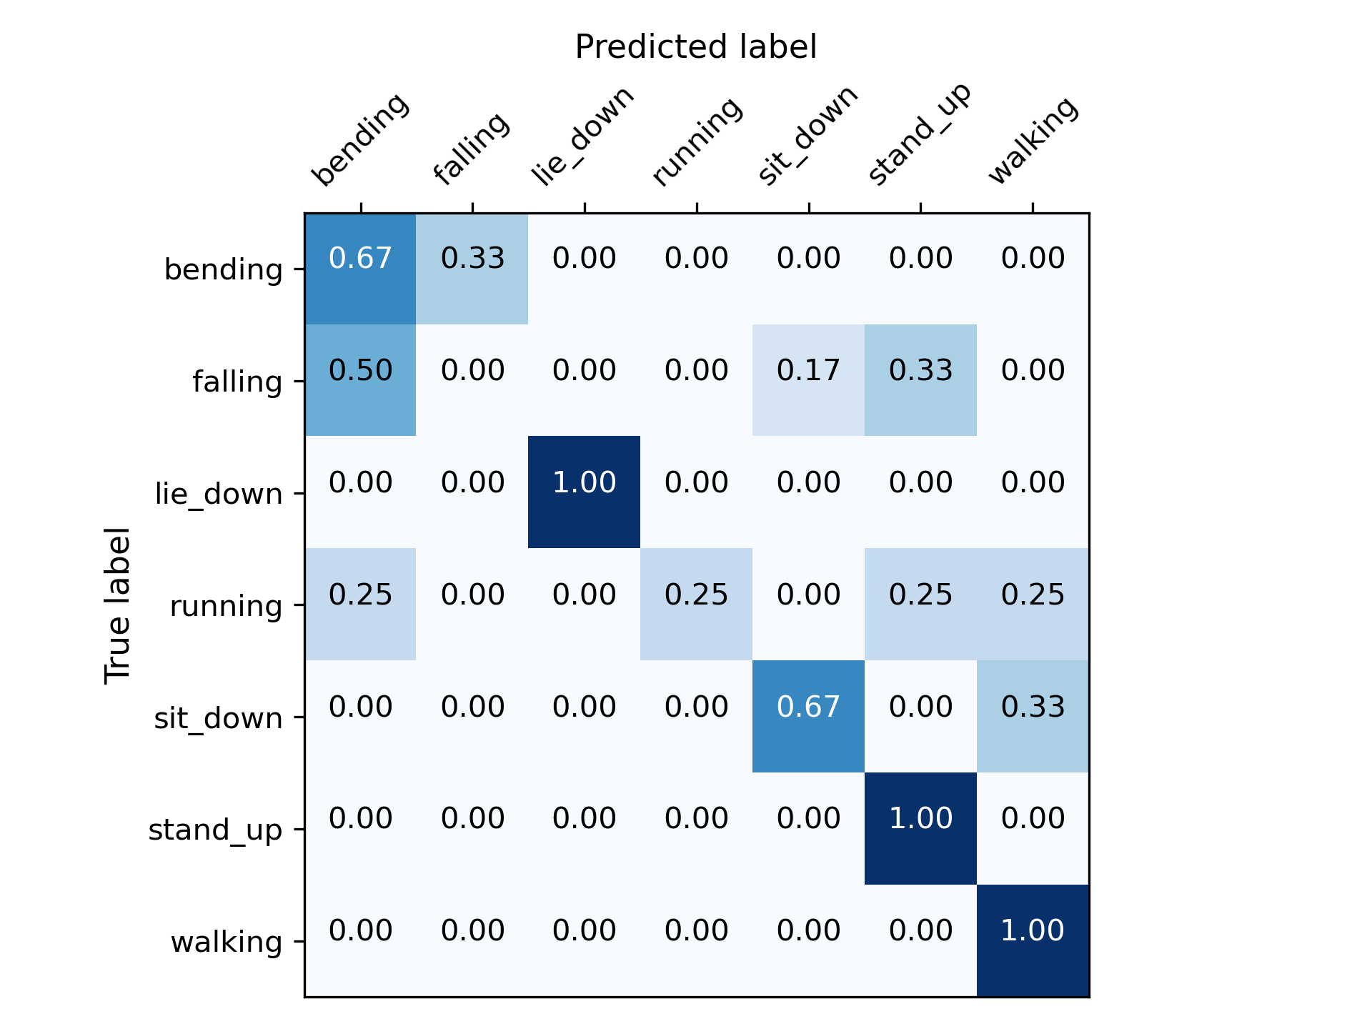
Simulation Results
Model average recognition accuracy for non-aligned configuration using subject 2 and 3 as source domain and subject 1 as target domain is 59.3%.

Slide 14
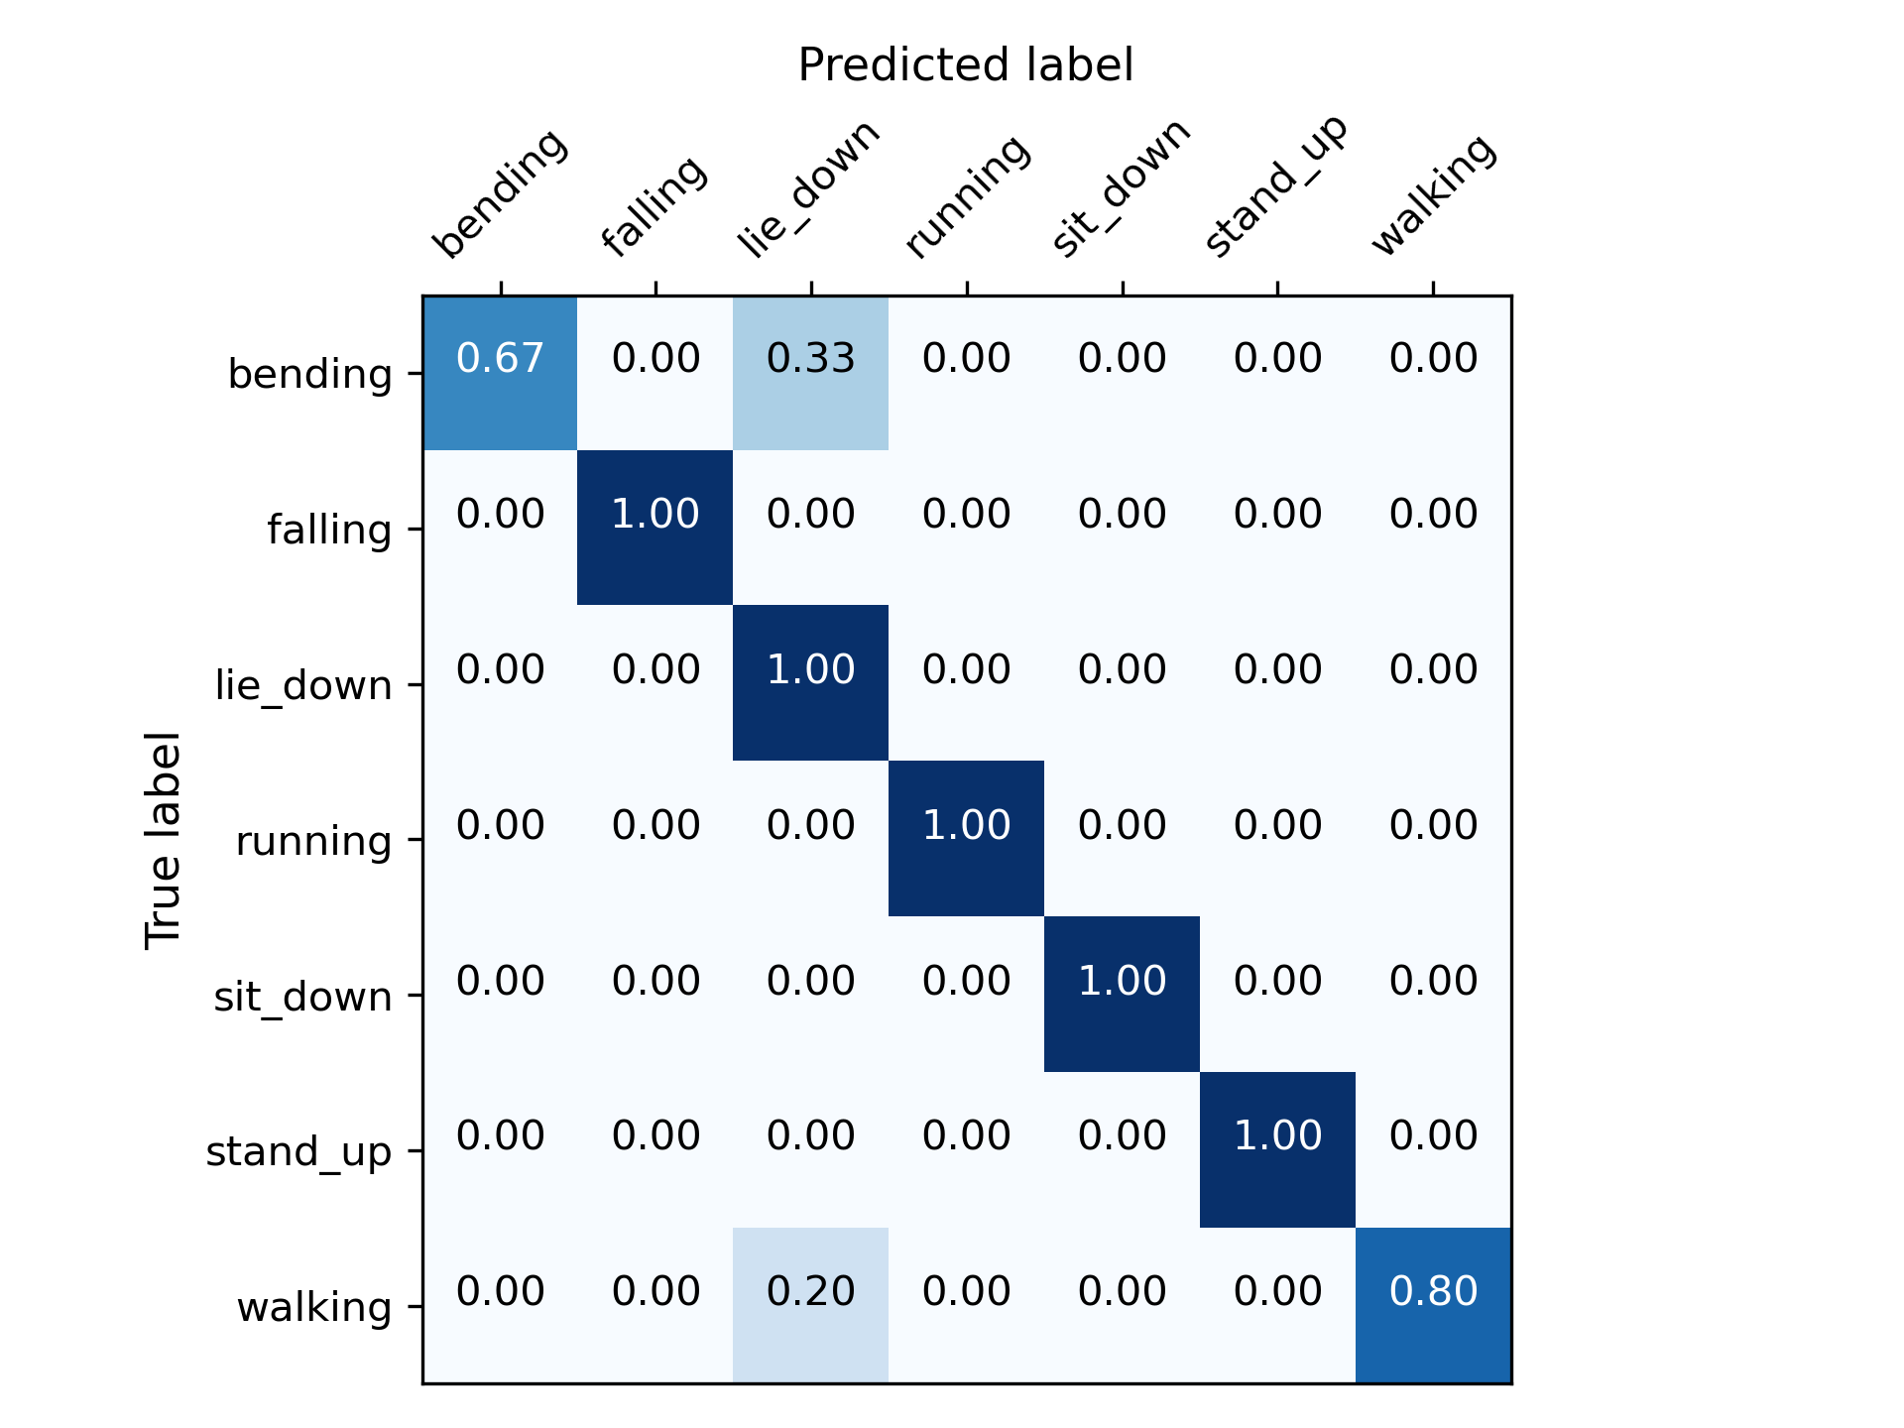
Simulation Results
Model average recognition accuracy for aligned configuration using subject 2 and 3 as source domain and subject 1 as target domain is 93.1%.

Slide 15
Conclusion
We have shown our alignment technique can robustly match the source to target domain and significantly improve recognition accuracy in cross-user conditions.
Model average simulation time for 9 different cross-user conditions is 2.66 minutes which shows that it's a lightweight model with simple model configuration.
We evaluate the model performance on different training target data percentages ranging from 100% to 5% in order to analyze model's reliability on minimum training target data samples.

