Slide 1


Interlinked Dynamics: Exploring the Correlations between Surface Temperature, Atmospheric CO2, Sea Level Rise, and Land Cover Changes
Prof. Georg Schwarz
Prof. Philip Heltweg
Professorship for open-source software
MADE Final Presentation
Hassan Ahmed - 23069970

Slide 2
Table of Contents
Introduction
Overview of the Project
Research Focus
Data Pipeline Module
Data Exploration Module
Analysis
Conclusion
References
Deployment: CI (Tests & Code Quality Checks)
Challenges
Data Sources, Structure and Quality
Documentation

Slide 3

Introduction
Climate Change is a critical issue affecting various environmental contexts
Rising global temperatures and shifting precipitation patterns
Increased frequency and severity of extreme weather events (e.g., hurricanes, droughts)
Melting polar ice and glaciers contributing to sea level rise
Changes in ecosystems and biodiversity loss
Impacts on agriculture, water resources, and human health

Slide 4
Research Focus
Investigative Questions
How do changes in atmospheric CO2 concentrations correlate with rising sea levels over time?
Is there a correlation between rising mean surface temperatures and land cover changes?
Significance
Understanding these correlations helps in predicting future climate scenarios
Informs policy-making and climate adaptation strategies
Provides insights into mitigating adverse effects on the environment and society

Slide 5
Challenges
Integration of data
Joining data from different sources but at the same time keep them standardized in terms of structures and measures
Quality of data
Dealing with the nonexistent values and ensuring that data is actual
Some of the tasks involved in the management of various levels of detail are for instance: Monthly information that can be contrasted with yearly information
Coverage over time
Make sure that datasets have to have overlapping periods for correlation analysis that makes sense
Alignment of geographical features
Classification of data into pre-defined areas of geography (for instance; countries, regions)
It would be possible to describe relationships between the different elements as rather complex
Restrictions in computing capabilities
To handle large amounts of data and perform complex statistical analysis since that is one of its strengths
Data Uncertainty
Managing risks and instabilities as to climate-related data and predictions

Slide 6
Data Sources, Structure and Quality
Annual Surface Temperature Change [2] (1961–2021): Time series, Yearly frequency, <8% missing data, no incorrect data
Monthly Atmospheric CO2 Concentrations [1] (1958-2023): Time series, Monthly frequency, no missing data, no incorrect data
Change in Mean Sea Levels [3] (1993-2022): Time series, Monthly frequency, no missing data, no incorrect data
Land Cover Altering Indicator [4] (1992–2020): Time series, Yearly frequency, <0.3% missing data, no incorrect data
Licenses and Permissions
The data sources are publicly available on IMF under open-data licenses
Detailed license information can be found at License

Slide 7
Overview of the Project
Data Engineering Toolkit
Modules
Documentation
Tests
Reports

Slide 8
Data Pipeline Module
Transform
delete_columns
fill_missing_values
drop_null_rows
rename_columns
filter_rows
add_new_column
change_column_type
standardize_date_column
rename_year_columns
Sub-Modules
Extractor, Transform, Loader
ETL Process
Data extraction, column deletion,
data standardization, data loading
Output
SQLite database with high-quality, consistent data
Data Sources (URLs)
Extractor
Loader
Transform
DB (SQLite)

Slide 9
Data Exploration Module
Sub-Modules
Visualization: Functions for visualizations and maps
Helper: Functions for further processing and reshaping data for visualization
Visualization
plot_average_value_map
plot_average_change
plot_column_over_time
plot_scatter
Helper
fetch_table
reshape_land_cover_data
prepare_data_for_maps
aggregate_average_change

Slide 10
Deployment: CI (Tests & Code Quality Checks)
Continuous Integration (CI)
Seamless integration using Github Actions
Automated Testing: Pytest is used as testing framework
Every module and every method is tested individually
Automate code quality checks
Ensure consistent formatting
Prevent common issues pre-commit
Hooks and Functions
Pre-commit Hooks:
trailing-whitespace: Removes trailing spaces
end-of-file-fixer: Adds newline at end of files
check-yaml: Validates YAML files
check-added-large-files: Blocks large files
check-ast: Checks Python syntax
requirements-txt-fixer: Fixes requirements.txt formatting
ruff: Lints and auto-fixes Python code
black: Formats Python code to PEP 8 standards
CI
Tests (Pytests)
Code Quality Checks
Pre-Commit Hooks
Ruff
Black (PEP 8)

Slide 11
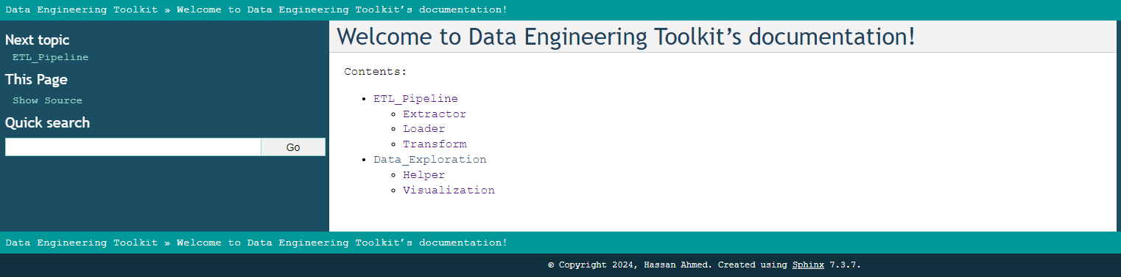
Documentation (HTML) -I
Viewable in web-browser
Local and easily updated to reflect any changes
Code comments are rendered, searchable, and structured

Slide 12
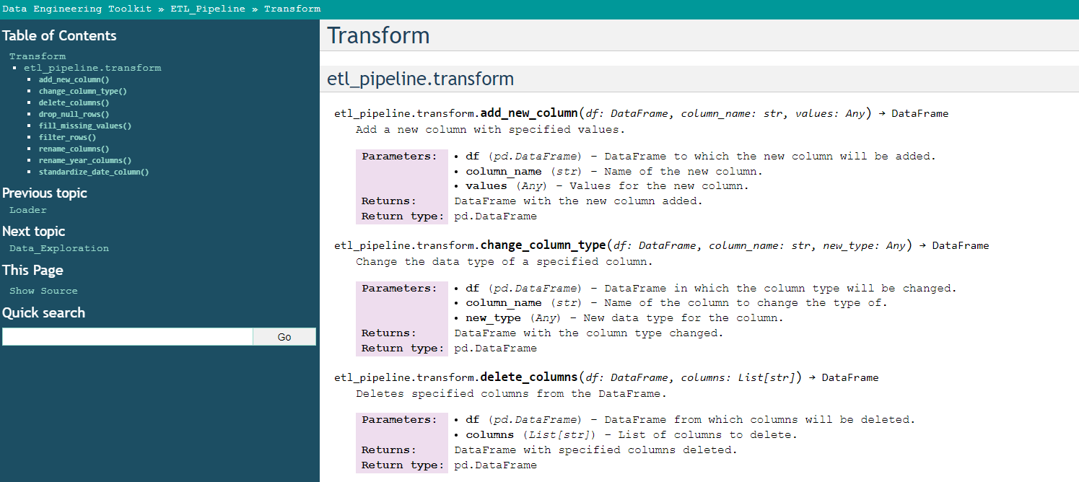
Documentation (HTML) - II

Slide 13
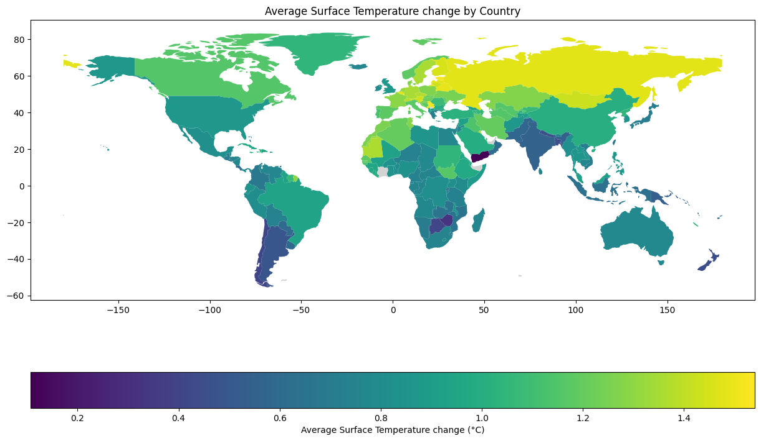
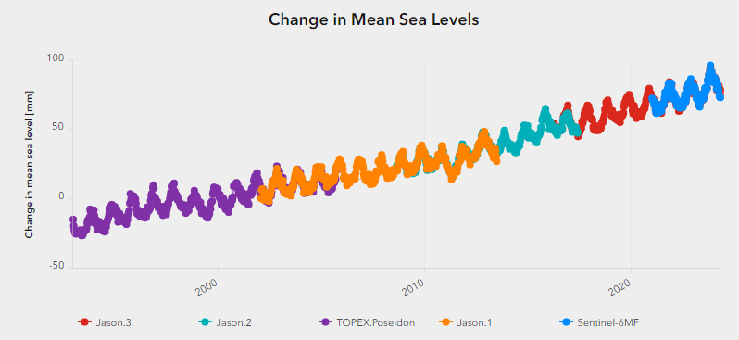
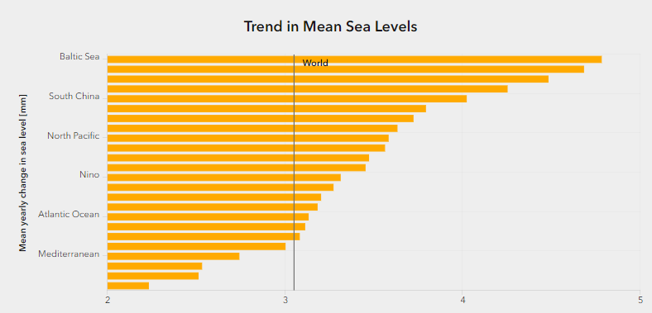
Analysis - I
Temperature Change
The Northern Hemisphere, especially higher latitudes
like Russia and Canada, show significant increases
Sea Level Rise
Trend of rising sea levels from 1993 to 2021
due to thermal expansion and melting ice caps,
highest in the Baltic Sea

Slide 14
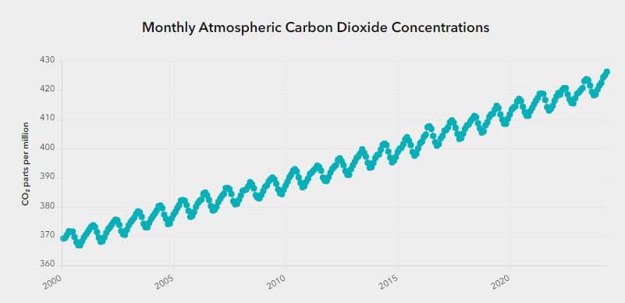
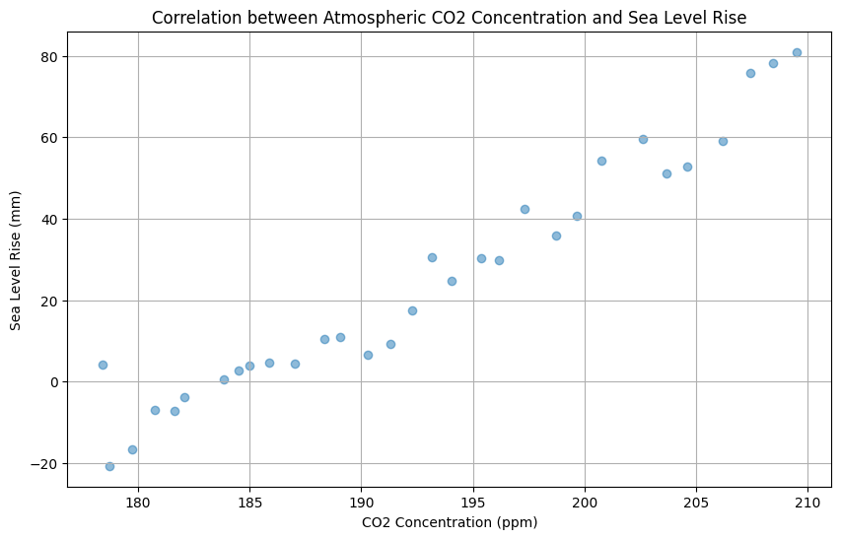
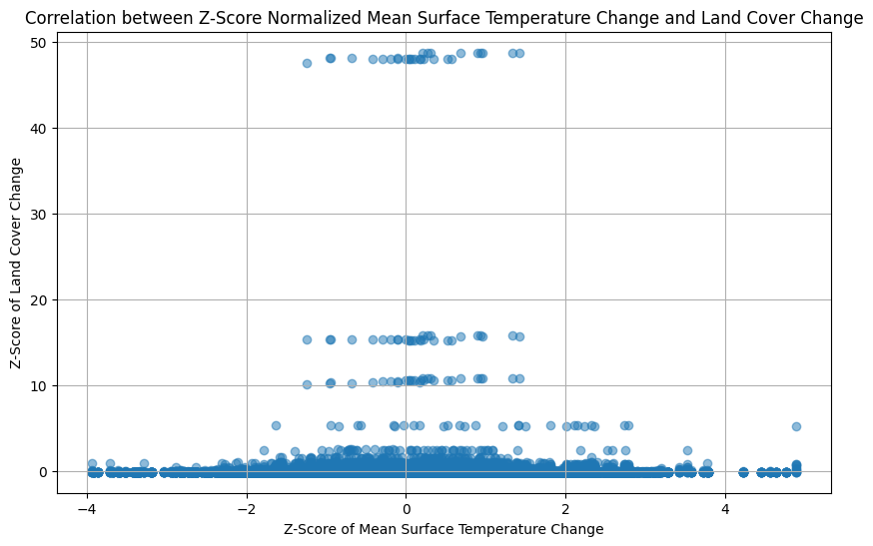
Analysis - II
CO2 Levels
Steady increase in atmospheric CO2 concentrations
from 2000 to 2021, continuous rise with seasonal variations
Correlation Analysis
Strong positive correlation between CO2 and sea level rise
No significant correlation between surface temperature
and land cover

Slide 15
Conclusion
CO2 and Sea Level Rise
CO2 levels are on the rise and so is the level of sea
There is a positive correlation between these two
This indicates that CO2 increase leads to thermal expansion and due to heat and ice melts leading to the rise of sea levels
Relationship between Temperature and Land Cover
No significant relationship was identified in this study
Possible influences: The decision-making policies connected to global climate regulations, methods of agriculture and their impact on the land, and the readiness of ecosystems to bounce back
Implications
Impact of CO2: Clear link to the greenhouse effect
The dynamics of the changes in the land cover can be associated with many factors other than temperature

Slide 16
Thank You Any Questions?

Slide 17
References
NOAA/GML Dr. Pieter Tans and Scripps Institution of Oceanography Dr. Ralph Keeling. World monthly atmospheric carbon dioxide concentrations. https://climatedata.imf.org/datasets/9c3764c0efcc4c71934ab3988f219e0e_0/about, 2024.
FAO. Temperature change. https://climatedata.imf.org/datasets/4063314923d74187be9596f10d034914_0/about, 2024.
NOAA Laboratory for Satellite Altimetry. Sea level rise. https://climatedata.imf.org/datasets/b84a7e25159b4c65ba62d3f82c605855/about, 2024.
FAO; IMF staff calculations. Land cover. https://climatedata.imf.org/datasets/b1e6c0ea281f47b285addae0cbb28f4b/about, 2024.

