Slide 1
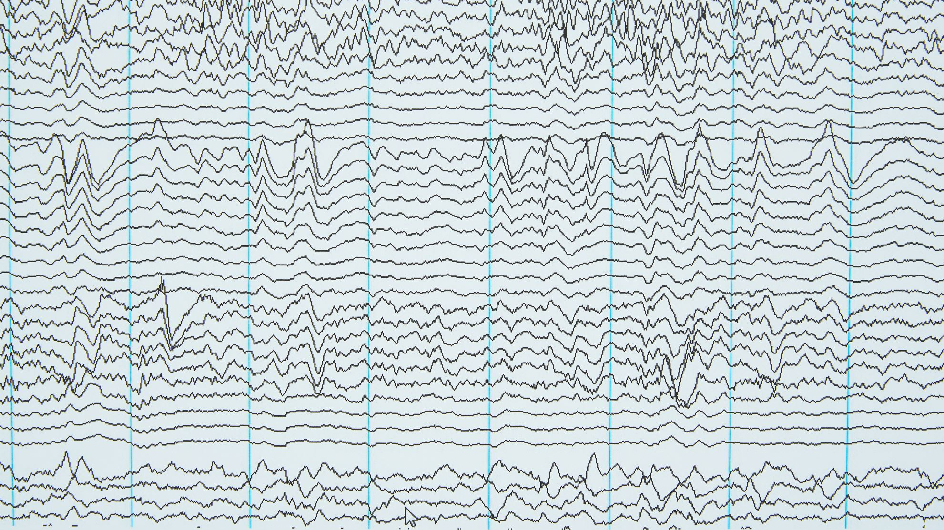
Complexity Modulation with Naturalistic Narrative Stimuli for Prognosis of Acute Brain-Injured Patients

Slide 2
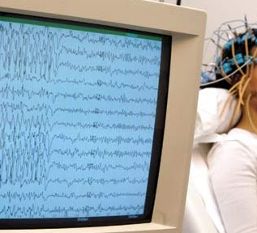


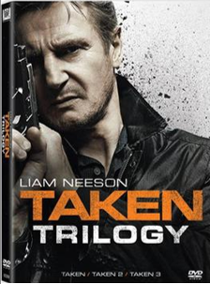
main
Towards an Objective Measure
The Problem: Accurate and timely prognosis of behaviorally unresponsive patients in the ICU
Behavioral measures are limited
EEG for assessing brain injured patients

Slide 3
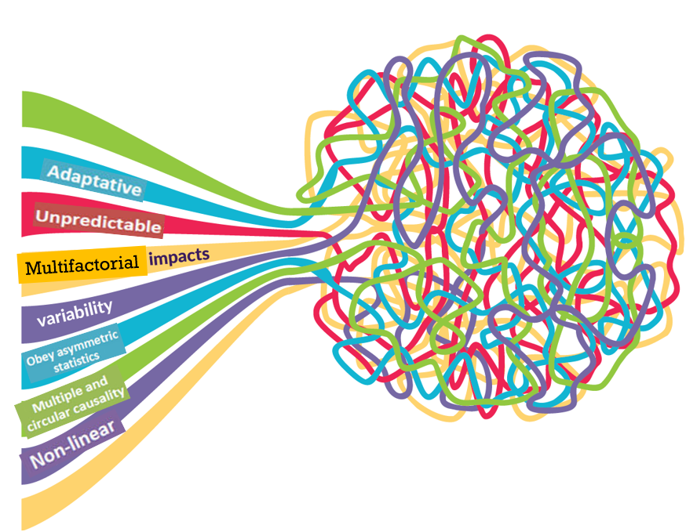
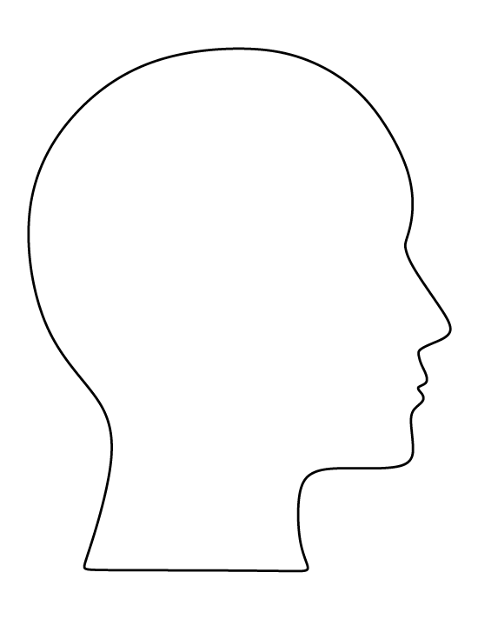
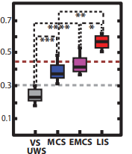
Complexity
Complexity measures quantify how predictable or random a brain signal is.
Complexity of brain signals from EEG used to capture changes in cognition and consciousness.
Casali et al., 2013 - Perturbation Complexity Index (PCI): EEG complexity following Transcranial magnetic stimulation (TMS).

Slide 4


Taken
Complexity
Prognosis
Notes:
complexity metrics for indexing consciousness and Taken as our perturbation, it may give us the benefits of a flexible model, without being too invasive.

Slide 5
Research Question:
Can differences in Complexity between Taken and its scrambled version capture early brain-based markers of recovery from serious brain injury?
Central hypothesis:
Changes in complexity during Taken will be predictive of recovery of consciousness and cognitive functions in acute coma patients in the ICU
Notes:
And this leads me to my RQ : Can differences in Complexity between auditory naturalistic stimulation and its scrambled version capture early brain-based markers of recovery from serious brain injury?
##########################################################################################
Will complexity Change while listening to an auditory movie Clip?
Because if it does change!!!!
We can use the movie as a sort of purtibation and measure the difference ON and OFF stimulation (rest and movie)
And since we have a scrambled condition we can measure the difference in EEG features between all 3 conditions
Well there is not a lot of evidence showing changes in complexity from awake w/out significant change in state.
Here is some evidence that supports my idea

Slide 6
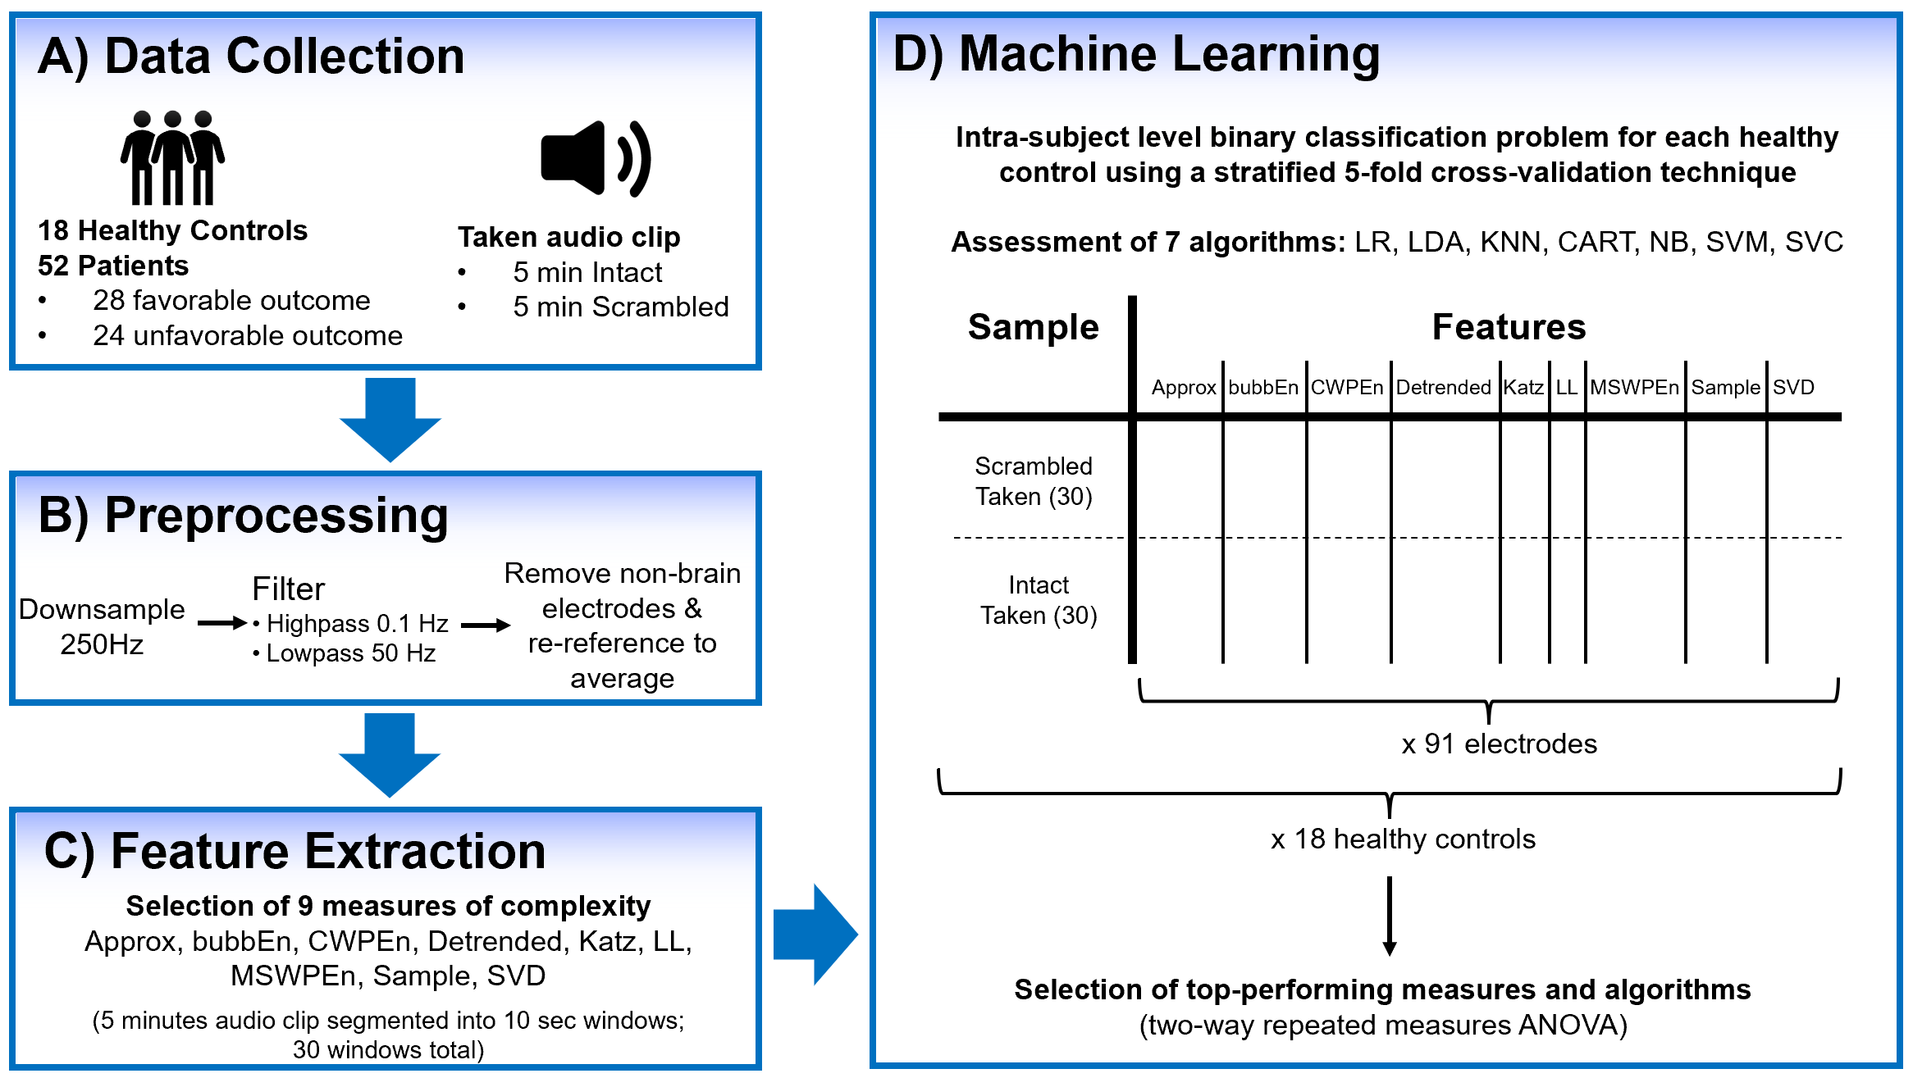
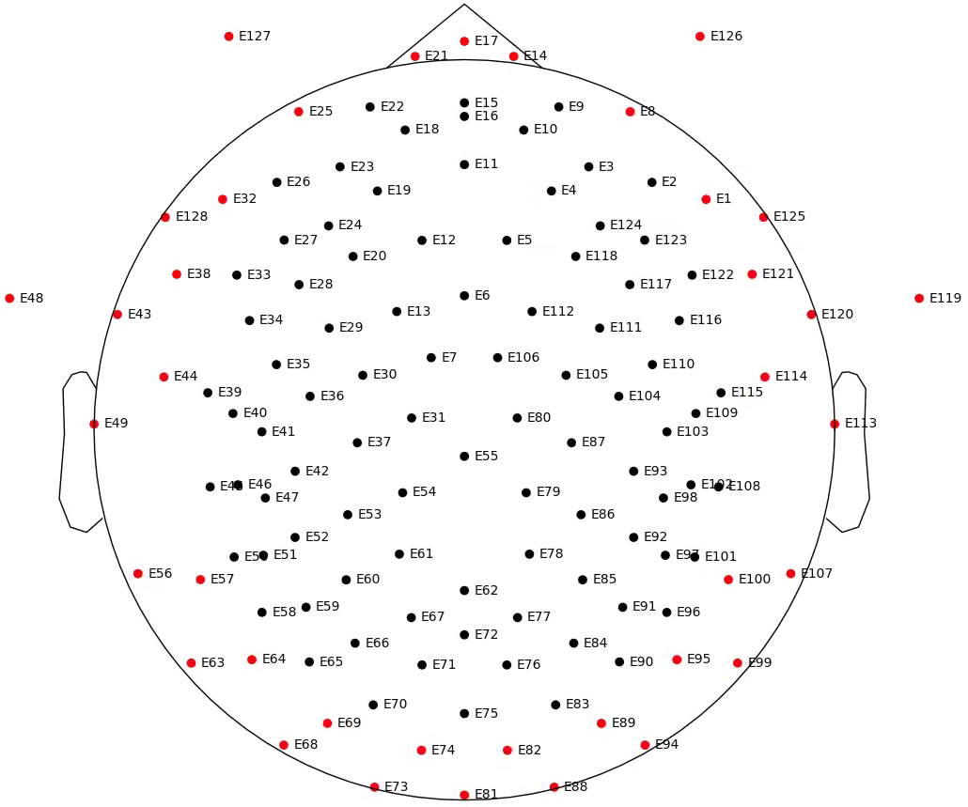

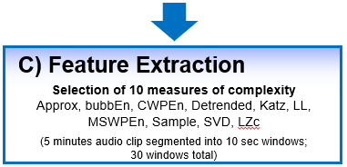
Methods
distorted by spectrally rotating the audio frequencies
Part 1
Part 2
Part 3
128-channel Hydrocel Geodesic Sensor Net
Only used 91 brain electrodes
Notes:
scrambled : distorted by spectrally rotating the audio frequencies
-128 channel EGI system
91 of those cahnnels were used for analysis
There are many measures to represent complexity mathematically (Shalizi, 2006). Moreover, it has been suggested that combinations of features synergistically outperform individual measures (Sitt et al., 2014). Therefore, I took a comprehensive approach and assessed 10 different commonly used complexity measures (SVD, Approx, Sample, Detrended, Katz, LL, MSWPEn, bubbEn, CWPEn, and LZc).

Slide 7
PART I: Comprehensive Evaluation of the Prognostic Utility of Complexity Scores using Intact VS Scrambled Audio Clips

Slide 8
Intra-subject level binary classification for discriminating between Intact and Scrambled Taken
For EACH participant:
Features
x 10 measures
x 7 algorithms:
LR (Logistic Regression)
LDA (Linear Discriminant Analysis)
KNN (K-Nearest Neighbors)
CART (Classification and Regression Trees)
NB (Naive Bayes)
SVM (Support Vector Machine)
SVC (Support Vector Classification)
Sample
Label
One Complexity Measure for each Electrode
0
Scrambled
Taken (30)
30
Intact
Taken (30)
60
Stratified 5-fold cross-validation technique (to train and test the models)
Selection of top-performing measures and algorithms with HC first
Notes:
I decided to use a machine learning approach to investigate this RQ because that whats commonly used in the lirtrature
Intra subject level classification means we create individualized ML models for each participant, tested and trained on only that participants data/
Okay so starting with the HC, we assessed each person individually (18 HC)

Slide 9
Results – Part I
Notes:
For part 1, there was no prognostic information in EEG complexity changes from scrambled to intact conditions.

Slide 10
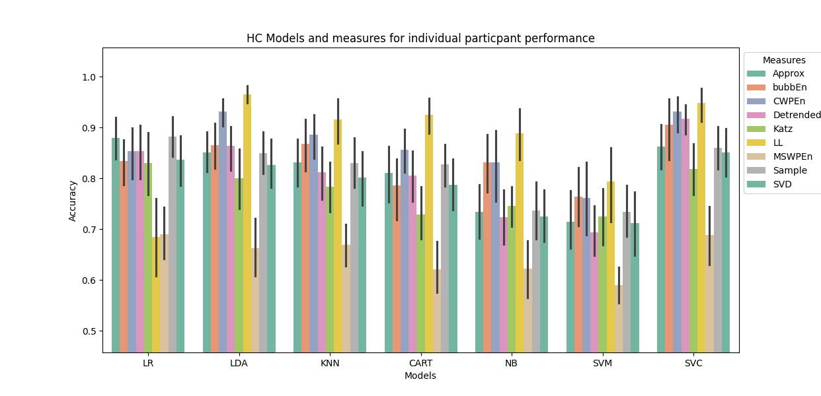
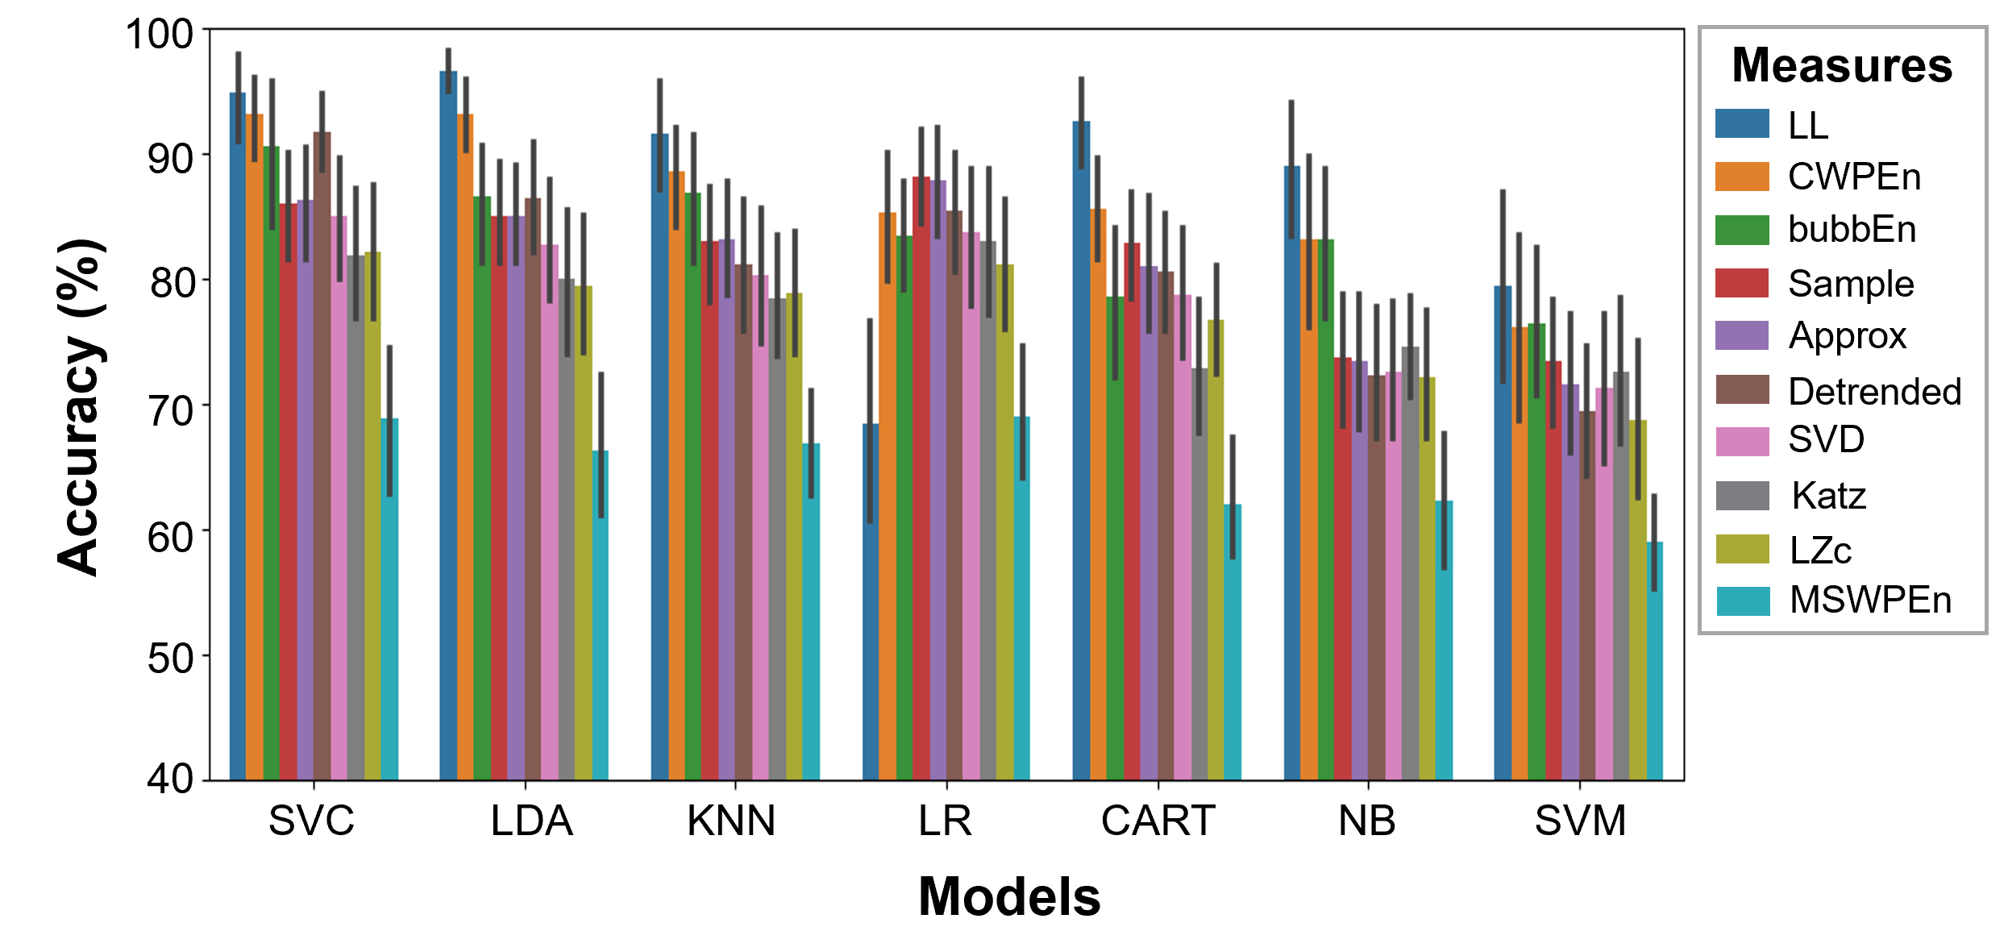
HC Models and Measures for Individual Participant Performance
Model Algorithm
SVC (Support Vector Classification)
LDA (Linear Discriminant Analysis)
Complexity
LL (Fractal Line Length index)
CWPEn (Conditional Weighted Permutation Entropy)
Measures
1.0
Approx
bubbEn
0.9
CWPEn
Detrended
0.8
Katz
Accuracy
LL
MSWPEn
0.7
Sample
SVD
0.6
0.5
LR
LDA
KNN
CART
NB
SVM
SVC
Models

Slide 11
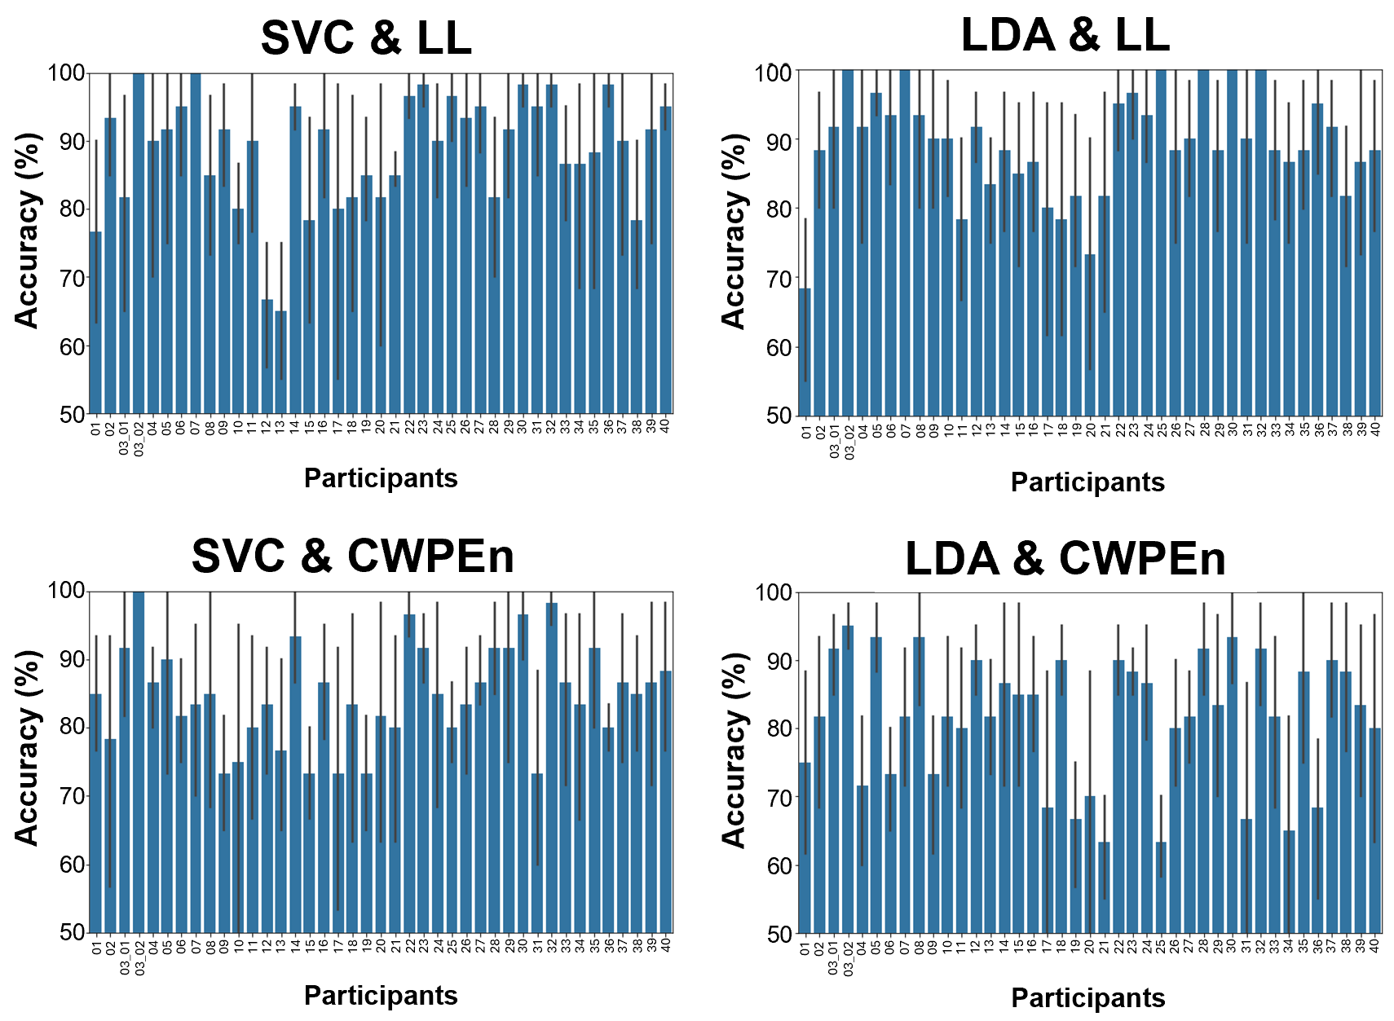
Individual Patient Accuracy Scores

Slide 12
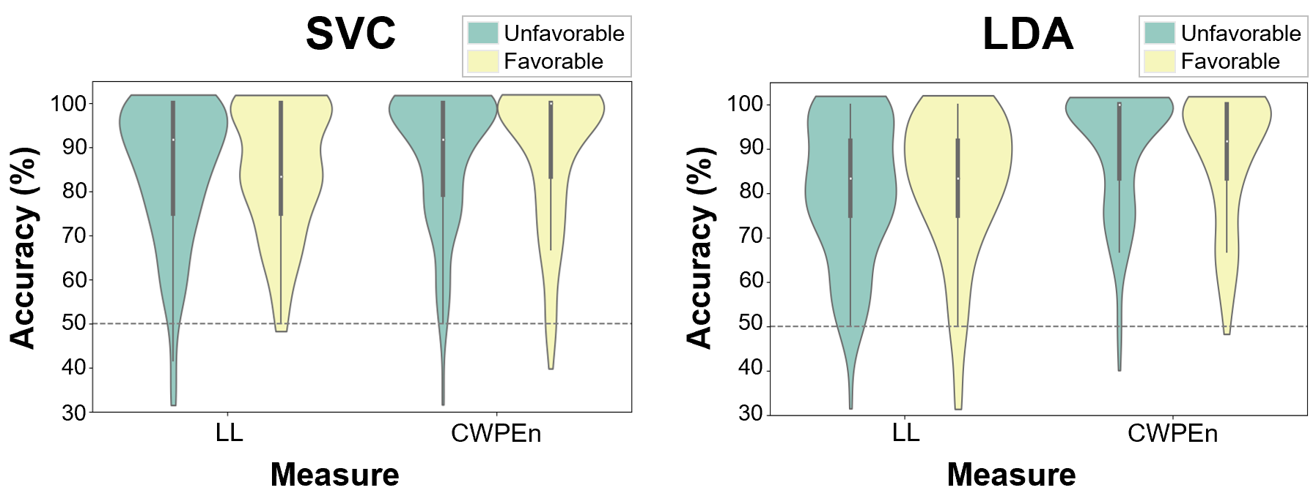
Group Differences of Outcome
Mann-Whitney U rank test on two independent samples:
LL: p-value = 0.657
CWPEn: p-value = 0.983
Mann-Whitney U rank test on two independent samples:
LL: p-value = 0.202
CWPEn: p-value = 0.351
Notes:
Note: Violin plots compare patients with favourable and unfavourable outcomes at the group level by looking at differences in individual accuracy scores from intra-subject binary classifications of Tasks. The accuracy scores are based on model performance using LDA or SVC algorithms with CWPEn or LL measures.
Group-level Differences in accuracy scores between Unfavourable and favourable were tested with the Mann-Whitney U tests. This was done using results from the top 2 feahres and algorithms. to test the accuracy scores difference between Unfavorable and Favorable ousSurprisingly, the resulting group-level accuracy scores were the same for patients with favourable and unfavourable outcomes (SVC & LL: p = 0.657; SVC & CWPEn: p = 0.983; LDA & LL: p = 0.202; LDA & CWPEn: p = 0.351; Figure 7). This means that patients' accuracy scores obtained using a combination of models SVM or LDA and measures LL or CWPEn are not related to a patient’s outcome.
These results suggest that using complexity measures to classify between Intact and Scrambled is not related to a patient’s outcome.

Slide 13
PART II: Assessing Differences for Outcome and Task using Spatial Lempel-Ziv Complexity
Notes:
This is to know what complexity is actually good for. Is it able to discriminate between tasks or Just outcome or both like we originally thought.
Two-way Mixed-factorial design with ‘Outcome’ as the between-subjects factor and ‘Task’ as the within-subjects.
To assess the main effects of outcome and task, and their potential interaction.
Based on the original hypothesis, We expect to see a main effect of outcome, a main effect of task. However that’s not what we find.

Slide 14
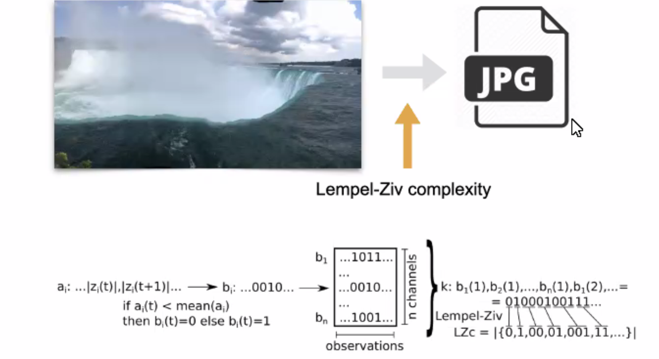
Statistical Analysis – Part II
(Schartner et al., 2015)

Slide 15
Results – Part II
Notes:
- Periminary results

Slide 16
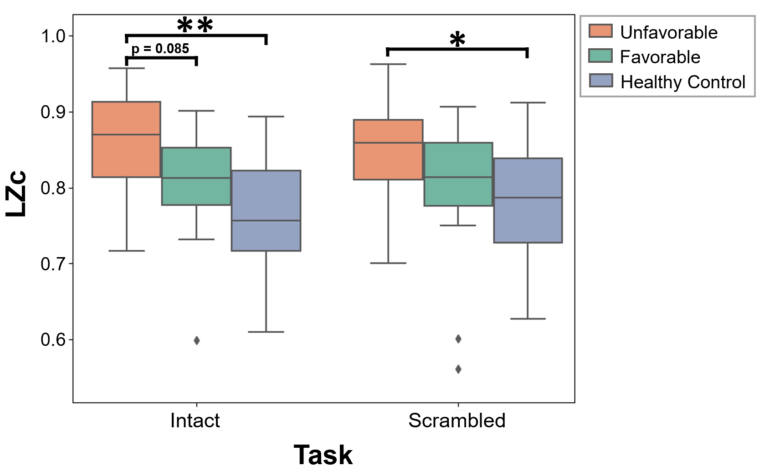
Mixed-factorial plot of LZC scores for Outcome and Task
Descriptive statistics.
Outcome | Task | n | Mean | SD | SEM | Skewness | Kurtosis
Unfavorable | Intact | 23 | 0.85 | 0.07 | 0.02 | -0.21 | -0.66
 | Scrambled | 23 | 0.84 | 0.08 | 0.02 | -0.32 | -0.90
Favorable | Intact | 17 | 0.77 | 0.13 | 0.04 | -1.83 | 2.85
 | Scrambled | 17 | 0.79 | 0.08 | 0.02 | -1.20 | 0.65
Healthy | Intact | 18 | 0.77 | 0.10 | 0.02 | -0.19 | -0.74
 | Scrambled | 18 | 0.78 | 0.08 | 0.02 | -0.39 | -0.59
Mixed Factorial ANOVA Results.
Source | SS | DF1 | DF2 | MS | F | p | ng2
Outcome | 0.059 | 2 | 55 | 0.07 | 5.02 | 0.010* | 0.15
Task | 0.000 | 1 | 55 | 0 | 1.17 | 0.284 | 0
Interaction | 0.002 | 2 | 55 | 0 | 2.69 | 0.077 | 0.01

Slide 17
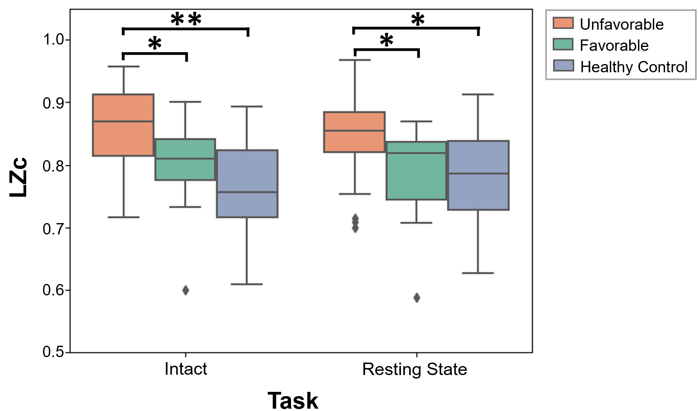
Rest == Intact == Scrambled

Slide 18
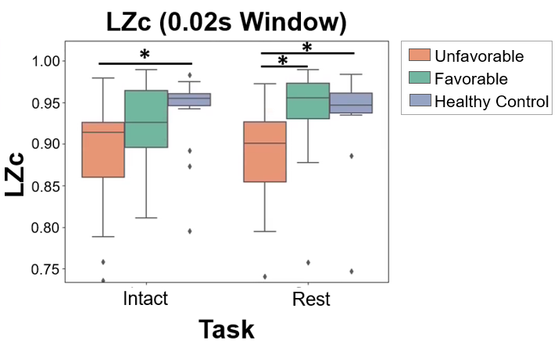
Directionality of Results is Dependent on Calculation Parameters

Slide 19
PART III: Predicting Outcome at an Individual Level

Slide 20
Statistical Analysis – Part III
Machine Learning
Binary Classification of Favourable and Unfavourable Outcomes
Each Model is created with data from all patients as individual samples
Complexity Features are derived from Rest data
K-Nearest Neighbours (KNN) algorithm
Model Evaluation
Stratified and Split into training and test sets without “double dipping” data to avoid overfitting.
Balanced accuracy scores
Allows us to make inferences about performance metrics obtained for each model
confusion matrices & Receiver Operating Characteristic (ROC) and Area Under the Curve (AUC) analyses

Slide 21
Results – Part III
25 unfavourable patients
20 favourable outcome
Notes:
- Periminary results

Slide 22
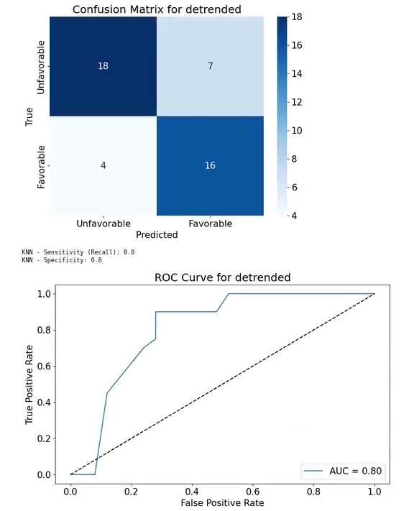
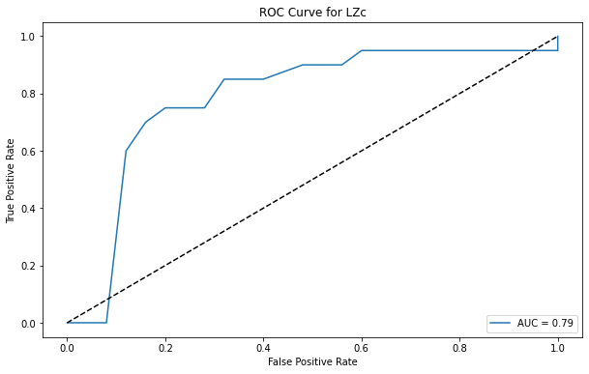
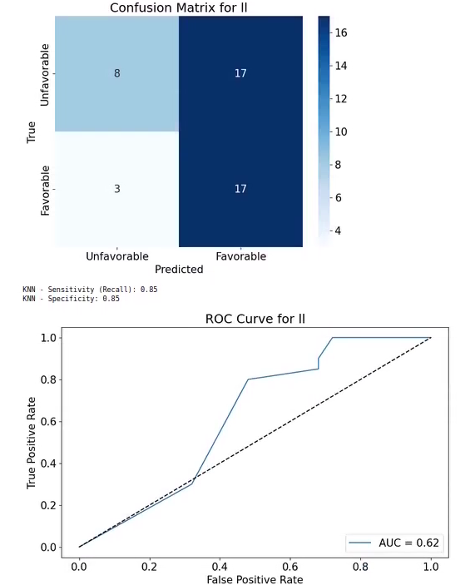
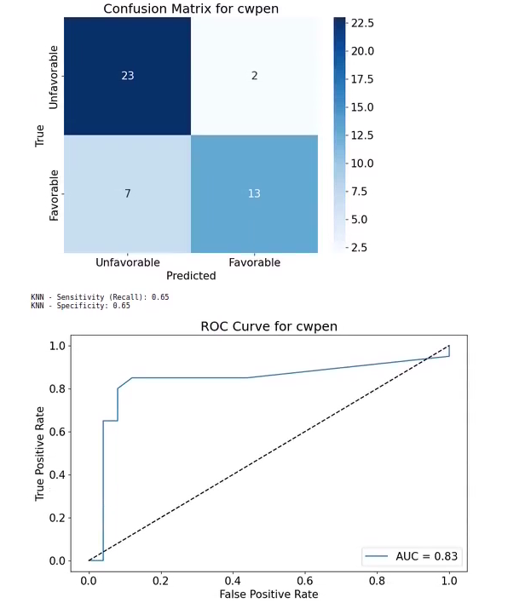
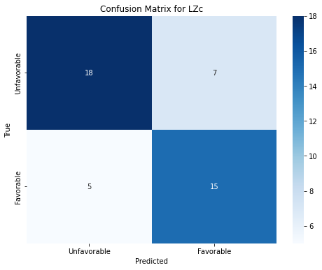
Measure | Accuracy | Sensitivity (TPR) | Specificity (TNR) | Area Under the Curve (AUC)
LZc | 0.73 | 0.75 | 0.72 | 0.79
SVD | 0.66 | 0.4 | 0.88 | 0.78
Approx | 0.78 | 0.75 | 0.80 | 0.77
Sample | 0.71 | 0.80 | 0.64 | 0.78
Detrended | 0.76 | 0.80 | 0.72 | 0.80
Katz | 0.76 | 0.70 | 0.80 | 0.79
LL | 0.55 | 0.85 | 0.32 | 0.62
MSWPEn | 0.71 | 0.80 | 0.64 | 0.78
bubbEn | 0.71 | 0.45 | 0.92 | 0.61
CWPEn | 0.80 | 0.65 | 0.92 | 0.83
LZc
Detrended
LL
CWPEn
*

Slide 23
Discussion

Slide 24
Summary
Conclusion
Part 1: results inconclusive
Part 2: No group-level difference between Intact & Scrambled
Part 2: Found group-level differences between Favourable & Unfavourable Outcome
Part3: Predicting Outcome at an individual-level
Original Hypothesis not supported
Complexity measures show potential for informing prognosis of Acute brian-injured patients in the ICU
Central Hypothesis:
Changes in complexity during Taken will be predictive of recovery of consciousness and cognitive functions in acute coma patients in the ICU.

