Slide 1

Smart Supply Chain: Delivery Performance Analysis
Data-Driven Insights to Reduce Delays & Recover Revenue
Hassan Ali Hassan

Slide 2
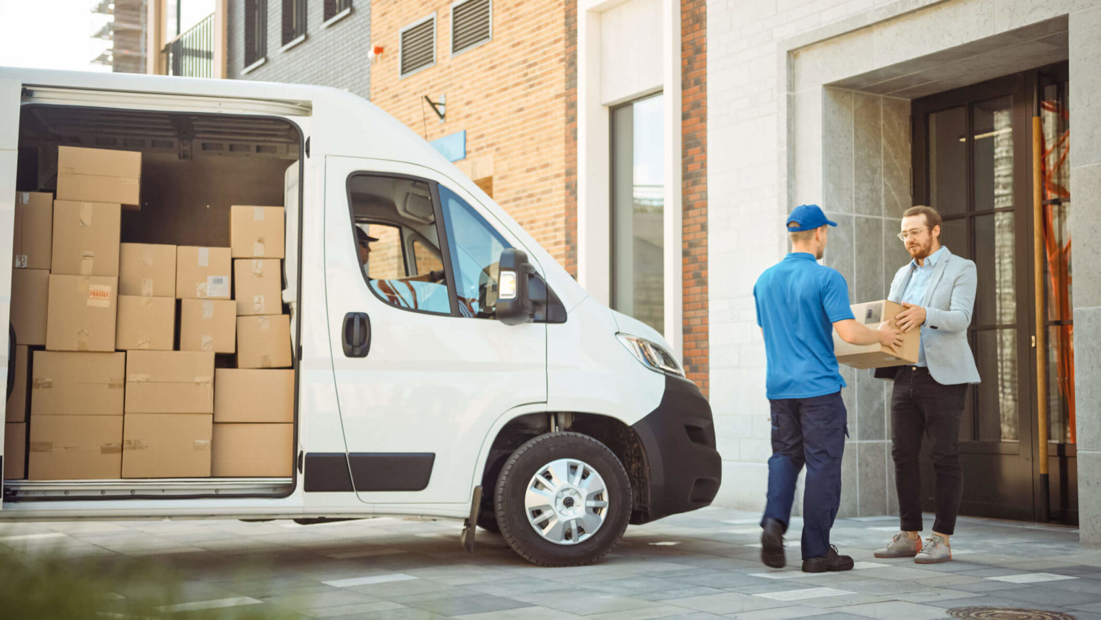
Smart Supply Chain: Delivery Performance Analysis
The Challenge: Bottlenecks in the Supply Chain
Critical Delivery Failures: Analysis revealed a staggering 36,048 orders failing to meet their scheduled delivery dates, directly impacting customer trust and brand reputation.
Severe Financial Impact (Revenue at Risk): These logistical bottlenecks have trapped approximately $20.1 Million in delayed transit. This represents a significant amount of capital tied up due to operational inefficiencies.
Customer Experience Degradation: The average delay duration across all delayed shipments is 1.62 days. In a competitive e-commerce landscape, this prolonged wait time significantly increases the risk of customer churn and negative reviews.

Slide 3

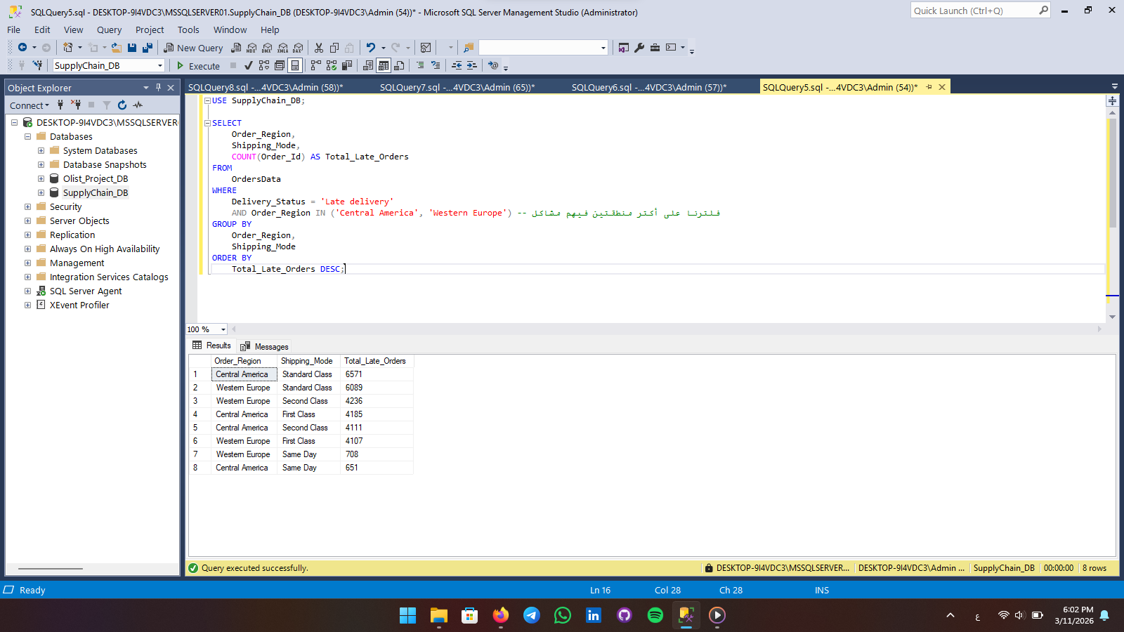
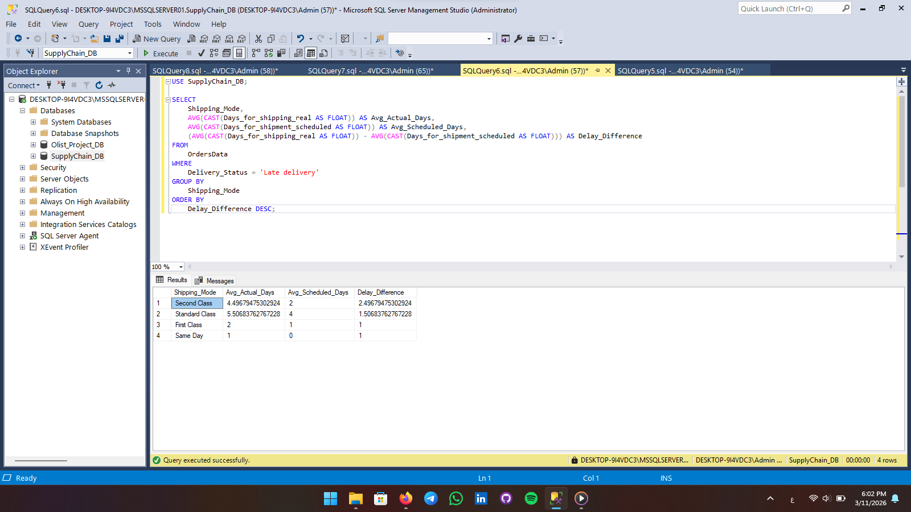
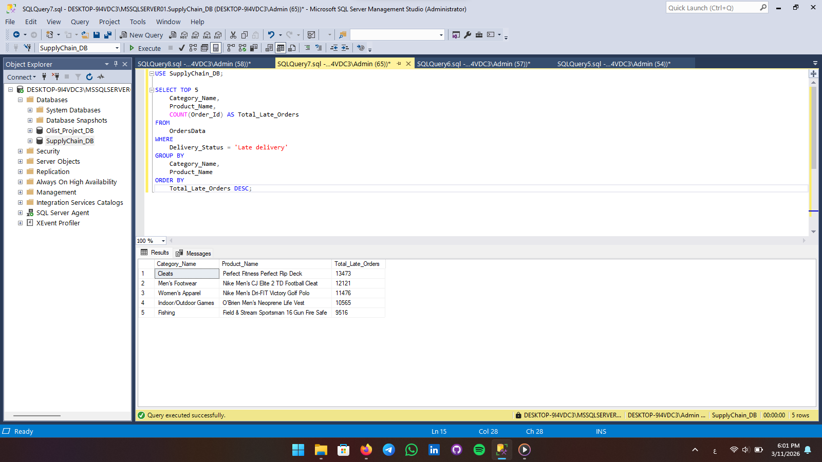
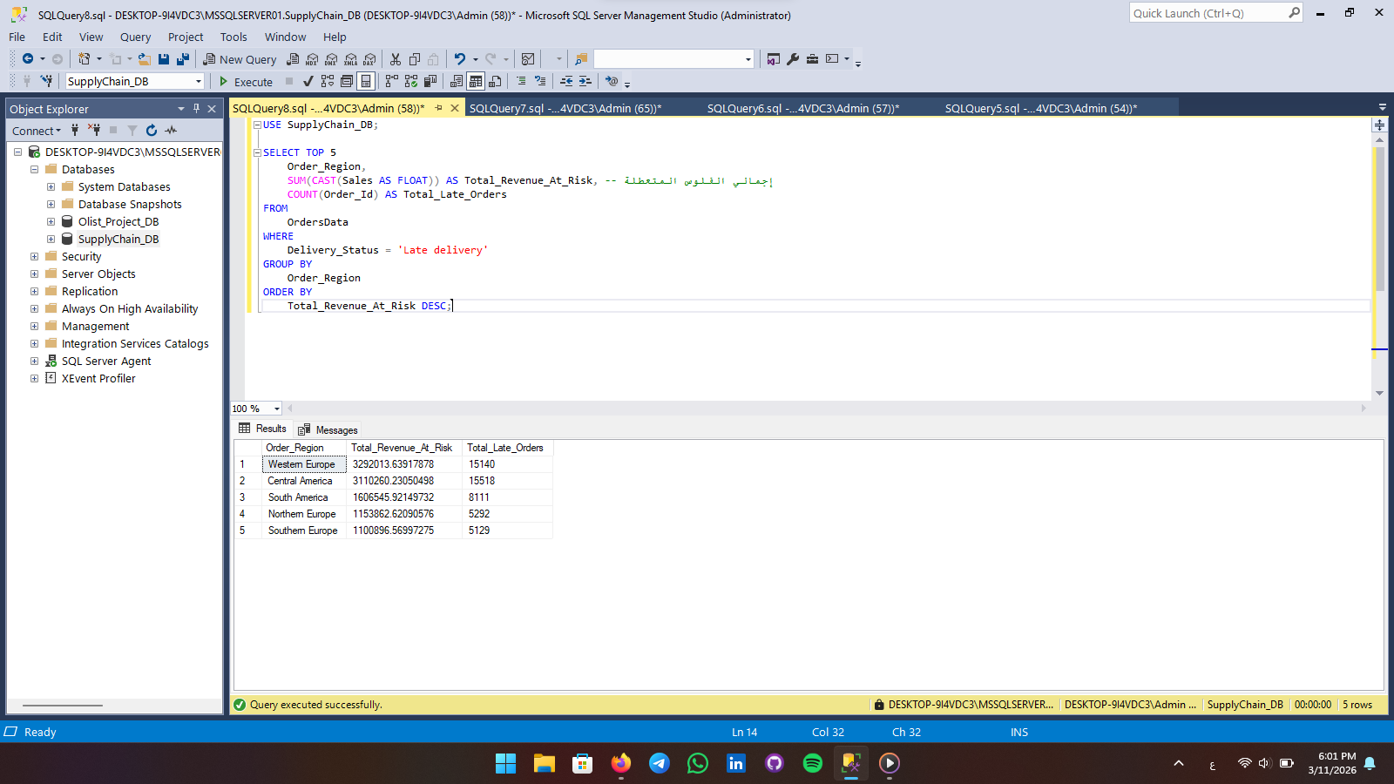
From Raw Data to Actionable Insights
Smart Supply Chain: Delivery Performance Analysis
The Challenge: Bottlenecks in the Supply Chain
Data Engineering & Analysis (SQL): Engineered complex queries to extract, clean, and manipulate massive raw transactional data. Calculated custom metrics such as exact delay durations (Actual vs. Scheduled shipping dates) and aggregated total financial risks.
Interactive Visualization (Tableau): Translated raw SQL outputs into a dynamic, interactive dashboard. Designed geographic heat maps, KPI cards, and trend lines to empower stakeholders to drill down into specific regions, shipping modes, and product categories for root-cause analysis.
Critical Delivery Failures: Analysis revealed a staggering 36,048 orders failing to meet their scheduled delivery dates, directly impacting customer trust and brand reputation.
Severe Financial Impact (Revenue at Risk): These logistical bottlenecks have trapped approximately $20.1 Million in delayed transit. This represents a significant amount of capital tied up due to operational inefficiencies.
Customer Experience Degradation: The average delay duration across all delayed shipments is 1.62 days. In a competitive e-commerce landscape, this prolonged wait time significantly increases the risk of customer churn and negative reviews.

Slide 4
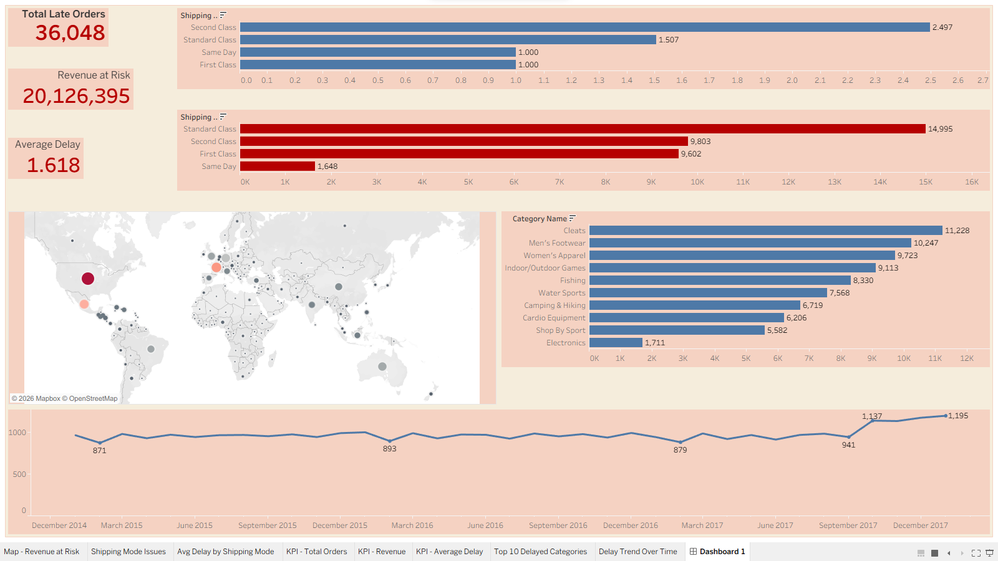
The Shipping Mode Paradox: While "Standard Class" accounts for the highest volume of delayed orders (nearly 15,000), "Second Class" shipping is operationally the most inefficient, recording the longest average delay of 2.5 days per order.
Product-Level Vulnerability: The "Cleats" and "Men's Footwear" categories are experiencing severe supply chain distress, leading the chart with over 11,200 delayed shipments. This indicates a potential vendor or warehouse-specific bottleneck.
Geographical Risk Zones: Geographic mapping exposes Western Europe and Central America as the primary operational pain points, indicating regional logistical failures or carrier underperformance in these specific territories.
Key Findings: Uncovering the Root Causes

Slide 5

Action Plan & Recommendations
1. Carrier Renegotiation & SLA Enforcement: Immediately review Service Level Agreements (SLAs) with carriers handling "Second Class" shipping. Enforce stricter penalties for delays or transition to more reliable third-party logistics (3PL) providers for this tier.
2. Supply Chain Audit for High-Risk Categories: Conduct an urgent inventory and fulfillment audit for the "Cleats" department. Assess warehouse picking processes and supplier lead times to eliminate internal fulfillment bottlenecks.
3. Regional Logistics Optimization: Reallocate logistical resources or partner with localized fulfillment centers in Western Europe and Central America to decentralize distribution and reduce the transit time to end consumers.

Slide 6

Thank you
Ready to transform raw data into strategic business solutions
Interactive Dashboard:[https://public.tableau.com/app/profile/hassan.ali3335/viz/SupplyChainDeliveryPerformanceAnalysis/Dashboard1?publish=ye]
SQL Code & Documentation: [https://github.com/HassanAliHassanAli]
Let's Connect: [www.linkedin.com/in/hassan-ali-ha2026] my phone number: [+201119253497]

