Slide 1



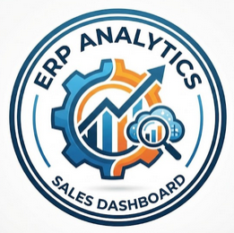
B2B Sales Performance Analysis: Unlocking ERP Data
Hassan Ali Hassan
Data Analyst | BIS Graduate
Built with Power BI & SAP Sample Data

Slide 2
Hassan Ali Hassan
Data Analyst | BIS Graduate
B2B Sales Performance Analysis: Unlocking ERP Data
Built with Power BI & SAP Sample Data

Slide 3

The Objective
The Challenge
Raw ERP systems (like SAP) generate massive, normalized datasets scattered across multiple relational tables
(Sales, Products, Customers).
This complexity makes it difficult for management to extract quick, actionable insights.
To design an automated, interactive Power BI dashboard that consolidates these tables into a single
"Source of Truth".
To enable data-driven decision-making for the executive team.

Slide 4
The Challenge
Raw ERP systems (like SAP) generate massive, normalized datasets scattered across multiple relational tables
(Sales, Products, Customers).
This complexity makes it difficult for management to extract quick, actionable insights.
The Objective
To design an automated, interactive Power BI dashboard that consolidates these tables into a single
"Source of Truth".
To enable data-driven decision-making for the executive team.

Slide 5

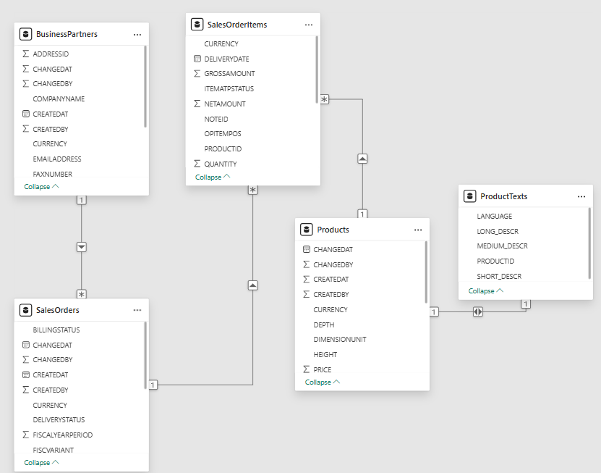
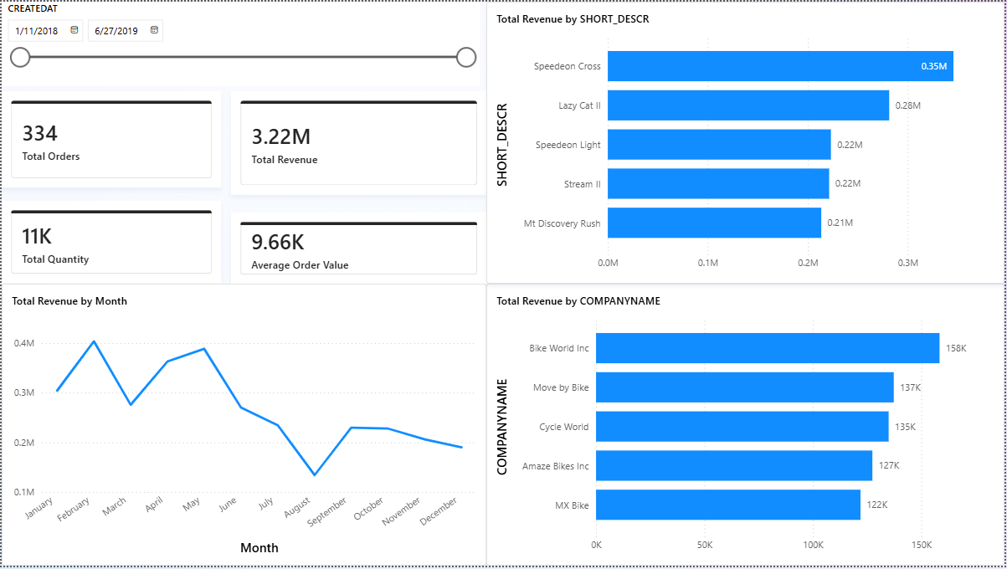
Executive Sales Dashboard
Dashboard includes an interactive timeline slicer for dynamic filtering

Slide 6
Executive Sales Dashboard
Dashboard includes an interactive timeline slicer for dynamic filtering

Slide 7
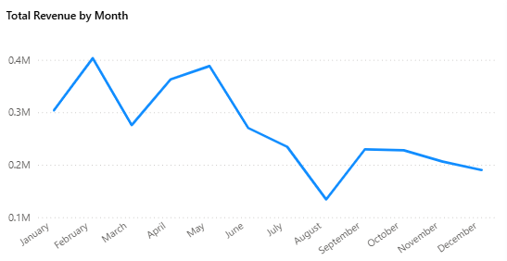



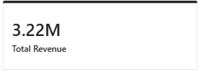

Key Business Insights
Generated $3.22M in total revenue across 334 B2B orders, maintaining a strong Average Order Value (AOV) of $9.66K.
Sales activity peaks significantly during February and May, but experiences a sharp, critical drop during late Summer (August).
"Bike World Inc." is the undisputed top client ($158K), while the "Speedeon Cross" dominates product sales ($0.35M).

Slide 8
Key Business Insights
Generated $3.22M in total revenue across 334 B2B orders, maintaining a strong Average Order Value (AOV) of $9.66K.
Sales activity peaks significantly during February and May, but experiences a sharp, critical drop during late Summer (August).
"Bike World Inc." is the undisputed top client ($158K), while the "Speedeon Cross" dominates product sales ($0.35M).

Slide 9

For further inquiries or discussion, feel free to reach out hassan.ali.ha2026@gmail.com +201119253497
Launch targeted promotional campaigns and discounts in July and August to counter the seasonal drop in sales.
Establish a "VIP Account Management" program for our top 5 clients (especially Bike World Inc.) to secure and expand these high-value relationships.v
Increase stock levels for the "Speedeon" and "Lazy Cat" product lines ahead of the early peak season (January/February) to prevent stockouts.

Slide 10
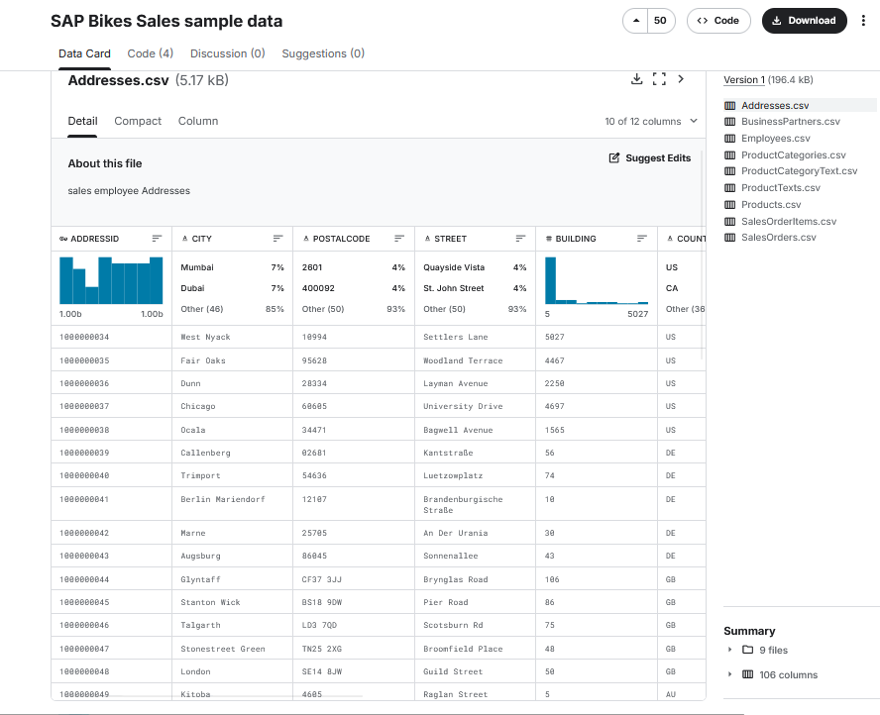
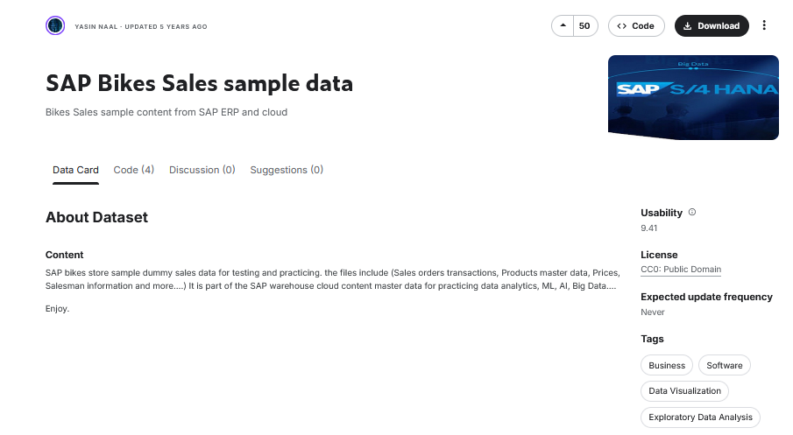
Launch targeted promotional campaigns and discounts in July and August to counter the seasonal drop in sales.
Establish a "VIP Account Management" program for our top 5 clients (especially Bike World Inc.) to secure and expand these high-value relationships.v
Increase stock levels for the "Speedeon" and "Lazy Cat" product lines ahead of the early peak season (January/February) to prevent stockouts.

Slide 11
Launch targeted promotional campaigns and discounts in July and August to counter the seasonal drop in sales.
Establish a "VIP Account Management" program for our top 5 clients (especially Bike World Inc.) to secure and expand these high-value relationships.v
Increase stock levels for the "Speedeon" and "Lazy Cat" product lines ahead of the early peak season (January/February) to prevent stockouts.

