Slide 1
Neonatal incubator regulation
Double DQN with SHAP explanations
Project 04
Ziad Kishk · Karim Ayman · Hassan Gebrill
Simulation only. Not suitable for clinical deployment.
Project source and frozen validation outputs
1
Notes:
Team names supplied by Hassan. Student IDs are intentionally deferred at the user’s request. This deck describes an educational simulation, not a medical device.
Sources: Project source and frozen validation outputs

Slide 2
Project objective and responsibilities
Objective: evaluate joint temperature and oxygen regulation under five modeled conditions.
Member 01: simulation environment, synthetic trajectories and PID/rule controller.
Member 02: Double DQN architecture, historical training and held-out evaluation.
Member 03: SHAP, aligned decision records and independent verification.
Project source and frozen validation outputs
2
Notes:
Member 01 owns the simulator, dataset, MDP and baseline. Member 02 owns DDQN training and evaluation. Member 03 owns explanations, decision validation and integration. All work uses the original trained checkpoint.
Sources: Project source and frozen validation outputs

Slide 3
Synthetic data and reliability
50 evaluation episodes: 5 scenarios × 5 paired seeds × 2 controllers.
Each episode contains 200 decisions at 45-second intervals: 2.5 simulated hours.
10,000 transitions, including 5,000 DDQN decisions with selected-head SHAP values.
Fixed schedules and one modeled phenotype limit generalization to new physiology.
Project source and frozen validation outputs
3
Notes:
There are no patient records. Five scenario schedules represent normal, ambient drop, porthole opening, initial hypothermia and oxygen desaturation. All claims concern one frozen checkpoint. The SHAP background reuses its 100 states for global explanations, so it is not a separate test distribution.
Sources: Project source and frozen validation outputs

Slide 4
Related work
Study | Method / evidence | Boundary / project relevance
Kaltsogianni et al. 2025 | Automated vs manual oxygen 40 infants, randomized trial | Oxygen-only, different population Our benchmark adds joint actuation
Double DQN 2016, foundational | Separate selection and valuation Atari evaluation | No neonatal evidence Our agent uses 25 joint actions
SHAP 2017, foundational | Additive feature attribution | Reference-dependent explanations Our audit checks Q-head attribution
Kaltsogianni et al. (2025), doi:10.1111/apa.17549; van Hasselt et al. (2016); Lundberg & Lee (2017)
4
Notes:
Kaltsogianni et al. studied 40 ventilated late-preterm/term infants, with a 92-96% target range. They found improved oxygen targeting but no significant difference in supplemental-oxygen duration. The 2025 journal issue follows first online publication in December 2024. DDQN and SHAP sources are foundational. These studies do not validate the current simulator.
Sources: Kaltsogianni et al. (2025), doi:10.1111/apa.17549; van Hasselt et al. (2016); Lundberg & Lee (2017)

Slide 5
Markov decision process
11 features: Tc, Tsk, Ta, chamber O2, SpO2, Tamb, dTa/dt, dO2/dt, phase, disturbance, scenario ID.
25 actions: 5 heater levels × 5 inspired-oxygen fractions. Action = 5 × heater index + oxygen index.
Reward = −temperature error² − 0.5 × oxygen band error² − 0.05 × effort + threshold penalty.
Modeled hard limits: Tc 35.5–38°C and SpO2 85–96%. These are simulation choices.
src/environment.py; src/q_network.py; config.yaml
5
Notes:
Feature order and action mapping are verified from source and checkpoint. Scenario and disturbance indicators give the DDQN privileged information. The reward uses post-step outcomes.
Sources: src/environment.py; src/q_network.py; config.yaml

Slide 6
Illustrative thermal and oxygen models
Cair dTa/dt = Qheater − Kloss(Ta − Tamb) − Kbaby(Ta − Tc)
Ccore dTc/dt = Kbaby(Ta − Tc), with Tskin = Tcore − 0.5°C
dCO2/dt = kblend(100 × FiO2 − CO2) − kleak(CO2 − 21)
SpO2 follows a lagged equilibrium driven by chamber O2 and a prescribed desaturation offset.
src/environment.py::_physics_substep; docs/parameter_provenance.md
6
Notes:
The simulator integrates lumped dynamics with substeps and clipping, then applies observation noise. Effective heat capacities are not measured neonatal physiology. Skin temperature is deterministically Tc minus 0.5°C. Chamber oxygen concentration is distinct from blood oxygen saturation.
Sources: src/environment.py::_physics_substep; docs/parameter_provenance.md

Slide 7
Frozen Double DQN
Architecture: normalized 11 inputs, two 128-unit ReLU layers, 25 linear Q outputs.
Double target: r + γ Qtarget(s′, argmaxa Qonline(s′, a)), with γ = 0.99.
Historical setup: replay, Huber loss, target synchronization and validation-based checkpoint selection.
Evaluation uses greedy actions. Original checkpoint SHA-256 starts 823A2CA6988A and remains unchanged.
src/ddqn_agent.py; src/q_network.py; results/ddqn/ddqn_tuned_seed0/manifest.json
7
Notes:
The .pt file is a trusted Python pickle containing TensorFlow/Keras weights and agent metadata. It is not a PyTorch checkpoint. No training was run in this finalization. Historical configuration hash differs from the current YAML, while checkpoint inference and evaluation reproduce.
Sources: src/ddqn_agent.py; src/q_network.py; results/ddqn/ddqn_tuned_seed0/manifest.json

Slide 8
Baseline and evaluation fairness
Baseline: temperature PID plus a saturation-driven oxygen rule.
Both controllers use identical scenario schedules and paired episode seeds.
DDQN additionally observes phase, scenario identity, disturbance and other physical features.
The result compares these two systems. It does not isolate DDQN architecture as the cause of any gain.
src/baseline.py; validation.py; FINAL_PROJECT_AUDIT.md
8
Notes:
The baseline consumes core temperature and oxygen saturation and retains PID memory. DDQN receives all 11 features, including scenario ID, phase and disturbance flag. Matching random seeds controls environment noise but does not equalize information.
Sources: src/baseline.py; validation.py; FINAL_PROJECT_AUDIT.md

Slide 9
SHAP methodology
DeepExplainer attributes the inference-mode online network. KernelExplainer provides the fallback.
For each fixed action: Q(s,a) ≈ background mean Q(a) + sum of 11 feature contributions.
Selected-head importance pools the greedy head at each state. Contrastive SHAP subtracts two heads.
A small reconstruction residual verifies consistency, not exact Shapley values or causality.
shap_explainer.py; docs/RELATED_WORK.md; SHAP_EXPLANATION_NOTES.md
9
Notes:
Deep SHAP applies DeepLIFT-based approximation rules. Kernel SHAP uses up to 100 sampled coalitions with L1 selection disabled. A failed Deep preflight falls back to Kernel before any decisions are logged. Later attribution errors stop execution. Both paths share one explainer.
Sources: shap_explainer.py; docs/RELATED_WORK.md; SHAP_EXPLANATION_NOTES.md

Slide 10
Background coverage and decision alignment
100 reference states: 82 idle, 8 active porthole and 10 active desaturation.
Selected ticks span the simulation timeline, but sampling remains imbalanced.
Each row records decision state, chosen action and its Q/SHAP before stepping the environment.
Reward and next state follow that decision. The verifier replays all 10,000 transitions.
Project source and frozen validation outputs
10
Notes:
100 states cover ticks 0-198. Counts are 82 idle, 8 active porthole and 10 active oxygen disturbance states. Idle includes cooling and recovery, so idle is not synonymous with healthy. One hundred states are deliberately stratified, not population representative.
Sources: Project source and frozen validation outputs

Slide 11
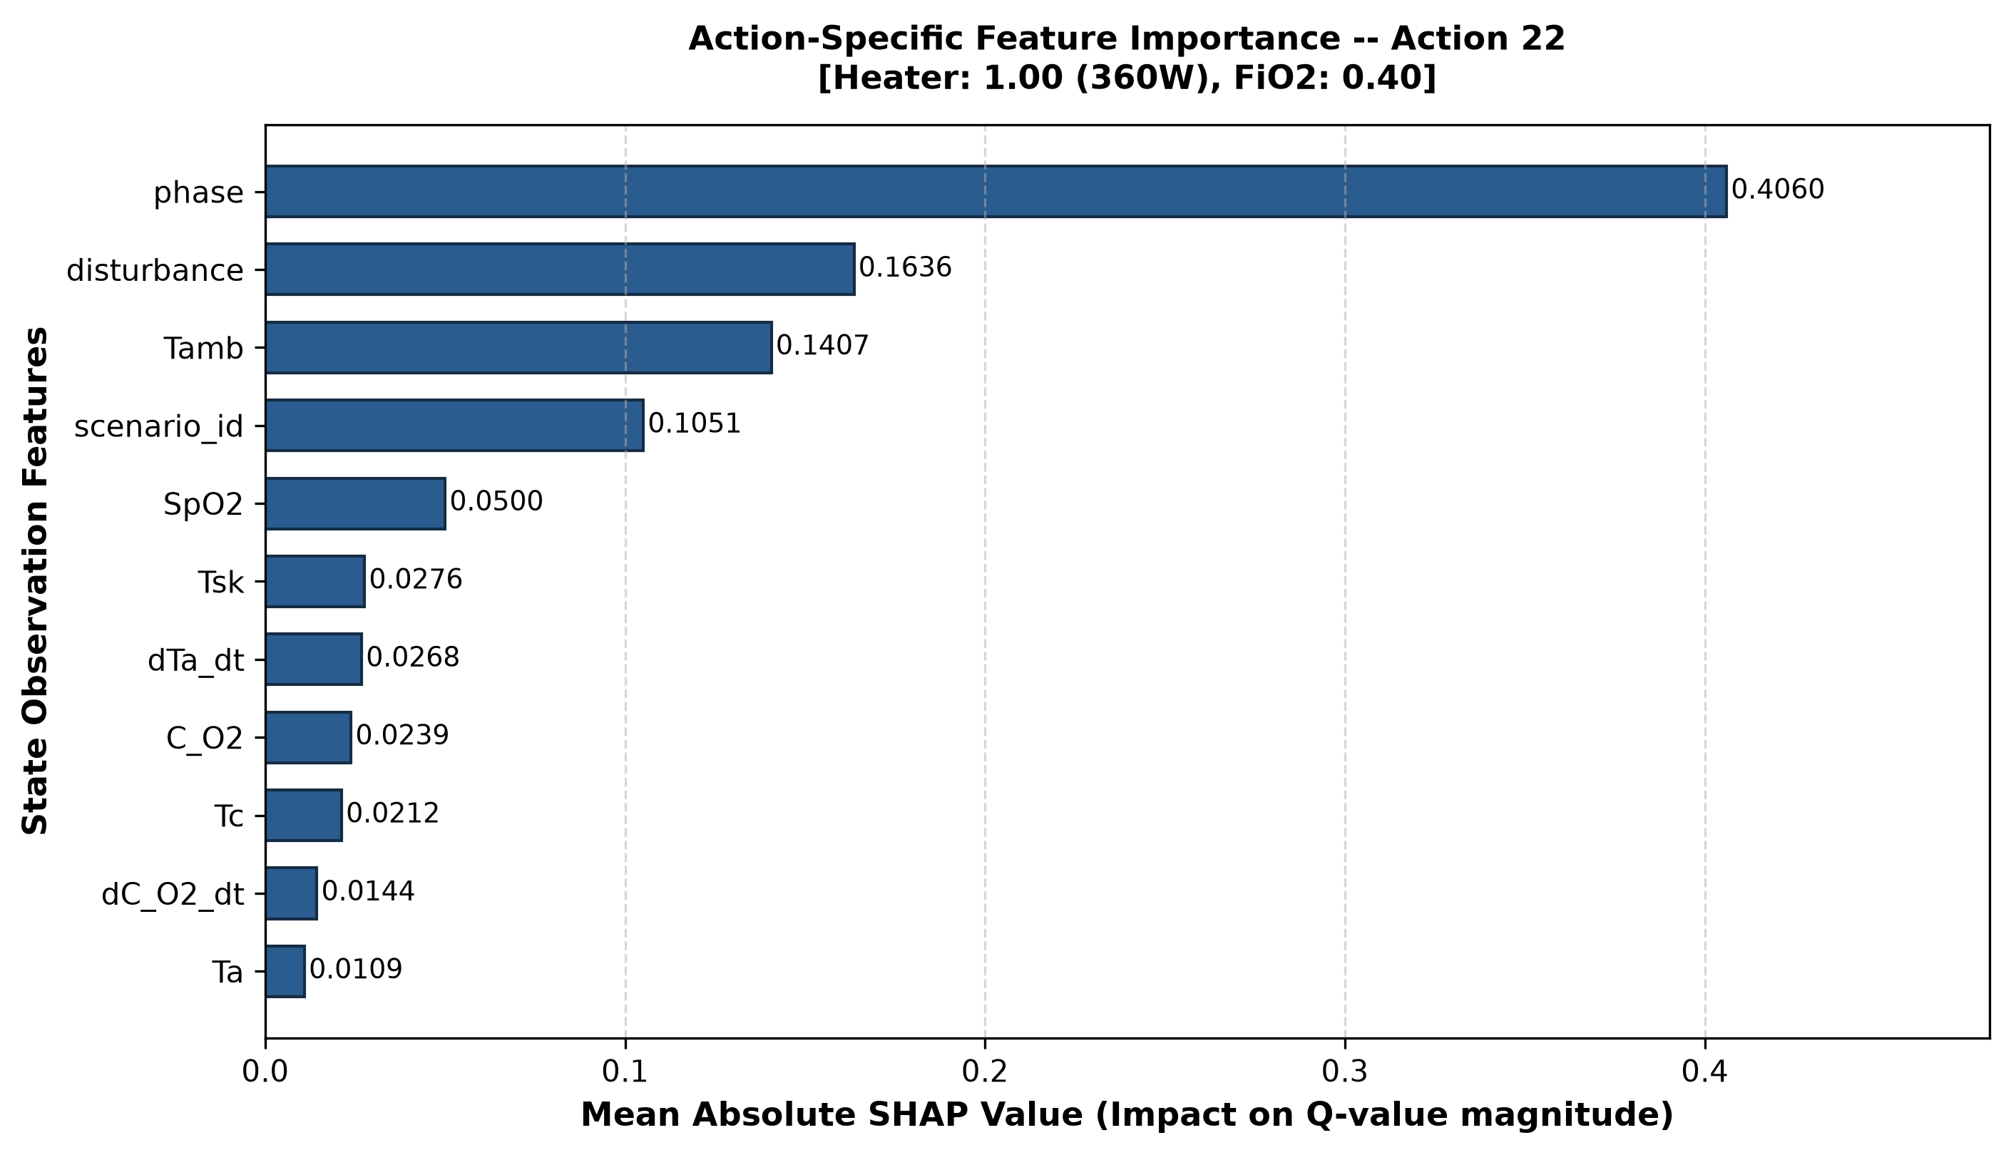
Feature importance depends on the Q head
Project source and frozen validation outputs
11
Notes:
Left: fixed action 22 (full heater, FiO2 0.40). Right: each state’s greedy action. Phase dominates both summaries, indicating dependence on the scripted timeline. This is model attribution, not a biological effect.
Sources: Project source and frozen validation outputs

Slide 12
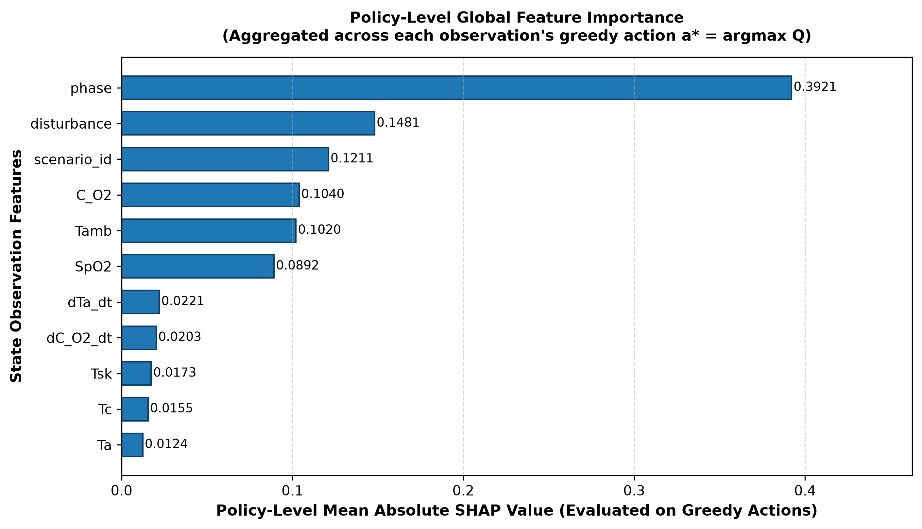
Importance across the selected actions
Project source and frozen validation outputs
12
Notes:
Selected-head importance pools each state’s greedy Q head. Phase has mean absolute attribution 0.3921. The fixed action 22 has phase attribution 0.4060. Both depend on the chosen reference distribution.
Sources: Project source and frozen validation outputs

Slide 13
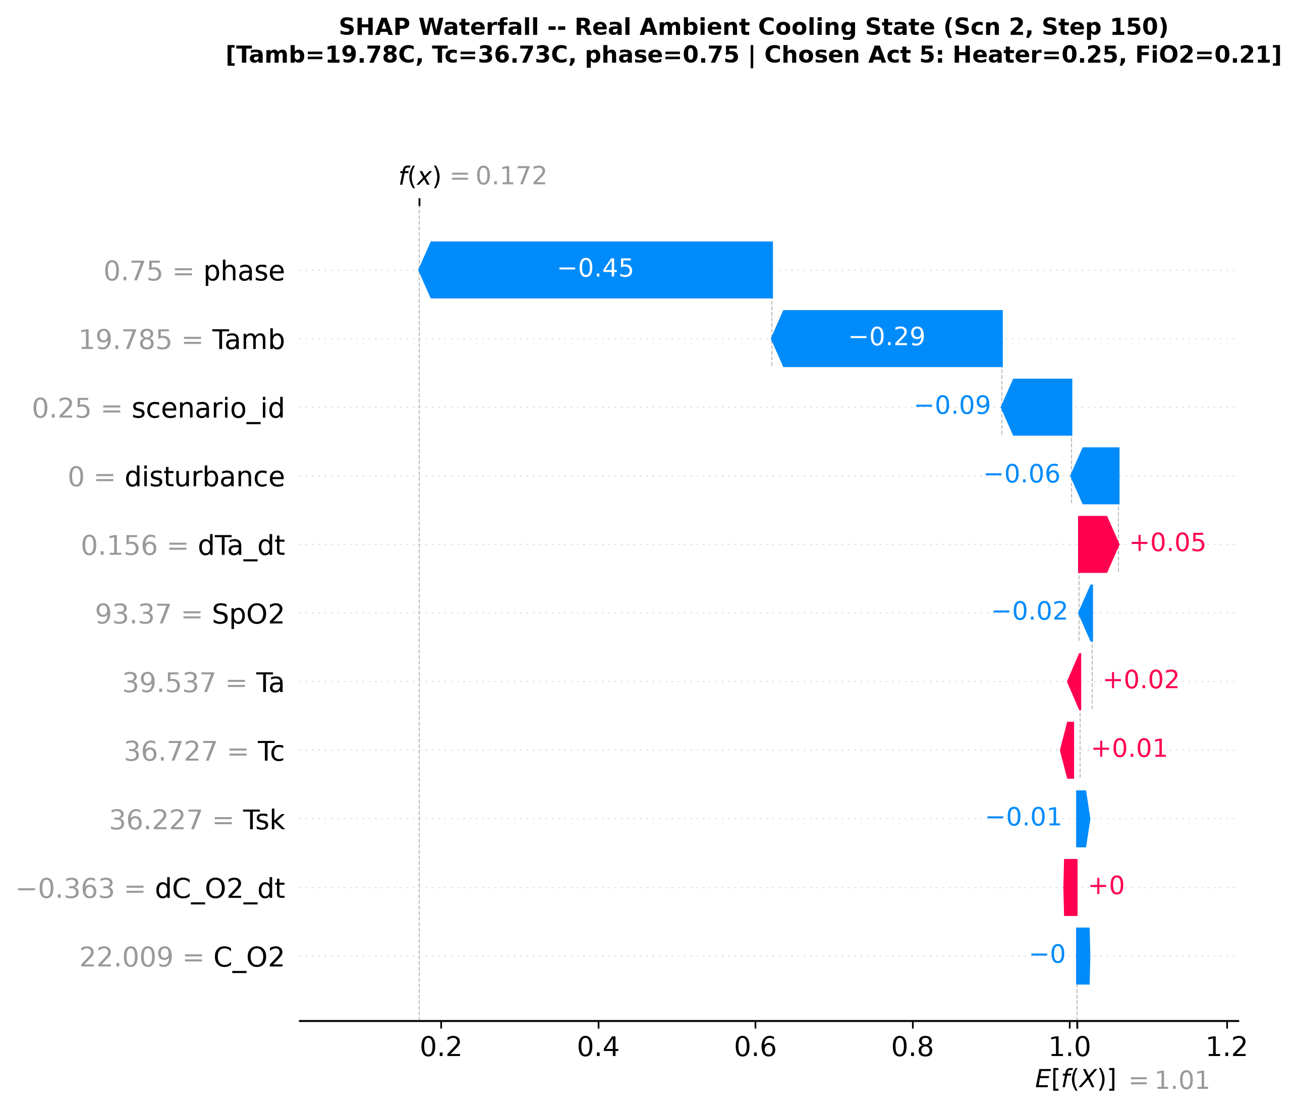
One actual ambient-cooling decision
Project source and frozen validation outputs
13
Notes:
Scenario 2, decision tick 150. The original checkpoint chooses action 5: heater fraction 0.25 and FiO2 0.21. Expected Q is about 1.0096 and actual Q is 0.1722. Features explain the estimated action value relative to the background, not whether that action is clinically appropriate.
Sources: Project source and frozen validation outputs

Slide 14
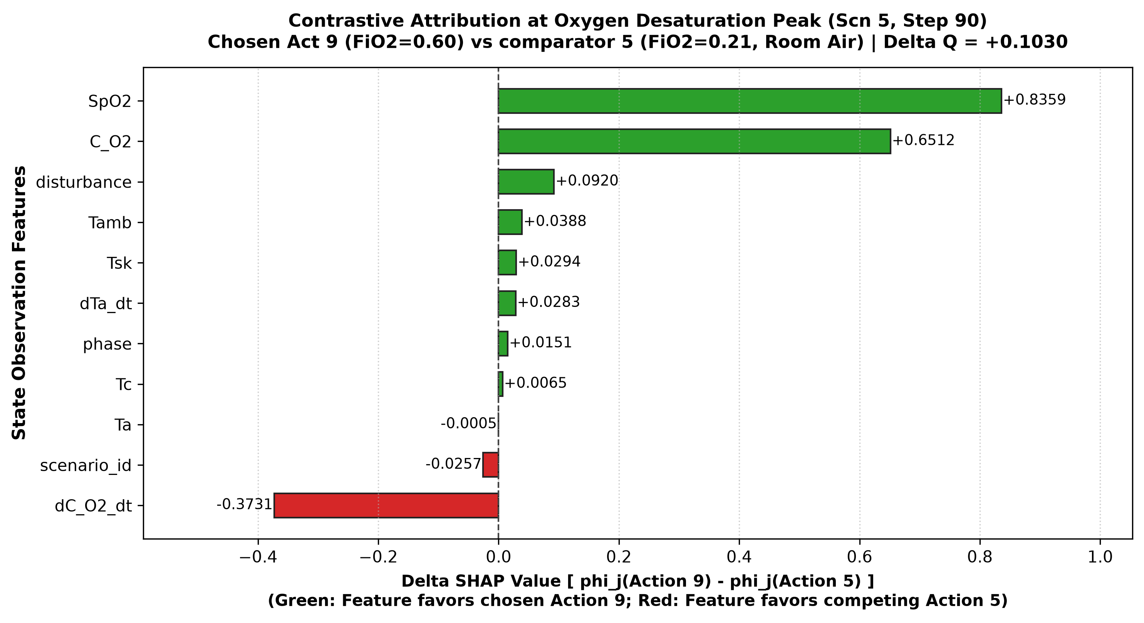
Why action 9 outranks action 5
Project source and frozen validation outputs
14
Notes:
Scenario 5, tick 90. Both actions use heater fraction 0.25, with FiO2 0.60 versus 0.21. The Q gap is +0.1030. Positive SpO2 and chamber-oxygen contributions offset a negative expected-value difference and other contributions.
Sources: Project source and frozen validation outputs

Slide 15
Five scenarios, different winners
Scenario | DDQN | Baseline | Difference
Normal | -25.63 | -10.18 | -15.44
Ambient cooling | -18.47 | -15.03 | -3.44
Porthole | -16.62 | -11.75 | -4.86
Hypothermia | -16.87 | -11.29 | -5.57
Oxygen desaturation | -25.71 | -66.16 | 40.45
Equal-scenario overall | -20.66 | -22.88 | +2.23
outputs/member03/validation/validation_episodes.csv
15
Notes:
Values are mean returns from five paired seeds per scenario. Baseline wins all 20 matched episodes in scenarios 1-4. DDQN wins all five oxygen-desaturation pairs. Overall weighting is equal across scenarios.
Sources: outputs/member03/validation/validation_episodes.csv

Slide 16
Return gains come with control trade-offs
Metric | DDQN | Baseline
Temperature time in band | 95.72% | 98.72%
SpO2 time in band | 81.62% | 95.26%
Mean normalized effort | 0.749 | 0.318
Heater energy per episode | 1111.97 kJ | 984.64 kJ
Joint-action switches / 199 opportunities | 184.44 | 120.12
Modeled hard-threshold terminations | 0 | 0
outputs/member03/validation/validation_summary.json
16
Notes:
Mean episode metrics over 25 episodes per controller. Zero modeled hard-threshold terminations is a simulated observation and supplies no evidence of clinical safety.
Sources: outputs/member03/validation/validation_summary.json

Slide 17
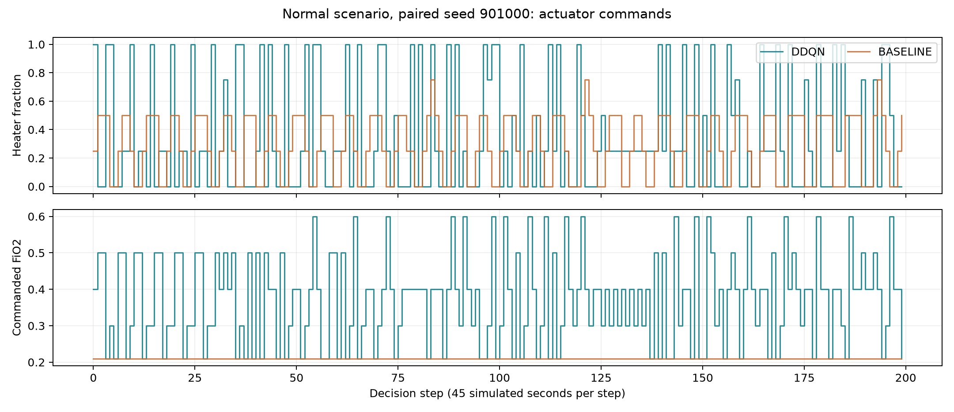
Actuator switching in a recorded episode
Project source and frozen validation outputs
17
Notes:
Normal scenario seed 901000, both controllers. This is one illustrative paired trajectory, not an average plot. The DDQN switches in 92.68% of adjacent decisions over all episodes. The reward penalizes actuator magnitude, not its rate of change. A causal switching-penalty experiment would require separate future training.
Sources: Project source and frozen validation outputs

Slide 18
Verification and reproducibility
95 regression tests, the Gymnasium checker and an independent replay check support the frozen benchmark.
Deep and Kernel runs use the full reference set. All 5,000 DDQN decisions have attributions.
Offline installation targets Windows x64 and CPython 3.14, with pinned TensorFlow RC and Keras nightly.
Current evaluation reproduces. Original training YAML bytes remain unavailable.
reports/checklist_evidence/; reproducibility/README.md; reports/FINAL_TEST_RESULTS.md
18
Notes:
The checkpoint and Member 01/02 implementations are unchanged. Fresh installation from the public index failed, so the delivery includes the exact local wheels with provenance and checksums. The historical training YAML hash mismatch remains explicitly unresolved.
Sources: reports/checklist_evidence/; reproducibility/README.md; reports/FINAL_TEST_RESULTS.md

Slide 19
Limitations and future work
Simplified physiology, one checkpoint, fixed disturbances and five seeds per scenario limit conclusions.
SHAP masking may create unrealistic feature combinations. Q estimates have no calibrated uncertainty.
Future work: observation-matched controls, unseen disturbances, sensor faults and actuator dynamics.
Simulation only. Not suitable for clinical deployment.
FINAL_PROJECT_HANDOVER.md; docs/RELATED_WORK.md
19
Notes:
No patient or hardware evaluation. Future changes must be evaluated separately against the preserved benchmark. SHAP cannot establish causality, uncertainty calibration or safety.
Sources: FINAL_PROJECT_HANDOVER.md; docs/RELATED_WORK.md

Slide 20
References
Kaltsogianni et al. (2025). Closed-loop automated oxygen control in late preterm and term, ventilated infants. doi:10.1111/apa.17549
van Hasselt, Guez & Silver (2016). Deep Reinforcement Learning with Double Q-learning. arxiv.org/abs/1509.06461
Lundberg & Lee (2017). A Unified Approach to Interpreting Model Predictions. arxiv.org/abs/1705.07874
SUPPORT Study Group (2010). Target Ranges of Oxygen Saturation in Extremely Preterm Infants. doi:10.1056/NEJMoa0911781
NICE NG124, recommendation 1.4.2: nice.org.uk/guidance/ng124/chapter/Recommendations
Full bibliography and comparison: docs/RELATED_WORK.md
20
Notes:
All titles and links checked against primary sources. SUPPORT oxygen-targeting is distinct from the CPAP/surfactant article formerly cited. NICE motivates the 91-95% target, not the simulator’s hard termination thresholds.
Sources: Full bibliography and comparison: docs/RELATED_WORK.md

Slide 21
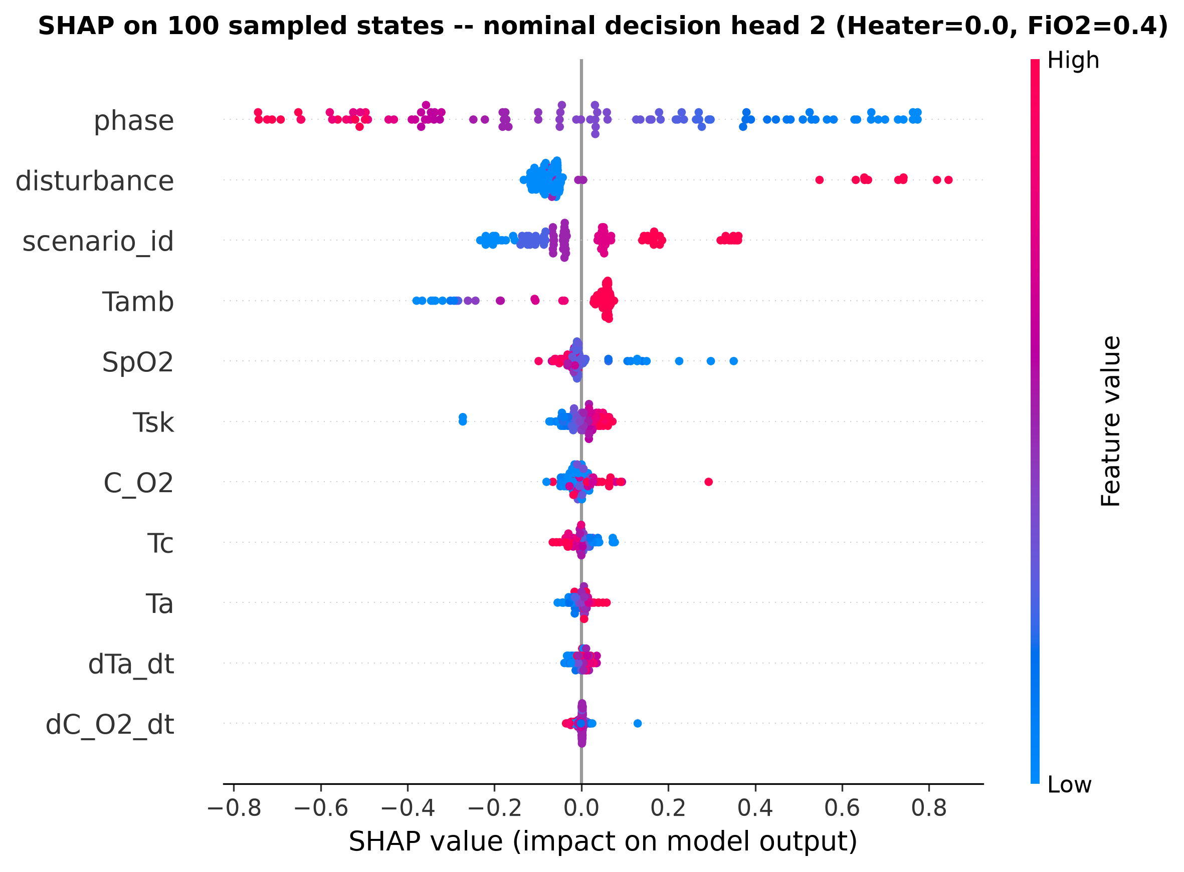
Appendix: fixed-head summary
Project source and frozen validation outputs
21
Notes:
This beeswarm explains nominal action 2 across the 100 reference states. It is not a policy-label explanation. Features are normalized for network inference.
Sources: Project source and frozen validation outputs

Slide 22
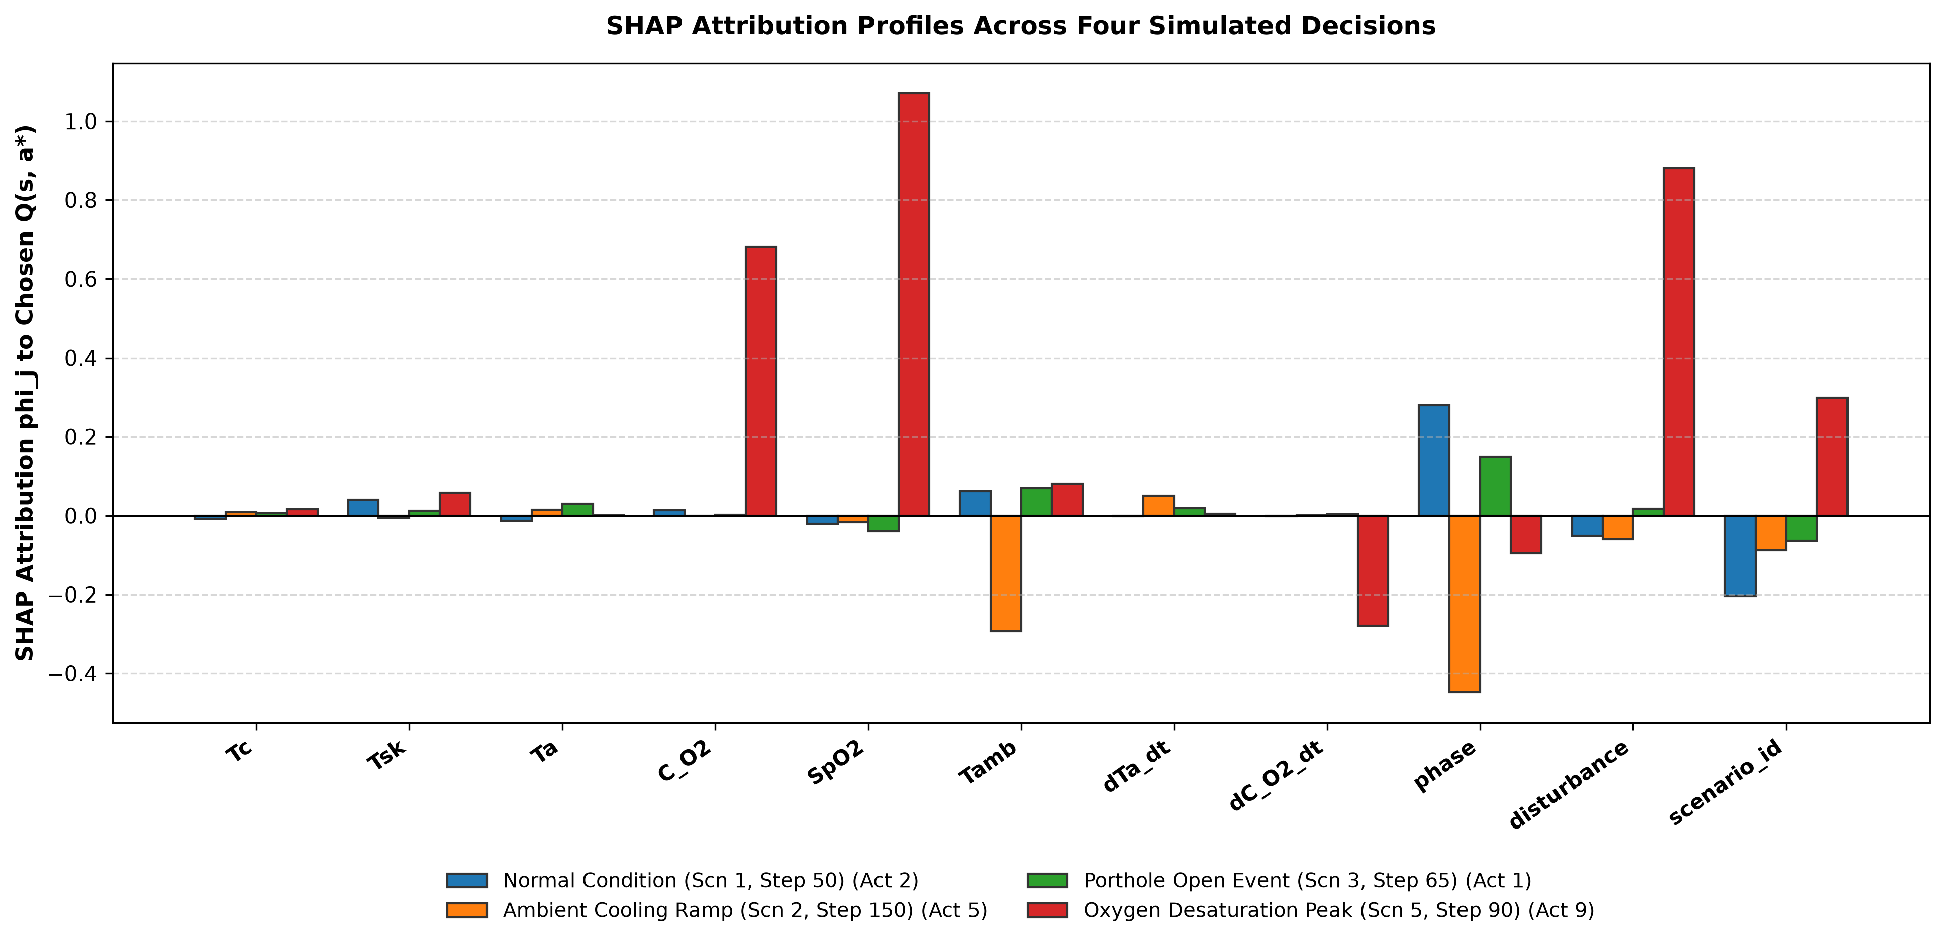
Appendix: four individual decisions
Project source and frozen validation outputs
22
Notes:
Different states and selected action heads are compared. Cross-scenario differences are descriptive and cannot establish causal effects.
Sources: Project source and frozen validation outputs

