Slide 1
SOURDOUGH: Synchrotron Observations Using Resolved Distributions Of Uptake, Geometry & Heterogeneity
Hassan Harb
Software Developer / Data Scientist
eBERlight Group
XSD
Sep 23, 2026

Slide 2
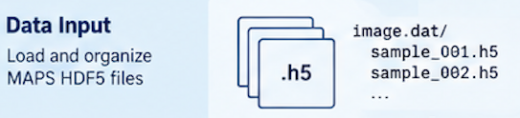
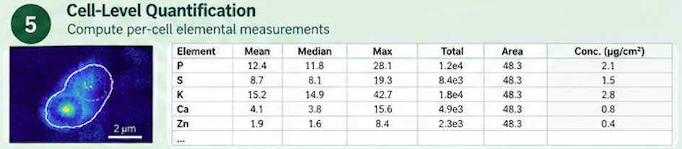
SOURDOUGH
Synchrotron Observations Using Resolved Distributions Of Uptake, Geometry & Heterogeneity
SOURDOUGH converts cellular XRF measurements into reviewed, quantitative, cell-level chemical datasets that scientists can compare across cells, mutants, and experimental conditions.

Slide 3
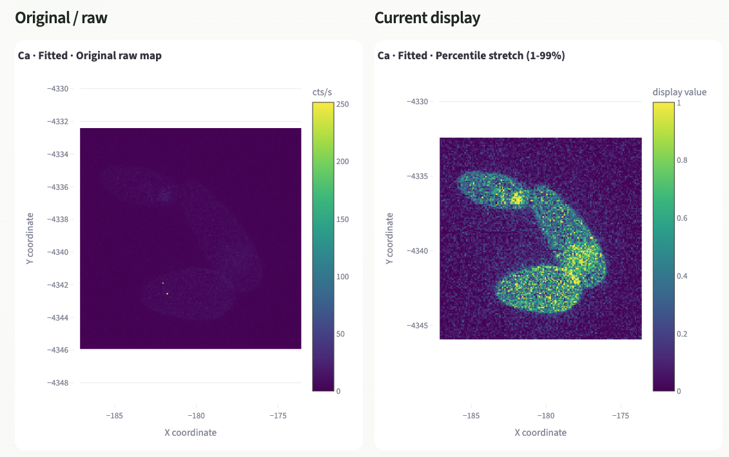
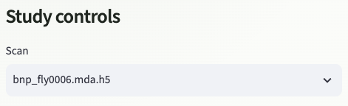

Quick showcase
Source file:
Element of interest:

Slide 4
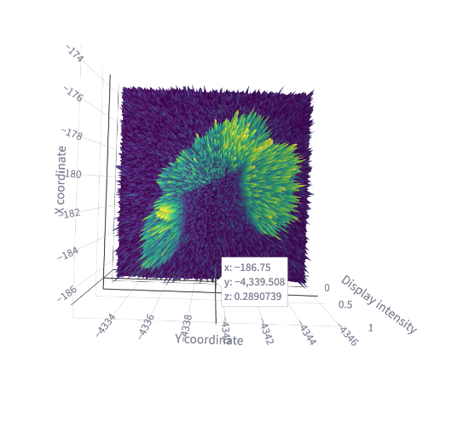
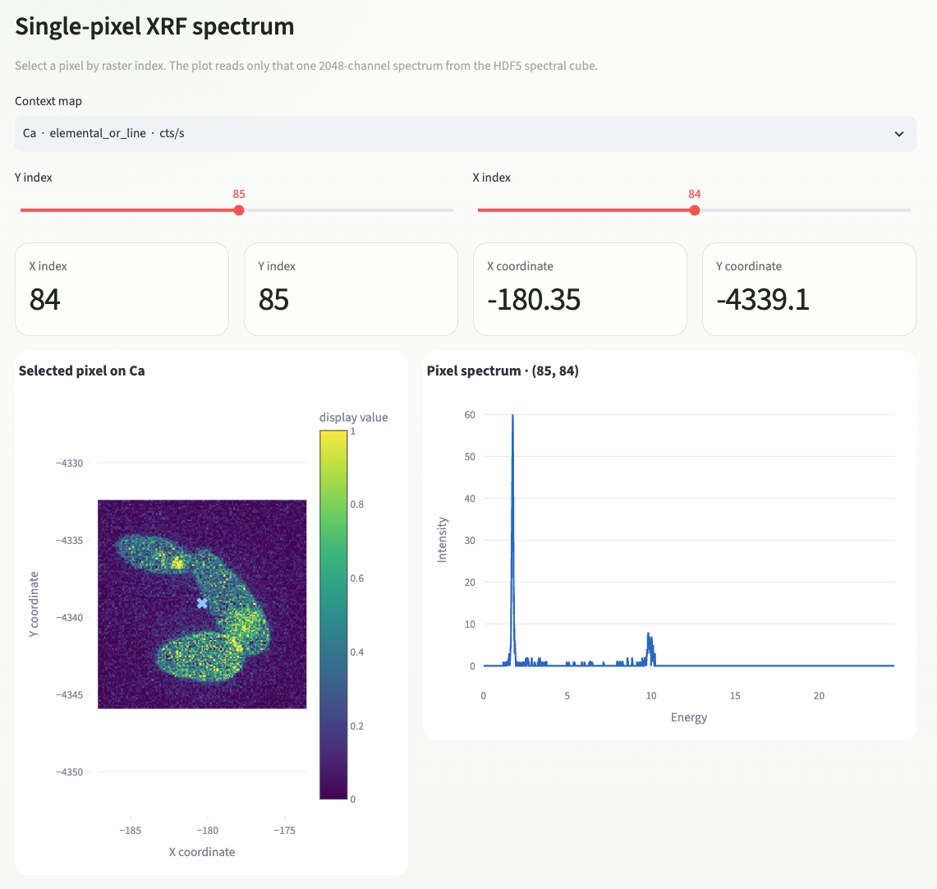
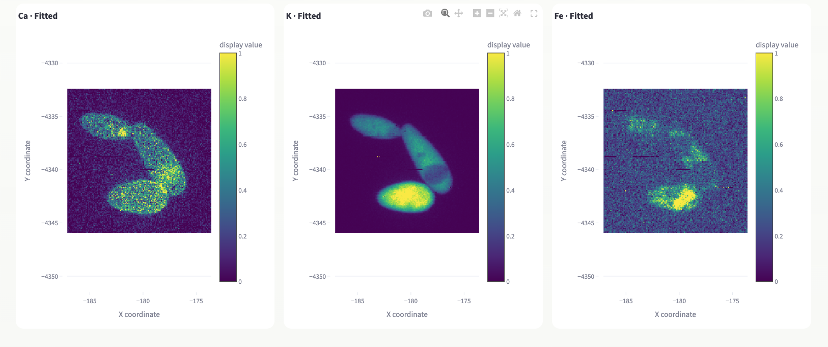
Quick Showcase
Side by side comparison
(Per element)
Interactive 3D surface
Single-pixel XRF visualizer
Demo (if time permits): http://localhost:8502/

Slide 5
In the works
Make measurements more reliable
Clean up problematic data
Improve cell identification
Add a review step for scientists
Build a complete profile for every cell
Discover patterns across many cells
Create clear reports and figures
Add an AI assistant at the end
Question:
If you had a magic wand, what would you want SOURDOUGH to do for you?

