Slide 1


Digital Design and Verification
For
SerDes System
Team members
Hassan Khaled Hassan
Abdelmagid Mohamed
Alaa Salah Abd-Elfattah
GP Final Discussion
Supervisor
Sponsored by
Dr. Ahmed M.Zaki

Slide 2
Overview on the project
USB-PHY & PIPE
USB-PHY Components
Clock and Data Recovery (CDR)
CDR Components
Phase Detector
Digital Loop Filter(DLF)
Phase Interpolator(PI)
CDR Integration
CDR Challenges
Verification On The System
Ending
Content

Slide 3
Overview on the project
USB-PHY & PIPE
USB-PHY Components
Clock and Data Recovery (CDR)
CDR Components
Phase Detector
Digital Loop Filter(DLF)
Phase Interpolator(PI)
CDR Integration
CDR Challenges
Verification On The System
Ending
Content

Slide 4
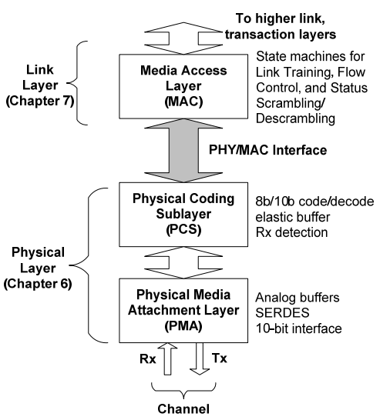
USB With PIPE

Slide 5
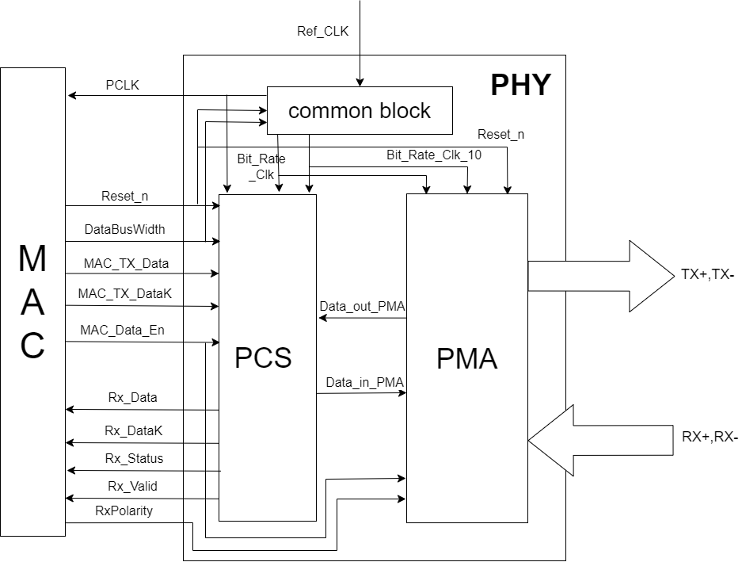
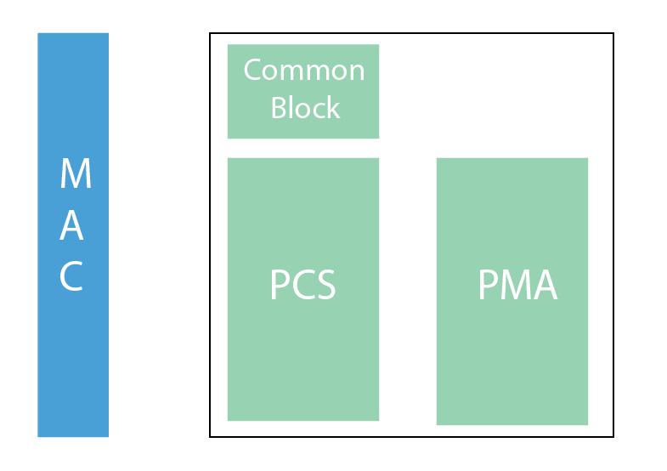
Physical Interface with PCIE & USB (PIPE)
PHY
PIPE

Slide 6
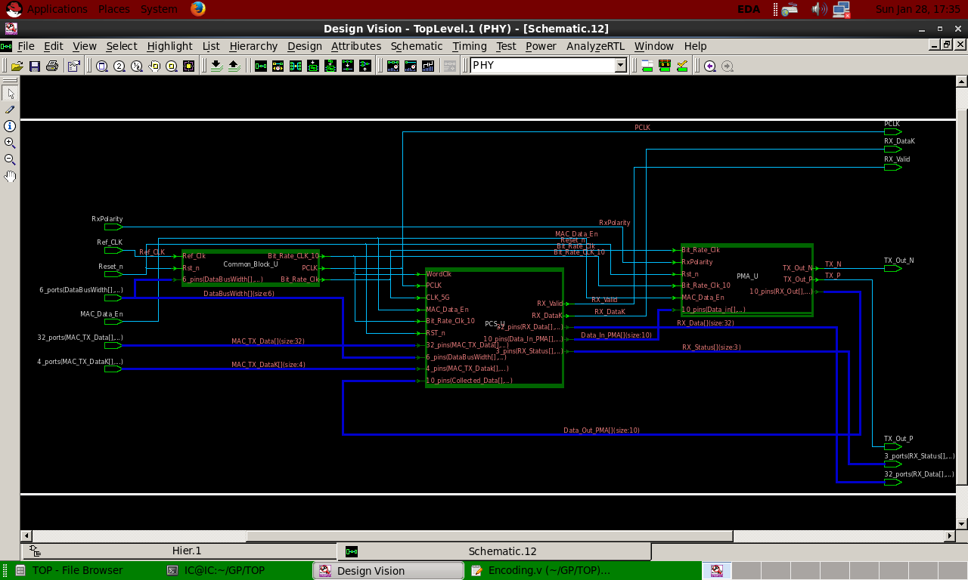

Slide 7
Introduction
Overview on the project
USB-PHY & PIPE
USB-PHY Components
Clock and Data Recovery (CDR)
CDR Components
Phase Detector
Digital Loop Filter(DLF)
Phase Interpolator(PI)
CDR Integration
CDR Challenges
Verification On The System
Ending
Content

Slide 8
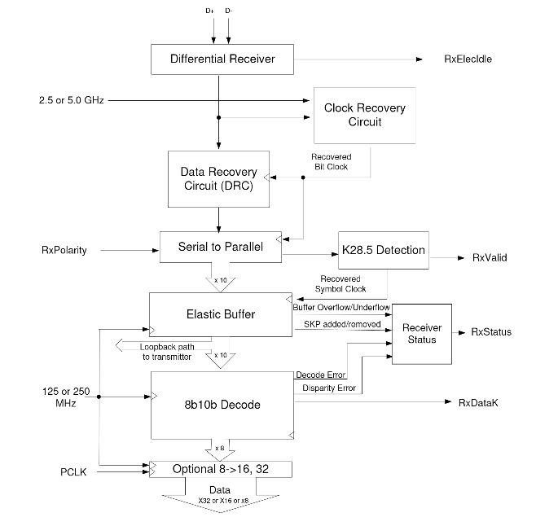
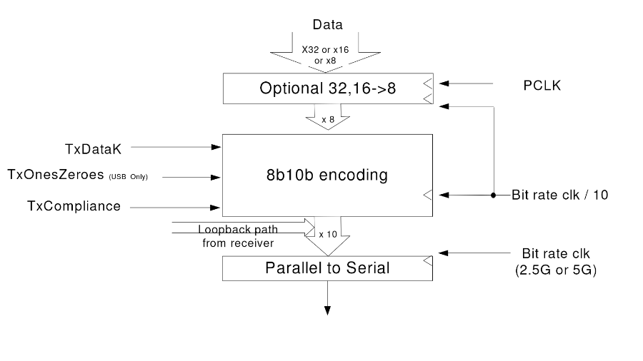
PCLK
Ref_CLK
Common Block
Bit_Rate_CLK
Bit_Rate_10_CLK
PHY-TX
PHY-RX

Slide 9

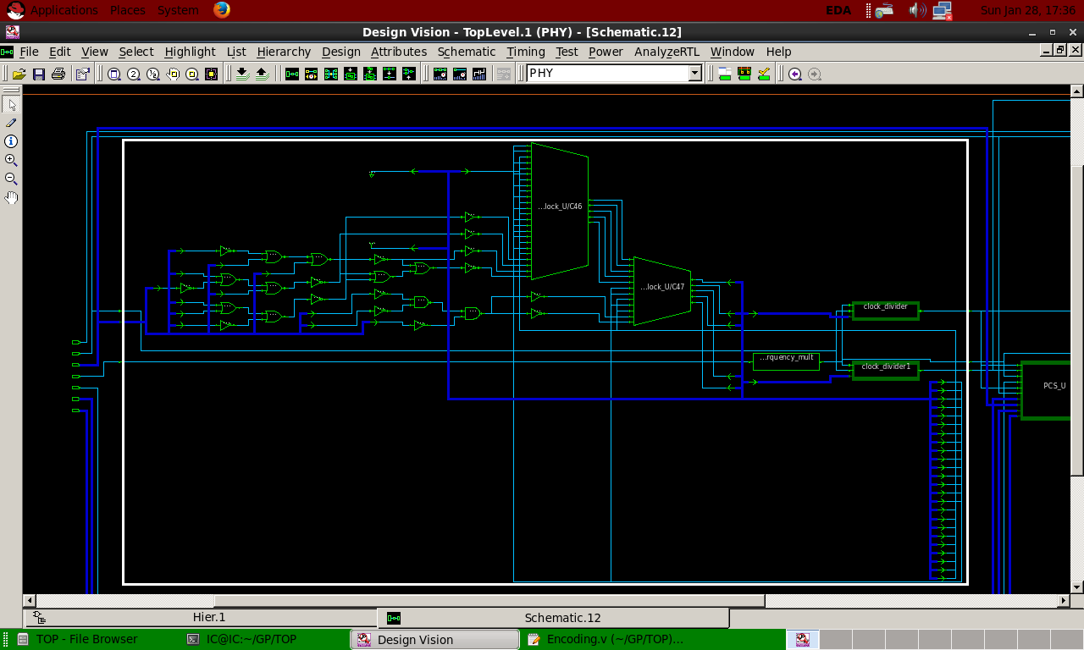
PCLK
Ref_CLK
Common Block
Bit_Rate_CLK
Bit_Rate_10_CLK
Common Block

Slide 10
PHY-TX
PCS-TX
PMA-TX

Slide 11
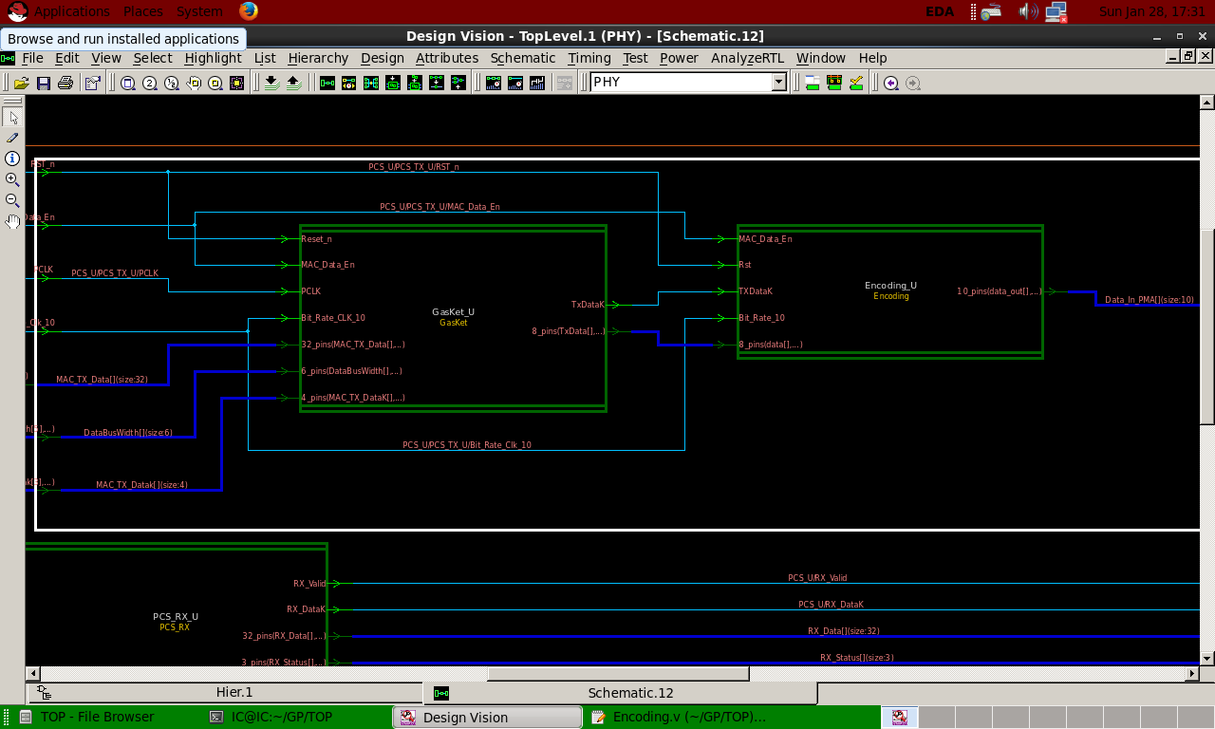
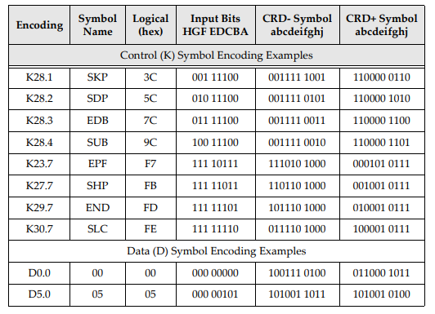
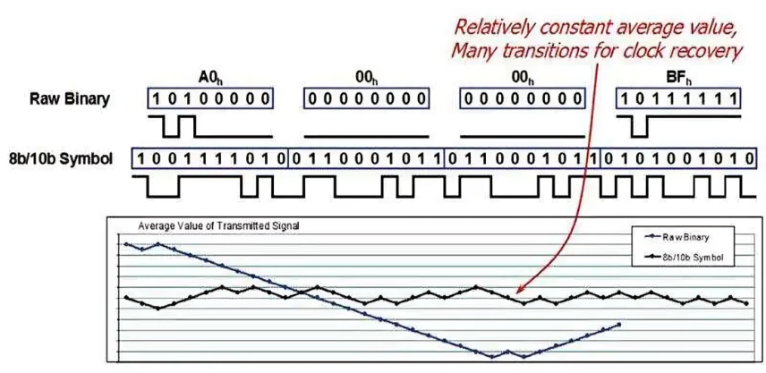
PCS-TX

Slide 12

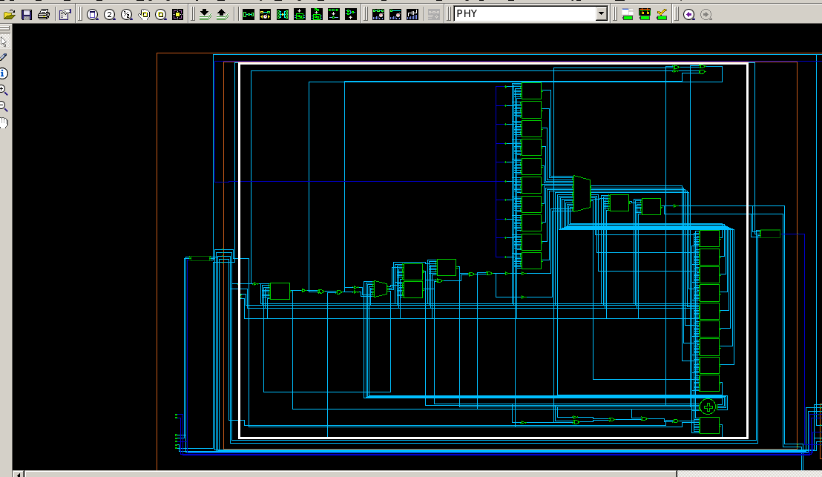
Parallel to Serial (P2S).
PMA-TX

Slide 13
PMA-RX
PHY-RX
PCS-RX

Slide 14
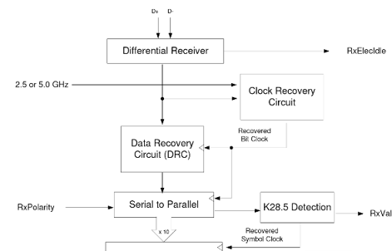
PMA-RX

Slide 15
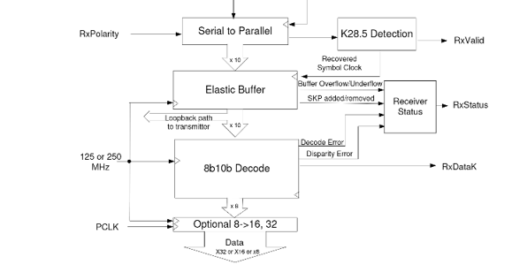
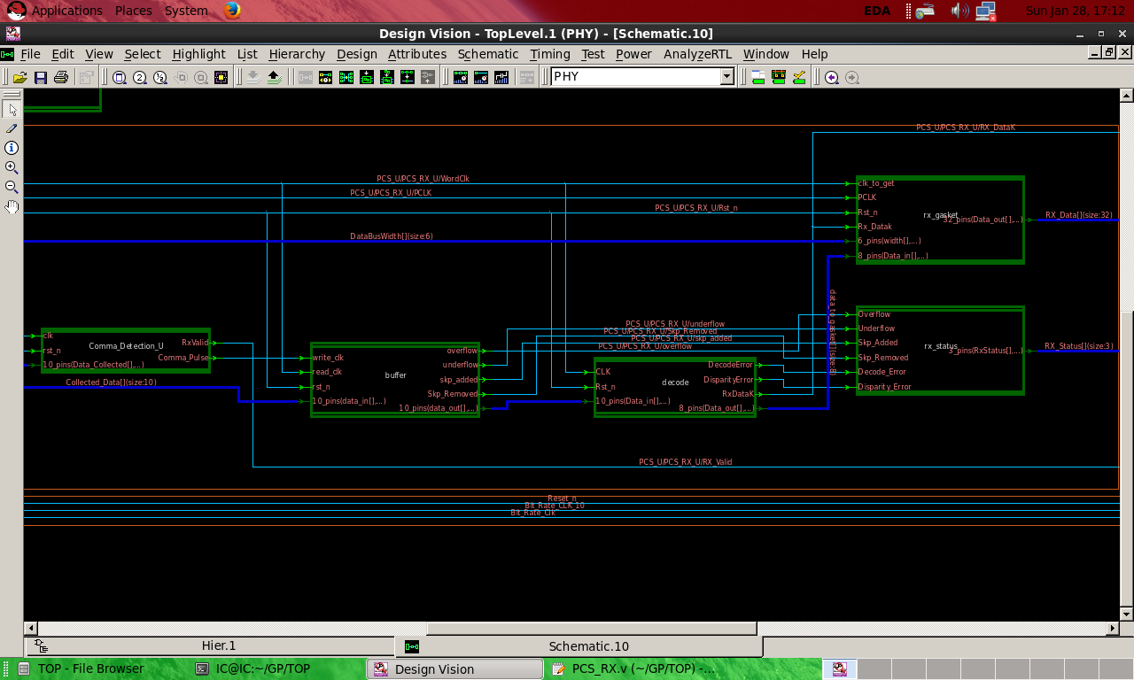
PCS-RX

Slide 16
Overview on the project
USB-PHY & PIPE
USB-PHY Components
Clock and Data Recovery (CDR)
CDR Components
Phase Detector
Digital Loop Filter(DLF)
Phase Interpolator(PI)
CDR Integration
CDR Challenges
Verification On The System
Ending
Content

Slide 17
Overview on the project
USB-PHY & PIPE
USB-PHY Components
Clock and Data Recovery (CDR)
CDR Components
Phase Detector
Digital Loop Filter(DLF)
Phase Interpolator(PI)
CDR Integration
CDR Challenges
Verification On The System
Ending
Content

Slide 18
CDR Has Three Main Components.

Slide 19
PI
PD
DLF
3
1
2

Slide 20
PD
Phase Detector

Slide 21
PI
PD
DLF
3
1
2

Slide 22
DLF
Digital Loop Filter

Slide 23
PI
PD
DLF
3
1
2

Slide 24
PI
Phase Interpolator

Slide 25
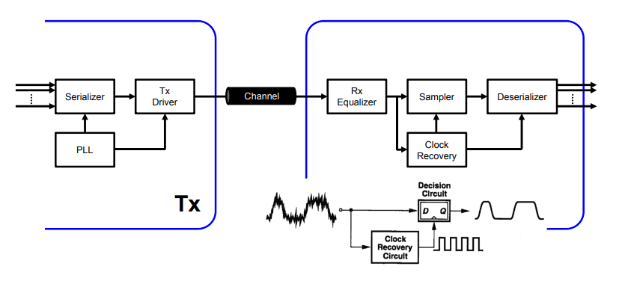
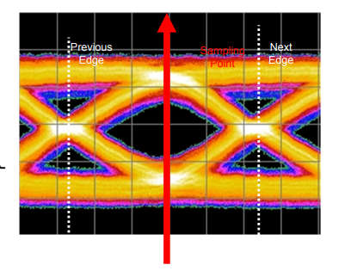
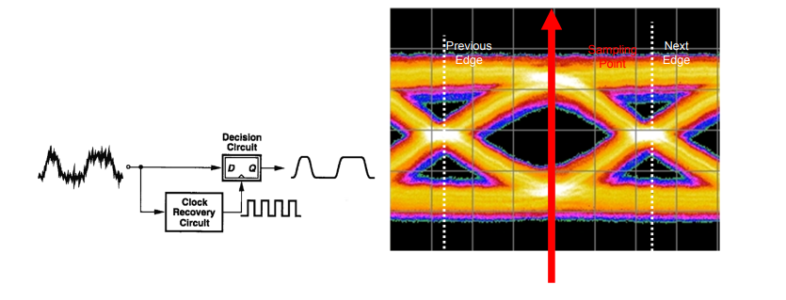
Integration With System

Slide 26
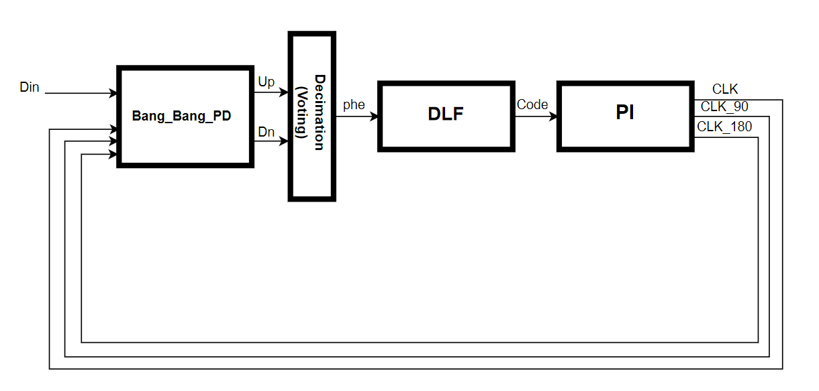

Slide 27
Channel
Content

Slide 28
Verification
Content

