Slide 1
FYP Evaluation: Presentation
Group Members:
Name: Muhammad Talha
Roll No: FA20-BCS-007
Name: Hassan Mahmood
Roll No: SP20-BCS-114
Supervisor:
Dr. Wajahat Mehmood Qazi

Slide 2
Deep Fake Text to Speech
DeepCloning.AI
Evaluator: Dr. Usama Bajwa

Slide 3
Introduction
Deepfake TTS(Text to Speech) uses AI technology for generating fake speech of targeted person using provided Input Text.
Voice Cloning involves the replication of a person's voice using AI techniques without their explicit knowledge.
Generated content doesn’t actually belongs to targeted person.

Slide 4
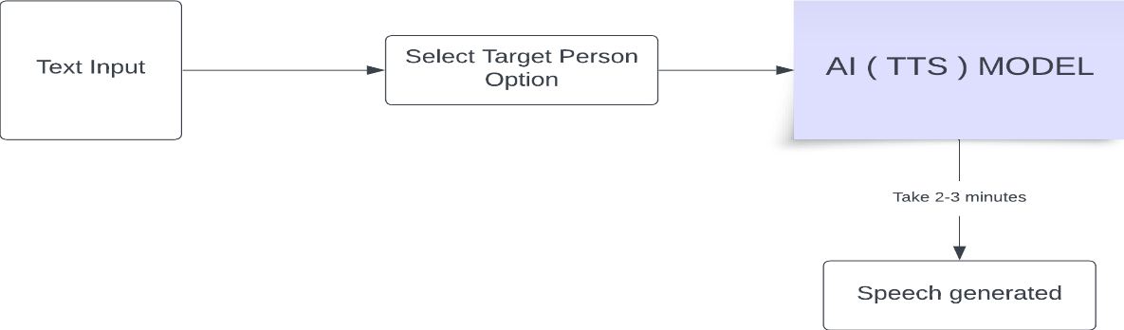
Process Diagram

Slide 5
Problem Statement
This Project aims the creation of Deepfakes text to speech on a single person dataset.
The cloning of target person should have nearly realistic results. Focusing on high quality generated results.
Developing End-to-End application Web Application includes feature of Text-to-Speech and voice Cloning.

Slide 6
Success Criteria
Our project's success is measured by achieving satisfactory accuracy in creating Deepfake voices from input and ensuring efficient real-time performance with minimum output generating time approx. (3-4 mins) and providing User-friendly UI.
Generation Time
satisfactory Results
User-Friendly App

Slide 7
Literature Review
Initially, we don’t have much understanding related to Deepfakes.
We explored an Research Paper Audio_Deepfakes: A Survey by Zahra Khanjani.
Provides initial understanding related to deepfake tts and voice cloning.

Slide 8
Literature Review (suno-bark)
Started Searching AI Models for deepfake cloning, Firstly explored Suno-bark TTS (source-code).
Suno-bark is a transformer-based text-to-audio model .
Can generate highly realistic, multilingual speeches.
Produce nonverbal communications like laughing, sighing and crying.
TTS feature provided in 13 languages with over 100+ speakers.
Limitation: Currently, suno-bark repository on GitHub doesn't provide official training scripts, which makes fine-tuning on custom dataset difficult.

Slide 9
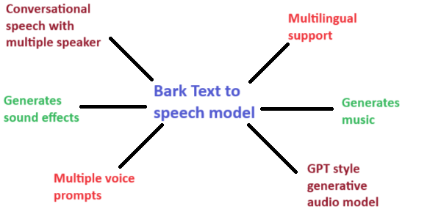
Literature Review (suno-bark)

Slide 10
Literature Review (RVC)
Explored another model, Retrieval-based voice Conversion (RVC). Which is a voice cloning model (speech-to-speech).
RVC is a pre-trained, Trained on the Large dataset. Retrieves similar voice segments from a pre-trained database.
Eliminates the need for large amounts of specific target speaker data.
Faster Training & Lower Requirements.
Dataset is Independent of the Language. If I train model in English dataset, can be used on Urdu voice Input.
Limitation: Potential for artifacts to get realistic Results, as voice emotions are influenced by the provided Input.

Slide 11
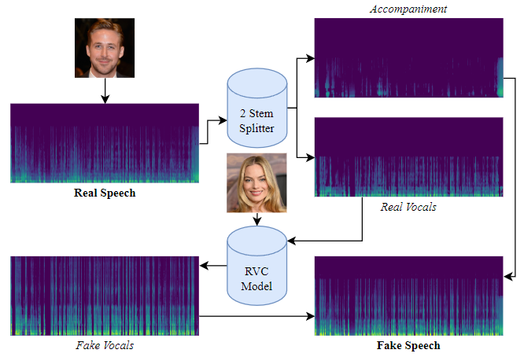
RVC Model

Slide 12
Literature Review (TTS)
We Explored some best available TTS model with voice cloning Capabilities.
Tortoise TTS is a very expressive TTS system with impressive voice cloning capabilities based on an GPT like autogressive acoustic model.
It has Strong Multi-Voice Capabilities means having multiple speakers options with various styles.
Tortoise excels at voice cloning. You can provide audio samples of a specific speaker.
Emotional Nuance: Through "prompt engineering," you can influence the emotional tone of the speech by adding prompts within the text.

Slide 13
Literature Review (TTS)
Tortoise TTS is a Slower model and need resources like GPU for usage.
XTTS is a super cool Text-to-Speech model that lets you clone voices in different languages built on the Tortoise tts.
Built on Tortoise, XTTS has important model changes that make cross-language voice cloning. XTTS-v2 supports 16 languages.
There is no need for an excessive amount of training data.
Its the same model that powers Coqui Studio, and Coqui API.

Slide 14
Methodology
Firstly, we decided of using suno-bark TTS. It’s a great model with good community support but with limitations.
As, we need to have a voice cloning feature on custom dataset. So, Currently, suno-bark repository on GitHub doesn't provide official training scripts, which makes fine-tuning on custom dataset difficult.
Moreover, execution time for suno-bark is also not feasible to use.

Slide 15
Methodology
Then, decided to use RVC, this model provides the WEBUI (gradio) for model training and usage. (source-code).
Challenges faced for using this Model,
Initially to test, we train Model, uses Sunder Pichai dataset (20 minutes) on Colab.
It took more than 8 hours to train on 400 epochs.
For testing results, we downloaded 5GB model files, uses on local machine.
In its source code, no Inference end-Points (API) provided for using this Model in our Application as it’s provide a gradio-based Web-UI.
GPU Required
No API End-point
Huge model

Slide 16
Methodology
As, no API end-point provided. Which makes it not feasible to use this way. After search, we find to use RVC model through Replicate.
RVC model on Replicate w provides inference API feature with model training.
Further GPU for training provided by Replicate Nvidia A40 (16GB).
Step by Step docs provided and model can be use with JavaScript as well.
It’s a paid service, but price for using model with GPU is not much.
GPU Provided
API End-point
Fast Excecuation

Slide 17
Methodology
For Voice Cloning, we Use RVC Model. But for Text-to-Speech, we tried different approaches.
WebAPI:
Converting Text to default person speech using web-API and then this speech pass to RVC model as Input.
But this approach has Limitations as results are not promising.
Tortoise TTS:
Then Uses Tortoise TTS. We provided it Input, and Targeted person voice for Cloning.
Limitation as take lot of time generating Ouptut even using GPU.
Results up till yet obtain, are not satisfactory

Slide 18
Methodology
For Voice Cloning, we Use RVC Model. But for Text-to-Speech, we tried different approaches.
XTTS:
Its Similar to Tortoise. Generate output very quickly.
Limitation as Results are not Promising but better than Tortoise.
We uses this model to Extract speech in given voice and then Passes it to RVC for better results.
Note: We are still working on Tortoise TTS and XTTS for achieving better results.

Slide 19
Voice Cloning Work Flow
On replicate, firstly we train the model on three different datasets.
Datasets includes Sir Wajahat Qazi (~20 mins), Imran Khan (~70 m) and Talha (~20 m) .
Training took time between 1 hour to 3 hrs.
Dataset prepared using Audacity tool.

Slide 20
Parameters for Training Model
Voice Cloning Work Flow
Epochs = 80 | 120
Batch Size = 7
f0Method = rmvpe
Sample_rate = 48k hz
f0Method: Feature Extracting Algorithms.
Rmvpe (most Popular)
Harvest
Dio

Slide 21
Voice Cloning Work Flow
Dataset Preparation Guide
For Audio Processing, we used Audacity, which provide almost all these features.
Background Noise Removal
Reducing Echo
Voice Pitch in -12 to 12 HZ:
Vocal Segmenting
Vocal Isolation / Doubling

Slide 22
Voice Cloning Work Flow
Cloning Input Voice
Provide clear Input Audio in mp3/wav format.
Input not more than 2 mins. Upload File or Record using App.
Set parameters includes target_Person, Pitch_detection_algo, reverb, protect, rms_mix_rate .
It took around 2-3 minutes to generate Output. Sample result shown in first slides.

Slide 23
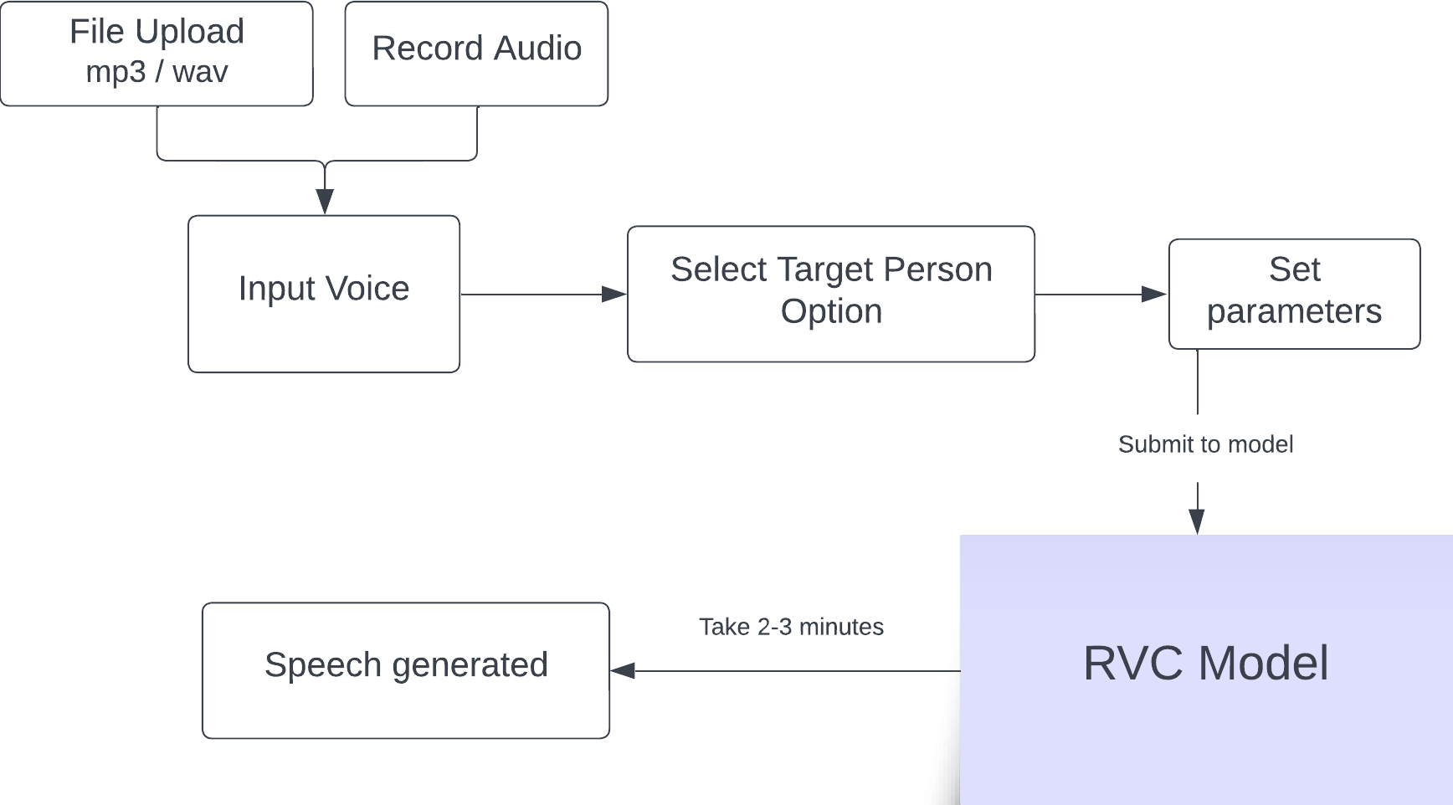
Voice Cloning Workflow

Slide 24
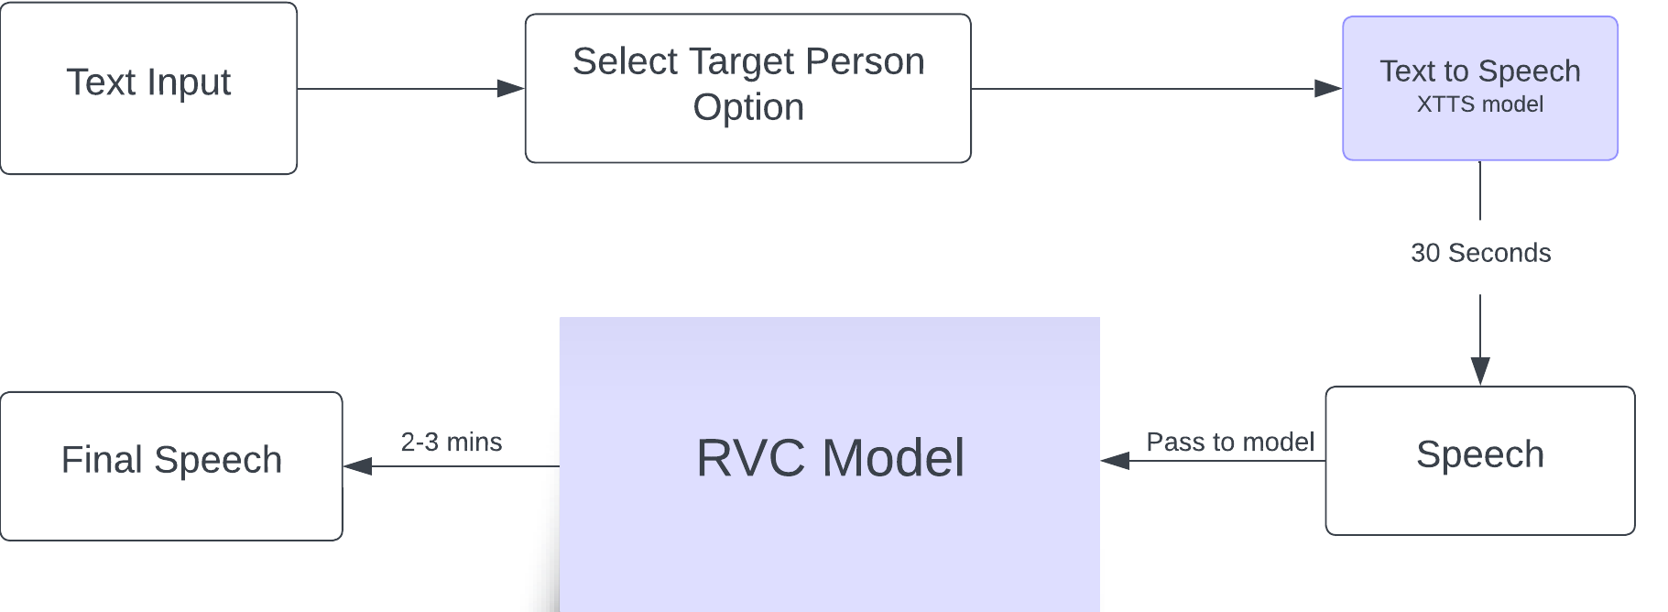
Text to Speech workflow

Slide 25
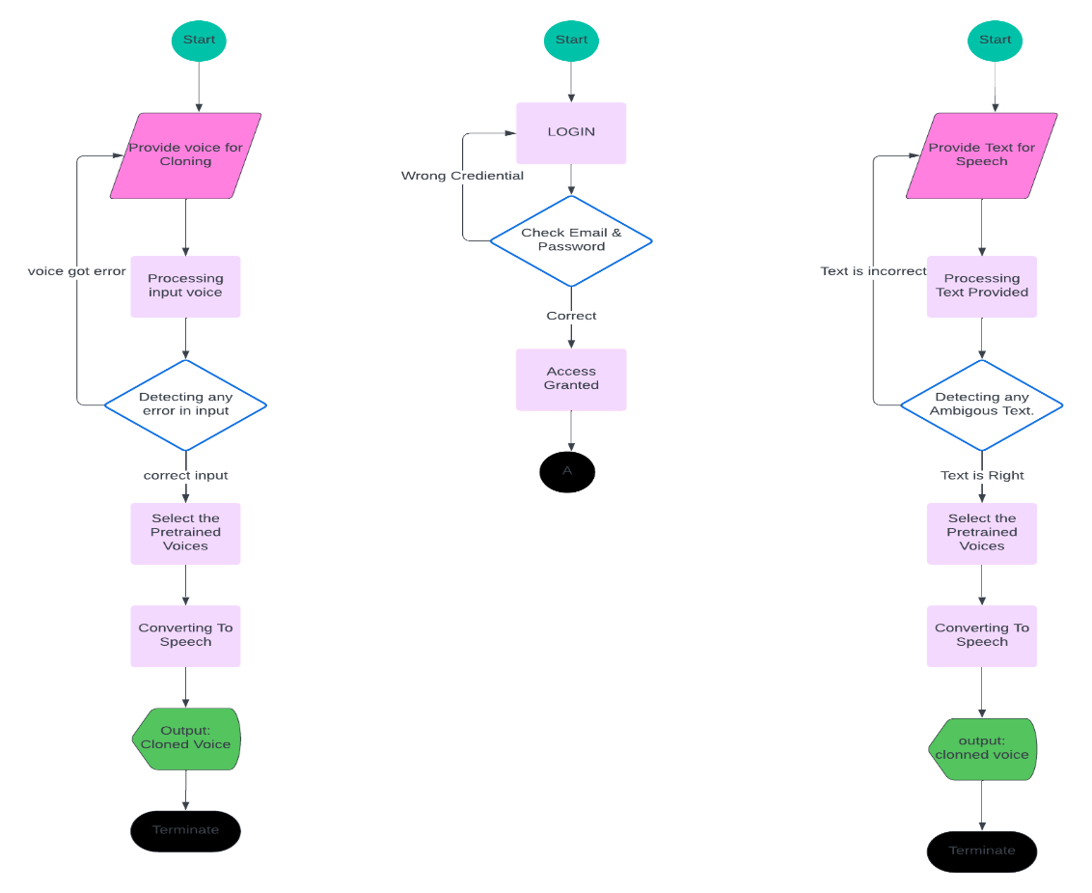
Application Architecture

Slide 26
Future Work
Working on TTS and completing this system.
Making App UI experience more better.
Documentation.
App Deployment.

Slide 27
Resources & Source Code
https://github.com/HassanMahmoodAwan/DeepFake-FYP-Project

