Slide 1

Diabetes
BY:Hasan Mohamed

Slide 2
Problem Statement
These data sets are all women and testing them to see if they have diabetes
I'm working with John Hopkins To review this data and print an article with the findings
There isn’t enough articles specifically describing the chances for women to get diabetes or not

Slide 3
Benefit Statement
This will give women a more in-depth description of there bodies
Leading to them seeing what they need to do for there body in order to never get diabetes

Slide 4
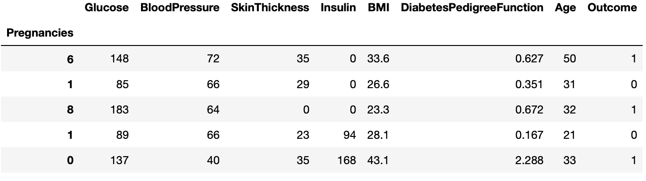
Data set 1

Slide 5
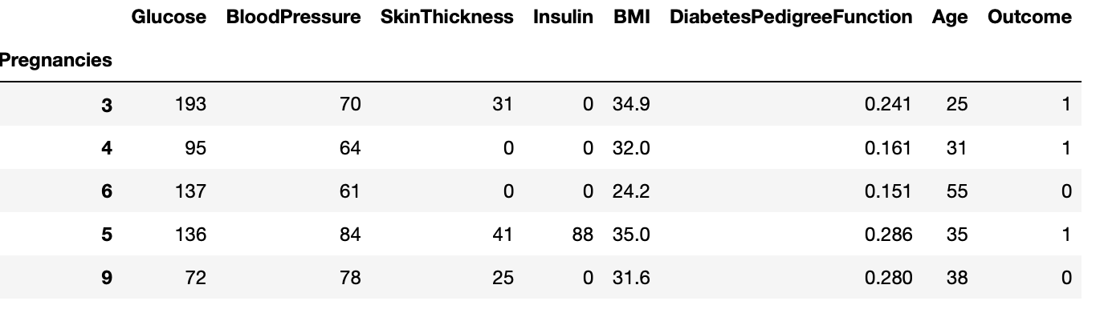
Data set 2

Slide 6
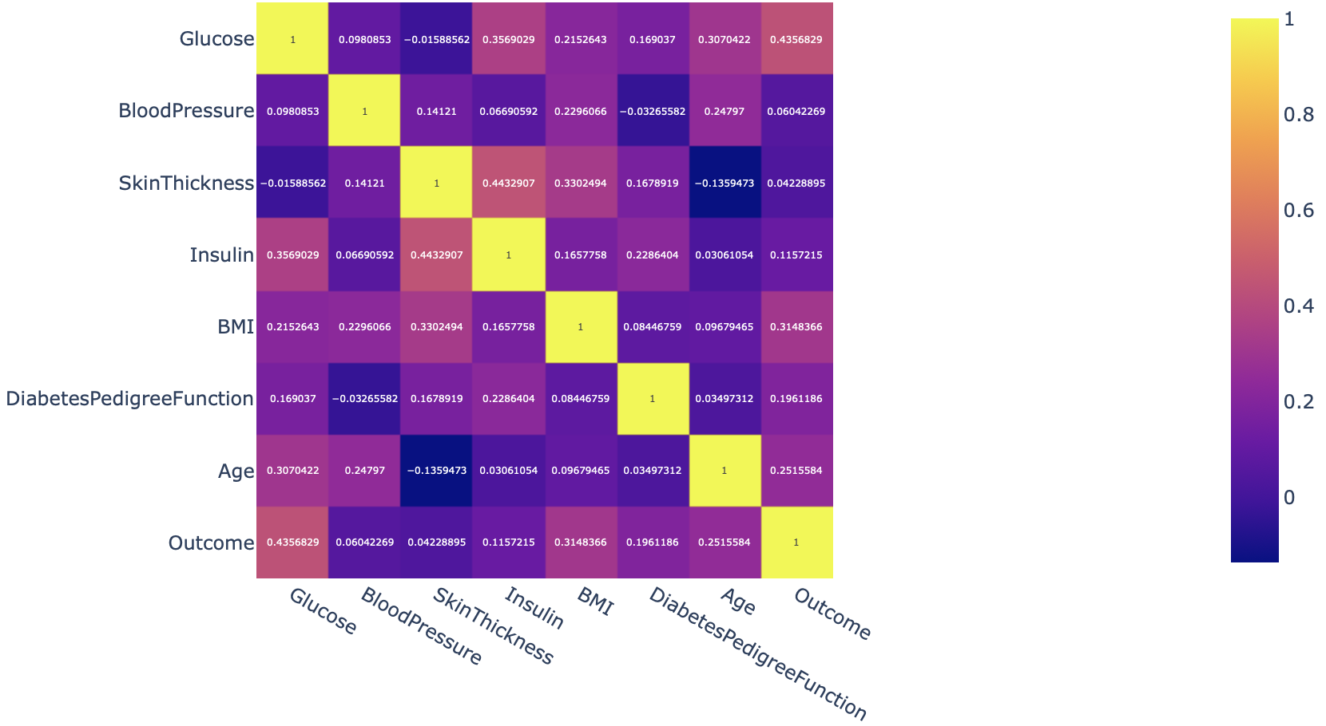
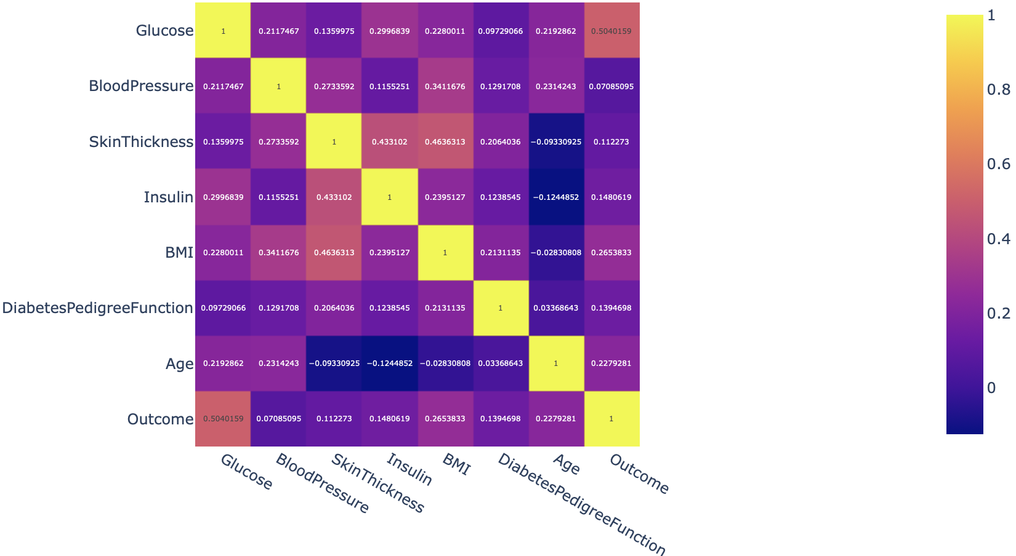
Heat diagrams

Slide 7
Machine learning
Data1: logistic regression 76% - Decision tree 100%
Data2: logistic regression 20%

Slide 8
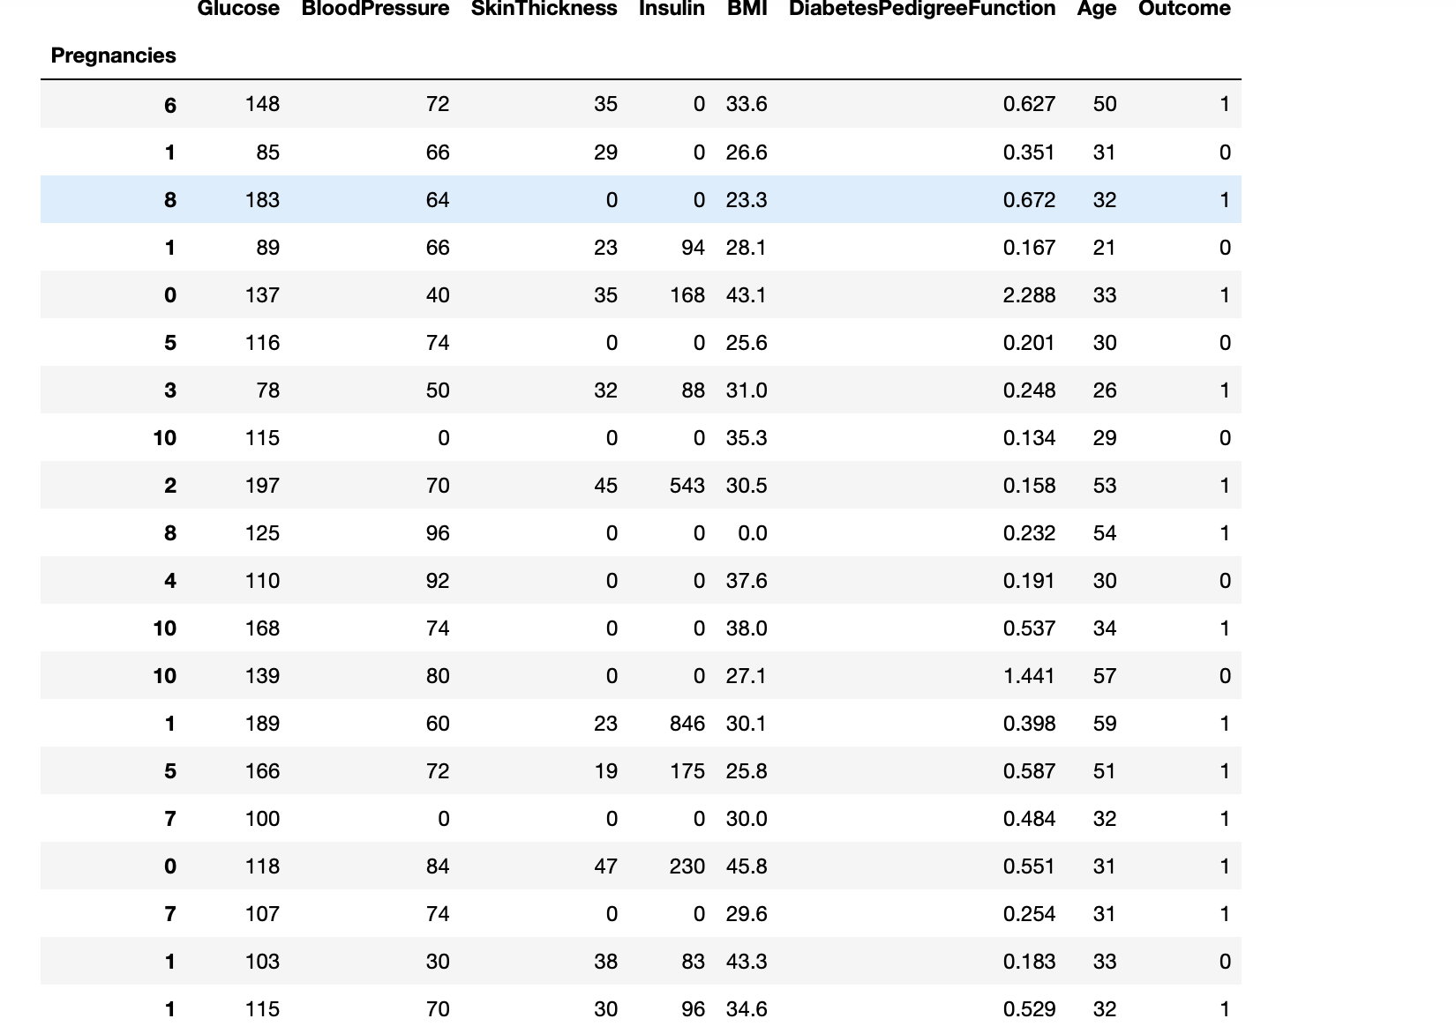
Concatenation Merge

Slide 9
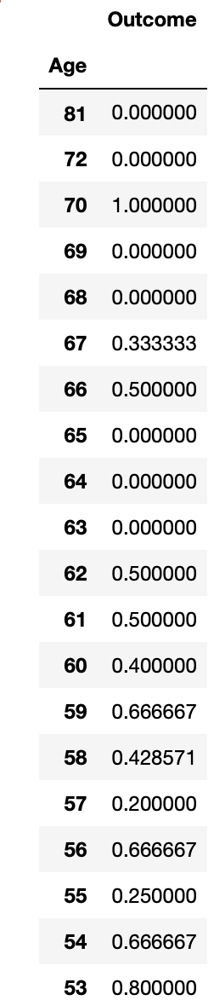
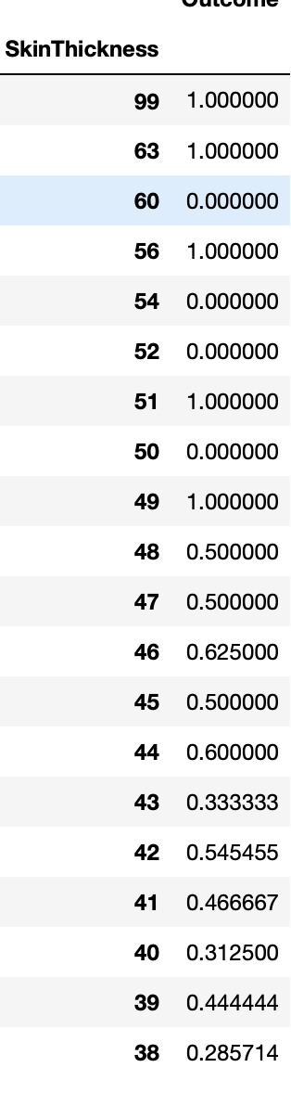
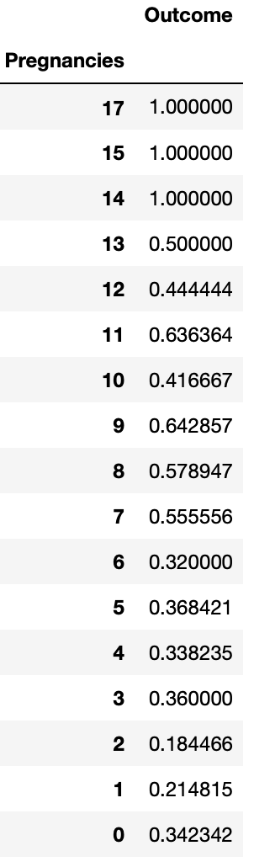
Group by

Slide 10
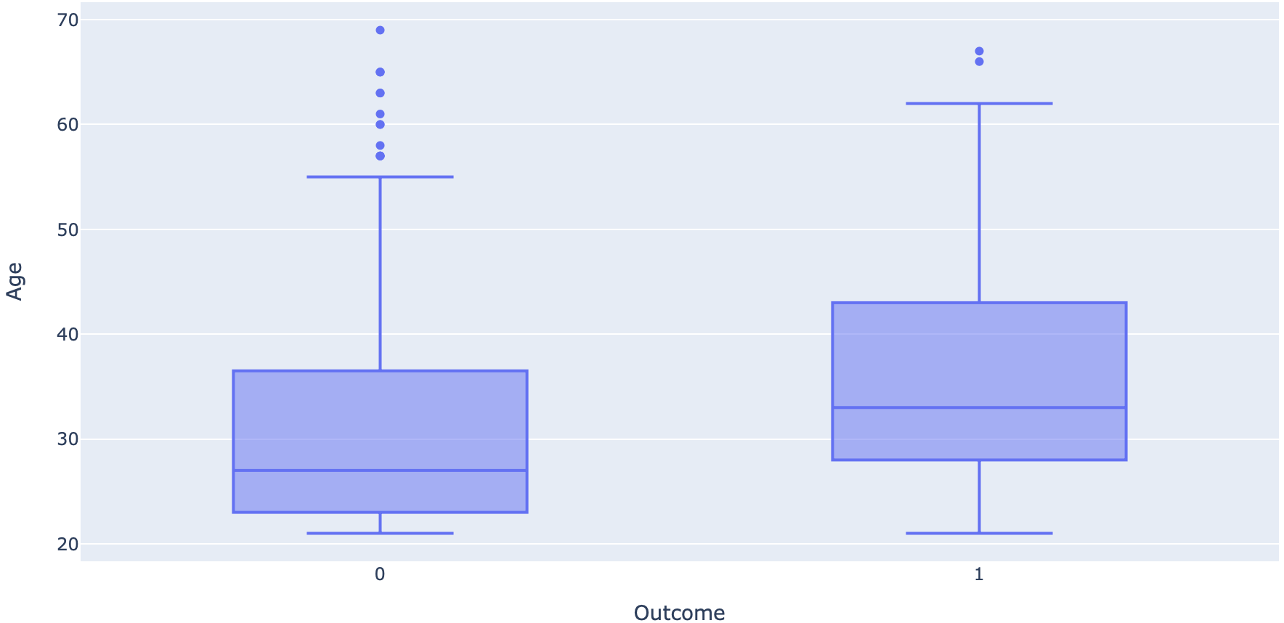
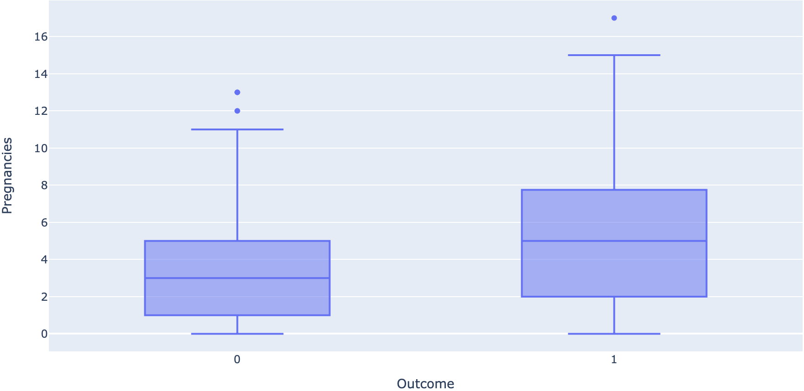
graphs

Slide 11
Insight
A new thing I discovered is skin thickness does play a role in getting diabetes never
I was able to support the theory that your family history does play a part in getting diabetes
I disagree with the theory that age plays such a big role its manly 50 50
Also, the most important one which separate's women and men completely is pregnancies
I found that The more pregnancies you have the more likely you are to getting diabetes

Slide 12
Recommendations
Printing this article, the biggest thing I would say is if you a mother of multiple children you need to be careful with you eating habits
Also, that you should get a full diabetes test every 6 months For people that have a history of diabetes or or have had children

Slide 13
Future work
There needs to be much more testing of women in the future so there can be much more accurate readings

