Slide 1
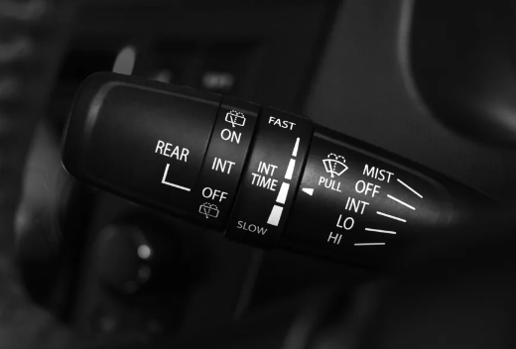
Full-Project Of
Wiper Controller System
Using Stateflow
Implementation & Testing
By:
Hassan Mohamed Hassan

Slide 2
Specifications
It is used to control the speeds of wiper through controlling the PWM of the DC motor of it.
Speeds of wiper change based on chosen mode
Modes are:
OFF
Low-speed
High-speed
Auto

Slide 3
Parameters
Parameter | Direction | Data_type | Function | Min | Max | Description
Wipr_Mod | Input | Uint8 | The mode of operation | 0 | 3 | 0 ➔ OFF 1 ➔ Auto 2 ➔ Low_speed 3 ➔ High_speed
Rain_Snsr_Err | Input | Bool | The error of the rain sensor | 0 | 1 | 0 ➔ Normal 1 ➔ Error
Wipr_Spd_Req | Input | Uint8 | Required speed level in case of auto mode | 0 | 7 | Vector of speeds [0 1 2 3 4 5 6 7]
Wipr_Pwm_Duty_Cyc | Output | Single | PWM command to wiper motor | 0 | 1 | Motor PWM
Wipr_Act | Output | Bool | Indication if motor is running | 0 | 1 | 0 ➔ Stop 1 ➔ Running

Slide 4
Requirements
Wiper system shall set Wipr_Pwm_Duty_Cyc with ‘0’ if Wipr_Mod is OFF.
Wiper system shall set Wipr_Pwm_Duty_Cyc with ‘40%’ if Wipr_Mod is Low_speed.
Wiper system shall set Wipr_Pwm_Duty_Cyc with ‘70%’ if Wipr_Mod is High_speed.
Wiper system shall set Wipr_Pwm_Duty_Cyc with ‘0’ if Wipr_Mod is Auto and Rain_Snsr_Err is True.
Wiper system shall set Wipr_Pwm_Duty_Cyc with a value of PWM table corresponding for Wipr_Spd_Req if Wipr_Mod is Auto and Rain_Snsr_Err is False.
Wiper system shall set Wipr_Act with ‘0’ if system is not activated.
Wiper system shall set Wipr_Act with ‘1’ if system is activated.
Sampling time is 10 ms.
Wipr_Spd_Req | 0 | 1 | 2 | 3 | 4 | 5 | 6 | 7
PWM | 0% | 40% | 45% | 50% | 55% | 60% | 65% | 70%

Slide 5
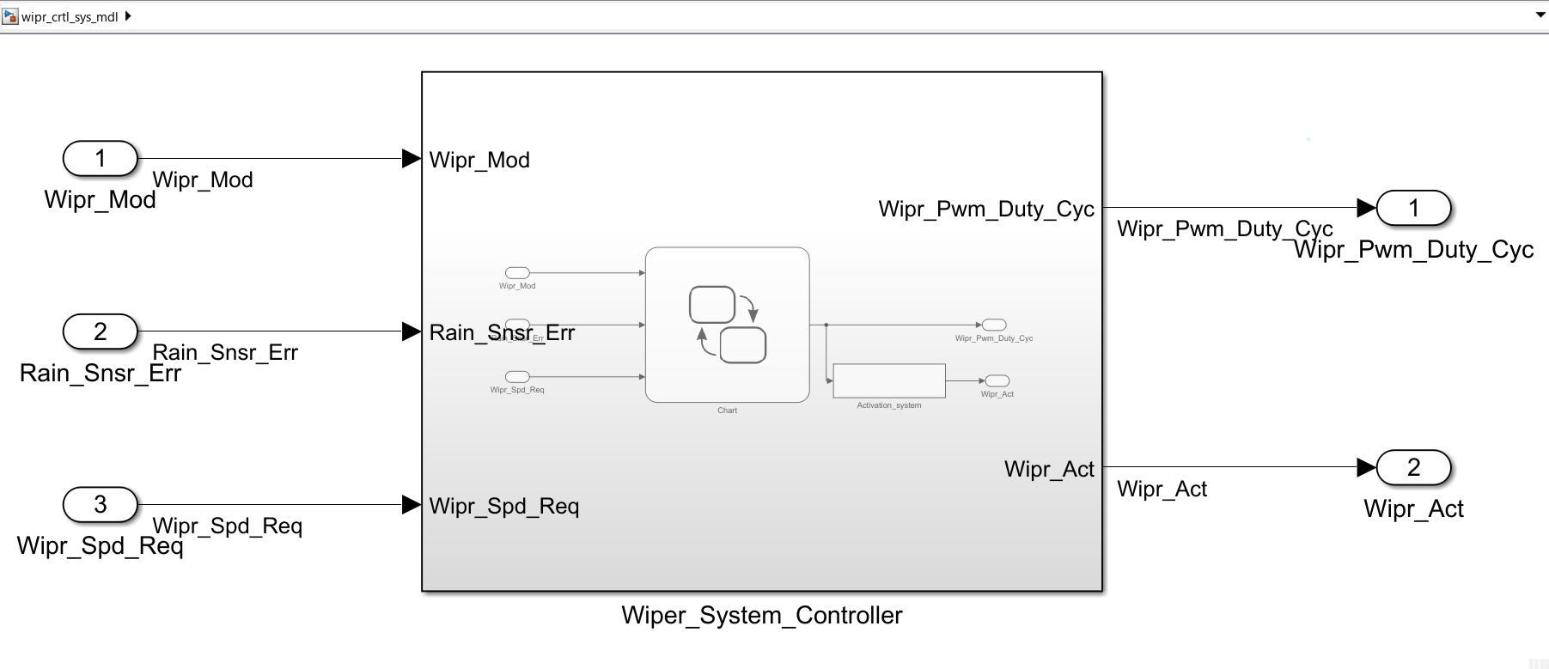
Simulink System Model 1st Level

Slide 6
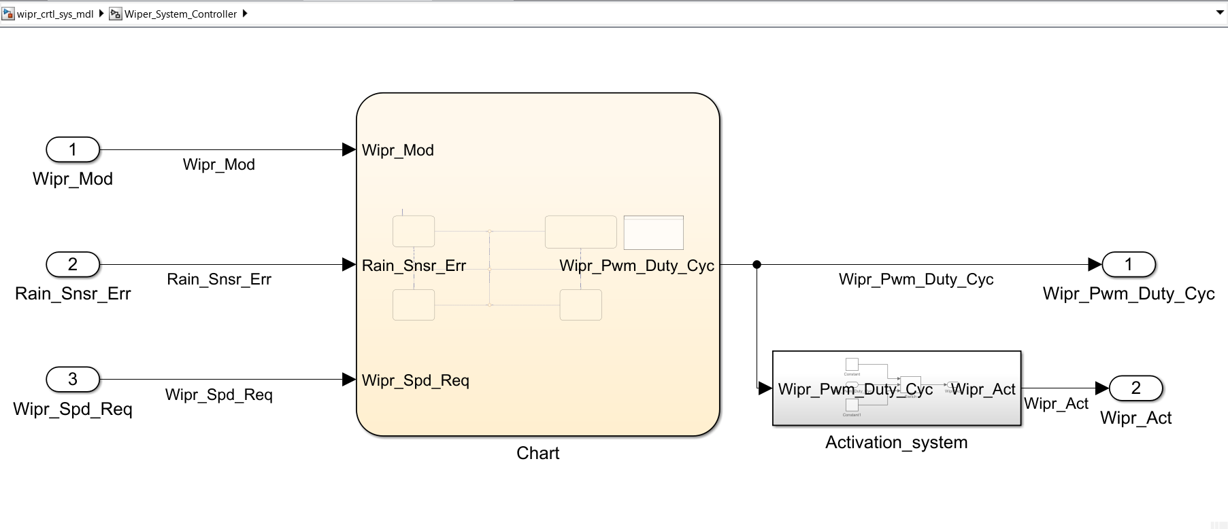
Simulink System Model 2nd Level

Slide 7
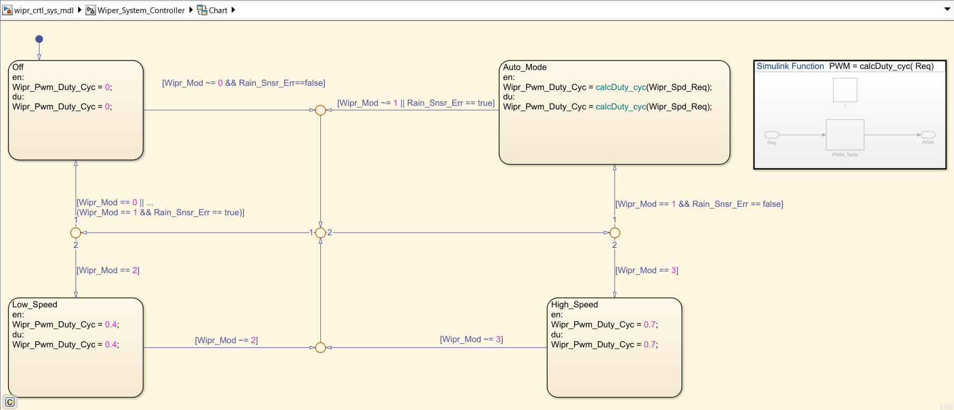
Stateflow System Model 3rd Level

Slide 8
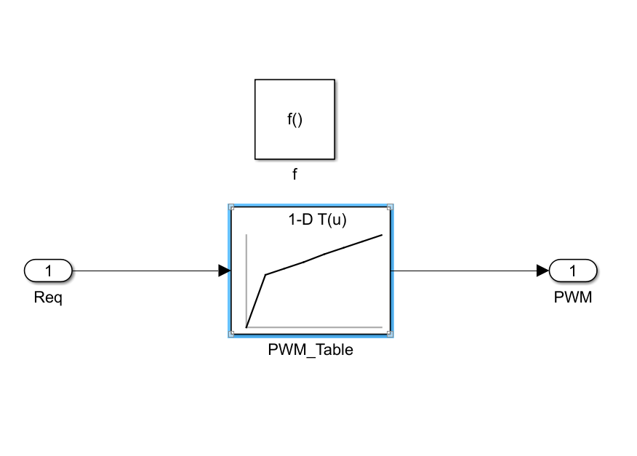
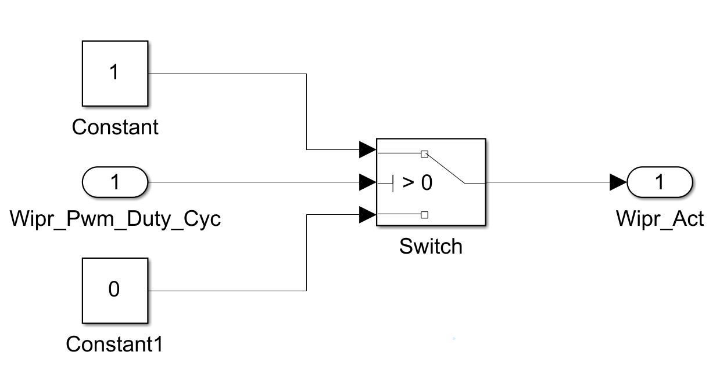
Helper Systems
Simulink Function To Calculate Duty Cycle In Auto Mode.
Subsystem To Determine If System Is Active Or Not.

Slide 9
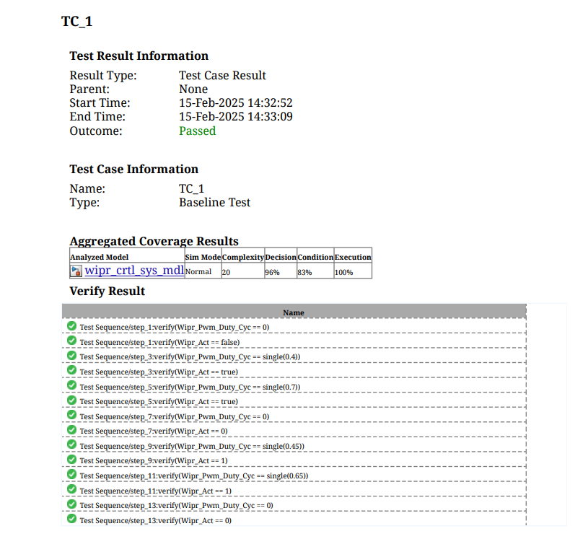
Testing The Model

Slide 10

Completion Certification

