Slide 1
Predict Diabetes Outcomes Based on Patient Data Project
Dr. Mahmoud Bassiouni
Eng. Rana Mohamed Mahmoud Ali

Slide 2
TEAM MEMBERS
HASSAN MOSTAFA HASSAN 2100776
KAREEM AYMAN ELEMARY 2100837
AHMED HUSSIEN ALM ELDIN 2100336

Slide 3

Agenda
ABSTRACTION
PROBLEM STATEMENT
DATASET INFORMATION
LEARNING OUTCOME
THE STEPS TO DO THIS PROJECT

Slide 4

ABSTRACTION
Diabetes is a complex and chronic medical condition that affects the body's ability to regulate blood sugar levels. It is characterized by high blood glucose levels resulting from either insufficient insulin production or ineffective utilization of insulin. There are several key aspects related to diabetes that should be taken into consideration, so we need machine learning algorithms to predict weather a person will git diabetes or not based on patient information with ML models like Logistic Regression, Multi-Layer Perceptron or Decision trees.

Slide 5

Problem statement
Predict if a person will have diabetes in the future based on diabetes prediction dataset by understanding its features and done machine learning algorithms on it.

Slide 6

Dataset information
The Diabetes prediction dataset is a collection of medical and demographic data from patients, along with their diabetes status (positive or negative). The data includes features such as age, gender, body mass index (BMI), hypertension, heart disease, smoking history, HbA1c level, and blood glucose level. This dataset can be used to build machine learning models to predict diabetes in patients based on their medical history and demographic information. This can be useful for healthcare professionals in identifying patients who may be at risk of developing diabetes and in developing personalized treatment plans. Additionally, the dataset can be used by researchers to explore the relationships between various medical and demographic factors and the likelihood of developing diabetes.

Slide 7
The students will understand how to use various machine learning algorithm on a dataset to make the model learns how predict the right output
LEARNING OUTCOME

Slide 8
The steps to do this project
Preprocessing
Logistic Regression
Multi-Layer Perceptron
Decision trees.

Slide 9
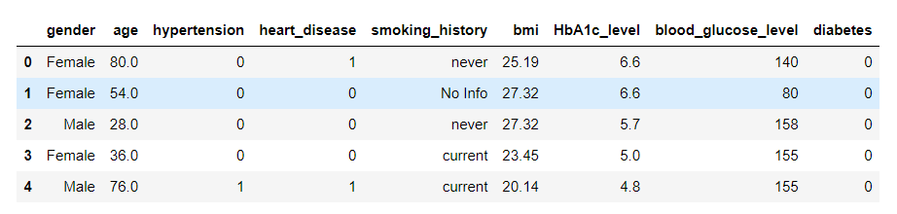
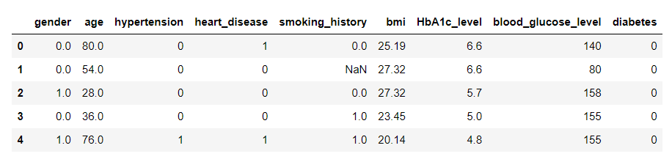
First, we read the data and cleaning it by checking if there is any null values and remove it and make sure it is ready for our model.
Preprocessing
Before Preprocessing
After Preprocessing

Slide 10
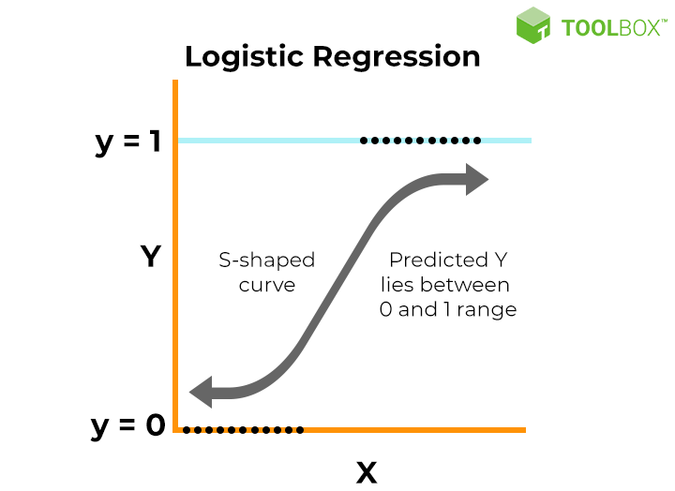
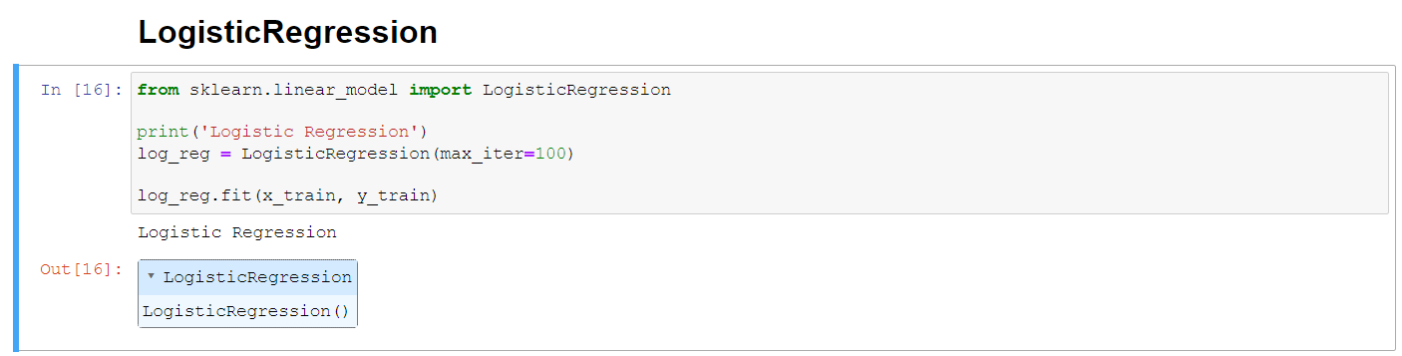
This type of statistical model (also known as logit model) is often used for classification and predictive analytics. Since the outcome is a probability, the dependent variable is bounded between 0 and 1.
Logistic Regression
Model Code
Graph

Slide 11
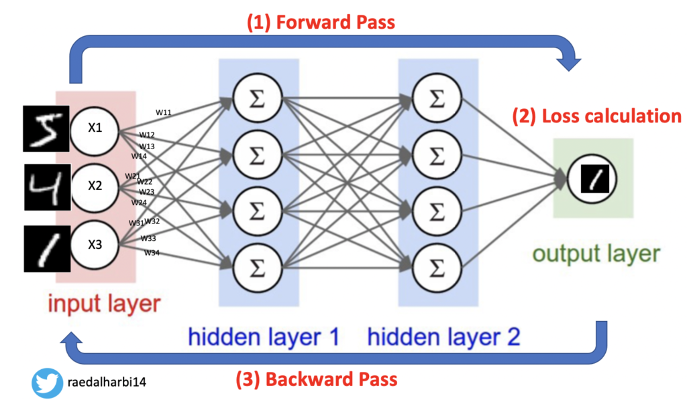
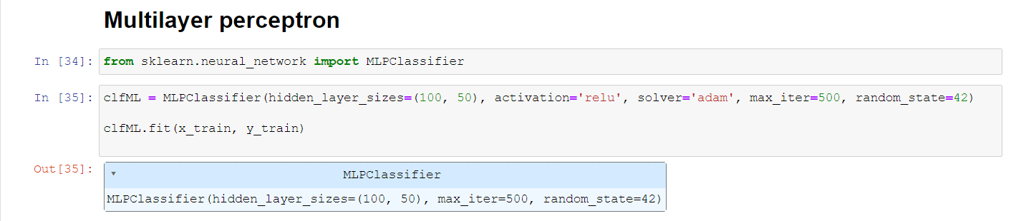
A multilayer perceptron (MLP) is a name for a modern feedforward artificial neural network, consisting of fully connected neurons with a nonlinear kind of activation function, organized in at least three layers.
Multi-Layer Perceptron
Code
Structure

Slide 12
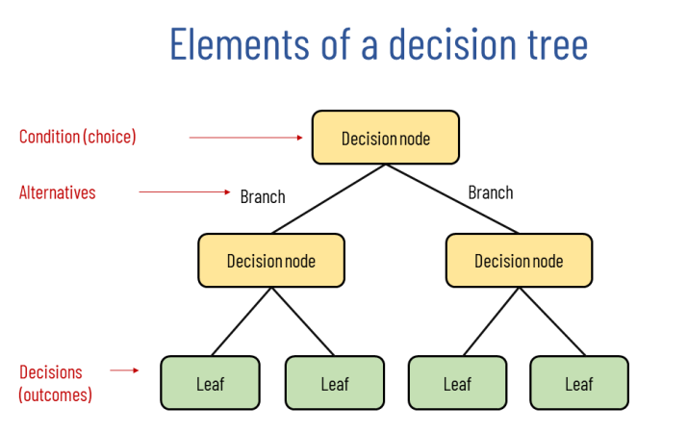
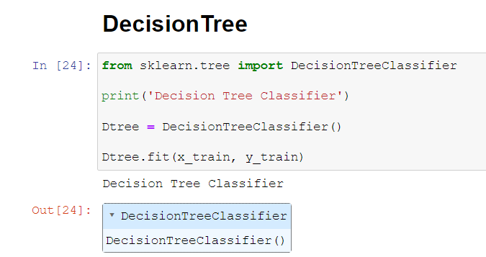
A decision tree is a supervised learning algorithm, which is utilized for both classification and regression tasks. It has a hierarchical, tree structure, which consists of a root node, branches, internal nodes and leaf nodes and it uses this tree structure to predict the outcome of the problem.
Decision trees
Structure
Code

Slide 13

Thank you

