Slide 1
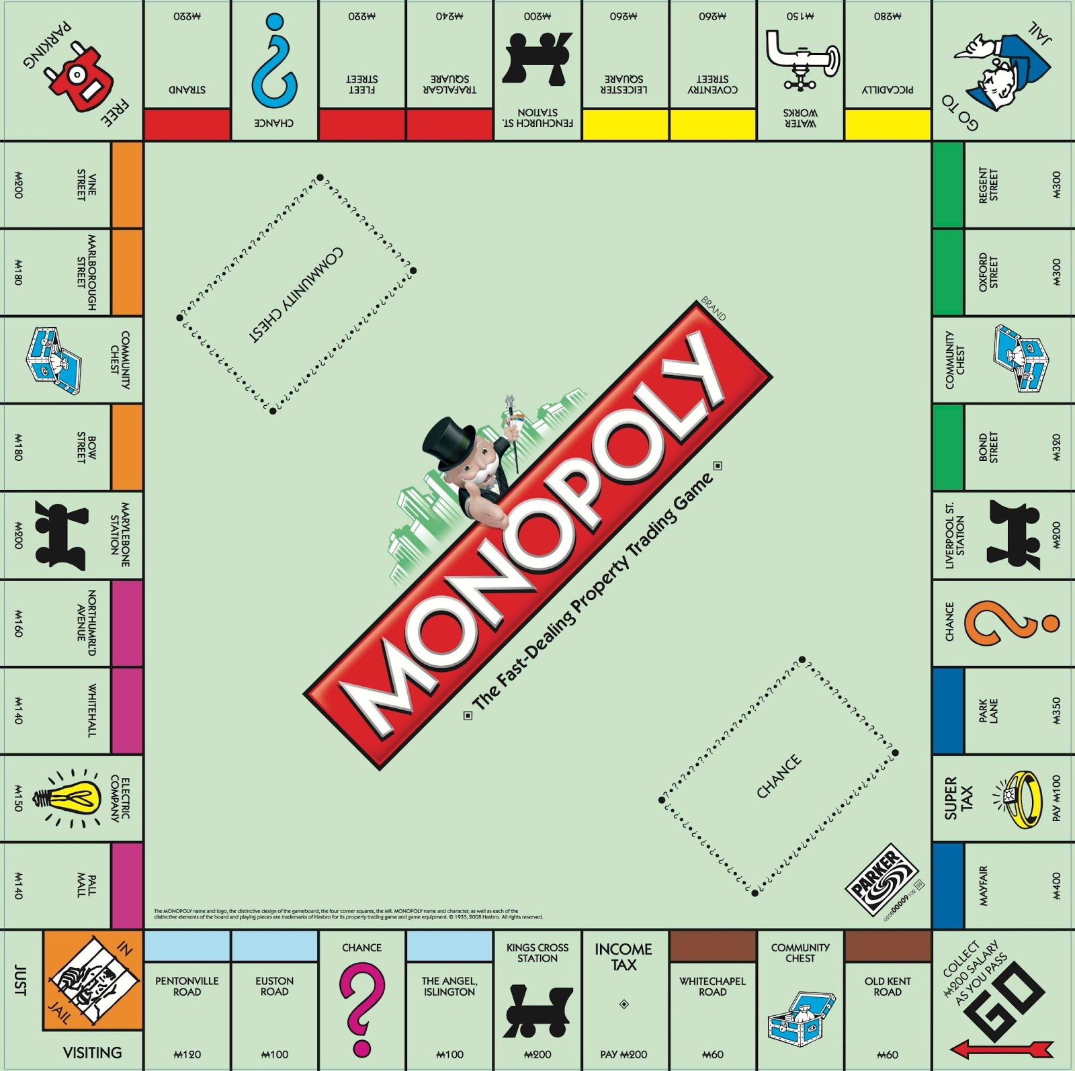

Monopoly Game
PROG8140 Final Project
Hassan Nahhal, Sungjoe Kim, Changho Choi

Slide 2
Background
Object : To Practice designing and object oriented programming skills
Simulating Monopoly Game, but customized to finish within 2 weeks
To minimize risk, iterative development was used
1st : with 1 kind of cell
2nd: with various kind of cell -> depending on cell, various rules are applied
To minimize integration risk, Github was used : merging continuously
Due to lack of skill and time, we didn’t made unit test code. Instead, test cases were made and tested.

Slide 3
Game Rules (1/2)
Number of Player will be between 2 and 8.
Game starts with getting # of Player from user and play until one Player remained
If Player has no enough money, he will be kicked out.
Initially, each Player will get $10,000
Each player will earn $1,000 for each turn of board
If a Player landed on a property cell, he can buy property cell by paying $2000
If another Player place the cell, which is owned by another player, he should pay $500
If a Player landed on Income Tax Cell, he will pay minimum of $2000 and 10% of his all property value

Slide 4
Game Rules (2/2)
If a Player landed on GotoJail Cell, he will pay $2000 for fine and move to Jail Cell and will be skipped at the next turn
If a Player landed on Jail Cell, he will be skipped at next turn and he will start at next cell
If a Player landed on Lot Cell, he will do nothing
If a Player can not pay money for rent, buying property, or paying fine due to shortage of cash, he should sell one of his property.
All property can be sold with price of 75% of original price.
If a Player doesn’t have money after selling property, he will be kicked out of the game.

Slide 5
Class Design
Game Master: Overall control of game
Die: return random number between 1 and 6
Player: Player manage own property and money, such as payrent, sell or buy property
GameBoard : Has 40 cells and controlled by GameMaster
Cell (abstract): use polymorphism landedon
GoCell
IncomeTaxCell
LotCell
GotoJailCell
JailCell
PropertyCell

Slide 6
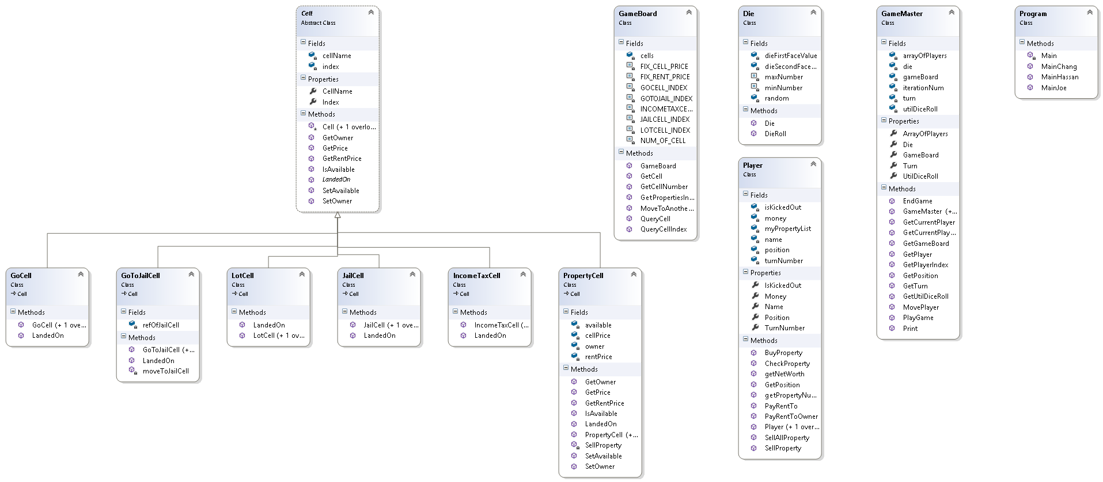
Class Diagram

Slide 7
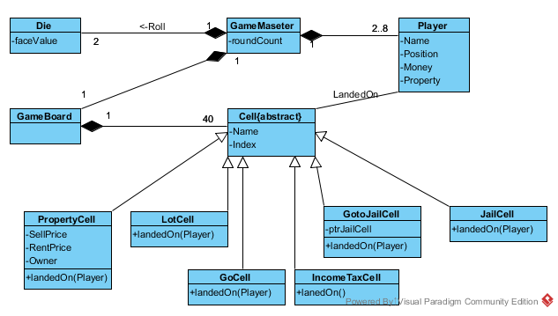
Domain Model

Slide 8
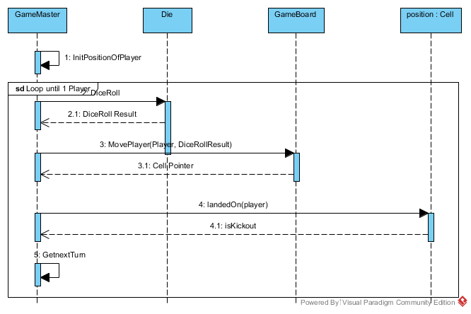
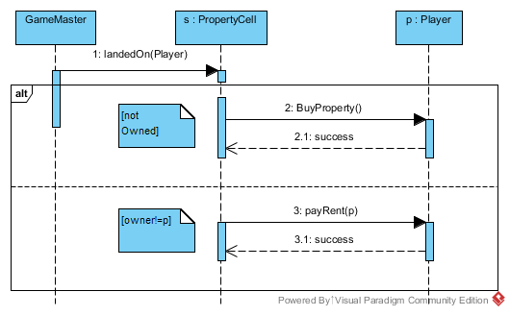
Sequence Diagram
Overall Operation
Landed on PropertyCell

Slide 9
Test Cases
Monopoly Test Cases (Test Category,Procedure, Expected Result)
No. | Category | Pass/Not | Procedure (Input) | Expected Result (Output)
1 | Number of Player | Pass | User input the number of player less than 2 or more than 8. | Shows invalid value message, repeat the prompt user to input valid value
2 |  | Pass | User input the number of player between 2 and 8 | The new game will start and display inishal state
3 | Initial State | Pass | check the initial values when the game start | chash, player name, location, property, status
4 | Changing Cash State | Pass | Each of player get addition cash by $1,000 when the player turns all cells . | Cash will increase by $1,000 and display
5 | Buy Cell | Pass | A current Player buy the property that does not belong to any player. | Display input prompt wheather buy or not?
6 |  | Pass | User input "Y" | Cash will decrease by $2,000 and display
7 |  | Pass | User Input "No" | Turn the next player and display the state
8 | Pay Rent Cell | Pass | A current player moves to the cell that is owned by another player. | Cash of a current player will decrease by $500 and display
9 |  | Pass | Transfer the cash from current player to the owner of current cell | Cash of the cell owner will increase by $500 and display
10 | Sell Property of Cell | Pass | A current Player sells the own cell with the value of 75% ($1,500) the original price($2,000) | Display the list the cells that the player's owned.
11 |  | Pass | A current Player is asked to input the number in the list of cell properties owned | When invalid value, repeat prompt for valid input
12 |  | Pass | A current Player input the valid number in the list of cell owned | Cash will increased by $1500 and display
13 | GoToJail Cell | Pass | When a current Player moves to the "Go to Jail" cell, fine payment will occur. If insufficient cash, execute the Sell Property Cellnowned. If have no cash, the player will be kicked out. | Cash will decrease by $2,000 and display
14 |  | Pass | If insufficient cash, execute the Sell Property Cellnowned. If have no cash, the player will be kicked out. | Display the state changed
15 | InCome Tax Cell | Pass | A current Player moves to the InCome Tax Cell, prompt the user to select $2,000 or 10% of owned property | Dsiplay the user input prompt for selection
16 |  | Pass | User input the selection of $2,000 | Cash will decrease by $2,000 and display
17 |  | Pass | User input the selection of 10% of owned property | Cash will decrease by the amount of 10% of property and display
18 |  | Pass | If insufficient cash, execute the Sell Property Cellnowned. If have no cash, the player will be kicked out. | Display the state changed

Slide 10
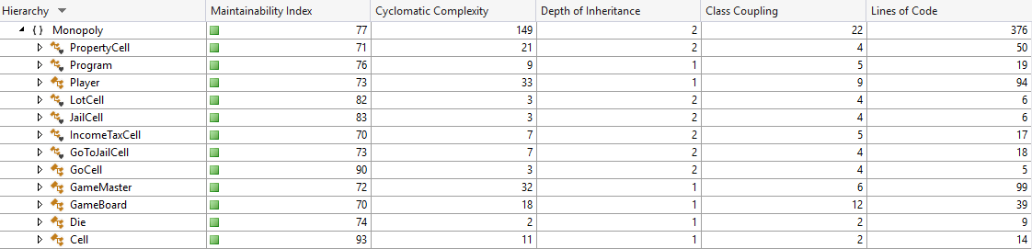
Code Metric

Slide 11
Thank you

