Slide 1
Predicting Demand in Fashion

Slide 2
Interest
See-Now-Buy-Now idea and it has been affecting people all time.
Predictive what to sell next week will be an advantage in the fashion industry.
Cutting the cost of shipping and storing.

Slide 3
Data acquisition
The dataset was provided by Zara.
The dataset attributes are sales, stock, SKUs, and product positioning on the website.
Table | Attributes | shape
products | product_id, family_id, subfamily_id, price | (15238,4)
Sales | date_number, product_id, color_id,size_id, sales,stock | (3736218,6)
Product blocks | product_id, block_id, | (15238,2)
positions | date_number, product_id, category_id, position, | (1507874,4)

Slide 4
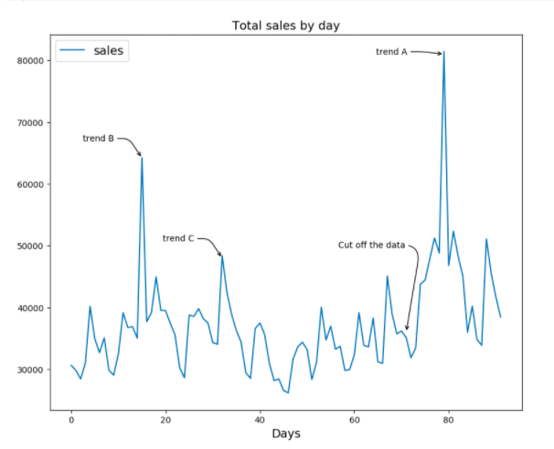
Sales by day
since the goal is to predict demand for next 3 weeks, the dataset split train(0-71) and test(72-91)

Slide 5
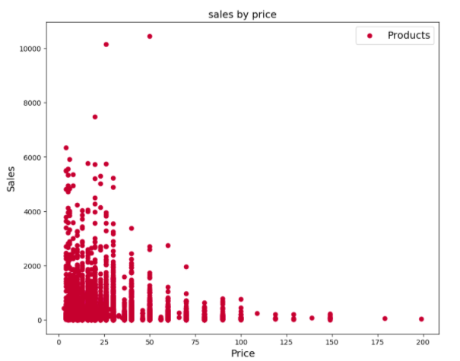
Sales by price
When the price is low, sales are high

Slide 6
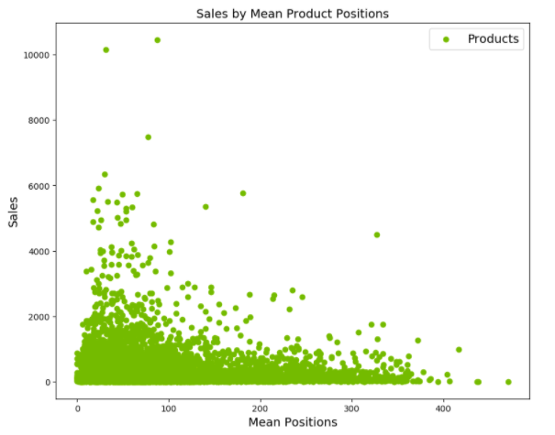
The mean products positions
When the mean is low (best), the sales are high.

Slide 7
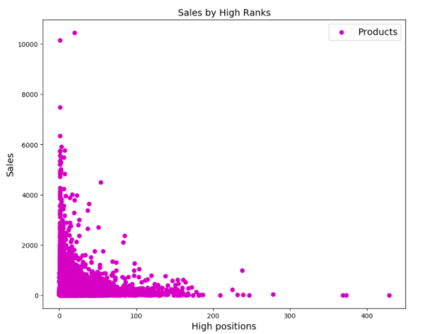
Sales by high ranks
the sales are high when the product has high rank

Slide 8
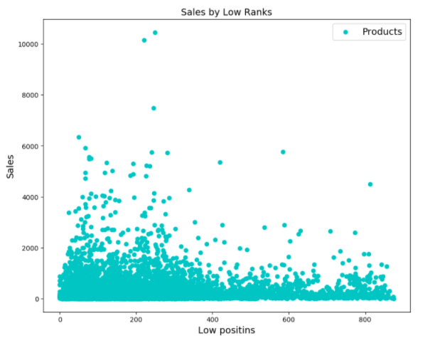
Sales by low ranks
sales are less when product rated by low

Slide 9
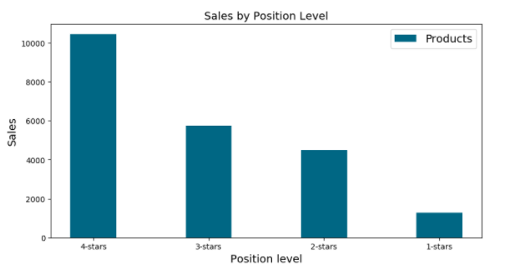
Sales by Position Level
sales increased by high rate

Slide 10
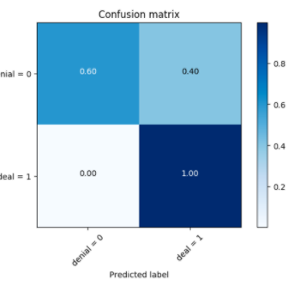
Confusion matrix
The model predicts that the total number of the deal product is 8020 while 413 products are in denial set.

Slide 11
conclusion
One of the ways to explore the trend in fashion is the online stores.
The classification analysis is not useful to predicts the demand in fashion because of many characteristics for the product such as category, color, and design.

