Slide 1
Assignment Report
Hassan Sherwani

Slide 2
Content
Data Preparation and Exploration
Data Preprocessing
ML model implementation, validation, evaluation
Applying deep learning model
Model selection, training of most optimized model, serialization.
API end-point
Model in production
Limitations
Notes:
Shall I add introduction of each paper?

Slide 3
1.Data Preparation
Data
1. Training data
2.Validation data
3.Testing data
Notes:
Divide original data into 80% , 20% test data
10K training data out of this training data is taken away i.e subsample
75-25 % train-val data split

Slide 4
1.EDA
Common practices i.e sanity check, missing values, duplicate values etc.
EDA w.r.t category
Noting categorical feature classes and their frequency i.e consistency check
time series analysis of features i.e category & publishers’ analysis
Further exploration of business and entertainment type using ER & BR.
EDA w.r.t news feature
Data exploration using feature extraction(word len, char len, stopwords, special characters, digits/numeric, upper case)
Data Cleaning
Data exploration using unigram , bigram and trigram
Comparison of n-gram before and after data cleaning
Notes:
Top category is entertainment. So we might assume that Top publishers ought to be entertainment related. But business ratio is higher among top publisher than entertainment.
So freelancers or smaller publishers might be writing more about entertainment. That’s why it accumulated to top category.

Slide 5
2. Vectorization
Vectorization
Countvector
TFIDF
Doc2vec
Word2vec
Keras embedding(word2vec) using tf tokenizer and sequence padding

Slide 6
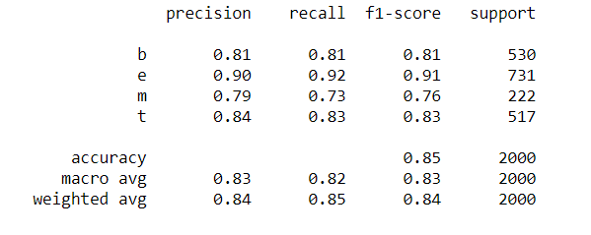
3.ML Models(Val)
Model | Accuracy
Logistic Regression Classifier | 83.9%
SVC | 84.90%
Naïve Bayes | 83.5%
Random Forest | 79.6%
Results for models using CV
Results from SVC model

Slide 7
3.ML Models(test)
Model | Vect | Accuracy | Precision | Recall | F1
LR | BOW | 70% | 72% | 70% | 70%
LR | TFIDF | 70% | 72% | 71% | 70%
LR | word2vec | 42% | 51% | 42% | 40%
LR | doc2vec | 36% | 13% | 36% | 19%
SVC | BOW | 68% | 71% | 68% | 67%
SVC | TFIDF | 70% | 71% | 70% | 69%
SVC | word2vec | 42% | 51% | 42% | 40%
SVC | doc2vec | 36% | 13% | 36% | 19%
RF | BOW | 65% | - | - | -
RF | TFIDF | 57% | 67% | 67% | 66%
RF | Word2vec | 51% | 54% | 51% | 48%
RF | Doc2vec | 35% | 28% | 35% | 22%
XGB | BOW | 35% | 13% | 36% | 19%
XGB | TFIDF | 26% | 7% | 26% | 10%
XGB | word2vec | 43% | 52% | 43% | 44%
XGB | doc2vec | 35% | 28% | 35% | 22%
MLP | BOW | 65% | 66% | 66% | 66%
MLP | TFIDF | 67% | 67% | 67% | 66%
MLP | word2vec | 49% | 50% | 49% | 45%
MLP | doc2vec | 41% | 50% | 49% | 45%

Slide 8
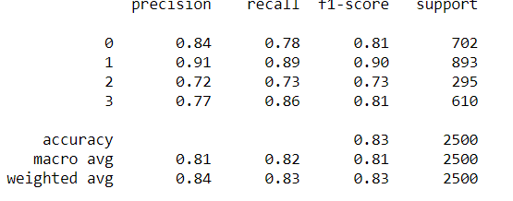
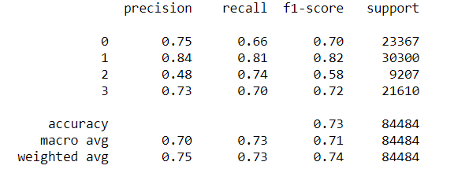
4.Deep Learning Model
Results for LSTM with validation data
Results for LSTM with test data

Slide 9
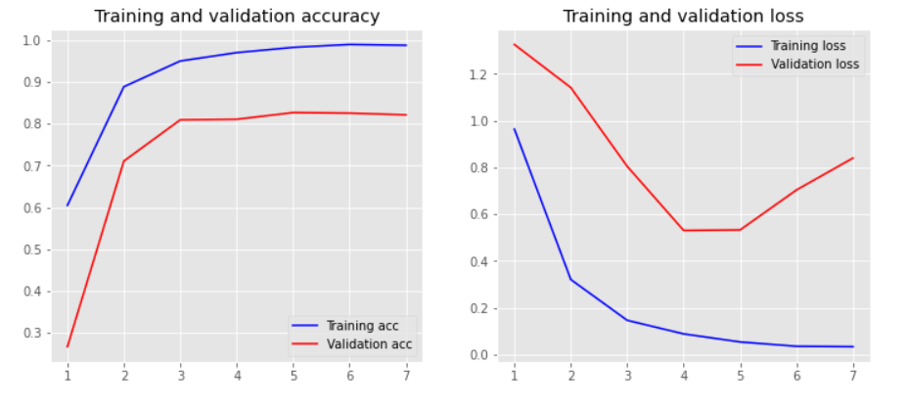
5. DL+ML:Overfitting Issue

Slide 10
ML Project Pipeline
ETL
Extract data from source
Model Implementation
Preprocess data
Transform in relation form
Load in
Apply model
Evaluate model
End Point
Create an API
Make available for internal use.

Slide 11
6.API end-point
Serialize model
Using flask webserver
Output: key , prediction_type, prob_score
Local + serverless
Git
Docker container
Fargate/Kubernetes
CI/CD
Version control
Running, logging, scheduling and monitoring.
Notes:
Fed official says weak data caused by weather, should not slow taperLos Angeles Times

Slide 12
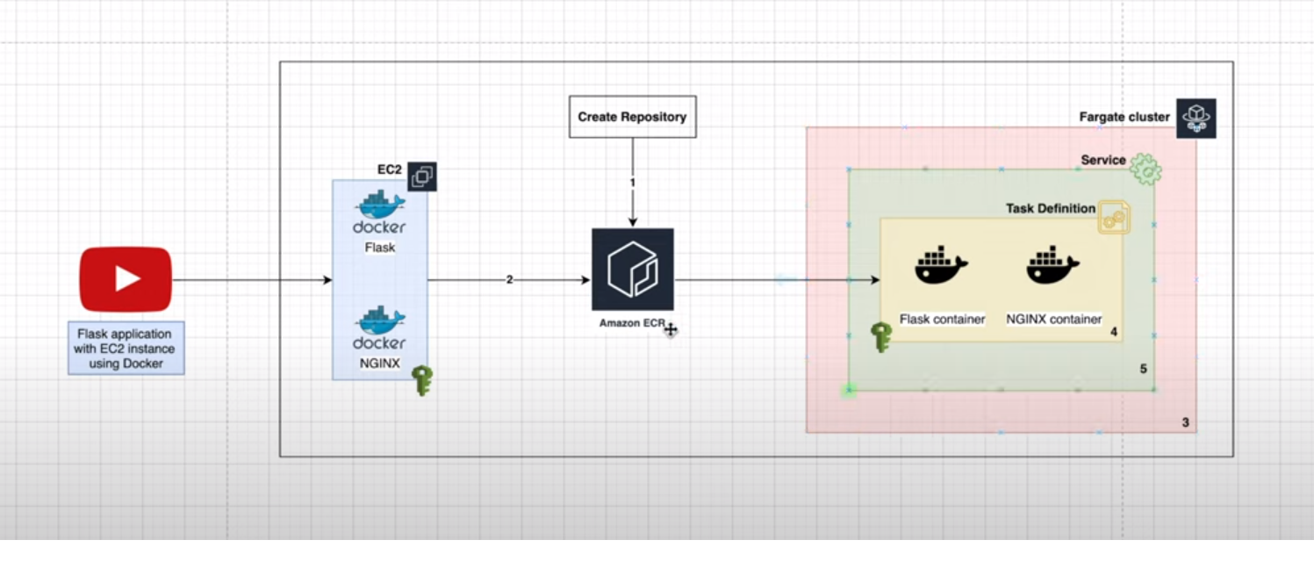
7.Model in production

Slide 13
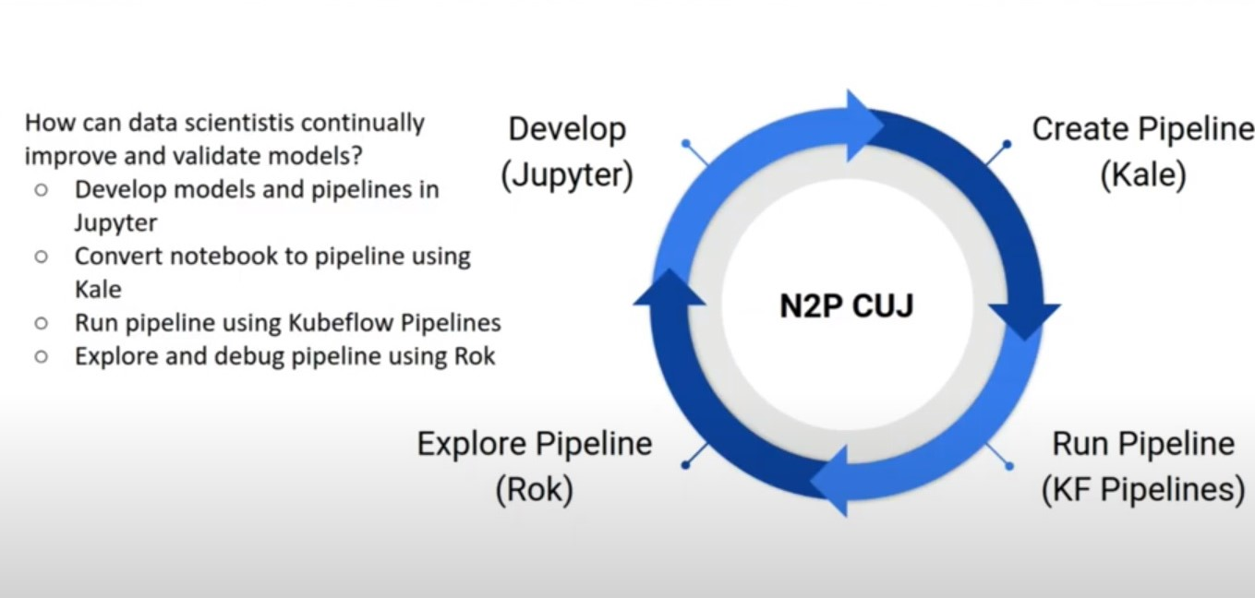
7.Model in production(2)

Slide 14
8.Limitation
Low computing power
Further deep learning exploration could have made
Over-fitting problem with ML+DL models
Less effort on special characters and their rules
Better GUI design

Slide 15

QUESTIONS

