Slide 1
Introduction/Innovation
Considering I am aiming for a career in the tech industry, I have selected a tech start-up to focus on in helping to reduce carbon emissions. According to the provided information [6], the top barriers to action are insufficient budget (39%), difficult to reduce emissions outside own operations (36%), and the difficulty of measuring environmental impact (30%). Since my application is free and open source and doesn’t require a lot of upkeep, it is relatively cheap to use to help tech SMEs with their Scope 2 emissions, which helps to mitigate the budget constraints of SMEs.
According to the UN, the tech industry currently accounts for about 3% of global emissions [1]. From this, enterprise technology is responsible for emitting about 350 to 400 megatons of carbon dioxide [2]. While this may not seem significant, the amount of CO2 released by enterprise technology is about equivalent to the amount of CO2 released by the entire UK between 2021 and 2022 [3]. Therefore, there is significant room for improvement in the tech industry.
Out of these 3% of emissions, 45% of these emissions are a result of large data centres [4]. Tech SMEs may be required to store large amounts of information on users for example and will require data centres to store this. These data centres can use large amount of electricity, and sometimes may have operations such as machine learning algorithms being executed which can be very resource intensive on the CPUs and GPUs and thus lead to increased power usage. Therefore, I am attempting to help tech startups with their Scope 2 emissions.
Lots of tech startups and tech SMEs often use cloud servers, however this doesn’t mean that they can’t optimise their workloads deployed to these cloud servers to perform heavier operations during “greener hours” thus mitigating the difficulty of reducing emissions outside their own operations
Therefore, I have decided to create an application for server PCs that will automatically schedule tasks – like the aforementioned machine learning algorithms- during times where there is more green energy available.
Wednesday 19th July 2023
By Hassan Mahmood

Slide 2
User Interface/Execution
To create my application, I will be using the Carbon Intensity API developed by the UK National Grid. This provides the carbon intensity of the electricity system in real time, so scheduling processes to run during a time when this is low, will help the SME improve their carbon footprint as it means more of the energy used to compute these resource intensive tasks is green energy.
The accompanying code in the GitHub repository, contains an MVP skeleton program which accomplishes this.
In the final application, the user would be able to add remote servers using an IP address, they’d be able to select a server name too. Then for each server, they would be able to create tasks, each task has a name, description, a path – where the command is to be executed, and the name of the shell script that is executed. The application then establishes an SSH connection with the IP address to execute tasks.
Every 60 seconds, the application will loop through the servers and check if the server has an available task and if it does then it will check if the carbon status is low and if it is, it will execute the task, however SSH functionality is not yet implemented.
Like the final application would be, the MVP code allows the creation of a server and tasks, represented in the code by a Server and Task classes respectively. However, as SSH functionality isn’t implemented yet, the execution of each task is represented by a new thread in the current machine instead of a separate machine.
As a result, the SME is able to schedule complex resource-intensive tasks during a period where there is lower carbon impact, thus helping the environment by reducing carbon emissions
The MVP is the backend of the application without a Graphical User Interface, a potential design of which is discussed on the next slide, so servers and tasks are manually created

Slide 3
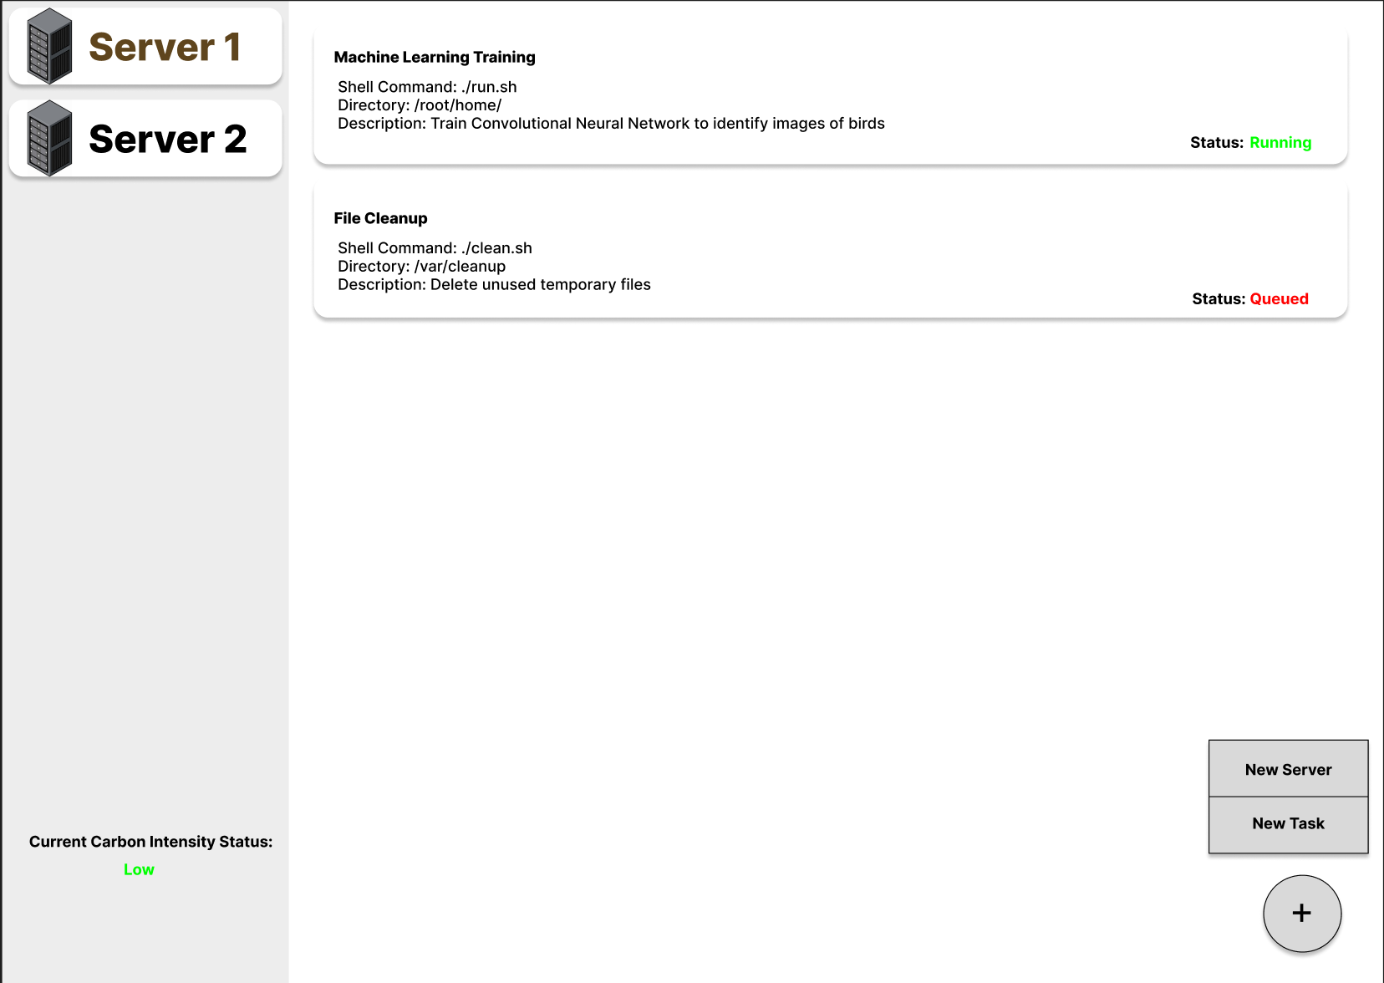
User Interface/Execution
For the frontend, I believe a desktop/web application would be the best fit. This would be able to connect to the servers and remotely queue tasks
My application has two ListView’s of the added servers on the left and the tasks in the queue on the right. Clicking on a server on the left list allows you to view all of the current queued tasks for that server on the right list
There is a button in the bottom right that allows you to add a new server to execute tasks on or create a new task in the queue that you can execute. Tasks can be dragged above each other to determine priority and which is run first
On the bottom left of the screen, the current carbon intensity for the UK is displayed, this is constantly updated every time the API is queried.
For each task in the tasks list, there is a bubble, at the top of the bubble is the name of the task, followed by the command executed, the directory the task is executed in as well as a description about what the task does. In the bottom right there is the status of the task. In the attached image, the Machine Learning Training task is running as the current carbon status is low and the file cleanup task is waiting for that one to complete before running

Slide 4
Business Model
Considering the application would be released as free open-source code, there would be no cost to adopt the application. However, it would require an employee to setup the application and connect the servers and regularly schedule the appropriate tasks however this would most likely only require 1-2 employees and not result in any significant additional expenditure. It also may be necessary to pay a small fee to use the API on a larger scale.
The application is available online for free, therefore would be quite easy for many different SMEs to adopt and implement as everyone is available to access it. Considering technology is one of the fastest growing industries in the world, there would be a large market for adoption of this technology, especially as the UK is attempting to be carbon neutral by 2050. However, as the application is only capable of checking the carbon status in the UK, it is limited to companies with UK-based data centres unless support for more regions is added. Profit can be made through advertisements or premium support subscriptions.
This application would be able to attract investment, especially by organisations focused on climate action as well as technology companies aiming to make a difference, and government funding could be possible if believed this could be vital in assisting with the 2050 Net Zero Strategy [5][6].
- If many organisations adopt this method, collectively there would be a noticeable reduction on carbon emissions. Currently 45% of technology carbon emissions are from data centres, therefore if there are more tasks being executed during hours where green energy is available, instead of times when it’s not, then the amount of carbon emissions released by the tech industry would hopefully decrease.

Slide 5
References
[1] https://www.fdmgroup.com/blog/environmental-impact-of-digitalisation/#:~:text=Digitalisation%20has%20resulted%20in%20a,rapidly%20as%20digitalisation%20takes%20over.
[2] https://www.mckinsey.com/capabilities/mckinsey-digital/our-insights/the-green-it-revolution-a-blueprint-for-cios-to-combat-climate-change
[3] https://assets.publishing.service.gov.uk/government/uploads/system/uploads/attachment_data/file/1147372/2022_Provisional_emissions_statistics_report.pdf
[4] https://www.statista.com/statistics/1255404/global-ict-products-relative-carbon-footprint-forecast-by-products/
[5] https://www.lloydsbankinggroup.com/media/press-releases/2021/lloyds-bank/sustainability-is-important-to-smes.html
[6] https://www.lloydsbank.com/assets/assets-business-banking/pdfs/from_now_to_net_zero.pdf

