Slide 1

HOTEl BOOKINGS ANALYSIS
Hassanat Awodipe
Tabatha Correa
Tamsir Jobe
24/02/2023​​

Slide 2

Presentation Outline
Aim of the Analysis
Analysis Questions
Data Cleaning
Data Analysis and Results
Conclusion

Slide 3

Targeted Marketing
AIM OF THE ANALYSIS
Analysis Questions:
What is the distribution of the average daily rate for each hotel type?
Which hotel type is mostly booked and then occupied?
Which months are the hotels mostly occupied?
Where do most of the guests comes from?
Are the guests usually families or individuals?

Slide 4
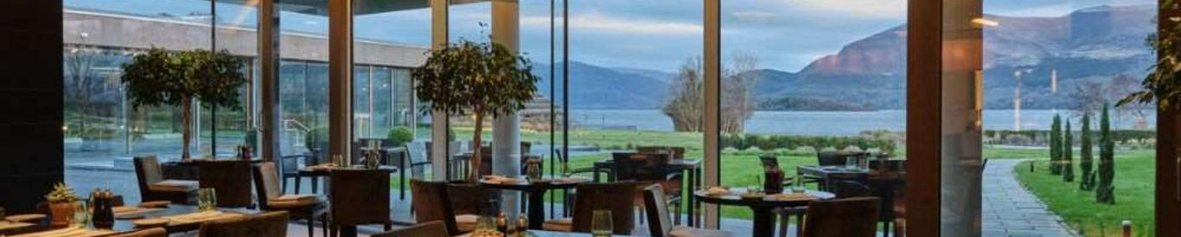
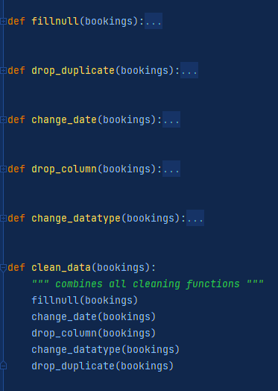
PREPROCESSING.PY
CLEANING Functions
THE DATASET
100,000+ rows and 32 columns
Year 2015 – 2017
Two kinds of hotels

Slide 5
analysis
utils.py
class AdrStats
analysis.py
def analyse_adr(data)
workflow.py
preprocess: clean_data()
analyse: all_analysis()
def analyse_...
def all_analysis()
__init__
plot_fig
summary_csv
class …
adr_stats = AdrStats(data)
adr_stats.plot_fig(filepath)
adr_stats.summary_csv(filepath)
compute_stats

Slide 6
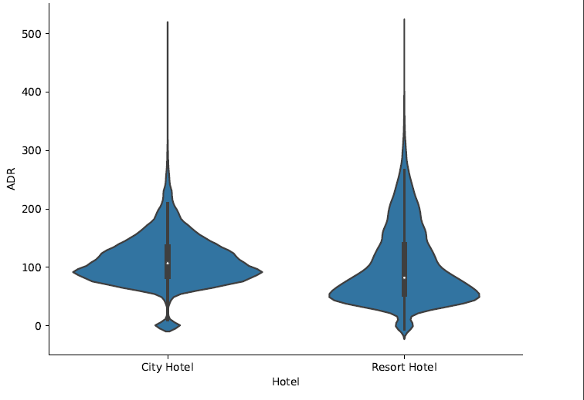
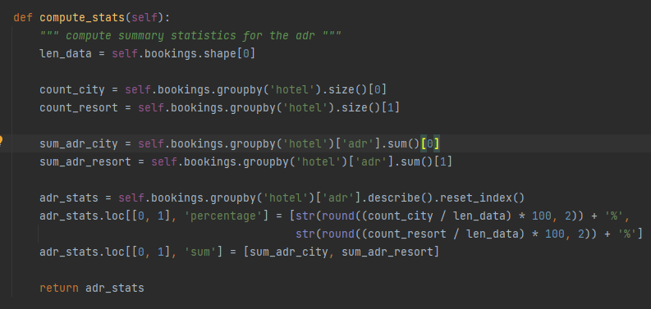
What is the distribution of the ADR for each hotel type?
Hotel Type

Slide 7
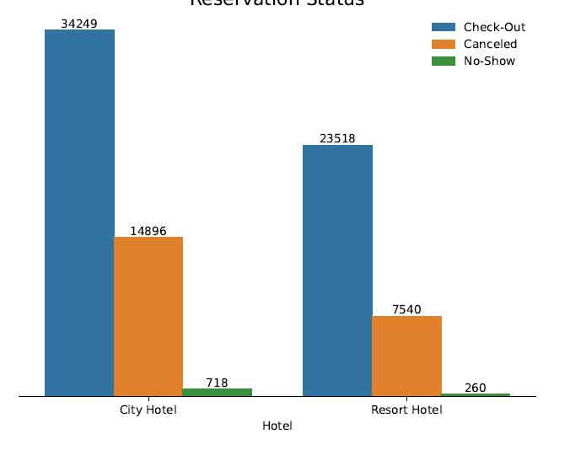
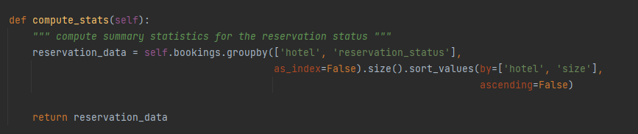
Which hotel type is mostly booked and then occupied?
Hotel Type

Slide 8
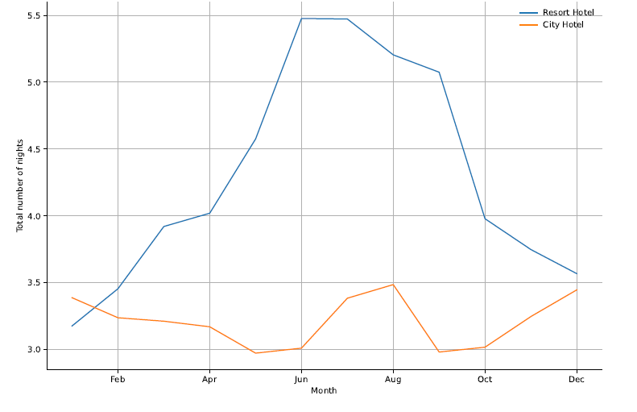
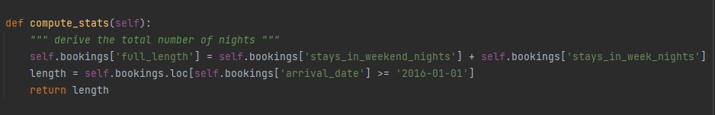
Which months are the hotels mostly occupied?
Campaign Timeline

Slide 9
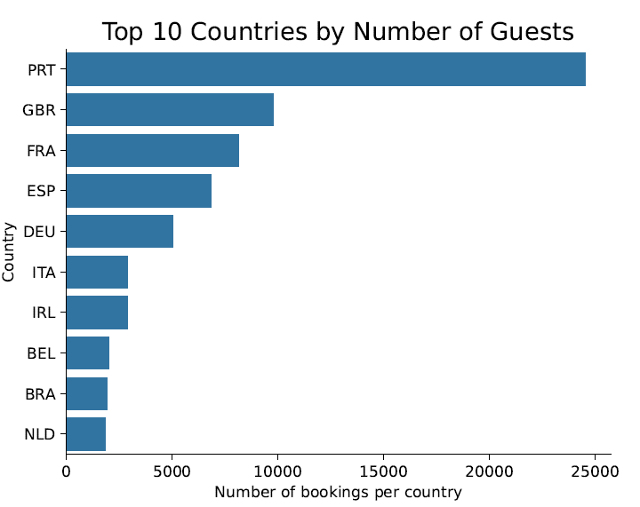
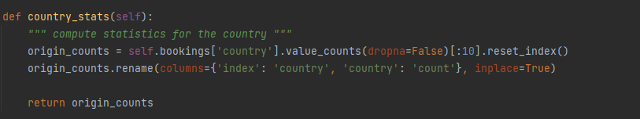
Where do most of the guests come from?
Target Audience

Slide 10
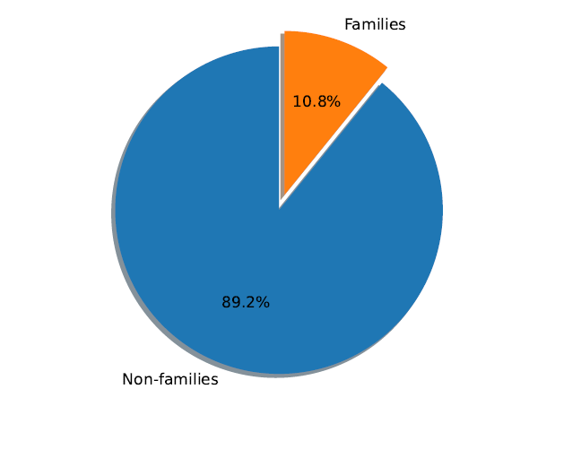
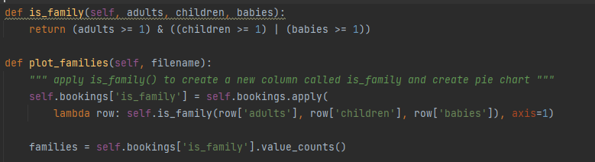
Are the guests usually families or individuals?
Target Audience

Slide 11
CONCLUSION
Hotel Type:
City: easily booked, easily cancelled
Resort: sparsely booked, guests stayed longer
Campaign Timeline:
Summer (City , Resort)
Nov - Dec (City)
Target Audience:
Non families
Europeans and Brazillians

Slide 12

Thank You!
Than

