Slide 1

DATA ANALYSIS & BUSINESS UNDERSTANDING
Internship Week 1 Task
Data Analysis & Business Understanding
Understanding customer purchase behavior ahead of a product recommendation system
Prepared by: Hassan Farooq
Registration No: AIMLB01-9835
Dataset: UCI Online Retail II (2009–2010, UK-based retailer)

Slide 2



PROJECT BRIEF
Objective of the Task
A retail company wants to understand customer purchase behavior before investing in a product recommendation system. Acting as a data analyst, this task explores real transaction data to surface patterns, quality issues, and business insight ahead of any modeling work.
Scope of This Report
Data structure & quality audit
Missing values & duplicate detection
Best-selling products (qty & revenue)
Country-level sales performance
Monthly revenue trend
Correlation & outlier analysis
Actionable business insights
Who are the customers?
What products sell the most?
Which countries drive revenue?
Online Retail II — Exploratory Data Analysis
2

Slide 3
THE DATASET
Dataset Overview
UCI “Online Retail II” — real invoice-level transactions from a UK-based online retailer
525,461
8
2009–2010
40
Total Rows
Columns
Time Period
Countries
Column Structure
Column | Type | Description
Invoice | object | Unique invoice / transaction number
StockCode | object | Product (item) code
Description | object | Product name
Quantity | int64 | Units purchased per line
InvoiceDate | datetime64 | Date & time of transaction
Price | float64 | Unit price (£)
Customer ID | float64 | Unique customer identifier
Country | object | Customer's country
Online Retail II — Exploratory Data Analysis
3

Slide 4

DATA QUALITY AUDIT
Missing Values & Duplicate Rows
No records were removed at this stage — observation only, per task requirements
Missing Values
Duplicate Rows
Customer ID
107,927
20.54%
6,865
Description
2,928
0.56%
exact duplicate rows (1.31% of all records)
Duplicate rows likely stem from repeated exports or re-entered line items. They inflate quantity and revenue totals if left untreated, so they are flagged here for cleaning in a later stage — not removed now, per this task's observation-only rule.
Customer ID is missing for roughly 1 in 5 transactions — these rows cannot be tied to an individual shopper, a key constraint for building a customer-level recommendation system.
Online Retail II — Exploratory Data Analysis
4

Slide 5
PRODUCT PERFORMANCE
Top 10 Best-Selling Products — by Quantity
Which items move the most volume?
Online Retail II — Exploratory Data Analysis
5

Slide 6
PRODUCT PERFORMANCE
Top 10 Best-Selling Products — by Revenue
Which items generate the most income (£)?
Online Retail II — Exploratory Data Analysis
6

Slide 7


KEY OBSERVATION
Volume Leaders ≠ Revenue Leaders
Only 2 of the top 10 best-sellers by quantity also rank in the top 10 by revenue
High Volume, Low Value
Low Volume, High Value
Cheap, high-turnover items dominate unit sales: cake cases, bird ornaments, and popcorn holders sell in the tens of thousands but individually contribute little revenue each.
The REGENCY CAKESTAND 3 TIER tops revenue at £163K despite far lower unit sales than the volume leaders — a higher price point drives outsized income per sale.
e.g. PACK OF 72 RETRO SPOT CAKE CASES — 46,106 units
Notably, "DOTCOM POSTAGE" and "POSTAGE" rank in the revenue top 10 — these are shipping charges, not real products.
Online Retail II — Exploratory Data Analysis
7

Slide 8
GEOGRAPHIC PERFORMANCE
Sales Performance by Country
United Kingdom drives the overwhelming majority of revenue
Country | Total Quantity | Total Revenue (£) | Orders
United Kingdom | 4,429,046 | 8,194,777.53 | 26,633
EIRE | 188,704 | 352,242.73 | 457
Netherlands | 181,823 | 263,863.41 | 150
Germany | 107,133 | 196,290.35 | 513
France | 74,471 | 130,769.90 | 297
Sweden | 52,238 | 51,213.51 | 83
Denmark | 227,030 | 46,972.95 | 33
Switzerland | 22,053 | 43,343.41 | 50
Spain | 18,332 | 37,084.90 | 85
Australia | 20,053 | 30,051.80 | 50
Revenue Concentration
~87.7% of total revenue originates from the UK — an important concentration risk to flag for the business.
Online Retail II — Exploratory Data Analysis
8

Slide 9
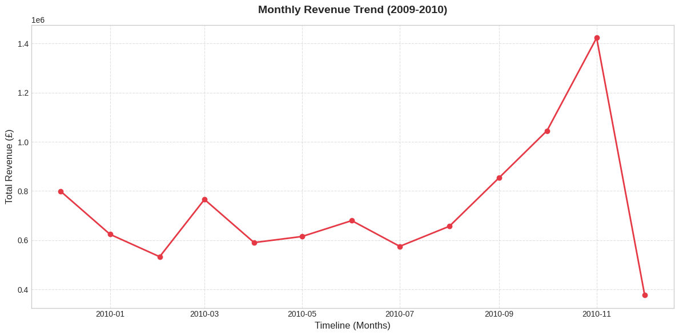
TIME-SERIES ANALYSIS
Monthly Revenue Trend (2009–2010)
Revenue builds steadily through the year, peaking in the pre-holiday months
Online Retail II — Exploratory Data Analysis
9

Slide 10
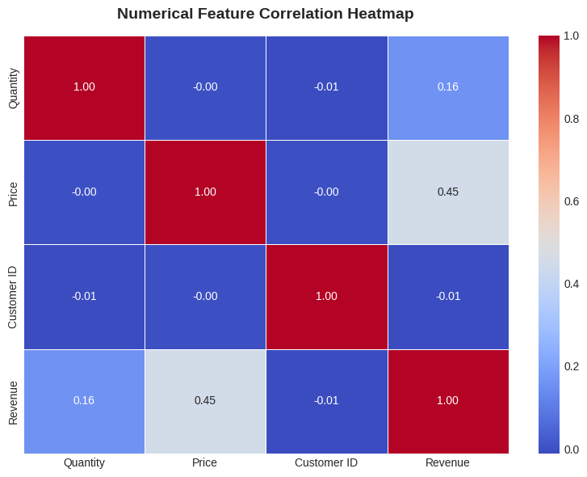
STATISTICAL ANALYSIS
Correlation Heatmap
Relationships between the dataset's numerical features
Reading the Matrix
Quantity and Revenue show a moderate positive correlation — expected, since revenue is derived directly from quantity.
Price correlates weakly with Quantity and Revenue — higher-priced items are not necessarily bought in bulk.
Customer ID shows negligible correlation with all numeric fields, as expected for an identifier.
No strong multicollinearity is present, which is favorable for future predictive modeling.
Online Retail II — Exploratory Data Analysis
10

Slide 11
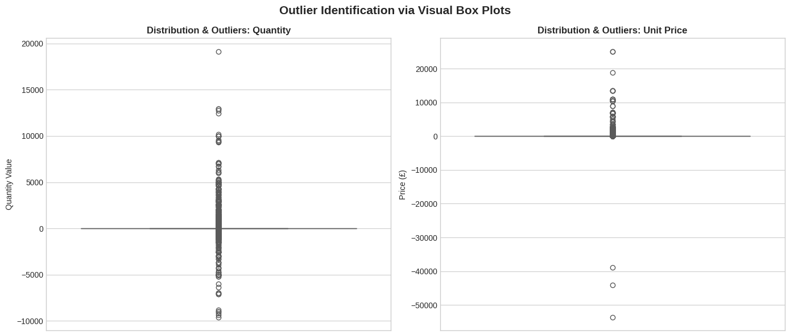
DATA QUALITY
Outlier Detection — Quantity & Price
Box plots reveal a small number of extreme values that will need attention before modeling
Both Quantity and Price show long tails, with a handful of transactions far outside the typical range — including bulk wholesale-style orders and a few unusually high or negative unit values (returns/cancellations).
Online Retail II — Exploratory Data Analysis
11

Slide 12
FINDINGS
Business Insights
What the data tells the business, before any modeling begins
1
Revenue is highly UK-concentrated
2
Best-sellers by volume differ from best-sellers by value
The UK contributes ~87.7% of total revenue, followed distantly by EIRE and the Netherlands — a geographic concentration risk worth diversifying against.
High-turnover, low-cost items (cake cases, ornaments) drive unit sales, while higher-priced items like the Regency Cakestand drive revenue — assortment and marketing strategy should treat these differently.
3
~20.5% of transactions lack a Customer ID
4
Shipping charges appear as “products” in revenue rankings
Over 107,000 rows cannot be linked to a specific shopper, limiting their usefulness for a customer-level recommendation system without further cleaning.
“DOTCOM POSTAGE” and “POSTAGE” rank in the top 10 by revenue — these are fees, not merchandise, and should be excluded from product-level analysis.
5
Revenue is seasonal, peaking pre-holidays
6
Data quality issues need resolution before modeling
Monthly revenue trends upward through the year, suggesting demand planning and recommendation logic should account for seasonality.
6,865 duplicate rows and outlier values in Quantity/Price should be cleaned and validated before any recommendation model is trained.
Online Retail II — Exploratory Data Analysis
12

Slide 13
LOOKING AHEAD
Recommendations & Next Steps
Preparing this dataset for a recommendation system
1
2
3
4
Clean before modeling
Handle outliers deliberately
Segment by geography
Engineer customer-level features
Remove duplicates, resolve missing Customer IDs, and separate fee line-items (postage) from real products.
Investigate extreme Quantity/Price values — distinguish bulk B2B orders and returns from genuine data errors.
Build UK and non-UK models or strategies separately, given the scale difference in transaction volume.
Once IDs are validated, aggregate RFM (Recency, Frequency, Monetary) features to power the recommendation engine.
Online Retail II — Exploratory Data Analysis
13

Slide 14


METHODOLOGY
Tools & Approach
A reproducible, notebook-based EDA workflow
Python
Core language for data loading, transformation, and analysis
pandas / NumPy
Data wrangling, aggregation, and numerical operations
Matplotlib / Seaborn
Visualization — trend lines, heatmaps, and box plots
Jupyter Notebook
Interactive, top-to-bottom reproducible analysis
Notebook runs end-to-end without errors, with titled, labeled, and legended plots throughout — fulfilling all Week 1 task requirements.
Online Retail II — Exploratory Data Analysis
14

Slide 15

Thank You
Questions & discussion welcome
GitHub Repository : https://github.com/Hassanfarooqbaloch/online-retail-eda
Hassan | Data Analysis & Business Understanding — Week 1 Task

