Slide 1

Medical Image Classification Description
Chest_X_ray )Dataset )

Slide 2
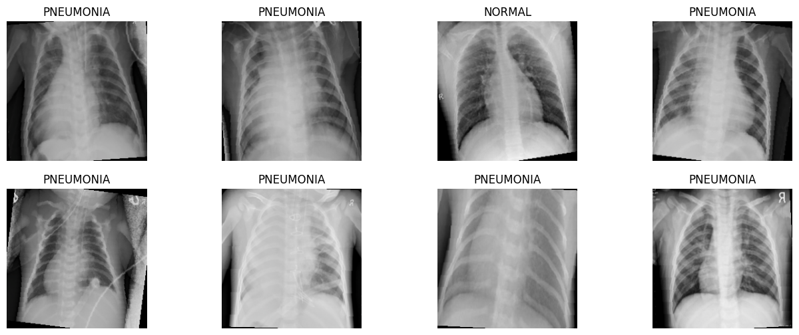
Chest_X_ray
Normal and Pneumonia

Slide 3
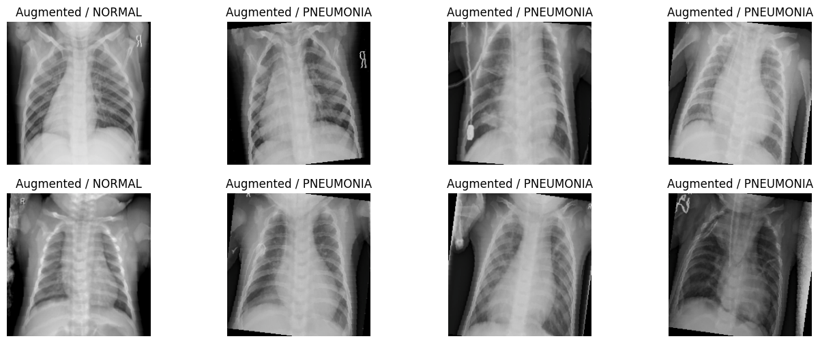
Several augmentation techniques were applied, including rotation, shifting, zooming, brightness adjustments, and flipping, to increase dataset diversity and reduce overfitting. These transformations generated new variations of both NORMAL and PNEUMONIA images, which contributed to improving the model’s generalization ability. The displayed images represent examples of the augmented data.

Slide 4
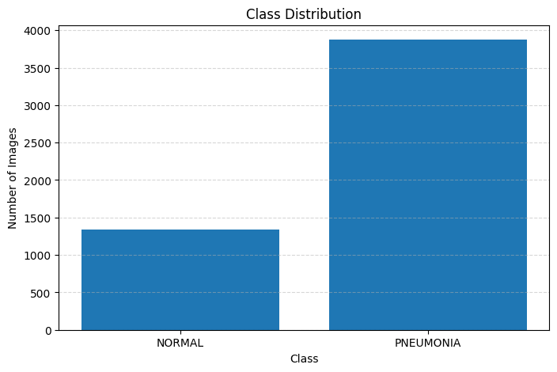
Chest_X_ray
Number Of Images: (NORMAL): 1341 (PNEUMONIA): 3875

Slide 5
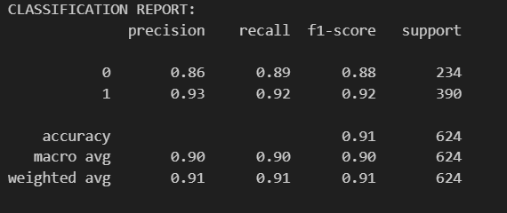
VGG-19 Model
Accuracy =91%

Slide 6
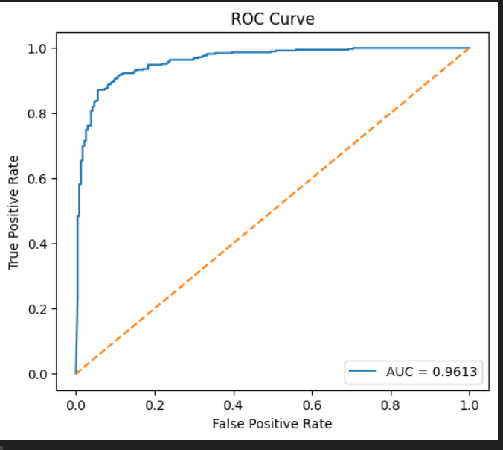
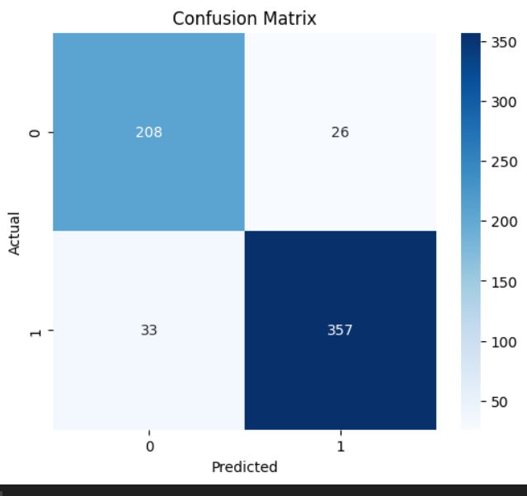
Results
VGG-19 Model
Accuracy =91%

Slide 7
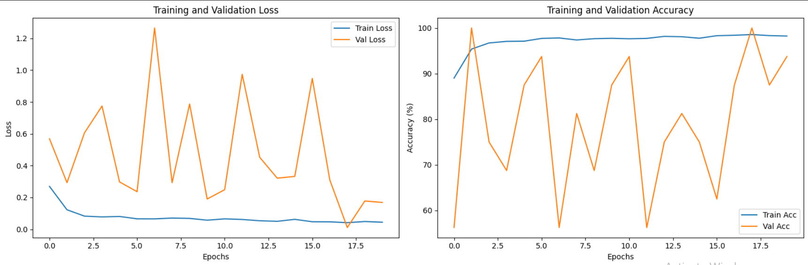
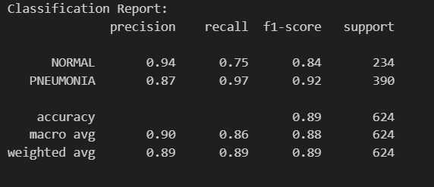
VIT Model
Accuracy =89%

Slide 8
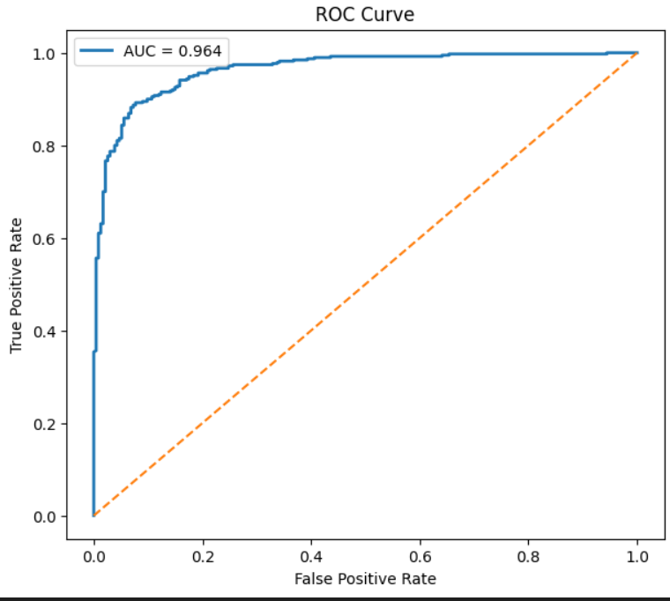
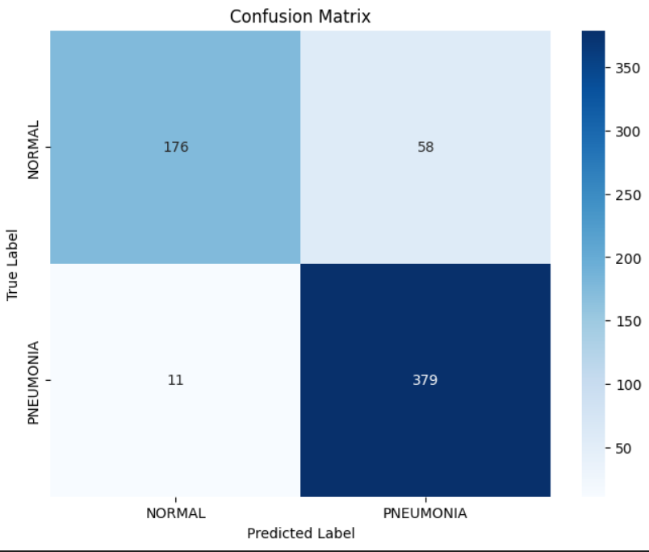
VIT Model
Accuracy =89%

Slide 9
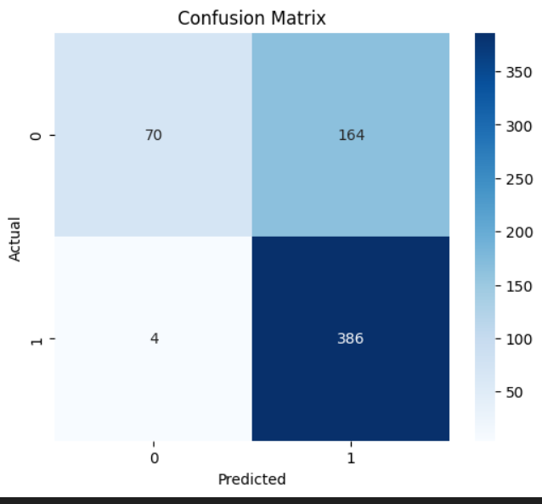
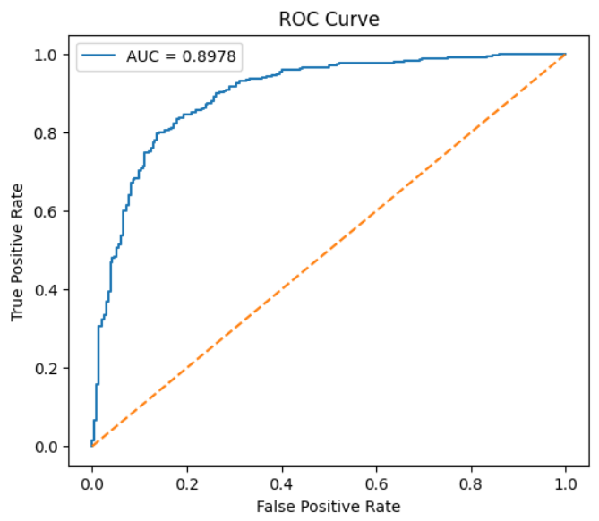
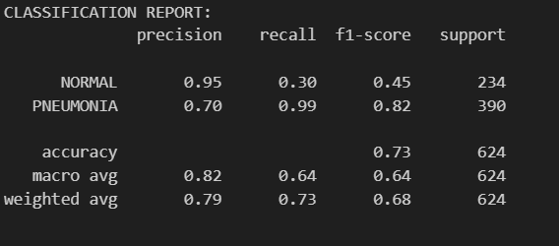
resnetModel
Accuracy =73%

Slide 10
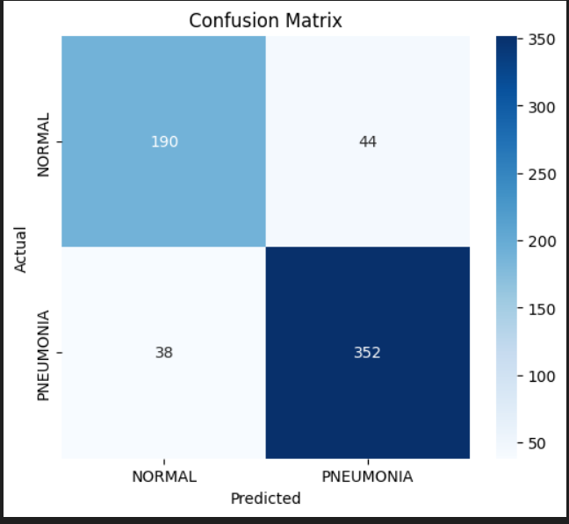
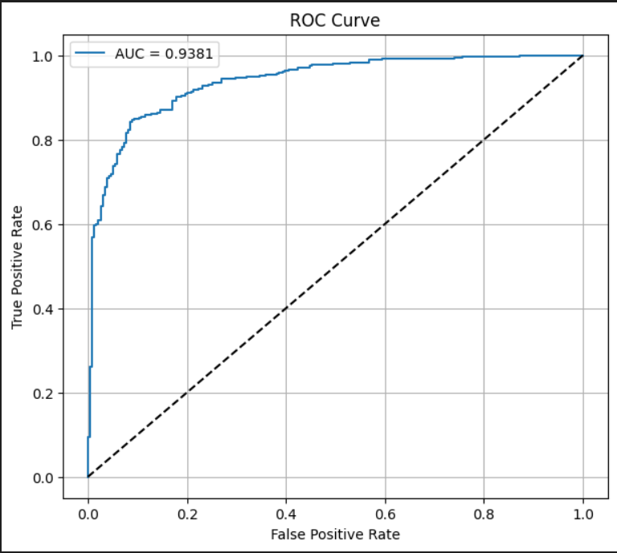
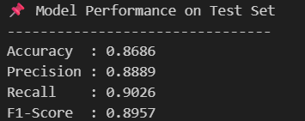
inception-Model
Accuracy =86%

Slide 11
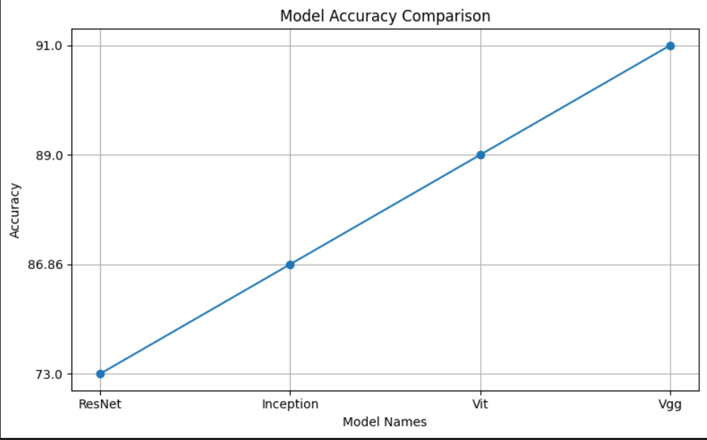
The out come from our research is that the best model for this problem was ,
the VGG -19 AS IT scored highest accuracy between all of them
The Conclusion

