Slide 1

British Airways Customer Review Insights
A Data-Driven Analysis of Skytrax Reviews

Slide 2
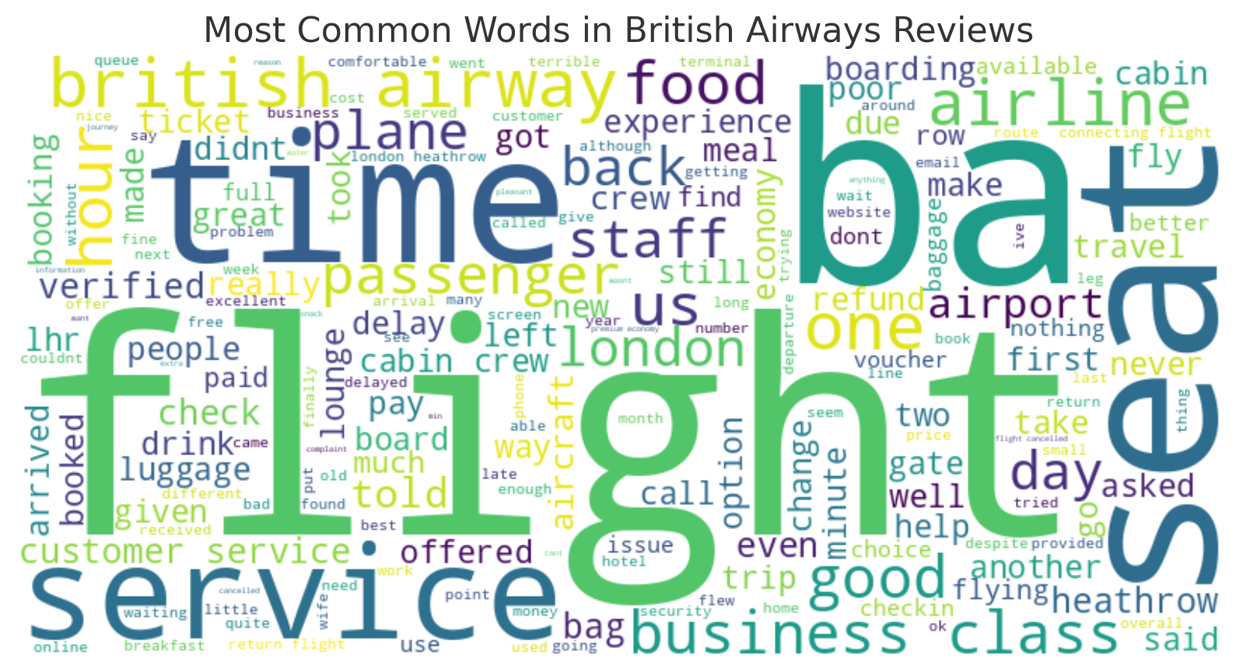
Key Insights and Visualizations:
Sentiment Analysis: Most customer reviews were Positive (64%), with a significant portion being Negative (36%).
Common Topics: Frequent mentions of crew, seats, service, flight experience, and delays.
Topic 1: Customers often highlight their experience with the crew, food, service, and business class.
Topic 2: Luggage issues, customer service problems, and flight delays were common in negative reviews.
Word Cloud: Visualizing the most common words from reviews.

