Slide 1

Customer Booking Prediction Model for British Airways
Predictive Model Insights and Performance Evaluation

Slide 2
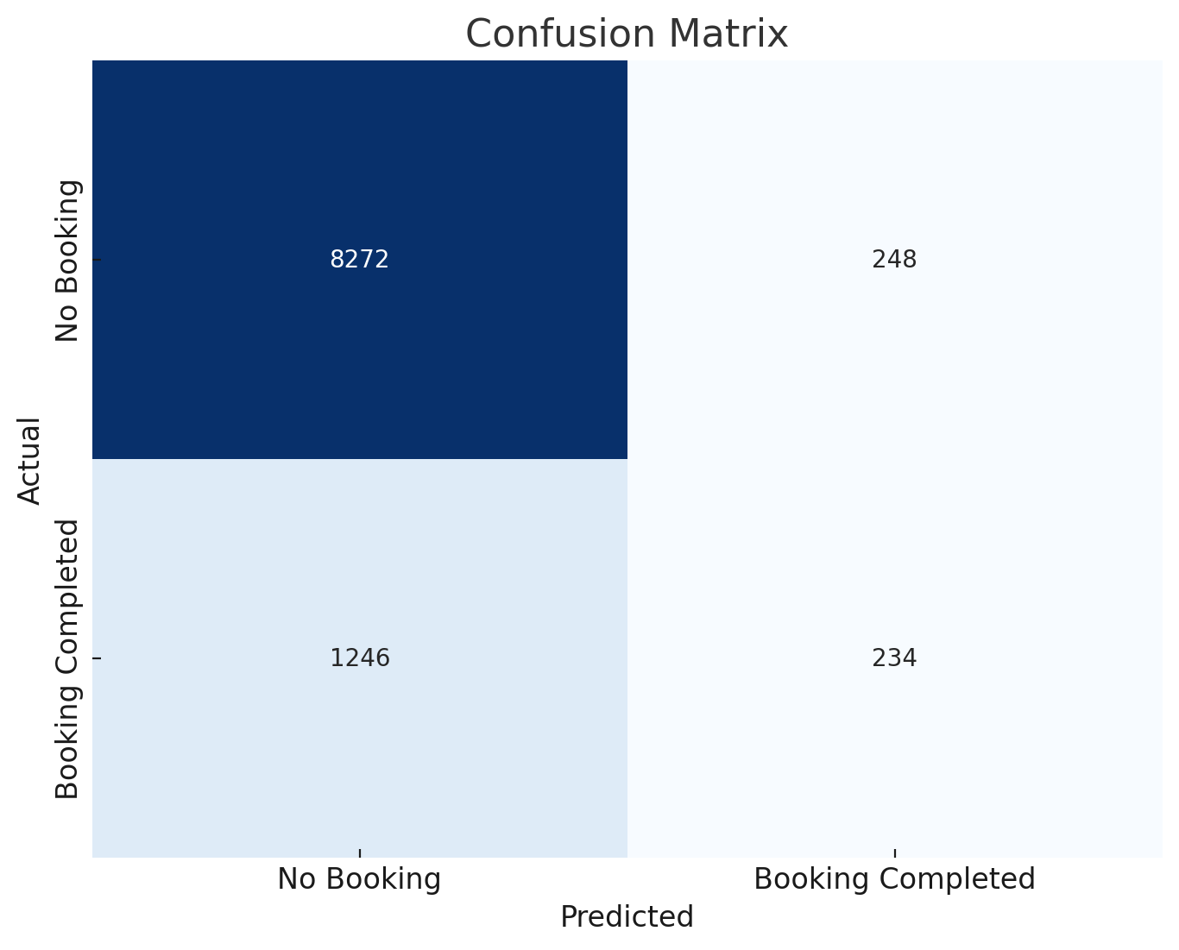
Key Insights and Results:
Key Insights:
Accuracy: The Random Forest model achieved an accuracy of 85.06% on the test dataset.
Imbalance Issue: The model performs well for predicting "No Booking" (Precision: 0.87, Recall: 0.97), but struggles with predicting "Booking Completed" (Precision: 0.49, Recall: 0.16).
Confusion Matrix: The confusion matrix reveals a high number of false negatives, where customers who completed bookings were predicted as not completing them.
Results:
Next Steps: To improve the prediction of completed bookings, we should consider handling class imbalance with oversampling or under sampling techniques and tuning the model further.

